Slide 1
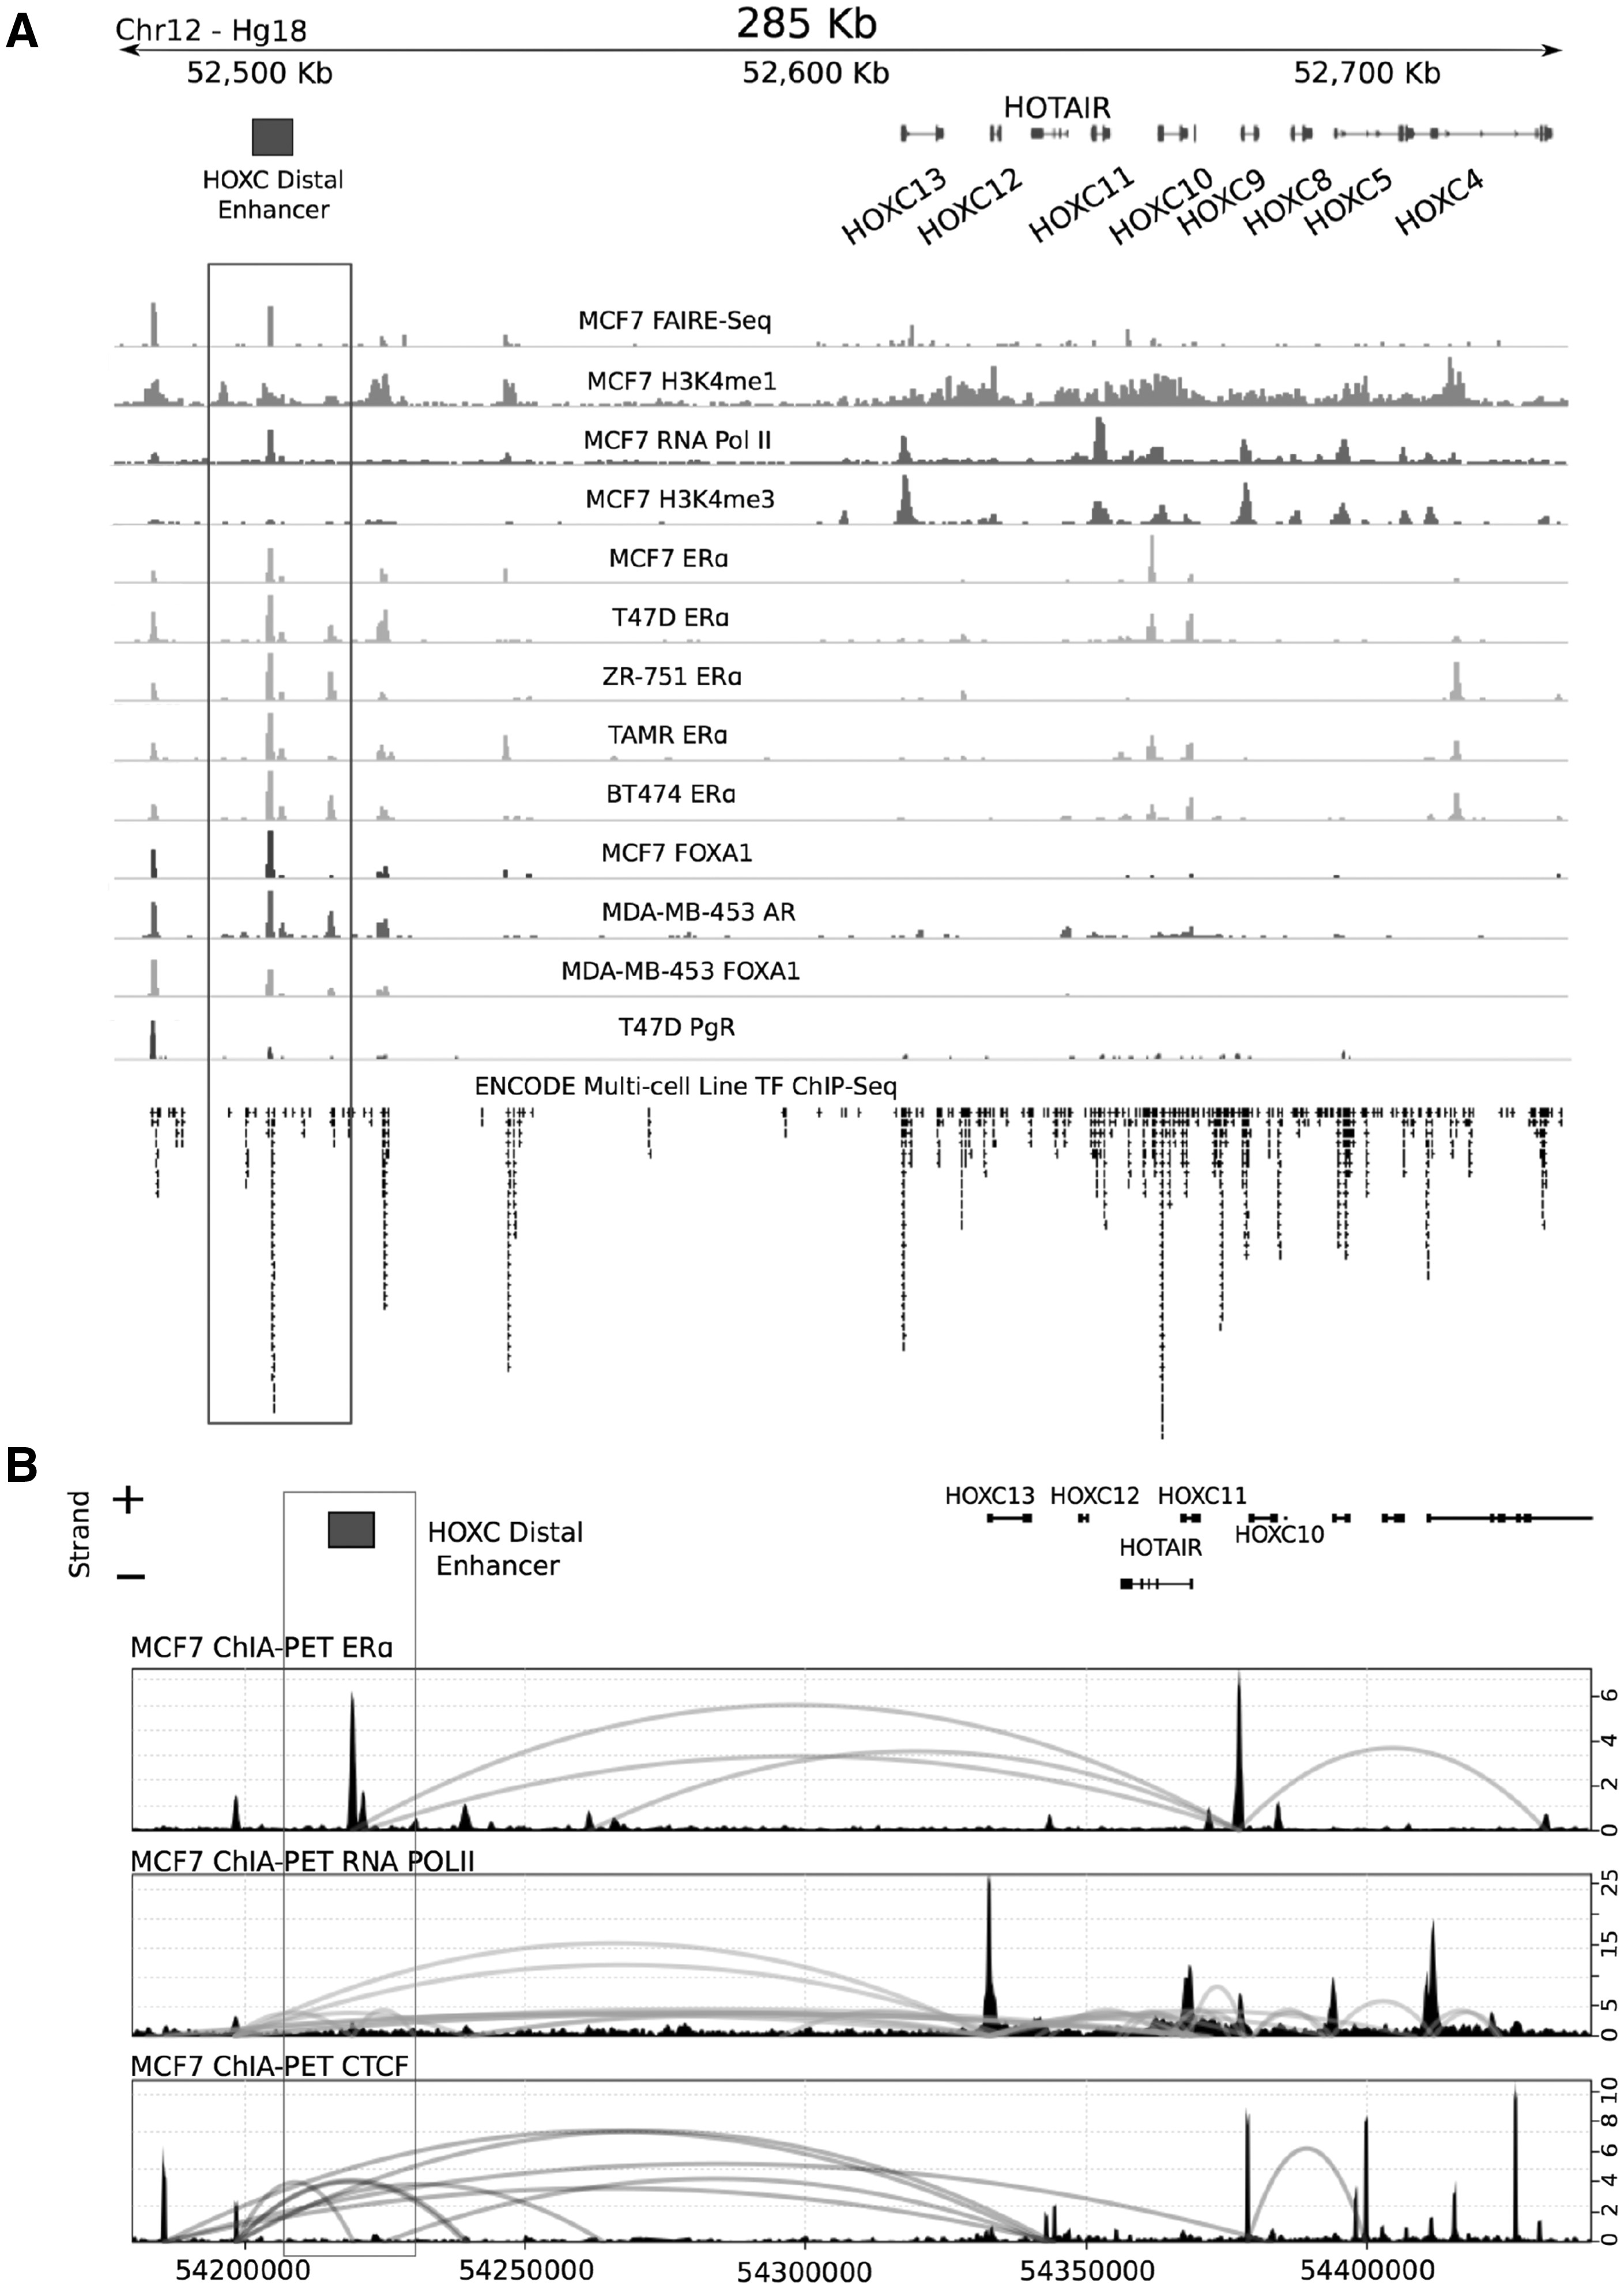
Figure 1. Identification of a HOXC putative cis-regulatory element by investigating chromatin modifications and ...
Notes:
Figure 1. Identification of a HOXC putative cis-regulatory element by investigating chromatin modifications and long-range interactions. (A) Histone modification and transcription factor binding across the HOXC locus, sourced from publically available ChIP-Seq data (Hg18), suggesting a putative enhancer ∼150 kb downstream of the HOTAIR gene. (B) ChIA-PET interactions for ESR1, RNA Polymerase II and CTCF with data sourced from GEO, GSE39495. Plots representing each interaction library include a wiggle track showing the binding of each transcription factor and a curved line that connects interacting genomic fragments indicating relative interaction frequency between fragments (right Y axis).
Unless provided in the caption above, the following copyright applies to the content of this slide: © The Author 2016. Published by Oxford University Press.This is an Open Access article distributed under the terms of the Creative Commons Attribution Non-Commercial License (http://creativecommons.org/licenses/by-nc/4.0/), which permits non-commercial re-use, distribution, and reproduction in any medium, provided the original work is properly cited. For commercial re-use, please contact journals.permissions@oup.com

