Slide 1
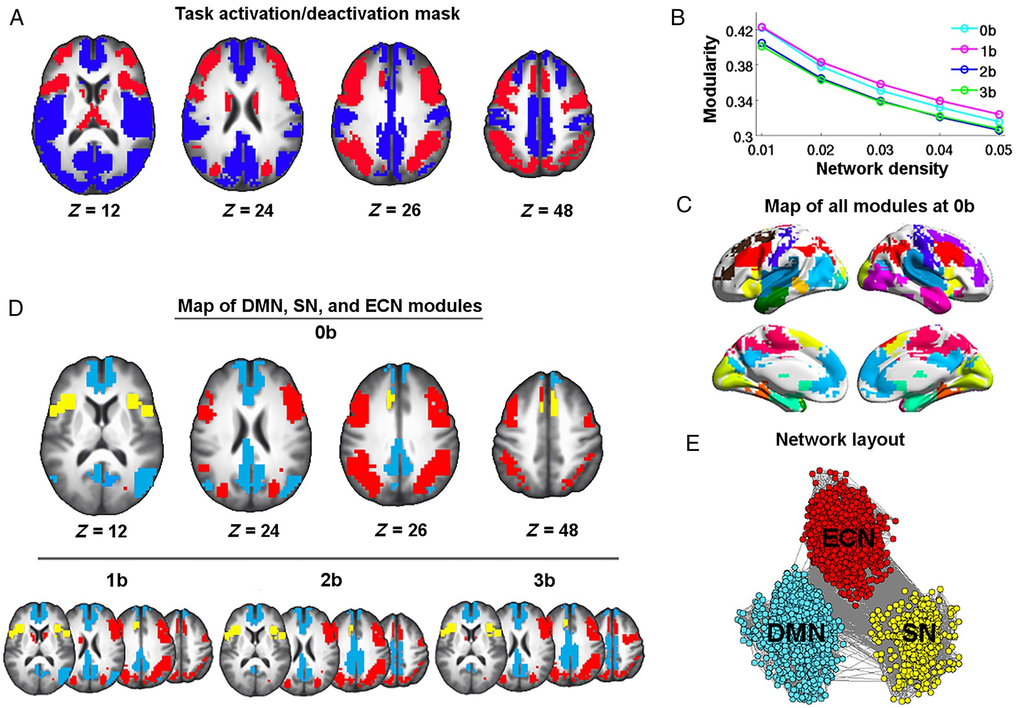
Figure 1. Illustration of module identification results. (A) Task mask generated from a combination of ...
Notes:
Figure 1. Illustration of module identification results. (A) Task mask generated from a combination of activation/deactivation maps across 1-back, 2-back, and 3-back against 0-back. Modularity analyses were performed within this mask. Brain areas showing task-related activation are depicted in red; areas showing task-related deactivation are depicted in blue. (B) The mean modularity across subjects obtained for 0-back, 1-back, 2-back, and 3-back at network sparsities ranging from 1% to 5%. (C) Module partitions of the 0-back brain graph thresholded at the highest density of 1%. (D) Maps of the DMN (blue), ECN (red), and SN (yellow) at 0-back, 1-back, 2-back, and 3-back. (E) A spring-embedded layout of nodes and edges within the DMN, ECN, and SN networks at 0-back. The network was visualized with the Pajek program (Batagelj and Mrvar 1998).
Unless provided in the caption above, the following copyright applies to the content of this slide: Published by Oxford University Press 2015. This work is written by (a) US Government employee(s) and is in the public domain in the US

Slide 2
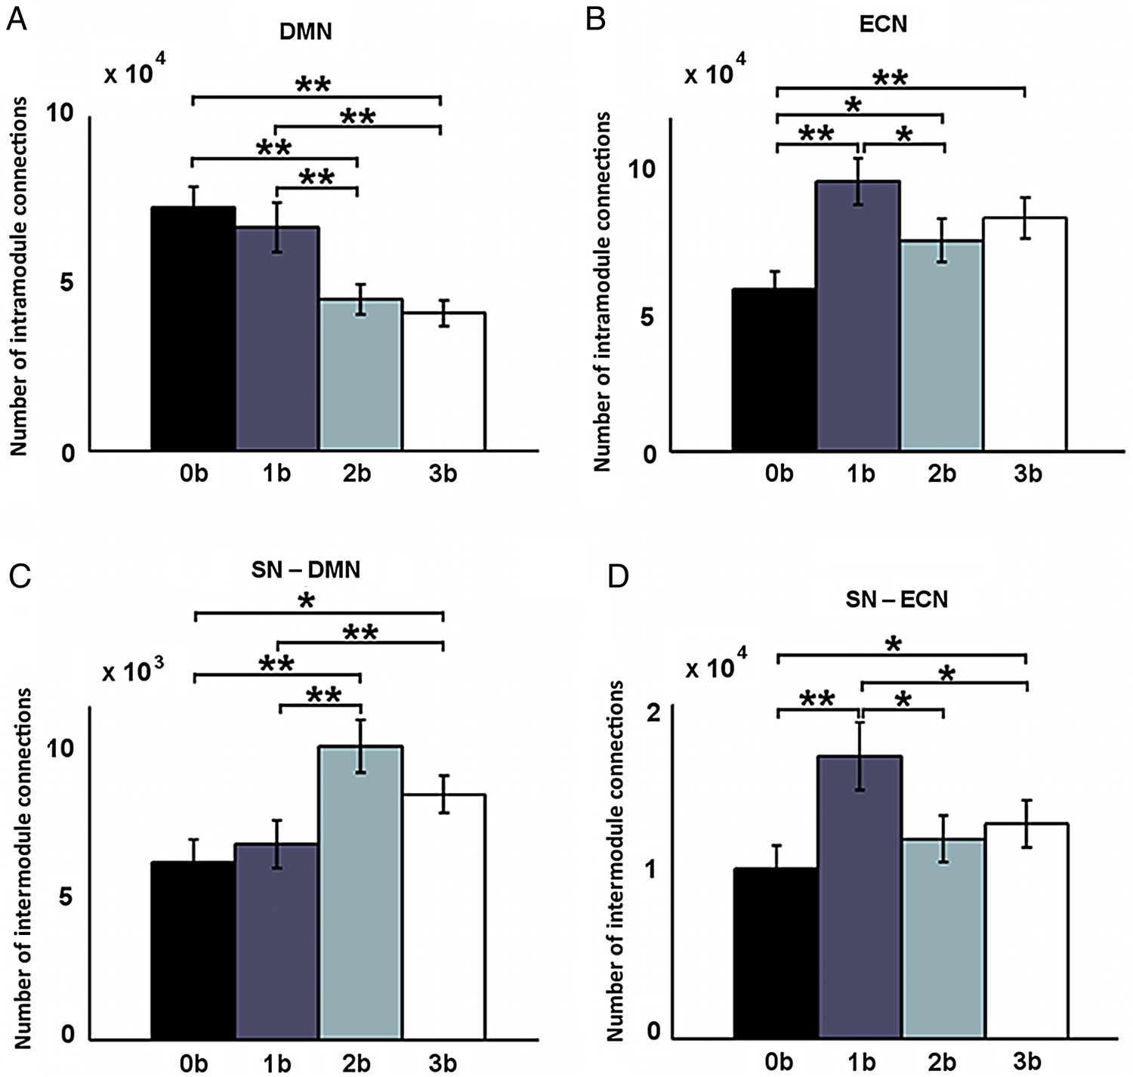
Figure 2. Load-dependent differences in intranetwork connections within the DMN (A) and the ECN (B), and internetwork ...
Notes:
Figure 2. Load-dependent differences in intranetwork connections within the DMN (A) and the ECN (B), and internetwork connections between the SN and the DMN (C) and between the SN and the ECN (D). Error bars refer to SE. **Pcorrected < 0.05, *Puncorrected < 0.05.
Unless provided in the caption above, the following copyright applies to the content of this slide: Published by Oxford University Press 2015. This work is written by (a) US Government employee(s) and is in the public domain in the US

Slide 3
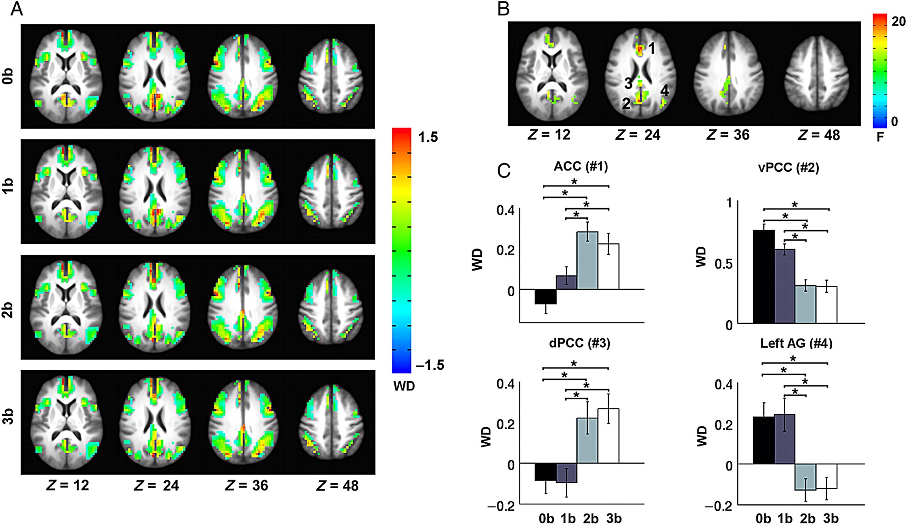
Figure 3. Load-dependent effects in WD. (A) The WD map at 0-back, 1-back, 2-back, and 3-back. (B) Repeated-measures ...
Notes:
Figure 3. Load-dependent effects in WD. (A) The WD map at 0-back, 1-back, 2-back, and 3-back. (B) Repeated-measures ANOVA revealed significantly modulated WD values by task load in the ACC (1) and ventral PCC (2), dorsal PCC (3), and left IPL (4). (C) Significant differences in WD across the 4 task loads in the 4 regions. Error bars refer to SE. *Pcorrected < 0.05.
Unless provided in the caption above, the following copyright applies to the content of this slide: Published by Oxford University Press 2015. This work is written by (a) US Government employee(s) and is in the public domain in the US

Slide 4
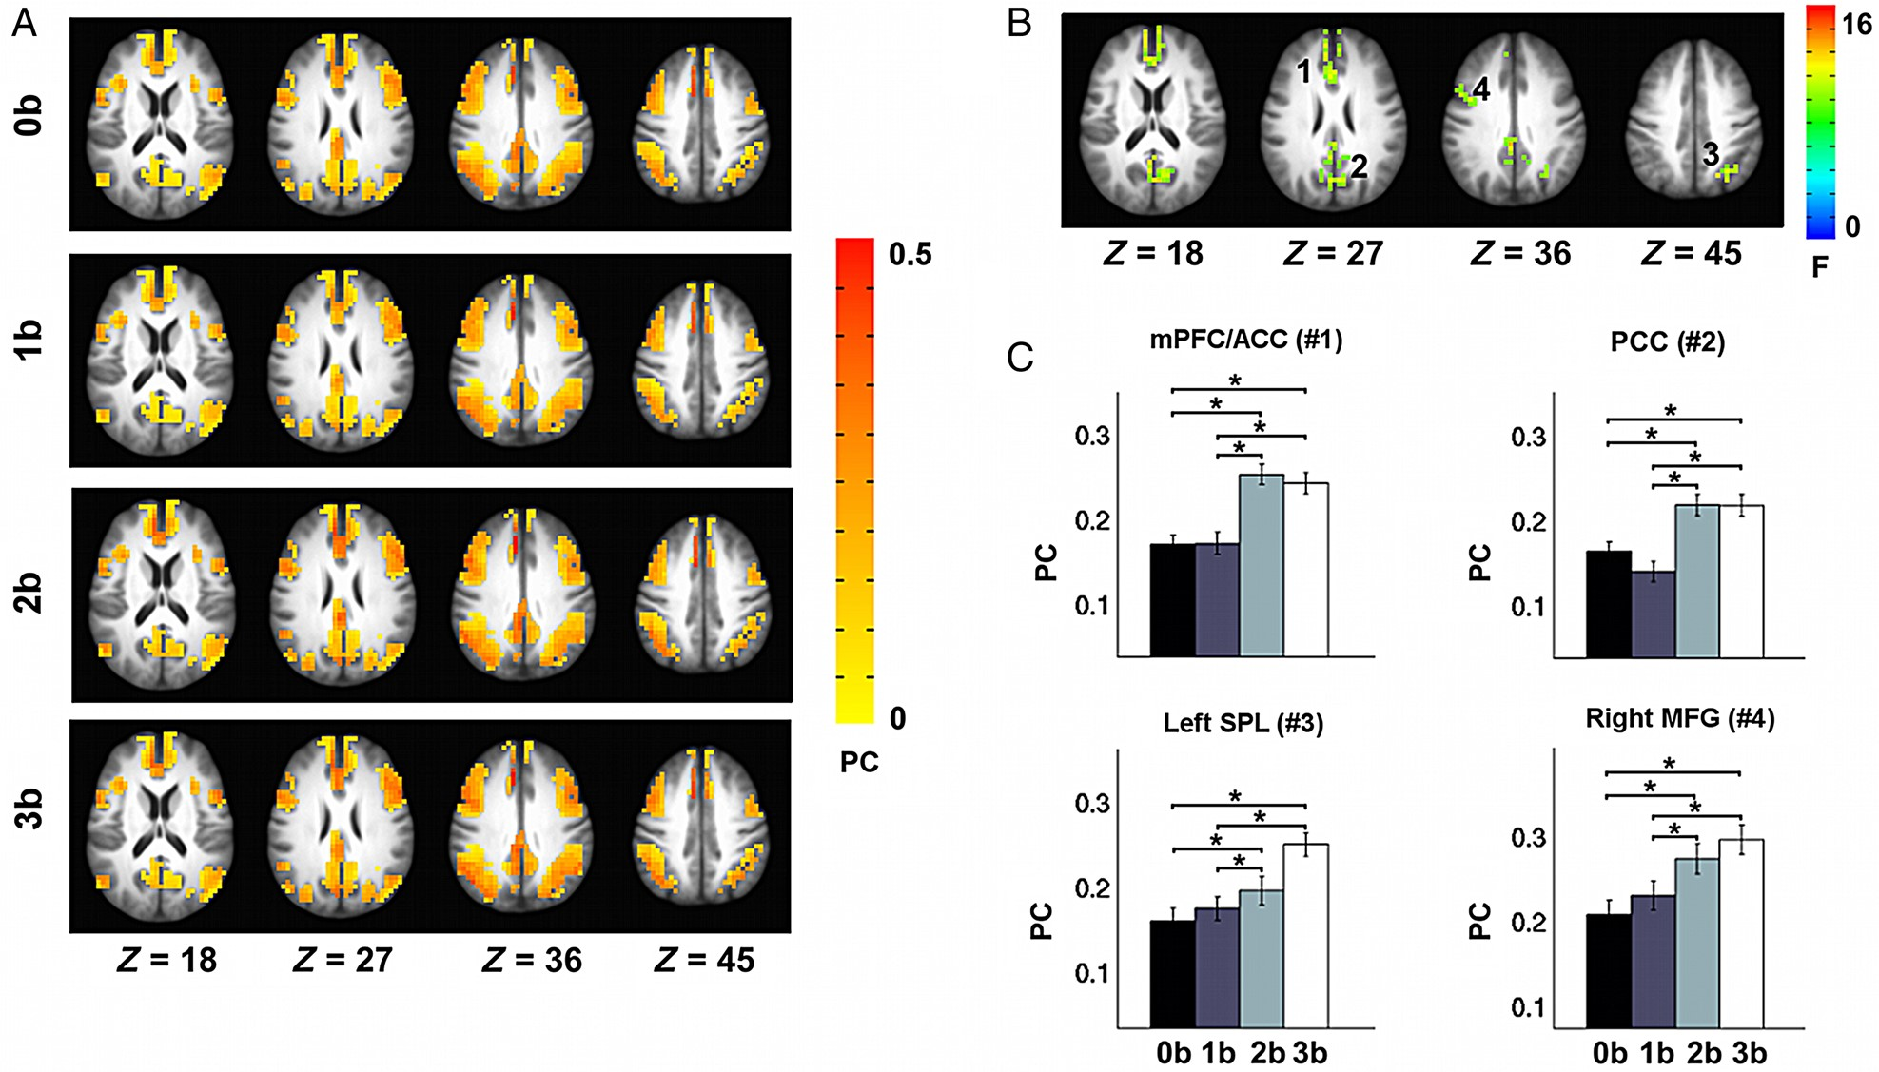
Figure 4. Load-dependent effects in PC. (A) The PC map at 0-back, 1-back, 2-back, and 3-back. (B) Repeated-measures ...
Notes:
Figure 4. Load-dependent effects in PC. (A) The PC map at 0-back, 1-back, 2-back, and 3-back. (B) Repeated-measures ANOVA revealed significantly modulated PC values by task load in the rACC (1) and PCC (2), left SPL (3), and right MFG (4). (C) Significant differences in PC across the 4 task loads in the 4 regions. Error bars refer to SE. *Pcorrected < 0.05.
Unless provided in the caption above, the following copyright applies to the content of this slide: Published by Oxford University Press 2015. This work is written by (a) US Government employee(s) and is in the public domain in the US

Slide 5
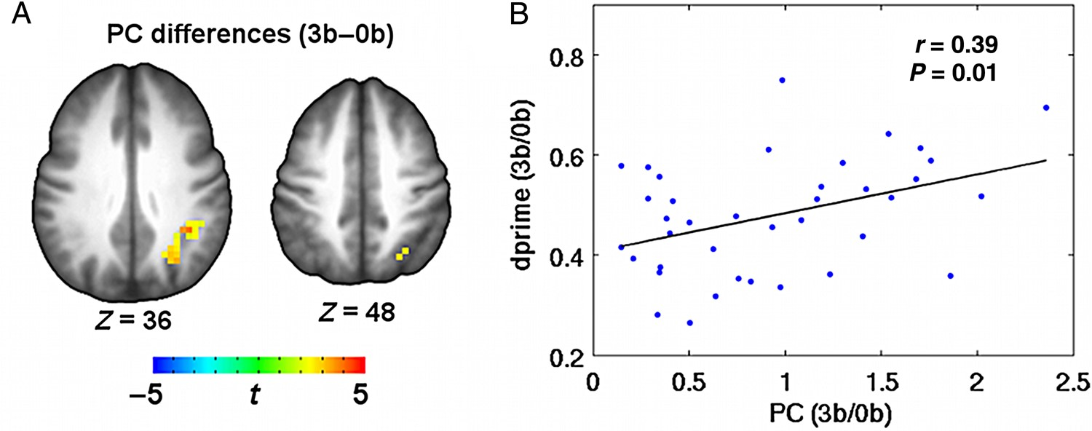
Figure 5. Relationship between WM task performance and PC in the left SPL at 3-back. (A) PC in the region of the left ...
Notes:
Figure 5. Relationship between WM task performance and PC in the left SPL at 3-back. (A) PC in the region of the left SPL showed significant modulation effect of task loads (3-back–0-back). (B) Plot of the average changes in PC (3-back/0-back) in the left SPL against dprime (3-back/0-back).
Unless provided in the caption above, the following copyright applies to the content of this slide: Published by Oxford University Press 2015. This work is written by (a) US Government employee(s) and is in the public domain in the US

Slide 6
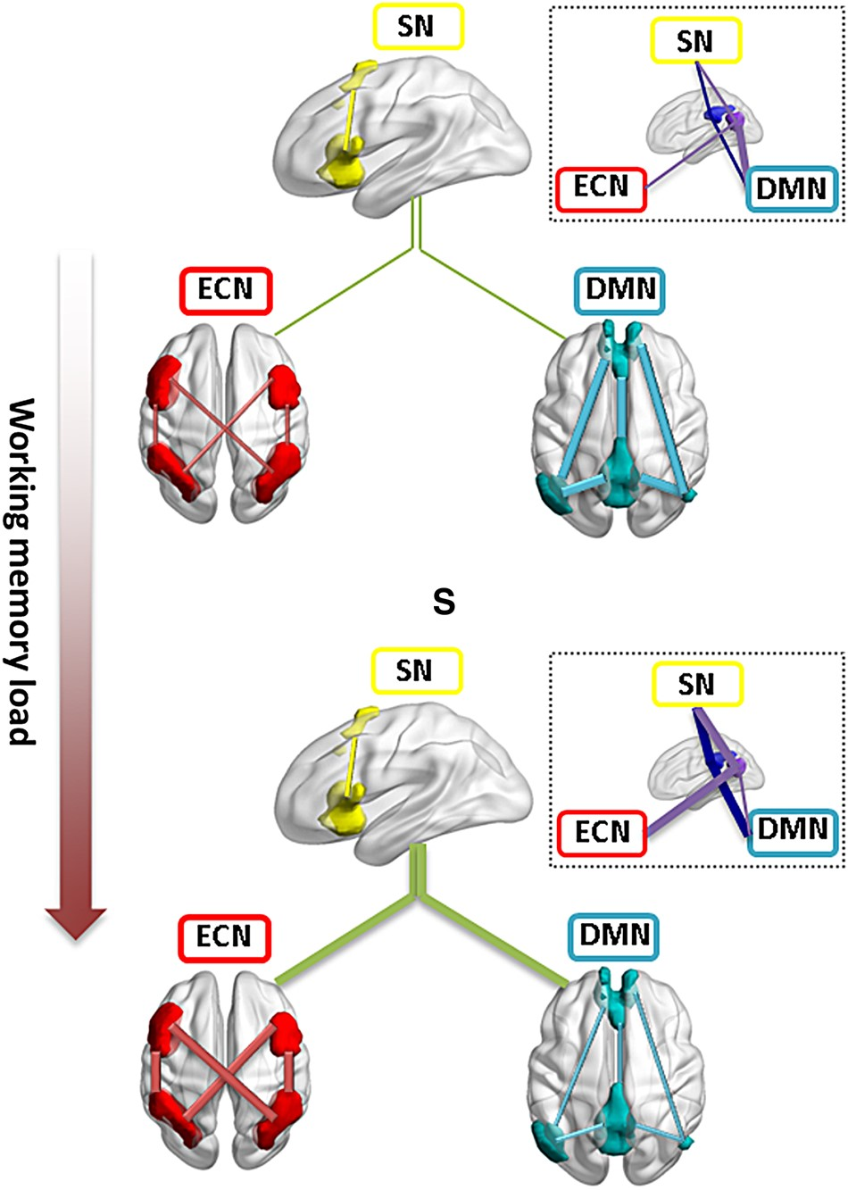
Figure 6. Schematic illustration of the load-dependent reorganization of intra- and inter-module connectivity among the ...
Notes:
Figure 6. Schematic illustration of the load-dependent reorganization of intra- and inter-module connectivity among the DMN, SN, and ECN. As task load increases, connectivity within DMN decreased whereas connectivity within ECN increases. SN showed more connections to both DMN and ECN. The inset figure circled by dashed lines shows the heterogeneous changes in intermodule connectivity for ventral (purple) and dorsal (dark blue) PCC subregions. The lines match the color of the brain modules or regions. Module-level intermodule connections are depicted in green color. PCC, posterior cingulate cortex. The 3D brain regions were drawn using the BrainNet viewer (www.nitrc.org/projects/bnv (Xia et al. 2013)).
Unless provided in the caption above, the following copyright applies to the content of this slide: Published by Oxford University Press 2015. This work is written by (a) US Government employee(s) and is in the public domain in the US

