Slide 1
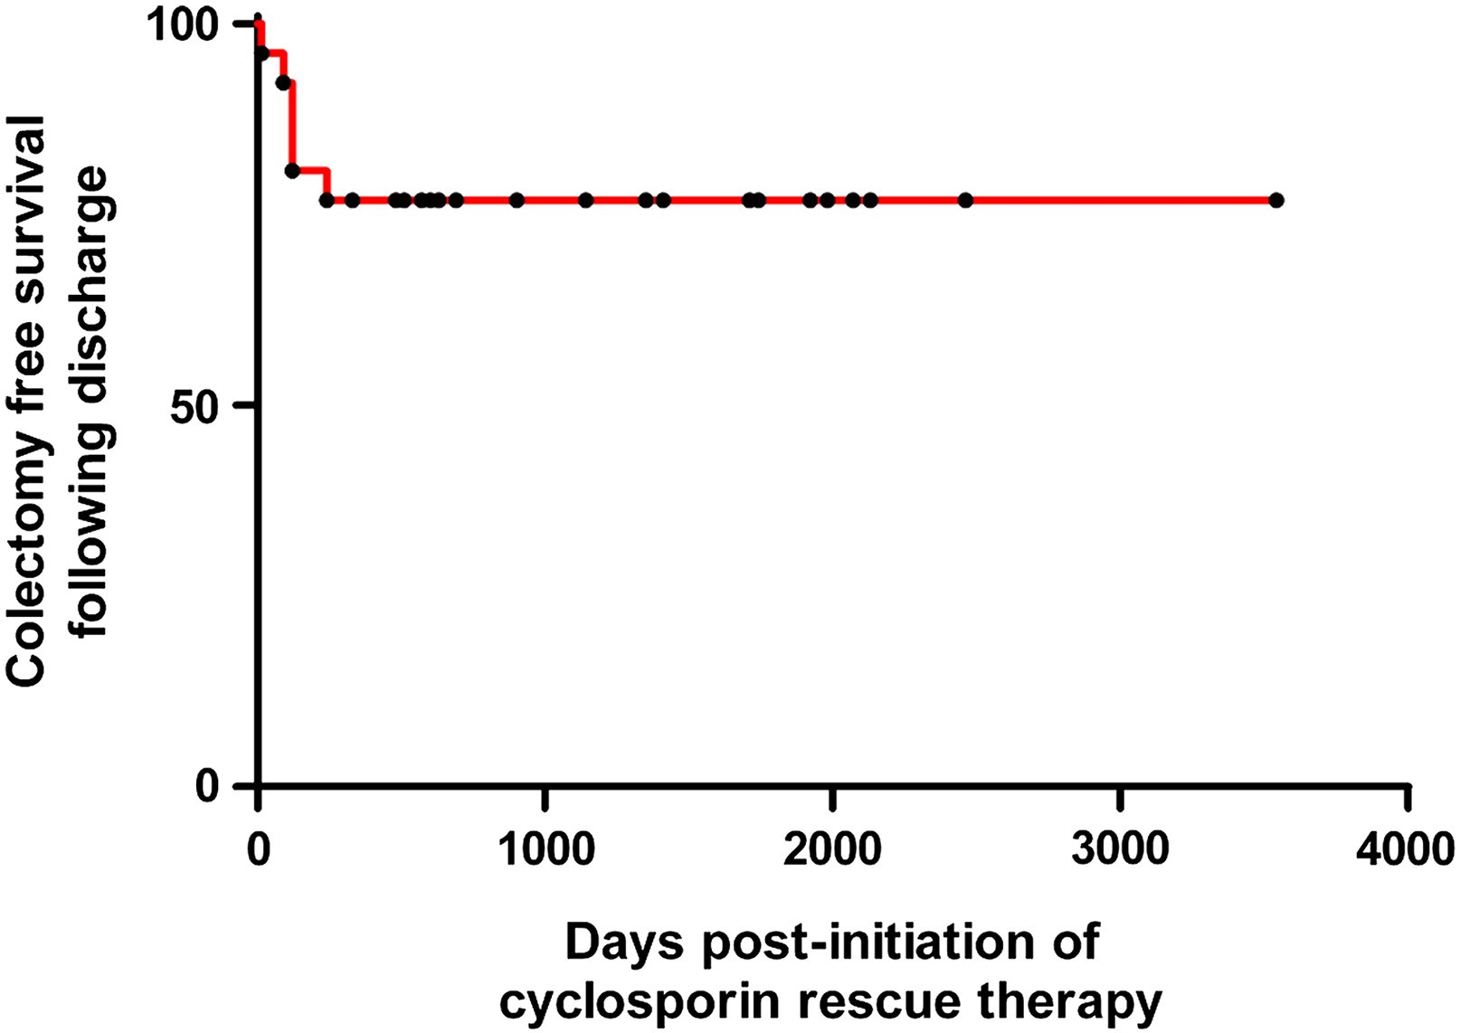
Figure 1 Kaplan-Meier curve showing colectomy-free survival in patients requiring Cyclosporin therapy following ...
Notes:
Figure 1 Kaplan-Meier curve showing colectomy-free survival in patients requiring Cyclosporin therapy following discharge.
Unless provided in the caption above, the following copyright applies to the content of this slide: © 2010 European Crohn's and Colitis Organisation

