Slide 1
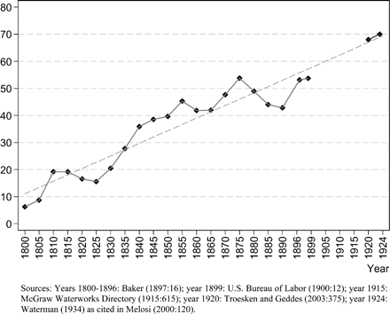
Figure 1. Percent of Waterworks Municipally Owned.
Notes:
Figure 1. Percent of Waterworks Municipally Owned.
Unless provided in the caption above, the following copyright applies to the content of this slide: © The Author 2010. Published by Oxford University Press on behalf of Yale University. All rights reserved. For Permissions, please email: journals.permissions@oxfordjournals.org

Slide 2
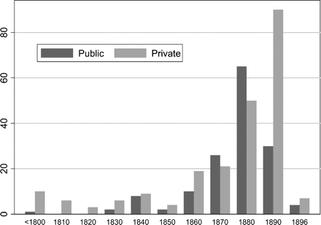
Figure 2. Number of Waterworks Built in Decade (ending date), by Original Ownership, Cities Larger than 10,000 in 1890 ...
Notes:
Figure 2. Number of Waterworks Built in Decade (ending date), by Original Ownership, Cities Larger than 10,000 in 1890 (n = 373).
Unless provided in the caption above, the following copyright applies to the content of this slide: © The Author 2010. Published by Oxford University Press on behalf of Yale University. All rights reserved. For Permissions, please email: journals.permissions@oxfordjournals.org

Slide 3
Figure 3. Reduced-Form Probit Estimates of Waterworks Ownership (Dependent variable = 1 if municipally owned in 1890; ...
Notes:
Figure 3. Reduced-Form Probit Estimates of Waterworks Ownership (Dependent variable = 1 if municipally owned in 1890; absolute value of t statistics in parentheses; *significant at 5%; **significant at 1%).
Unless provided in the caption above, the following copyright applies to the content of this slide: © The Author 2010. Published by Oxford University Press on behalf of Yale University. All rights reserved. For Permissions, please email: journals.permissions@oxfordjournals.org

Slide 4
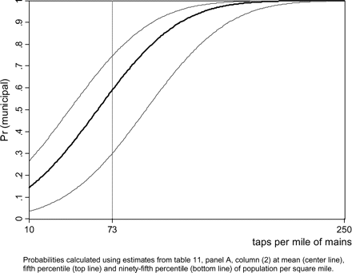
Figure 4. Estimated Probability of Municipal Ownership.
Notes:
Figure 4. Estimated Probability of Municipal Ownership.
Unless provided in the caption above, the following copyright applies to the content of this slide: © The Author 2010. Published by Oxford University Press on behalf of Yale University. All rights reserved. For Permissions, please email: journals.permissions@oxfordjournals.org

