Slide 1
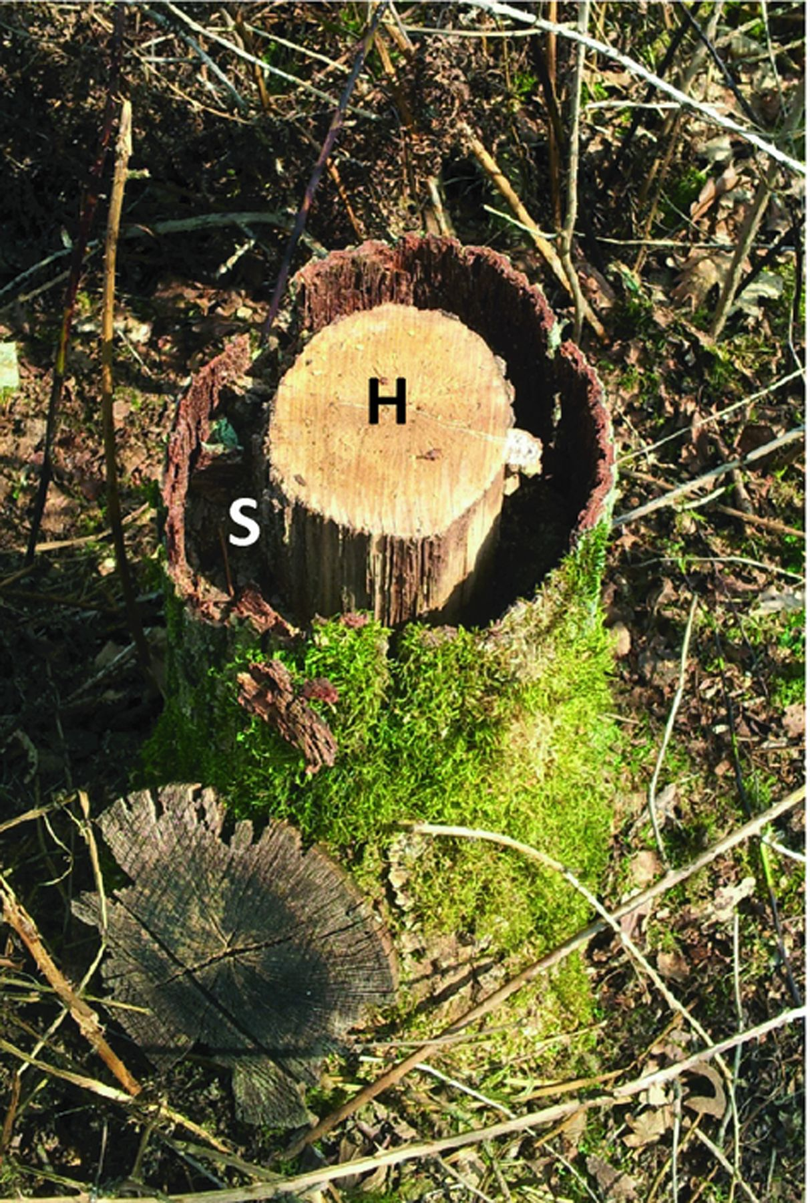
Figure 2 A field example of the influence of substrate quality on fungal decomposition. A stump of Oak ( Quercus ...
Notes:
Figure 2 A field example of the influence of substrate quality on fungal decomposition. A stump of Oak ( Quercus robur L.) 5 years after cutting. The zone containing sapwood (S) has almost completely been degraded whereas the heartwood (H) is apparently intact. Resistance of heartwood to decomposition by fungal decomposers is strongly influenced by moisture content, permeability of the wood and the presence of organic (toxic) substances (Cornelissen et al ., 2012 ). Photo by Henk Eshuis.
Unless provided in the caption above, the following copyright applies to the content of this slide: © 2012 Federation of European Microbiological Societies.

Slide 2
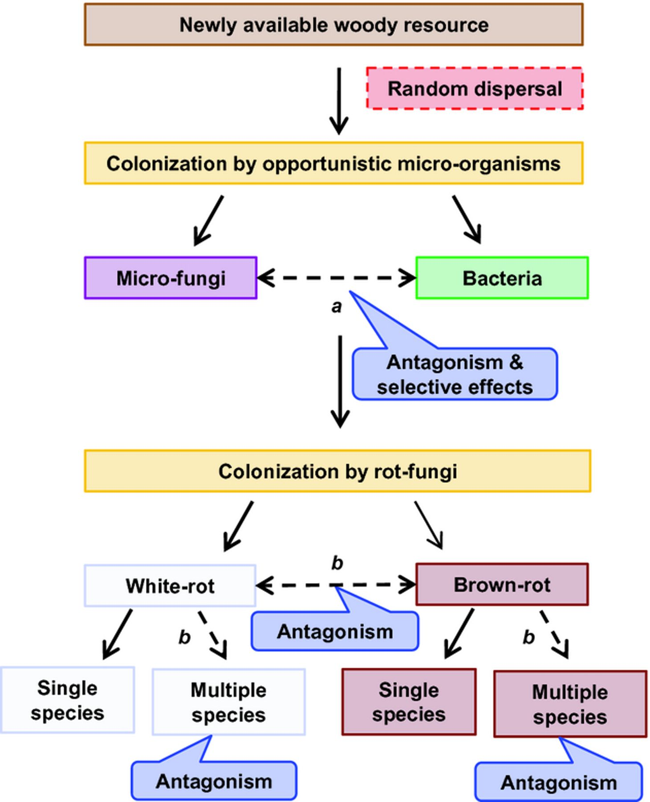
Figure 3 Hypothesized development of fungal decomposer communities and interactions during wood decay. Dashed arrows ...
Notes:
Figure 3 Hypothesized development of fungal decomposer communities and interactions during wood decay. Dashed arrows indicate competitive microbial interactions (see text for effects on decay rate).
Unless provided in the caption above, the following copyright applies to the content of this slide: © 2012 Federation of European Microbiological Societies.

Slide 3
Figure 1 Hand carved mouse from decaying beech wood. Distinct territorial zones occupied by different wood-decaying ...
Notes:
Figure 1 Hand carved mouse from decaying beech wood. Distinct territorial zones occupied by different wood-decaying fungi are clearly visible. The lighter zones contain a fungus exhibiting relatively high ligninolytic activity. Fungal competitive interactions in wood often result in a deadlock situation in which neither fungus makes a headway into the territory of the other, often with the formation of dark interaction zone lines comprising plates formed from highly melanized contorted hyphae (Boddy, 2000 , 2001 ). The presence of different fungi in adjacent decay columns within large wood samples may result in decreases in decay rates. Wood sculpture by Bart Ensing.
Unless provided in the caption above, the following copyright applies to the content of this slide: © 2012 Federation of European Microbiological Societies.

