Slide 1
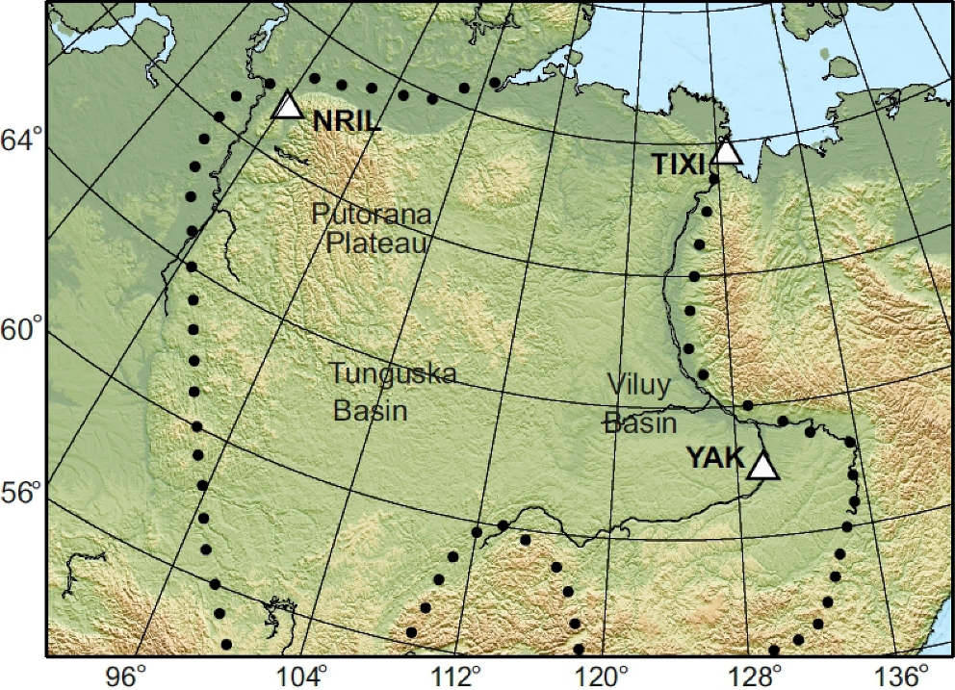
Figure 1. Map of the Siberian Craton with seismograph stations. Boundaries of the craton are shown by dots.
Notes:
Figure 1. Map of the Siberian Craton with seismograph stations. Boundaries of the craton are shown by dots.
Unless provided in the caption above, the following copyright applies to the content of this slide: © The Authors 2017. Published by Oxford University Press on behalf of The Royal Astronomical Society.

Slide 2
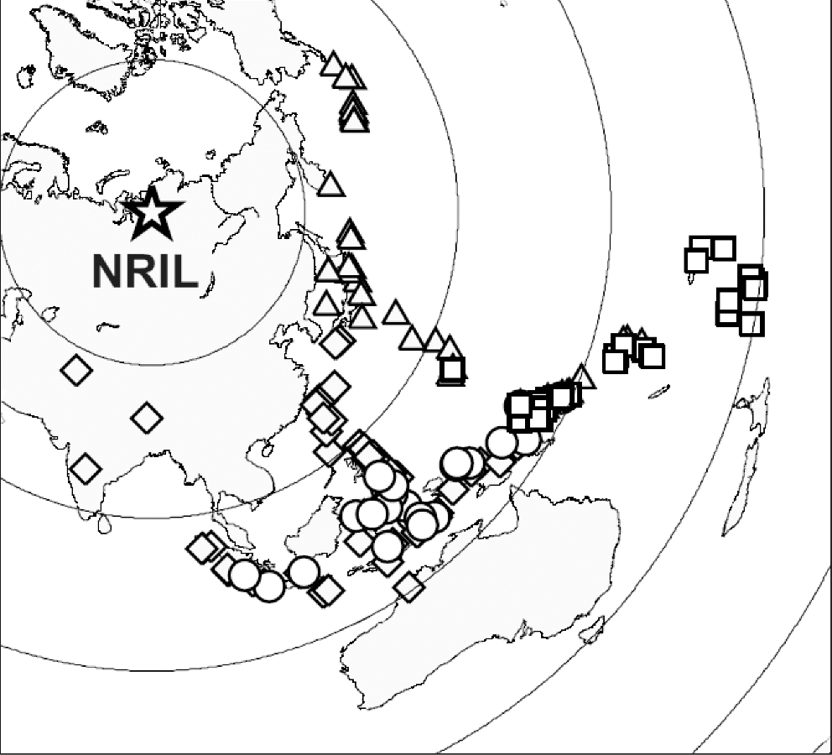
Figure 2. Epicentres of the seismic events that were used in calculations of receiver functions for seismograph station ...
Notes:
Figure 2. Epicentres of the seismic events that were used in calculations of receiver functions for seismograph station NRIL: PRFs in the back azimuths around 100°—triangles, SRFs in the back azimuths around 100°—squares, PRFs in the back azimuths around 140°—diamonds, SRFs in the back azimuths around 140°—circles.
Unless provided in the caption above, the following copyright applies to the content of this slide: © The Authors 2017. Published by Oxford University Press on behalf of The Royal Astronomical Society.

Slide 3
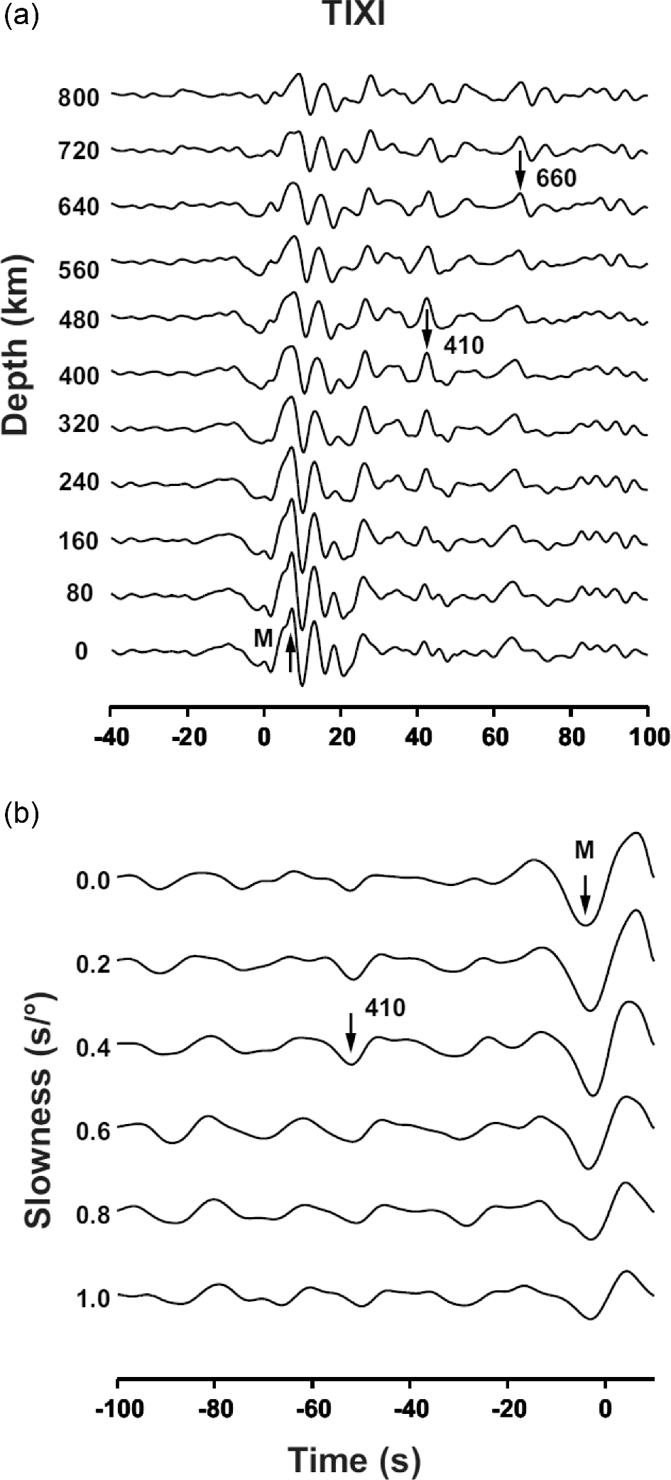
Figure 3. Stacked receiver functions for station TIXI: (a) PRFs and (b) SRFs. The numbers attached to the traces of ...
Notes:
Figure 3. Stacked receiver functions for station TIXI: (a) PRFs and (b) SRFs. The numbers attached to the traces of PRFs in (a) are trial depths in km; the arrivals of the Ps converted phases from the Moho, 410 and 660 km discontinuities are marked by arrows. The numbers attached to the traces of SRFs in (b) are trial values of differential slowness in s deg−1. The Sp phases from the Moho and the 410 km discontinuity are marked by arrows.
Unless provided in the caption above, the following copyright applies to the content of this slide: © The Authors 2017. Published by Oxford University Press on behalf of The Royal Astronomical Society.

Slide 4
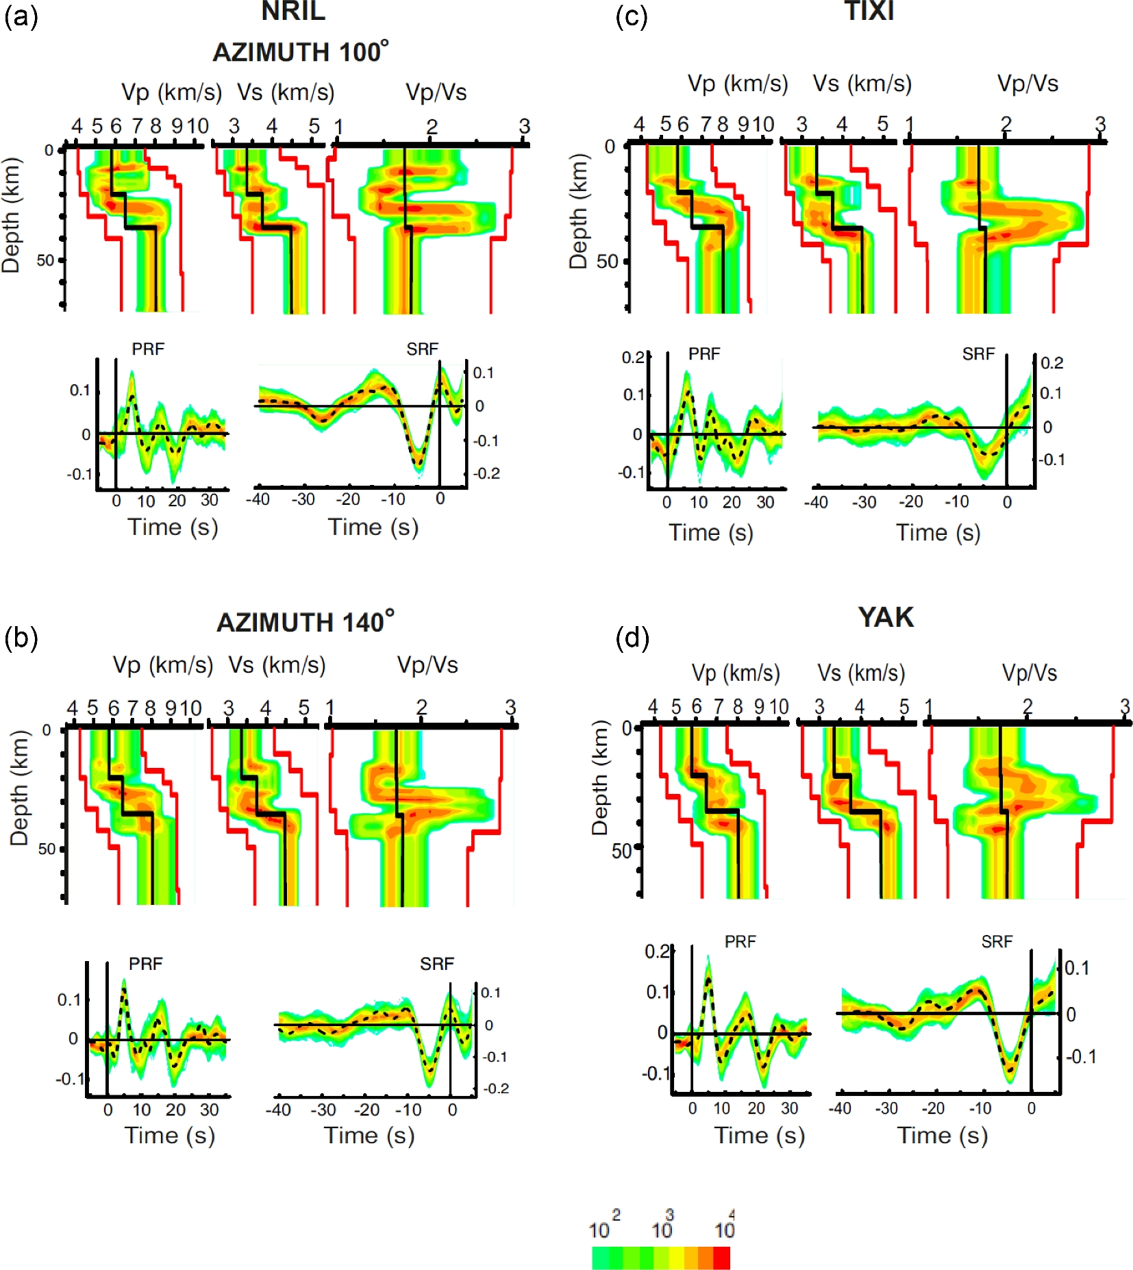
Figure 4. Results of the inversion for NRIL in back azimuths around 100° (a) and 140° (b), TIXI (c) and YAK (d). ...
Notes:
Figure 4. Results of the inversion for NRIL in back azimuths around 100° (a) and 140° (b), TIXI (c) and YAK (d). Posterior distributions of the free model parameters (Vp, Vs, Vp/Vs) are shown by colour code. Similar statistics for the modelled receiver functions are shown by the same code. The actual receiver functions are shown by dash lines. Velocities of IASP91 model and limits of the search are shown by black and red lines, respectively.
Unless provided in the caption above, the following copyright applies to the content of this slide: © The Authors 2017. Published by Oxford University Press on behalf of The Royal Astronomical Society.

Slide 5
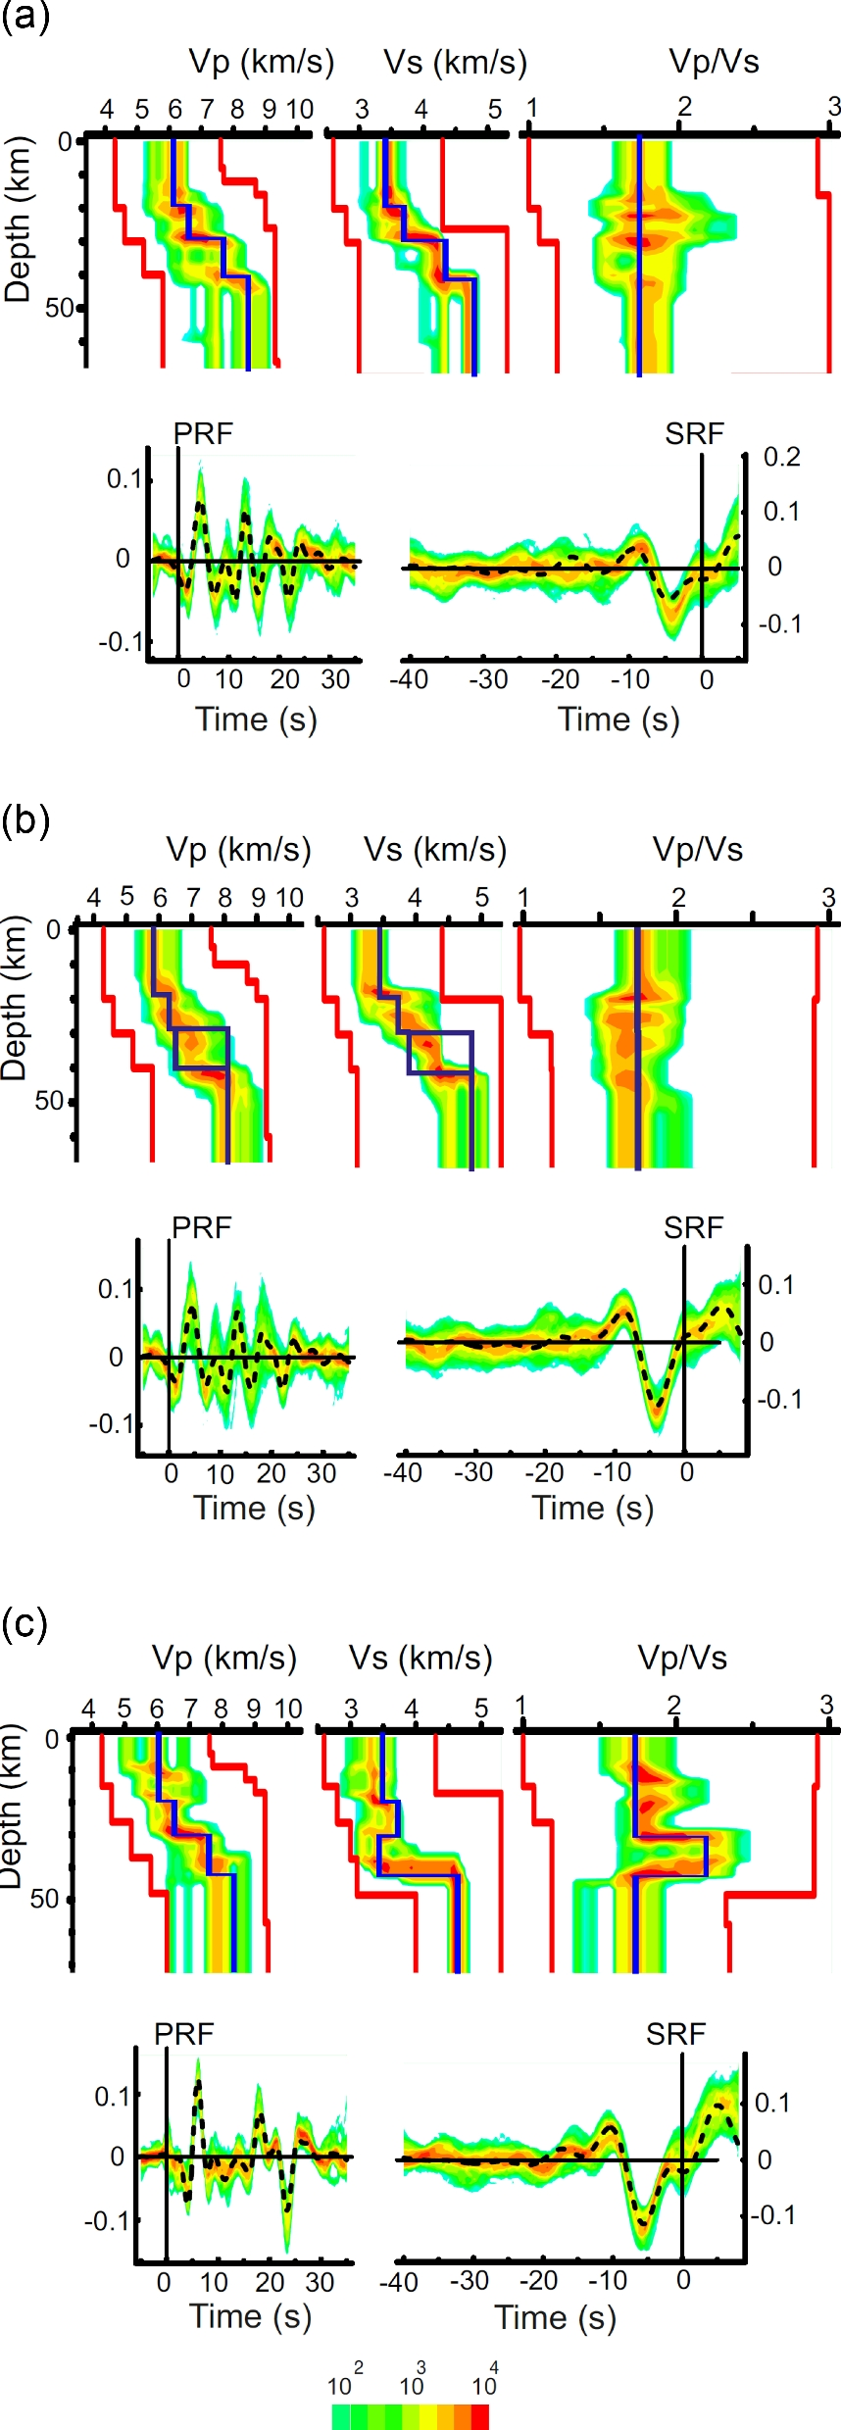
Figure 5. The same as in Fig. 4 but for the synthetic receiver functions that were calculated for the velocity profiles ...
Notes:
Figure 5. The same as in Fig. 4 but for the synthetic receiver functions that were calculated for the velocity profiles shown by blue lines. The blue rectangles in (b) represent the depth range and the velocities in the stack of thin layers.
Unless provided in the caption above, the following copyright applies to the content of this slide: © The Authors 2017. Published by Oxford University Press on behalf of The Royal Astronomical Society.

Slide 6
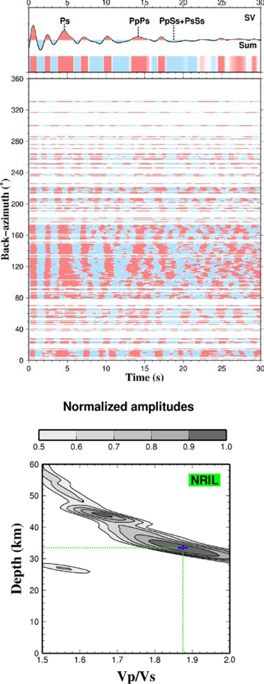
Figure 6. Evaluation of crustal parameters for station NRIL by H–k technique. (a) Q-component traces of the PRFs are ...
Notes:
Figure 6. Evaluation of crustal parameters for station NRIL by H–k technique. (a) Q-component traces of the PRFs are ordered according to back azimuth and shown by colour code. Seismic phases Ps, PpPs and PpSs + PsSs are detected by summation of all traces with moveout time corrections. (b) Crustal thickness versus Vp/Vs ratio.
Unless provided in the caption above, the following copyright applies to the content of this slide: © The Authors 2017. Published by Oxford University Press on behalf of The Royal Astronomical Society.

Slide 7
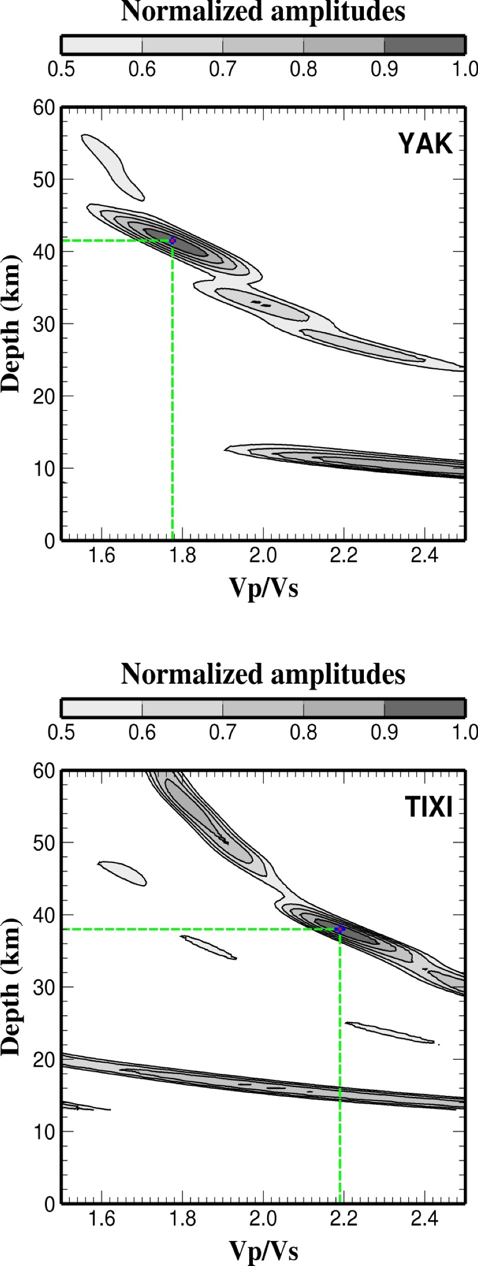
Figure 7. The same as in Fig. 6(b) but for stations YAK and TIXI.
Notes:
Figure 7. The same as in Fig. 6(b) but for stations YAK and TIXI.
Unless provided in the caption above, the following copyright applies to the content of this slide: © The Authors 2017. Published by Oxford University Press on behalf of The Royal Astronomical Society.

Slide 8
Figure 8. The same as in Fig. 4 but for stations CART, MNGR and SHL.
Notes:
Figure 8. The same as in Fig. 4 but for stations CART, MNGR and SHL.
Unless provided in the caption above, the following copyright applies to the content of this slide: © The Authors 2017. Published by Oxford University Press on behalf of The Royal Astronomical Society.

