Slide 1
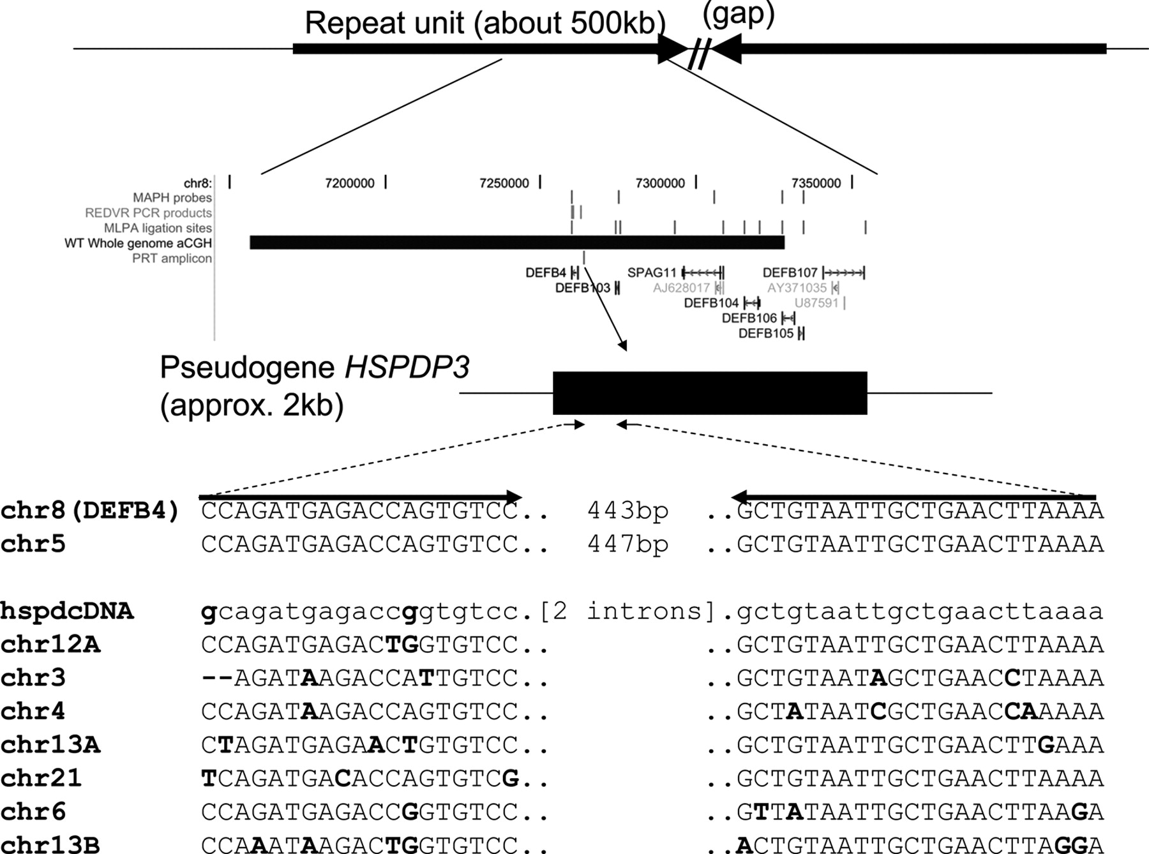
Figure 1 Principle of the PRT assay at DEFB4 . The top line shows the general structure of the repeat unit containing ...
Notes:
Figure 1 Principle of the PRT assay at DEFB4 . The top line shows the general structure of the repeat unit containing DEFB4 (which has two inverted rather than tandem repeats in the March 2006 assembly). The middle panel shows the locations of the genes SPAG11 , DEFB4 and DEFB103–107 , together with the locations of probes or amplicons used in MAPH, REDVR, MLPA and PRT, and the extent of the clone (10C3) used in array-CGH ('WT Whole Genome aCGH'). In the detailed display at the bottom, the primers amplify products from the HSPDP3 pseudogene upstream of DEFB4 on chromosome 8, and from a reference copy on chromosome 5, but have multiple mismatches (bold) with other copies of the element. In this way a single primer pair can be used to amplify two very similar products, one from near DEFB4 , the other from chromosome 5.
Unless provided in the caption above, the following copyright applies to the content of this slide: © 2006 The Author(s).This is an Open Access article distributed under the terms of the Creative Commons Attribution Non-Commercial License (http://creativecommons.org/licenses/by-nc/2.0/uk/) which permits unrestricted non-commercial use, distribution, and reproduction in any medium, provided the original work is properly cited.

Slide 2
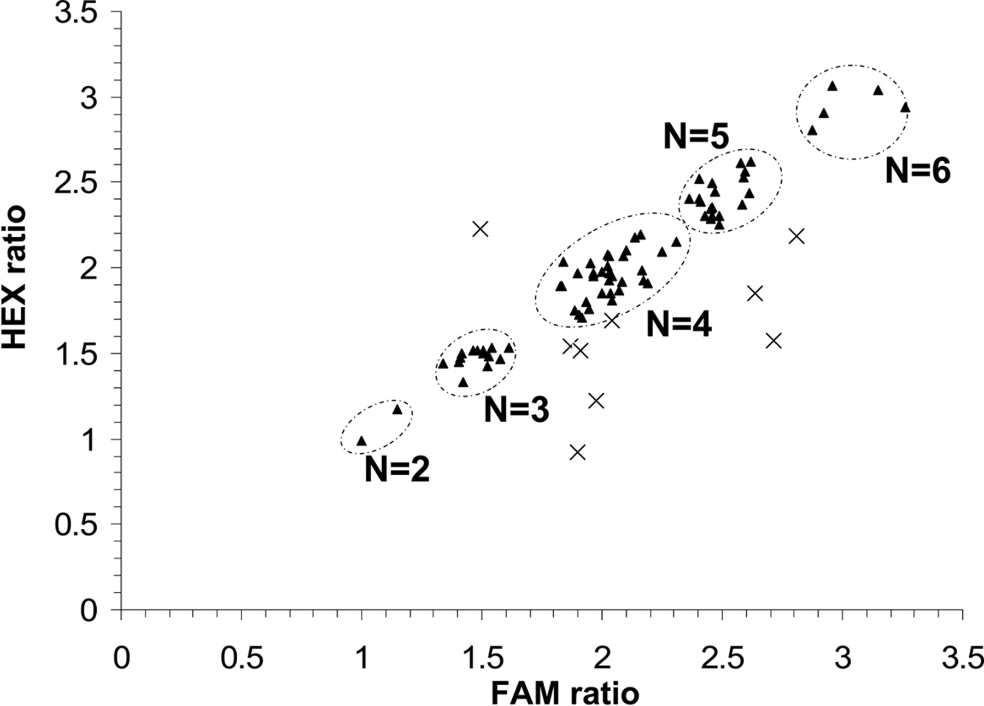
Figure 2 Comparison of ratios (chromosome 8: chromosome 5) from FAM- and HEX-labelled products in a single experiment. ...
Notes:
Figure 2 Comparison of ratios (chromosome 8: chromosome 5) from FAM- and HEX-labelled products in a single experiment. Pairs of ratios (triangles) meeting the quality-control criteria (73 samples) cluster around groups corresponding to copy numbers of 2, 3, 4, 5 and 6. Crosses show results rejected for having too great a difference between FAM and HEX ratios (10 samples).
Unless provided in the caption above, the following copyright applies to the content of this slide: © 2006 The Author(s).This is an Open Access article distributed under the terms of the Creative Commons Attribution Non-Commercial License (http://creativecommons.org/licenses/by-nc/2.0/uk/) which permits unrestricted non-commercial use, distribution, and reproduction in any medium, provided the original work is properly cited.

Slide 3
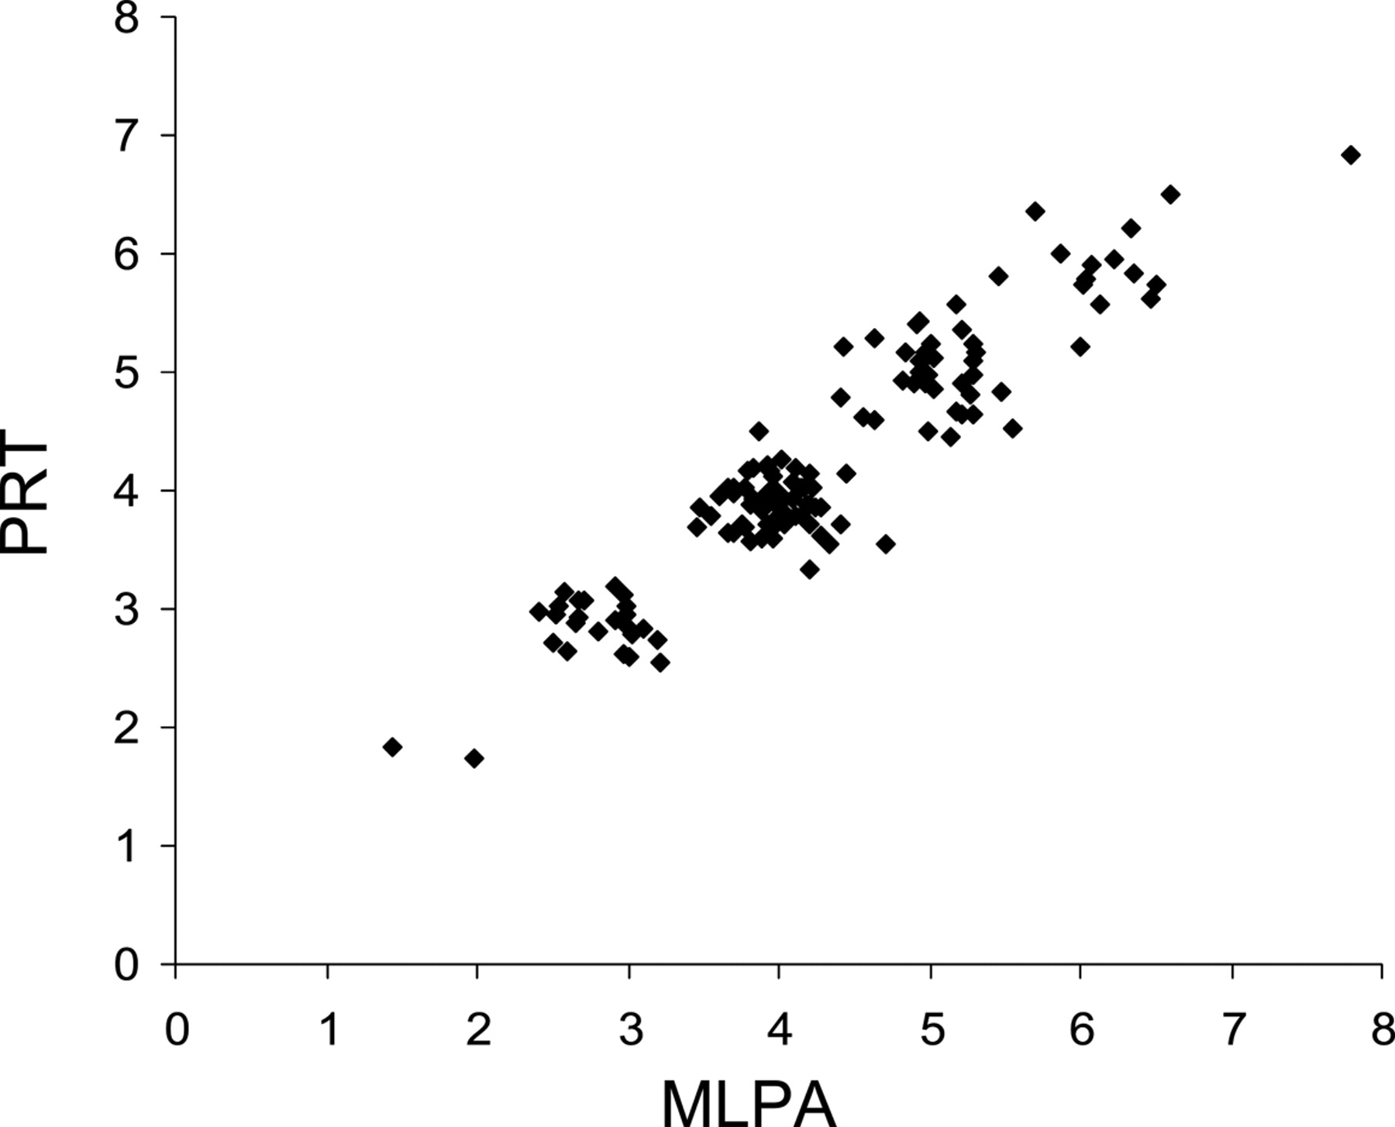
Figure 3 Comparison between unrounded copy number estimates from PRT, with unrounded data from MLPA for the same 135 ...
Notes:
Figure 3 Comparison between unrounded copy number estimates from PRT, with unrounded data from MLPA for the same 135 samples.
Unless provided in the caption above, the following copyright applies to the content of this slide: © 2006 The Author(s).This is an Open Access article distributed under the terms of the Creative Commons Attribution Non-Commercial License (http://creativecommons.org/licenses/by-nc/2.0/uk/) which permits unrestricted non-commercial use, distribution, and reproduction in any medium, provided the original work is properly cited.

Slide 4
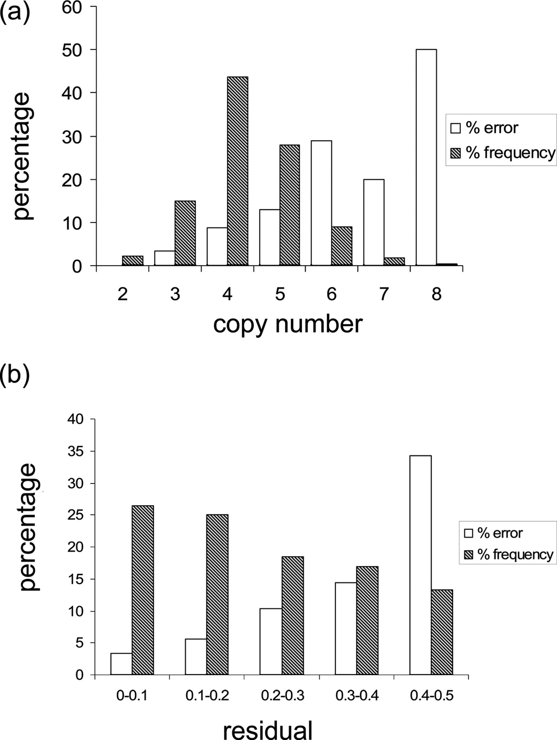
Figure 4 Correlation between error attributable to first-pass PRT and ( a ) copy number or ( b ) absolute difference ...
Notes:
Figure 4 Correlation between error attributable to first-pass PRT and ( a ) copy number or ( b ) absolute difference between the unrounded and integer values measured (‘residual’). In each case the inferred percentage error in each subcategory is shown by the open columns. Shaded columns show the relative frequencies of each copy number or residual category in the data set.
Unless provided in the caption above, the following copyright applies to the content of this slide: © 2006 The Author(s).This is an Open Access article distributed under the terms of the Creative Commons Attribution Non-Commercial License (http://creativecommons.org/licenses/by-nc/2.0/uk/) which permits unrestricted non-commercial use, distribution, and reproduction in any medium, provided the original work is properly cited.

Slide 5
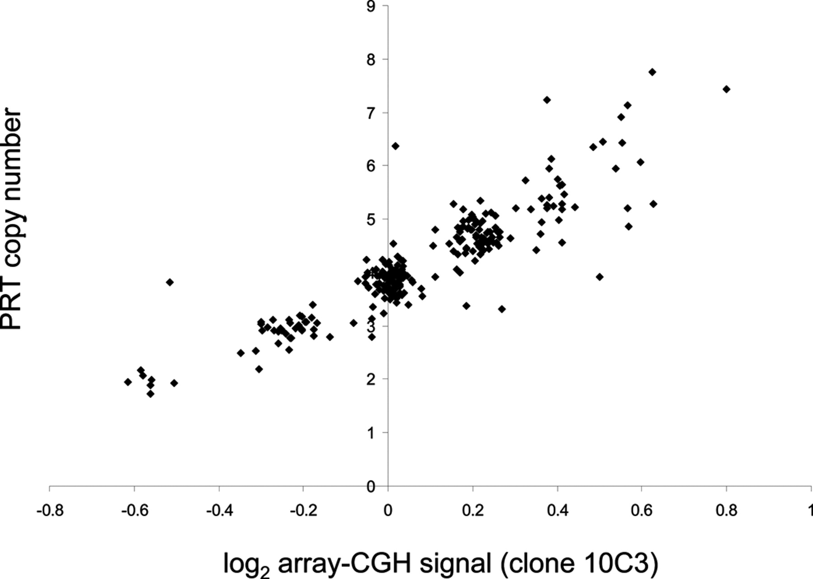
Figure 5 Comparison between first-pass PRT typing (unrounded values) and normalized signal from a clone from the ...
Notes:
Figure 5 Comparison between first-pass PRT typing (unrounded values) and normalized signal from a clone from the DEFB4 region in array-CGH for 261 samples from the HapMap study.
Unless provided in the caption above, the following copyright applies to the content of this slide: © 2006 The Author(s).This is an Open Access article distributed under the terms of the Creative Commons Attribution Non-Commercial License (http://creativecommons.org/licenses/by-nc/2.0/uk/) which permits unrestricted non-commercial use, distribution, and reproduction in any medium, provided the original work is properly cited.

