Slide 1
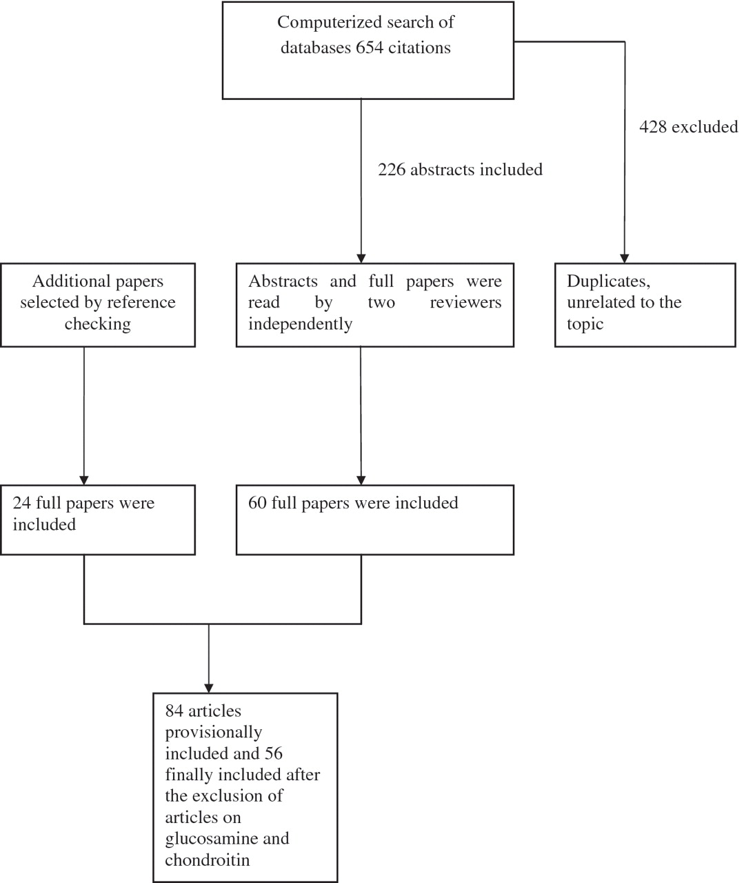
Fig. 1 Process of selecting articles for inclusion in the review.
Notes:
Fig. 1 Process of selecting articles for inclusion in the review.
Unless provided in the caption above, the following copyright applies to the content of this slide: © The Author 2010. Published by Oxford University Press on behalf of the British Society for Rheumatology. All rights reserved. For Permissions, please email: journals.permissions@oup.com

