Slide 1
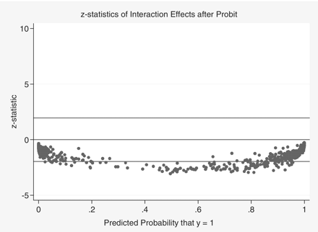
Figure 1 Z-statistics of election interaction effects
Notes:
Figure 1 Z-statistics of election interaction effects
Unless provided in the caption above, the following copyright applies to the content of this slide: © The Author 2011. Published by Oxford University Press on behalf of CSF Associates: Publius, Inc. All rights reserved. For permissions, please email: journals.permissions@oup.com

Slide 2
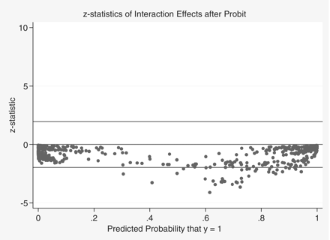
Figure 2 Z-statistics of education interaction effects
Notes:
Figure 2 Z-statistics of education interaction effects
Unless provided in the caption above, the following copyright applies to the content of this slide: © The Author 2011. Published by Oxford University Press on behalf of CSF Associates: Publius, Inc. All rights reserved. For permissions, please email: journals.permissions@oup.com

