Slide 1
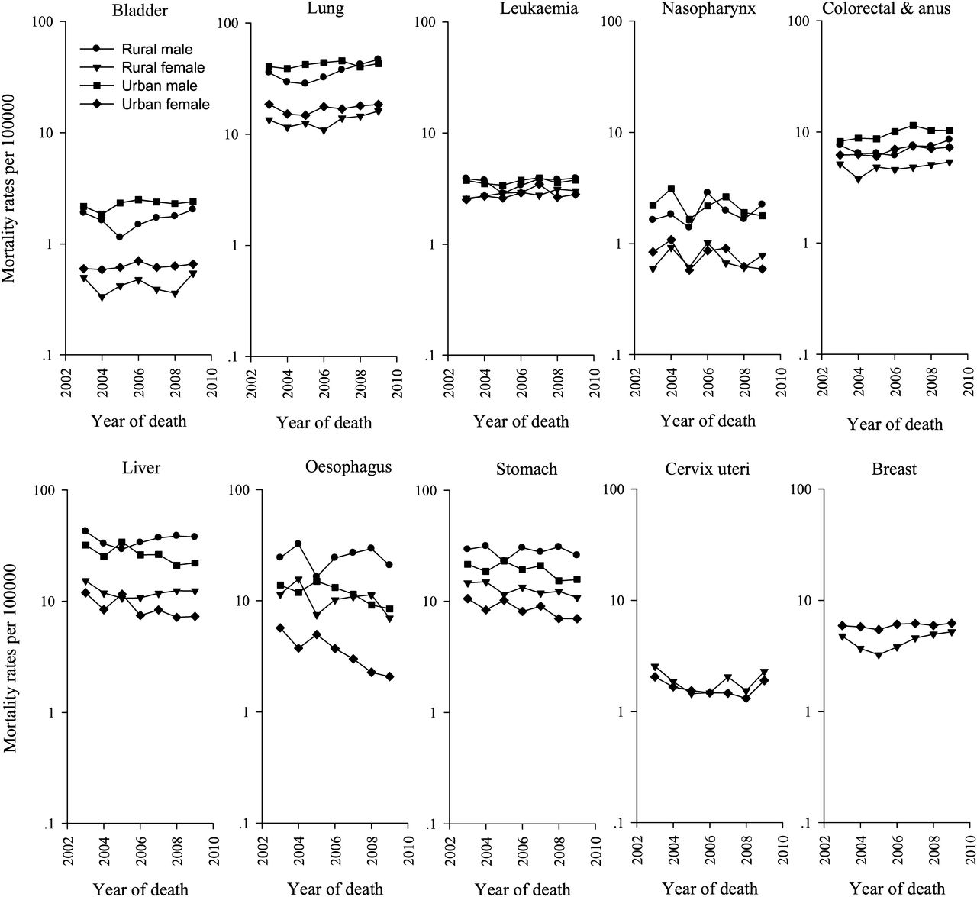
Figure 1. Trends in age-standardized mortality rates on a log scale by area and sex for all the reported cancers in ...
Notes:
Figure 1. Trends in age-standardized mortality rates on a log scale by area and sex for all the reported cancers in China during 2003–2009.
Unless provided in the caption above, the following copyright applies to the content of this slide: © The Author 2012. Published by Oxford University Press on behalf of the European Society for Medical Oncology. All rights reserved. For permissions, please email: journals.permissions@oup.com.

Slide 2
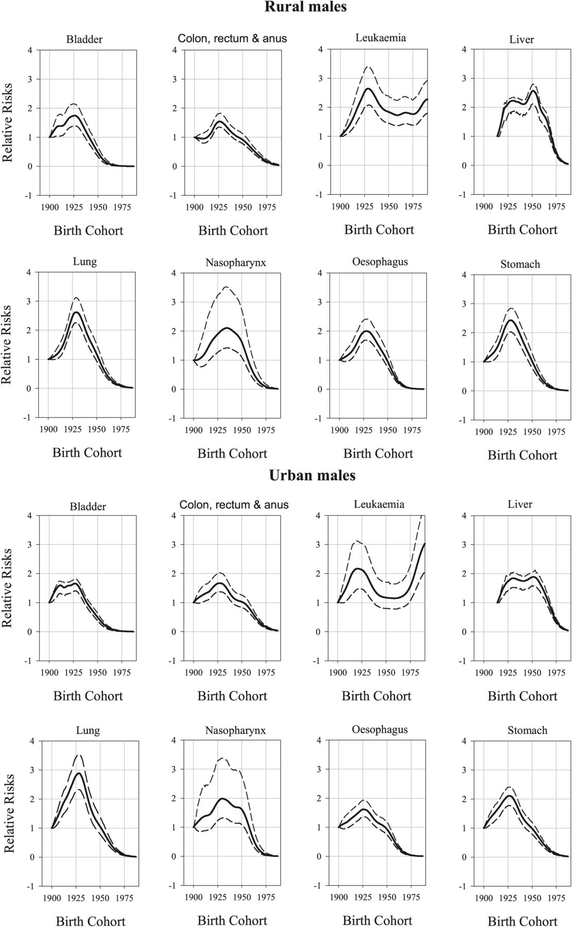
Figure 2. The relative risks curves (solid lines) of cohort effects with bootstrapped 95% confidence intervals (dashed ...
Notes:
Figure 2. The relative risks curves (solid lines) of cohort effects with bootstrapped 95% confidence intervals (dashed lines) with respect to a base year from the generalized additive models for rural and urban males, respectively.
Unless provided in the caption above, the following copyright applies to the content of this slide: © The Author 2012. Published by Oxford University Press on behalf of the European Society for Medical Oncology. All rights reserved. For permissions, please email: journals.permissions@oup.com.

Slide 3
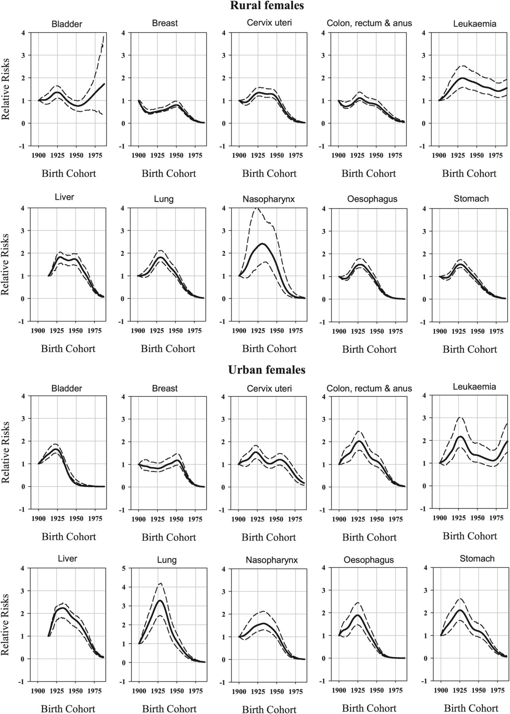
Figure 3. The relative risks curves (solid lines) of cohort effects with bootstrapped 95% confidence intervals (dashed ...
Notes:
Figure 3. The relative risks curves (solid lines) of cohort effects with bootstrapped 95% confidence intervals (dashed lines) with respect to a base year from the generalized additive models for rural and urban females, respectively.
Unless provided in the caption above, the following copyright applies to the content of this slide: © The Author 2012. Published by Oxford University Press on behalf of the European Society for Medical Oncology. All rights reserved. For permissions, please email: journals.permissions@oup.com.

