Slide 1
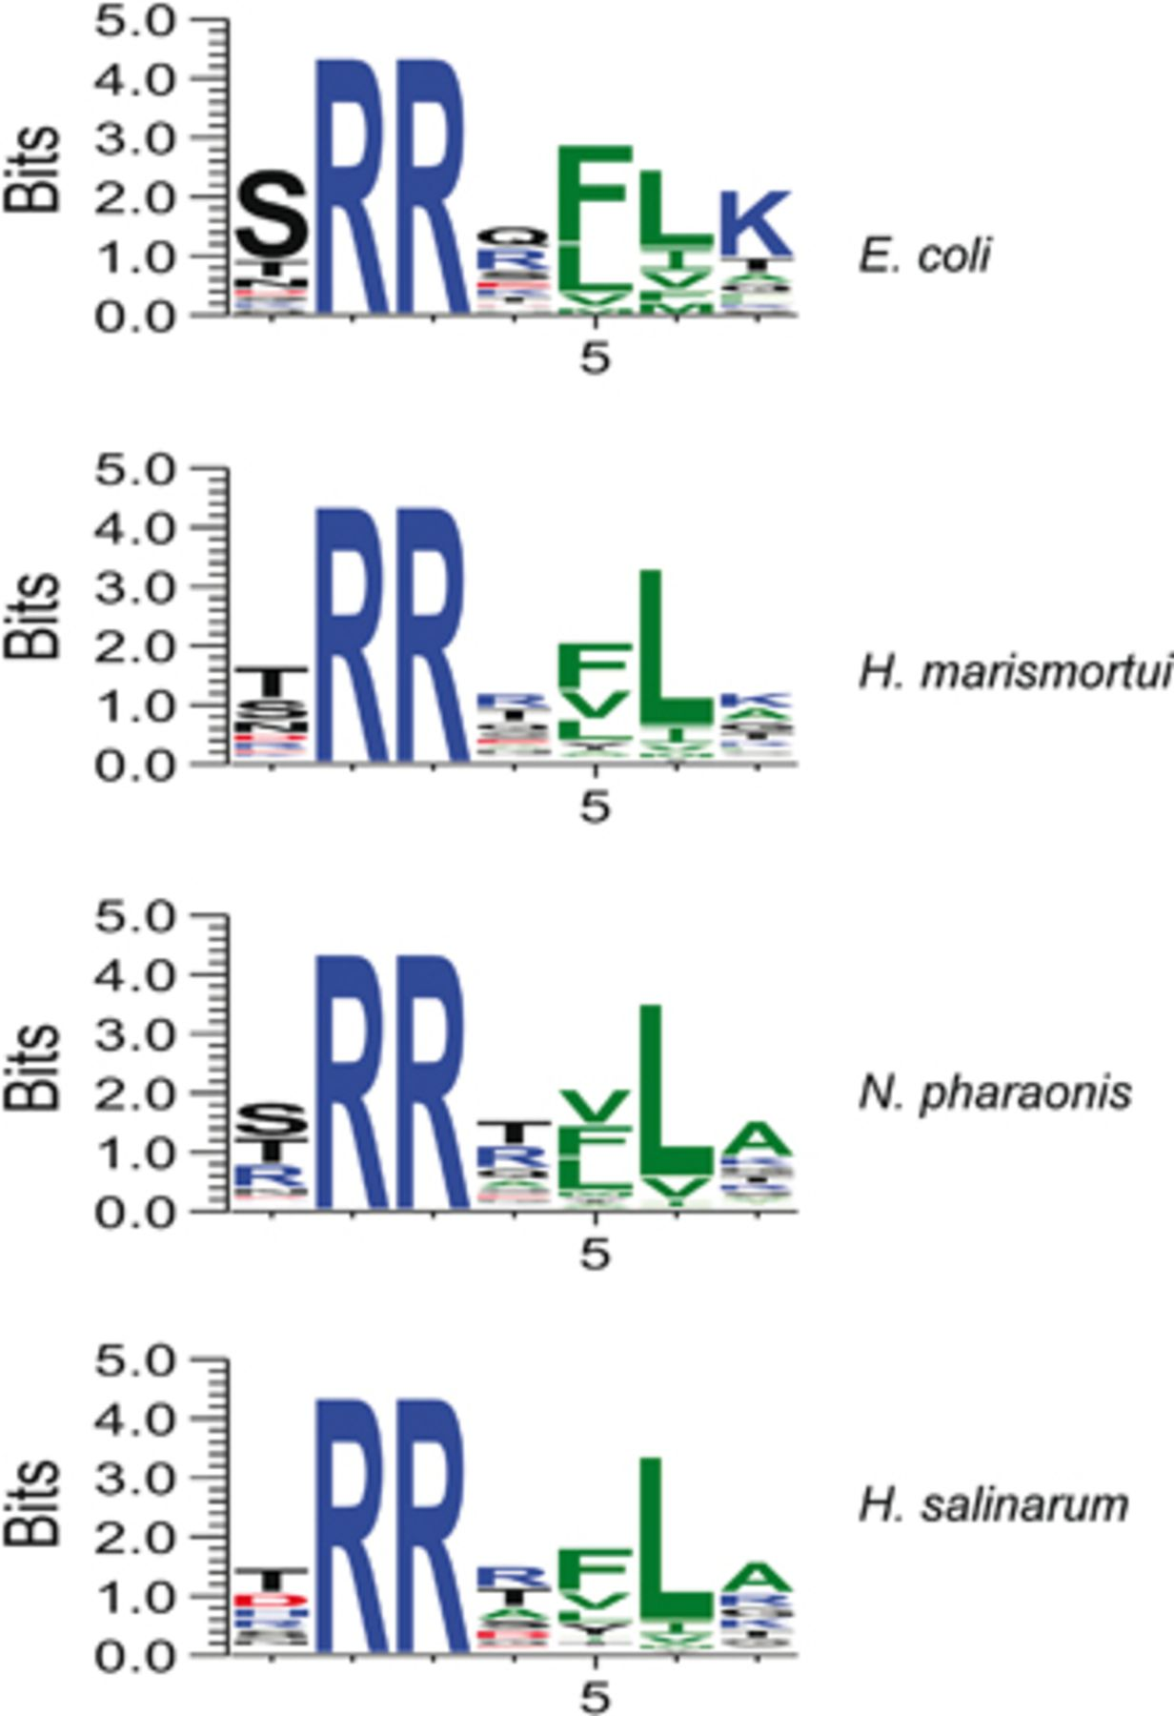
1 Tat motifs of Escherichia coli, Haloarcula marismortui, Natromonas pharaonis, and Halobacterium salinarum ...
Notes:
1 Tat motifs of Escherichia coli, Haloarcula marismortui, Natromonas pharaonis, and Halobacterium salinarum were obtained as outlined in Materials and methods. The final datasets contained 24 Tat substrates for E. coli, 94 for H. marismortui, 41 for H. salinarum, and 74 for N. pharaonis. Sequence logos were generated with weblogo 3, with positively charged residues in blue, negatively charged residues in red, hydrophobic residues in green, and polar residues in black. The x-axis shows the position in the twin-arginine motif, with the two arginines as positions 2 and 3. The y-axis shows the information content expressed in bits (Crooks et al., 2004).
Unless provided in the caption above, the following copyright applies to the content of this slide: © 2010 Federation of European Microbiological Societies Published by Blackwell Publishing Ltd. All rights reserved

Slide 2
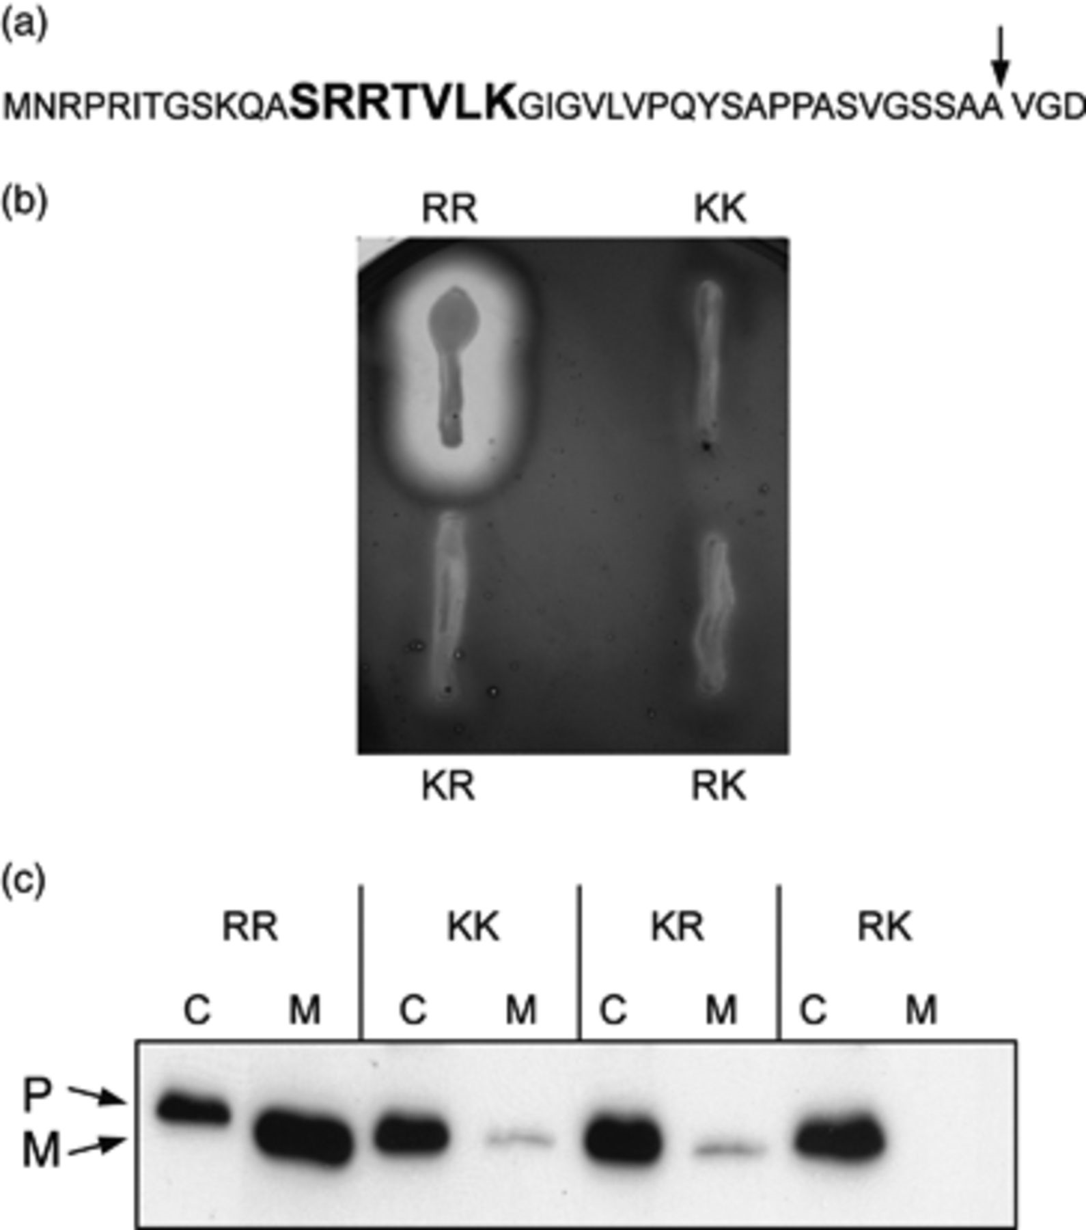
2 Secretion of AmyH with changes in positions 14 and 15 of the AmyH signal peptide. (a) The signal peptide of ...
Notes:
2 Secretion of AmyH with changes in positions 14 and 15 of the AmyH signal peptide. (a) The signal peptide of AmyH, with the residues that were substituted in this study indicated in bold. The arrow indicates the position where the signal peptide is cleaved. (b) AmyH secretion assays on starch-agar plates; (c) Western blot showing AmyH in cells (C) and medium (M). Replacements in Arg14 and/or Arg15 of the signal peptide are indicated. P, precursor of AmyH; M, mature AmyH.
Unless provided in the caption above, the following copyright applies to the content of this slide: © 2010 Federation of European Microbiological Societies Published by Blackwell Publishing Ltd. All rights reserved

Slide 3
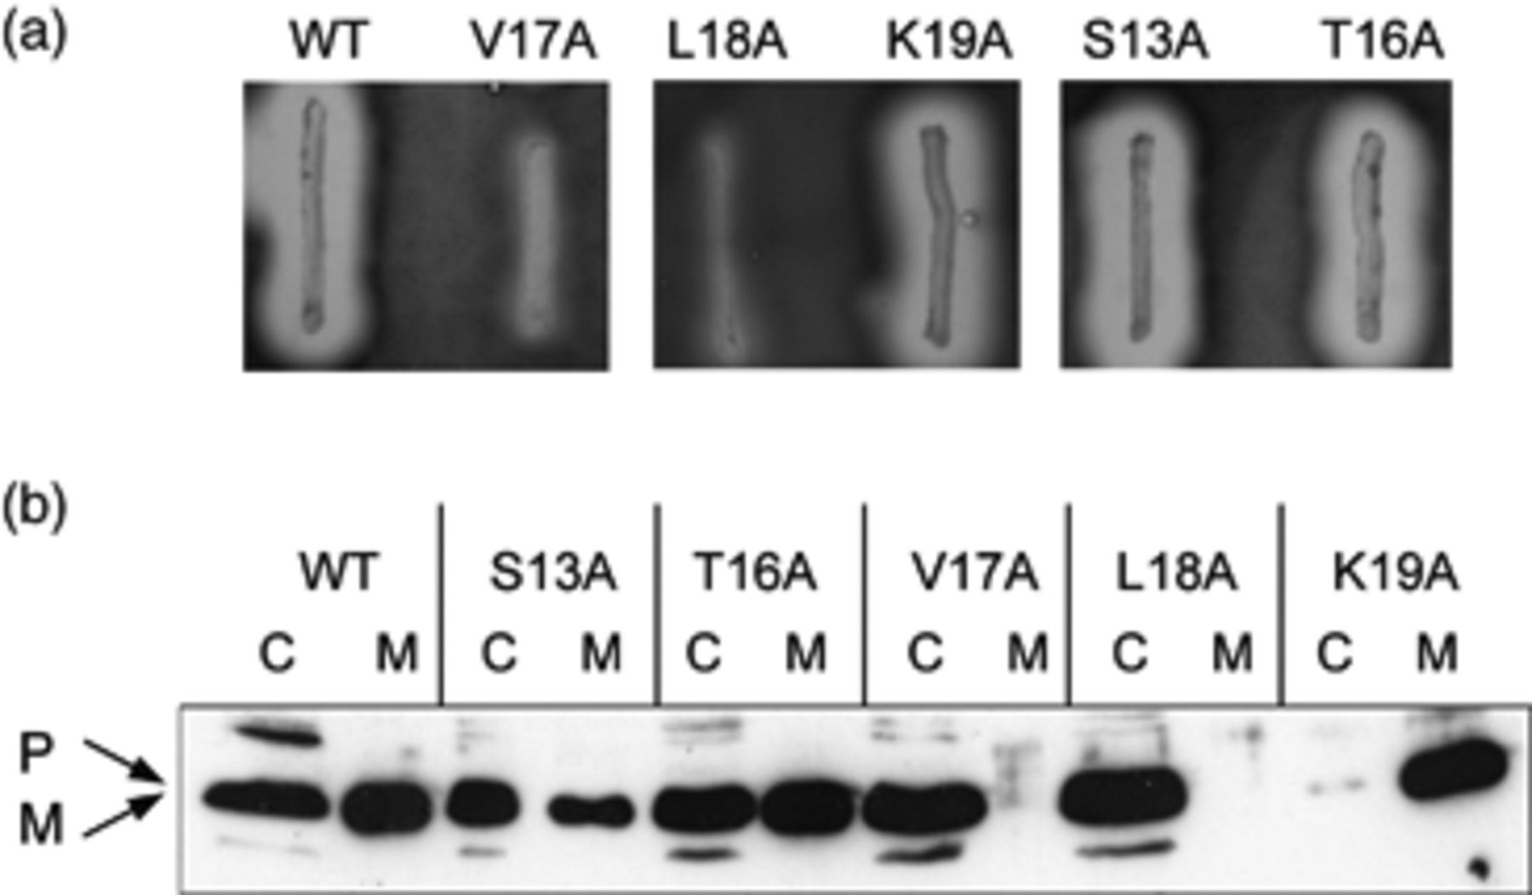
3 Secretion of AmyH with replacements in the signal peptide of residues surrounding the two arginines. (a) AmyH ...
Notes:
3 Secretion of AmyH with replacements in the signal peptide of residues surrounding the two arginines. (a) AmyH secretion assays on starch-agar plates; (b) Western blot showing AmyH in cells (C); and medium (M). Replacements in the signal peptide are indicated. P, precursor of AmyH; M, mature AmyH.
Unless provided in the caption above, the following copyright applies to the content of this slide: © 2010 Federation of European Microbiological Societies Published by Blackwell Publishing Ltd. All rights reserved

