Slide 1
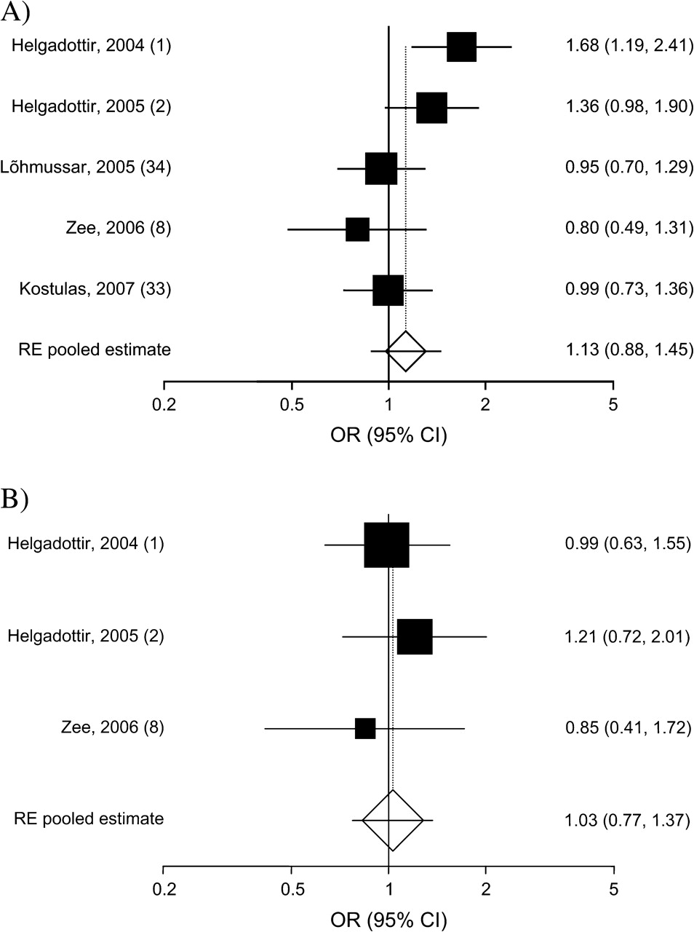
Figure 1. Random-effects (RE) odds ratio (OR) for the association between variants in the arachidonate ...
Notes:
Figure 1. Random-effects (RE) odds ratio (OR) for the association between variants in the arachidonate 5-lipoxygenase-activating protein (ALOX5AP) gene and risk of stroke in studies included in a meta-analysis. A) HapA haplotype; B) HapB haplotype. The OR estimate for each study is marked with a solid black square; the size of each square represents the weight the corresponding study exerted in the meta-analysis. The pooled estimate is displayed as a diamond. The horizontal axis is plotted on a log scale. Bars, 95% confidence interval (CI).
Unless provided in the caption above, the following copyright applies to the content of this slide: American Journal of Epidemiology © The Author 2009. Published by the Johns Hopkins Bloomberg School of Public Health. All rights reserved. For permissions, please e-mail: journals.permissions@oxfordjournals.org.

Slide 2
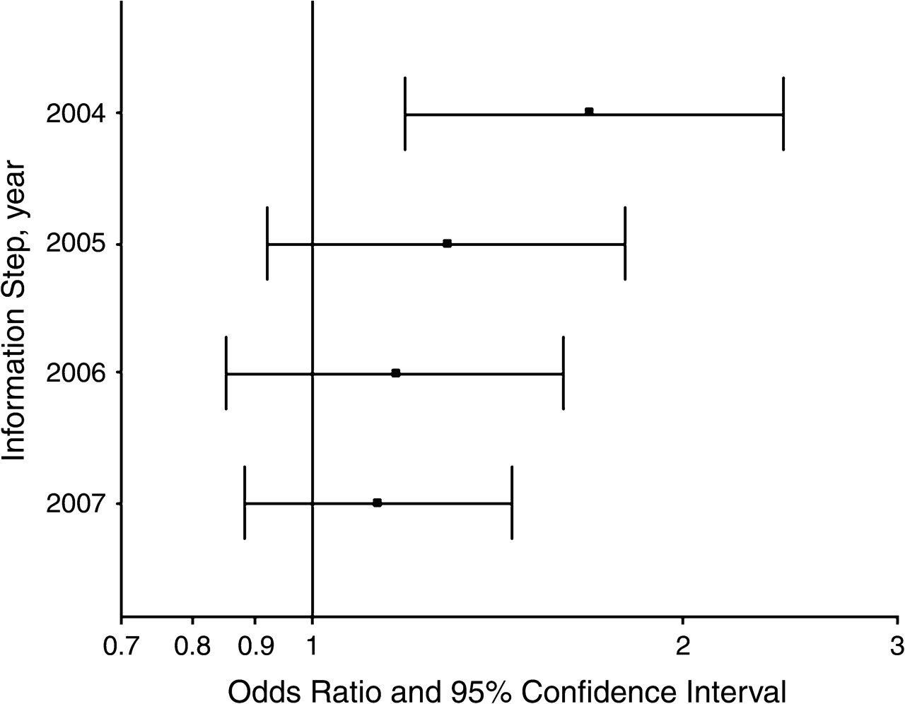
Figure 2. Random-effects pooled odds ratio at the end of each year-information step in a cumulative meta-analysis of ...
Notes:
Figure 2. Random-effects pooled odds ratio at the end of each year-information step in a cumulative meta-analysis of the relation between the HapA haplotype of the arachidonate 5-lipoxygenase-activating protein (ALOX5AP) gene and risk of stroke. Bars, 95% confidence interval.
Unless provided in the caption above, the following copyright applies to the content of this slide: American Journal of Epidemiology © The Author 2009. Published by the Johns Hopkins Bloomberg School of Public Health. All rights reserved. For permissions, please e-mail: journals.permissions@oxfordjournals.org.

