Slide 1
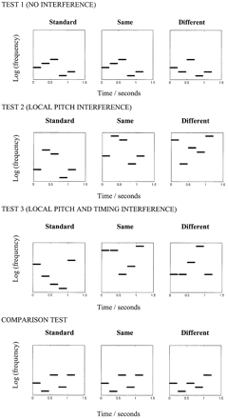
Fig. 1 Examples of the auditory tests. The standard sequence represents the first pitch sequence presented to ...
Notes:
Fig. 1 Examples of the auditory tests. The standard sequence represents the first pitch sequence presented to participants. The ‘same’ sequence is the second sequence presented when the correct response is ‘same’; the ‘different’ sequence is the second sequence presented when the correct response is ‘different’.
Unless provided in the caption above, the following copyright applies to the content of this slide: The Guarantors of Brain 2003

Slide 2
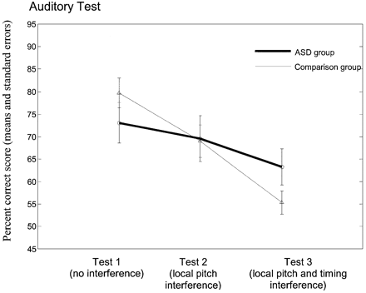
Fig. 2 Performance on the three pitch direction change tests. Mean data for the two groups. Error bars ...
Notes:
Fig. 2 Performance on the three pitch direction change tests. Mean data for the two groups. Error bars correspond to SEs.
Unless provided in the caption above, the following copyright applies to the content of this slide: The Guarantors of Brain 2003

