Slide 1
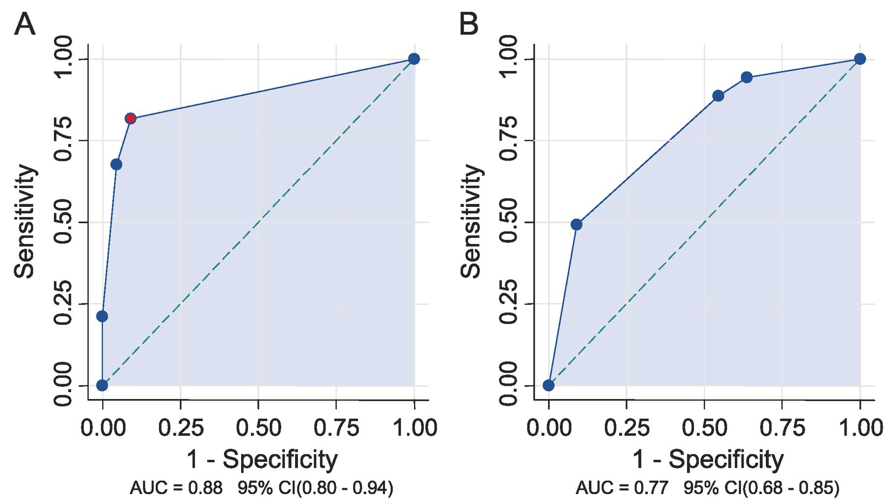
FIGURE 1 Receiver operating characteristic curves were used to compare the performances of 2 scoring systems. (A, B) ...
Notes:
FIGURE 1 Receiver operating characteristic curves were used to compare the performances of 2 scoring systems. (A, B) The first takes into account Braak neurofibrillary tangle (NFT) staging and cortical microinfarcts (CMIs) (A) and the second β-amyloid (Aβ) staging and CMI (B). Curve A contains the best-performing threshold score (red point), as close as possible to the theoretically ideal of a sensitivity of 1 and a specificity of 1 (1 − specificity = 0). This point corresponds to a Braak NFT stage IV and CMI score of 2. Also, note that the area under the curve (AUC, shaded area) is significantly larger in A compared with that in B. CI indicates confidence interval.
Unless provided in the caption above, the following copyright applies to the content of this slide: Copyright © 2010 by the American Association of Neuropathologists, Inc.

Slide 2
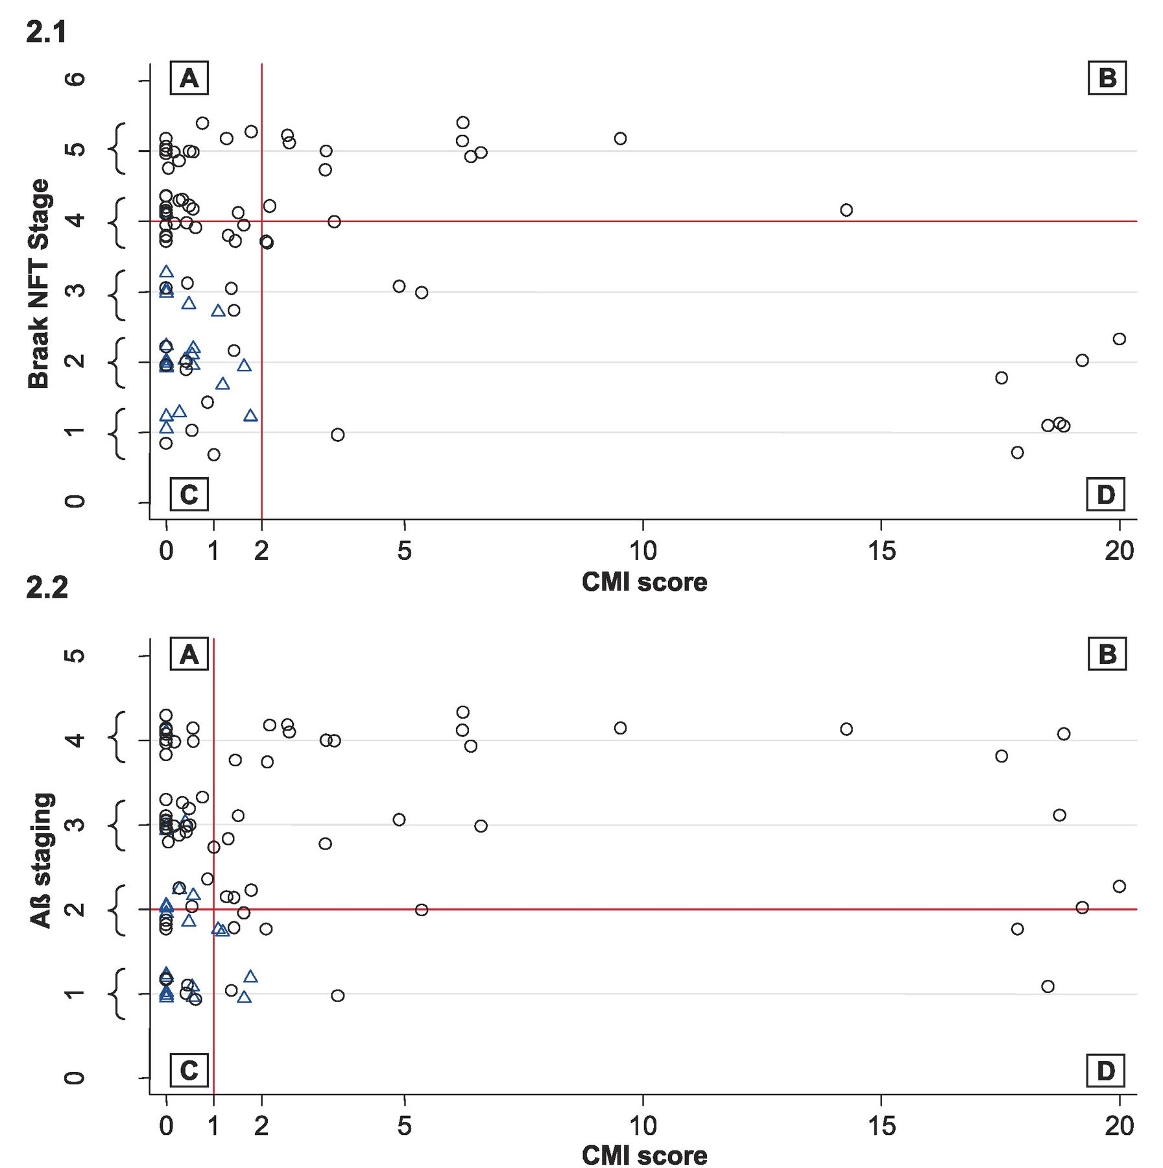
FIGURE 2 Scatter plots of demented (black circle) and nondemented (blue triangle) cases according to the best cutoff ...
Notes:
FIGURE 2 Scatter plots of demented (black circle) and nondemented (blue triangle) cases according to the best cutoff values for Braak neurofibrillary tangle (NFT) stage (2.1) and β-amyloid (Aβ) staging (2.2) and cortical microinfarct (CMI) score. Black circles represent demented cases with high degenerative scores and low vascular scores in area A (pure Alzheimer disease), high vascular scores and low degenerative scores in area D (pure vascular dementia), and high vascular and degenerative scores in area B (mixed dementia). Several cases present with dementia, although both vascular and neurodegenerative scores are low (black circles in area C), suggesting that the coexistence of subthreshold degenerative and vascular lesions may have a synergistic effect. To avoid superimposition of multiple cases, a 10% random noise was applied to all points; brackets on the y axis indicate the magnitude of the jitter.
Unless provided in the caption above, the following copyright applies to the content of this slide: Copyright © 2010 by the American Association of Neuropathologists, Inc.

Slide 3
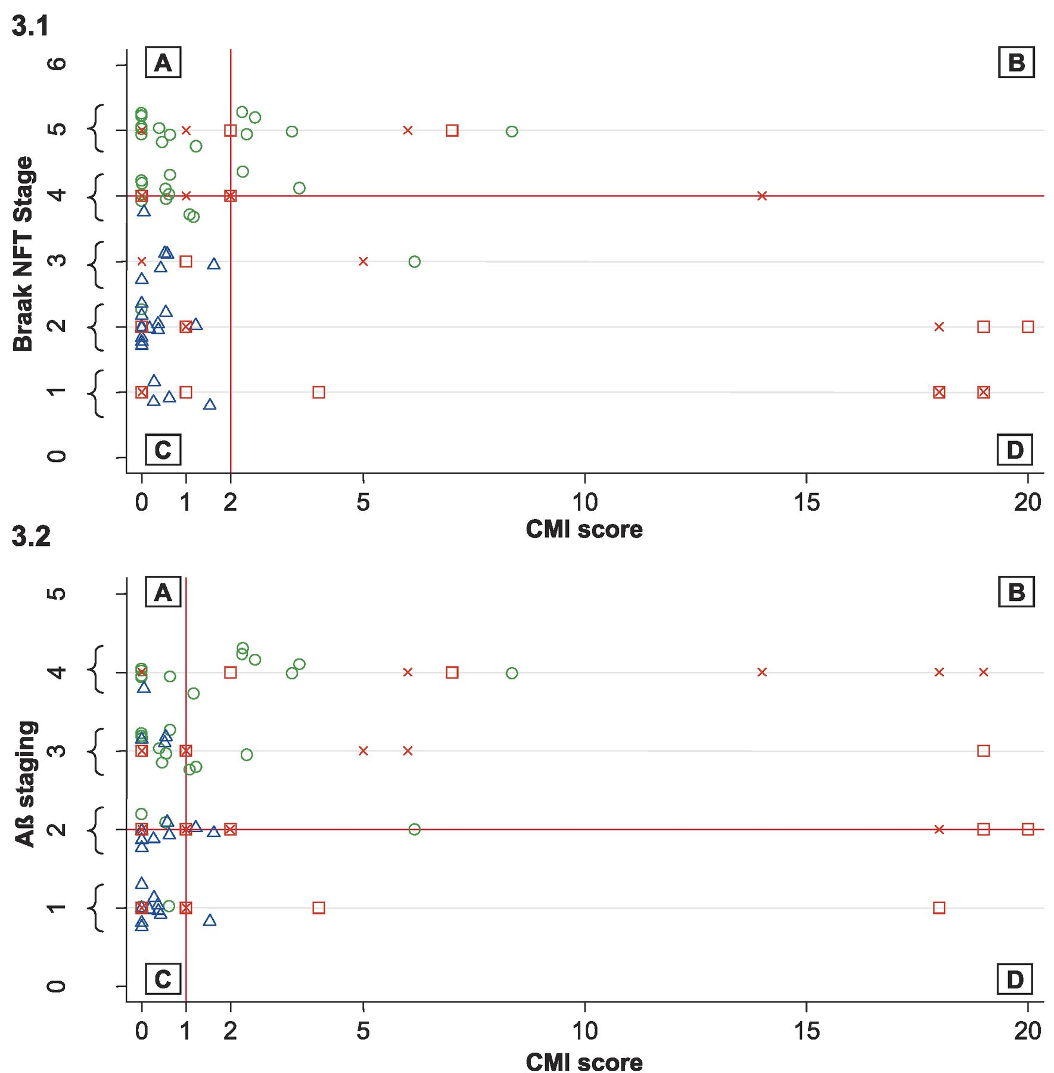
FIGURE 3 Scatter plots with cases coded according to their clinical DSM-IV diagnosis (nondemented, blue triangle; ...
Notes:
FIGURE 3 Scatter plots with cases coded according to their clinical DSM-IV diagnosis (nondemented, blue triangle; Alzheimer disease [AD], green circle; vascular dementia, red square; mixed dementia, red cross) for the combination of Braak neurofibrillary tangle (NFT) stage and cortical microinfarct (CMI) score (3.1) as well as A-amyloid (Aβ) staging and CMI score (3.2). Note the general agreement between clinical diagnosis and neuropathologic definition of AD but not for vascular or mixed cases. To avoid superimposition of multiple cases, a 10% random noise was applied to all points; brackets on the y axis indicate the magnitude of the jitter.
Unless provided in the caption above, the following copyright applies to the content of this slide: Copyright © 2010 by the American Association of Neuropathologists, Inc.

