Slide 1
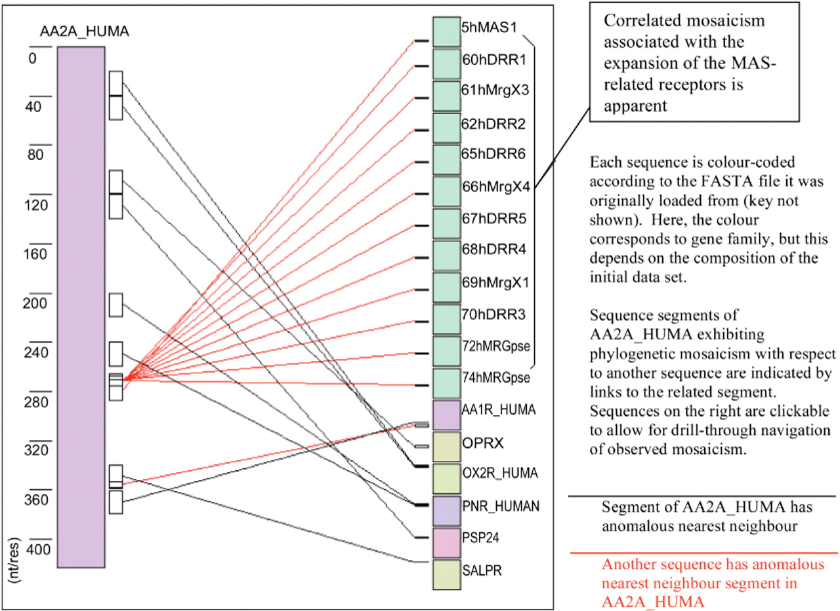
Fig. 1. Sample graphical output from TreeMos for the Human AA2A gene protein sequence, with respect to other proteins ...
Notes:
Fig. 1. Sample graphical output from TreeMos for the Human AA2A gene protein sequence, with respect to other proteins in the Human GPCR gene superfamily. AA2A is represented on the left with scale in residues. Other members of the superfamily which have phylogenetically anomalous relationships with AA2A are represented on the right at reduced scales.
Unless provided in the caption above, the following copyright applies to the content of this slide: © The Author 2008. Published by Oxford University Press. All rights reserved. For Permissions, please email: journals.permissions@oxfordjournals.org

