Slide 1
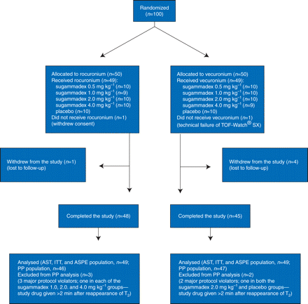
Fig 1 Patient flow diagram. ASPE, all-subjects-pharmacokinetically evaluable; AST, all-subjects-treated; ITT, ...
Notes:
Fig 1 Patient flow diagram. ASPE, all-subjects-pharmacokinetically evaluable; AST, all-subjects-treated; ITT, intention-to-treat; PP, per-protocol.
Unless provided in the caption above, the following copyright applies to the content of this slide: © The Author [2010]. Published by Oxford University Press on behalf of the British Journal of Anaesthesia. All rights reserved. For Permissions, please email: journals.permissions@oxfordjournal.org

Slide 2
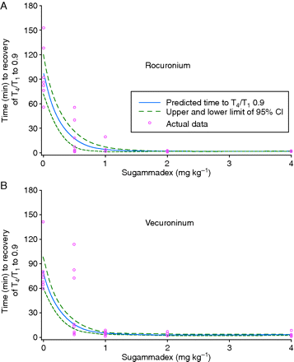
Fig 2 Estimated dose–response relationship between recovery of T₄/T₁ ratio to 0.9 and the ...
Notes:
Fig 2 Estimated dose–response relationship between recovery of T4/T1 ratio to 0.9 and the dose of sugammadex administered after (a) rocuronium 0.9 mg kg−1 and (b) vecuronium 0.1 mg kg−1, with 95% confidence intervals (CI; PP subjects).
Unless provided in the caption above, the following copyright applies to the content of this slide: © The Author [2010]. Published by Oxford University Press on behalf of the British Journal of Anaesthesia. All rights reserved. For Permissions, please email: journals.permissions@oxfordjournal.org

Slide 3
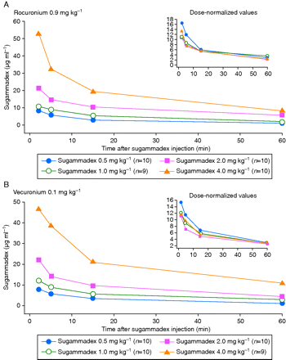
Fig 3 Median total (sum of free and bound) plasma concentration–time profiles of sugammadex administered after (a) ...
Notes:
Fig 3 Median total (sum of free and bound) plasma concentration–time profiles of sugammadex administered after (a) rocuronium 0.9 mg kg−1 and (b) vecuronium 0.1 mg kg−1 (all subjects pharmacokinetically evaluable). The inset graphs show dose-normalized concentrations of sugammadex [(µg ml−1)/(mg kg−1)] vs time (min) after sugammadex administration.
Unless provided in the caption above, the following copyright applies to the content of this slide: © The Author [2010]. Published by Oxford University Press on behalf of the British Journal of Anaesthesia. All rights reserved. For Permissions, please email: journals.permissions@oxfordjournal.org

Slide 4
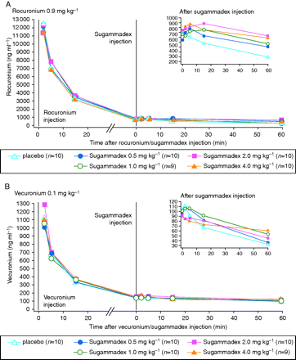
Fig 4 Median plasma concentration–time profiles of (a) rocuronium after administration of rocuronium 0.9 mg ...
Notes:
Fig 4 Median plasma concentration–time profiles of (a) rocuronium after administration of rocuronium 0.9 mg kg−1 followed by sugammadex 0.5–4.0 mg kg−1 or placebo and (b) vecuronium after administration of vecuronium 0.1 mg kg−1 followed by sugammadex 0.5–4.0 mg kg−1 or placebo (all subjects pharmacokinetically evaluable). The inset graphs show concentrations of rocuronium and vecuronium (ng ml−1) vs time (min) after sugammadex administration.
Unless provided in the caption above, the following copyright applies to the content of this slide: © The Author [2010]. Published by Oxford University Press on behalf of the British Journal of Anaesthesia. All rights reserved. For Permissions, please email: journals.permissions@oxfordjournal.org

