Slide 1
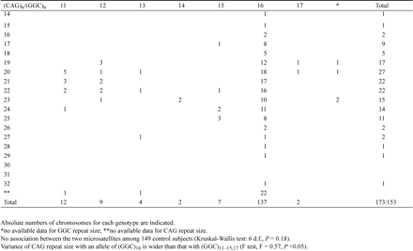
Table 1 Distribution of (CAG)_{n} and (GGC)_{n} in control subjects
Notes:
Table 1 Distribution of (CAG)n and (GGC)n in control subjects
Unless provided in the caption above, the following copyright applies to the content of this slide: © 1996 Oxford University Press

Slide 2
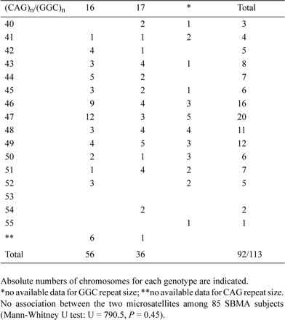
Table 2 Distribution of (CAG)_{n} and (GGC)_{n} in SBMA subjects
Notes:
Table 2 Distribution of (CAG)n and (GGC)n in SBMA subjects
Unless provided in the caption above, the following copyright applies to the content of this slide: © 1996 Oxford University Press

