Slide 1
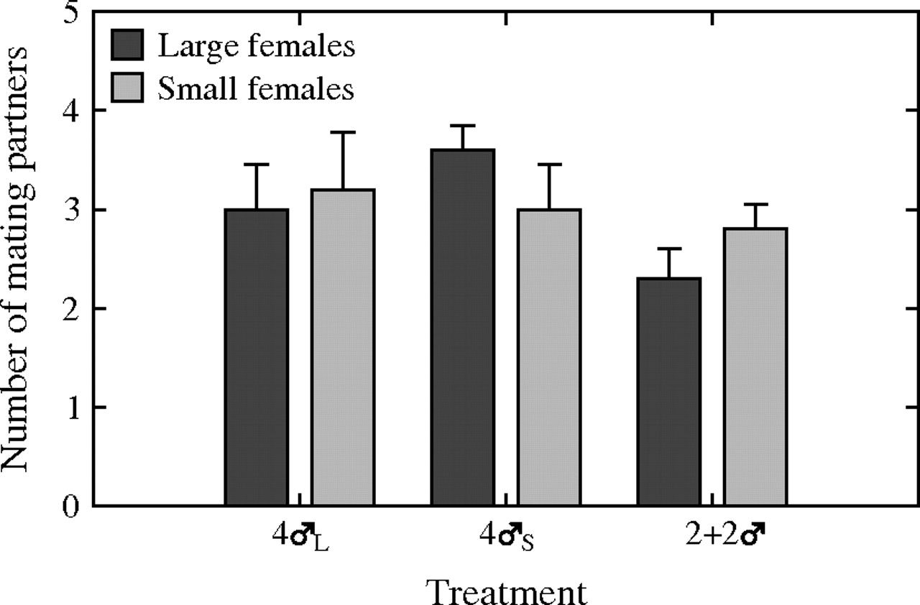
Figure 1 Mean number of mating partners for large and small females in each treatment. Error bars represent SDs.
Notes:
Figure 1 Mean number of mating partners for large and small females in each treatment. Error bars represent SDs.
Unless provided in the caption above, the following copyright applies to the content of this slide: © The Author 2009. Published by Oxford University Press on behalf of the International Society for Behavioral Ecology. All rights reserved. For permissions, please e-mail: journals.permissions@oxfordjournals.org

Slide 2
Figure 2 Mean number of eggs laid by large and small females in 1 and 4 males (A); Mean number of eggs laid by ...
Notes:
Figure 2 Mean number of eggs laid by large and small females in 1 and 4 males (A); Mean number of eggs laid by different-sized females in large or small males in the heterogeneous group (B); Error bars represent SDs and asterisks indicate significantly different values.
Unless provided in the caption above, the following copyright applies to the content of this slide: © The Author 2009. Published by Oxford University Press on behalf of the International Society for Behavioral Ecology. All rights reserved. For permissions, please e-mail: journals.permissions@oxfordjournals.org

Slide 3
Figure 3 Mean size of the eggs laid by large and small females in 1 and 4 males (A); Mean size of the eggs laid by ...
Notes:
Figure 3 Mean size of the eggs laid by large and small females in 1 and 4 males (A); Mean size of the eggs laid by different-sized females in large or small males in the heterogeneous group (B). Error bars represent SDs and asterisks indicate significantly different values.
Unless provided in the caption above, the following copyright applies to the content of this slide: © The Author 2009. Published by Oxford University Press on behalf of the International Society for Behavioral Ecology. All rights reserved. For permissions, please e-mail: journals.permissions@oxfordjournals.org

