Slide 1
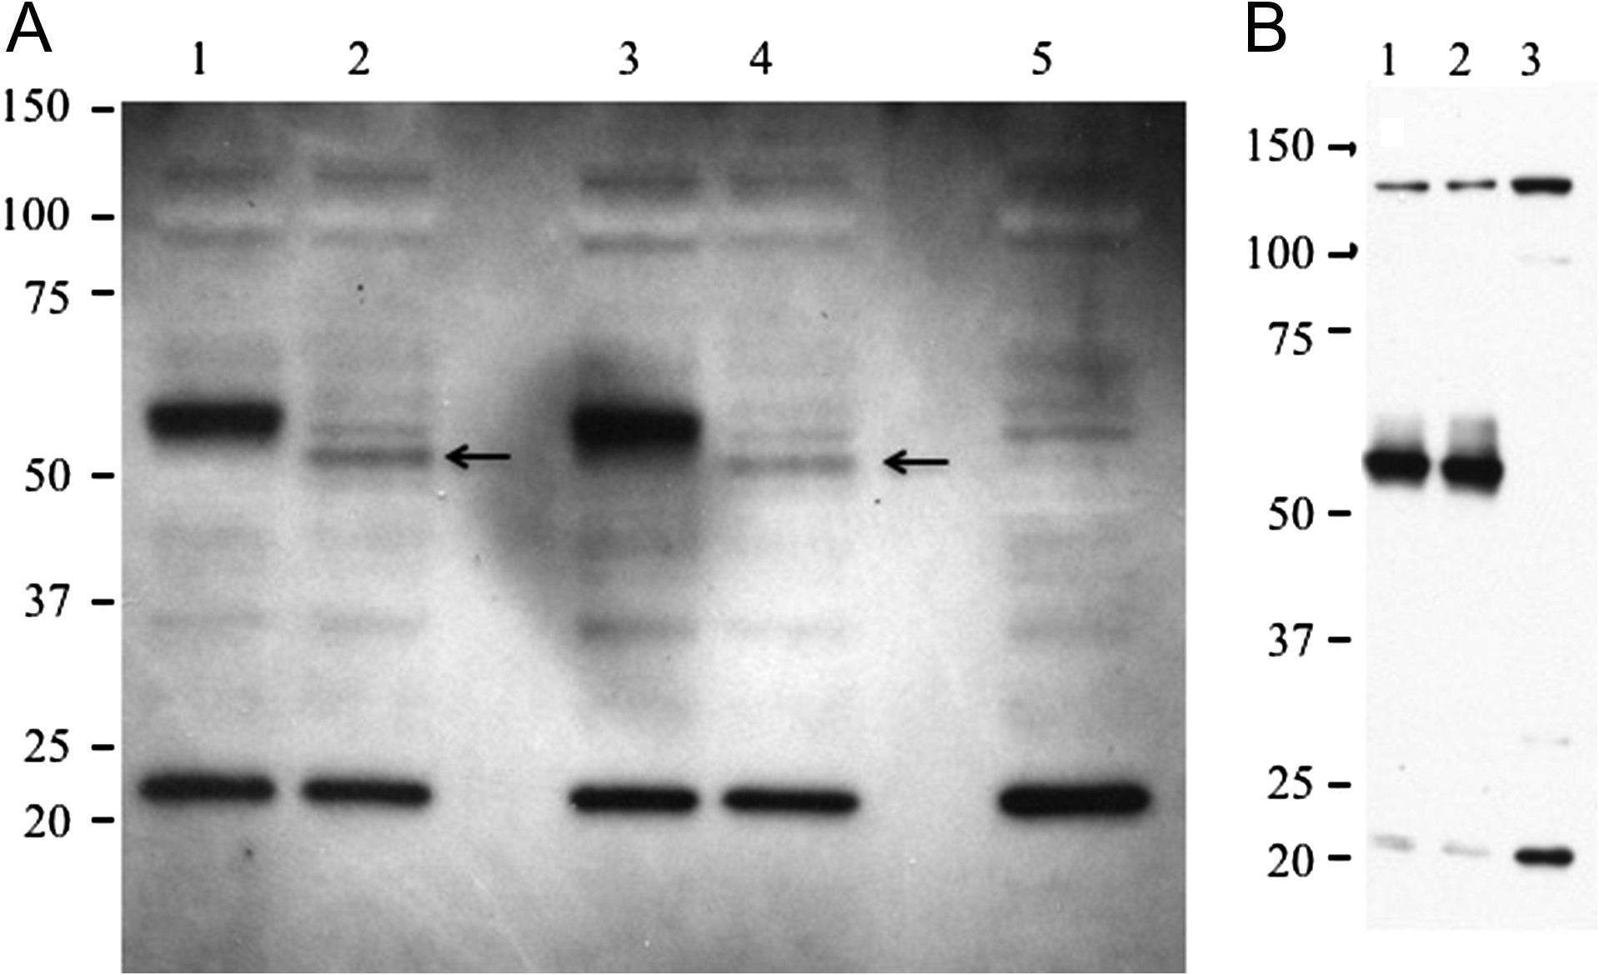
Fig. 1. Western blot analysis of GalNAc-4-ST1, GalNAc-4-ST1(R > W), GalNAc-4-ST1-V5His and GalNAc-4-ST1(R > W)V5His ...
Notes:
Fig. 1. Western blot analysis of GalNAc-4-ST1, GalNAc-4-ST1(R > W), GalNAc-4-ST1-V5His and GalNAc-4-ST1(R > W)V5His expressed in HEK-293T cells. HEK-293T cells were transfected with pcDNA3.1 encoding GalNAc-4-ST1, GalNAc-4-ST1(R > W), GalNAc-4-ST1-V5His, or GalNAc-4-ST1(R > W)V5His. Cells were washed, lysed using SDS-PAGE loading buffer and equal aliquots analyzed by SDS-PAGE. Following electrophoretic transfer to PVDF membranes the GalNAc-4-ST1 was detected by incubation with a rabbit anti-GalNAc-4-ST1 raised to purified recombinant GalNAc-4-ST1 (A) or with Sigma Prestige rabbit polyclonal anti-CHST8 (HPA016004) (B). (A) Lane 1, GalNAc-4-ST1-V5His; lane 2, GalNAc-4-ST1; lane 3, GalNAc-4-ST1(R > W)V5His; and lane 4, GalNAc-4-ST1(R > W). Lane 5, Vector control. (B) Lane 1, GalNAc-4-ST1; lane 2. GalNAc-4-ST1(R > W); and lane 3, vector control. The position of GalNAc-4-ST1 in Lane 2 and GalNAc-4-ST1(R > W) in Lane 4 is indicated by the arrows. The location of molecular weight standards is indicated.
Unless provided in the caption above, the following copyright applies to the content of this slide: © The Author 2017. Published by Oxford University Press. All rights reserved. For permissions, please e-mail: journals.permissions@oup.com

Slide 2
Fig. 2. GalNAc-4-ST1 and GalNAc-4-ST(R > W) are active when expressed in HEK-293T and HaCat cells. HEK-293T, HaCat-RK ...
Notes:
Fig. 2. GalNAc-4-ST1 and GalNAc-4-ST(R > W) are active when expressed in HEK-293T and HaCat cells. HEK-293T, HaCat-RK and HaCat-KK were each cotransfected with pCMV-GLuc-PSG23-MycHis and either pcDNA3.1 vector, pcDNA3.1-GalNAc-4-ST1 or pcDNA3.1-GalNAc-4-ST1(R > W). Aliquots of medium containing equal light units of Gaussia luciferase activity were incubated with immobilized WFA in 96-well plates. After washing, the amount of luciferase activity bound was determined as described previously (Fiete et al. 2012a). The amount bound in the absence of cotransfected GalNAc-4-ST1 was designated as 100%. The amount of GLuc-PSG23 bound when GalNAc-4-ST1 or GalNAc-4-ST1(R > W) was cotransfected is indicated as a percent of that bound in the absence of GalNAc-4-ST1. Assay were performed in triplicate and the SEM is indicated.
Unless provided in the caption above, the following copyright applies to the content of this slide: © The Author 2017. Published by Oxford University Press. All rights reserved. For permissions, please e-mail: journals.permissions@oup.com

Slide 3
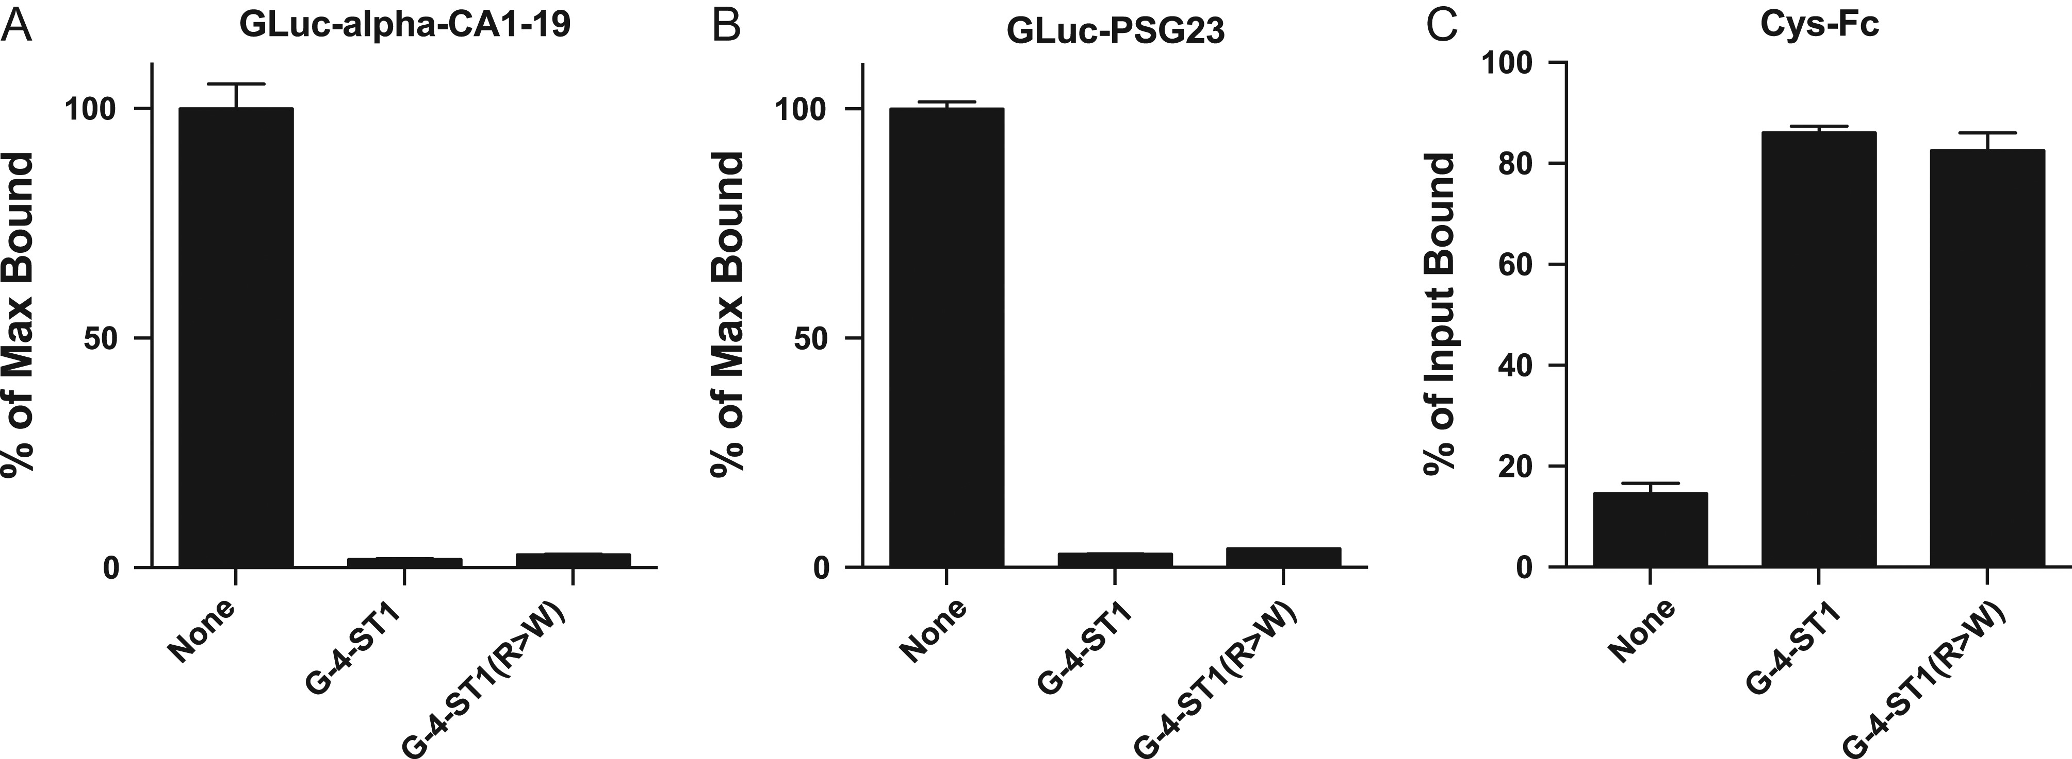
Fig. 3. GalNAc-4-ST1 and GalNAc-4-ST1(R > W) modify N-glycans bearing LacdiNAc on GLuc-alpha-CA1-19 and GLuc-PSG23 ...
Notes:
Fig. 3. GalNAc-4-ST1 and GalNAc-4-ST1(R > W) modify N-glycans bearing LacdiNAc on GLuc-alpha-CA1-19 and GLuc-PSG23 with terminal sulfate. CHO/T3 cells were cotransfected with pCMV-GLuc-PSG23-MycHis or pCMV-GLuc-alpha-CA1-19 and either pcDNA3.1 vector, pcDNA3.1-GalNAc-4-ST1 or pcDNA3.1-GalNAc-4-ST1(R > W). GLuc-alpha bears 2 N-linked glycans and GLuc-PSG23 7 N-linked glycans that can be modified with LAcdiNAc termini. Aliquots of medium containing equal light units of Gaussia luciferase activity were incubated with immobilized WFA (A and B). The amount of GLuc-alpha (A) and GLuc-PSG23 (B) bound in the absence of GalNAc-4-ST1 or GalNAc-4-ST1(R > W) was designated as 100% (None). The amount of GLuc-alpha and GLuc-PSG23 bound when expressed in the presence of GalNAc-4-ST1 or GalNAc-4-ST1(R > W) is presented as a percent of the maximum bound. In Panel C aliquots containing equal light units of GLuc-PSG23 activity were incubated with Cys-Fc immobilized on magnetic beads. The percent of the activity not captured by the Cys-Fc was used to determine the percent of the input bound in the absence of GalNAc-4-ST1 (none) and in the presence of GalNAc-4-ST1 or GalNAc-4-ST1(R > W). Assay were performed in triplicate and error bars designate the SEM.
Unless provided in the caption above, the following copyright applies to the content of this slide: © The Author 2017. Published by Oxford University Press. All rights reserved. For permissions, please e-mail: journals.permissions@oup.com

Slide 4
Fig. 4. Levels of GalNAc-4-ST1 (CHST8) mRNA are low in mouse and human keratinocytes as compared to mouse pituitary. ...
Notes:
Fig. 4. Levels of GalNAc-4-ST1 (CHST8) mRNA are low in mouse and human keratinocytes as compared to mouse pituitary. The steady state levels of GalNAc-4-ST1 (CHST8) (A), β4GalNT3 (B4GALNT3) (B) and β4GalNT4 (B4GALNT4) (C) relative to HPRT1 were determined for mouse primary keratinocytes (mKt), mouse pituitary (mPit), human keratinocyte cells lines HaCatKK and HaCatRK using Taqman as described previously (Mi et al. 2014). Assays were performed in triplicate.
Unless provided in the caption above, the following copyright applies to the content of this slide: © The Author 2017. Published by Oxford University Press. All rights reserved. For permissions, please e-mail: journals.permissions@oup.com

