Slide 1
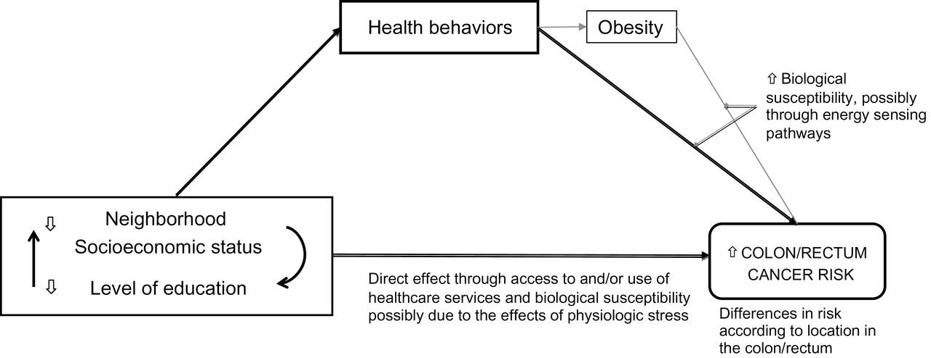
Figure 1. Conceptual model of the relationships among socioeconomic factors, health behaviors, and colorectal cancer ...
Notes:
Figure 1. Conceptual model of the relationships among socioeconomic factors, health behaviors, and colorectal cancer risk. Neighborhood socioeconomic status refers to the racial composition and socioeconomic context within a given unit of aggregation for area-level socioeconomic measures. The health behaviors examined are physical activity, dietary pattern, and smoking. This grouping does not imply a causal relationship between smoking and obesity.
Unless provided in the caption above, the following copyright applies to the content of this slide: © The Author 2012. Published by Oxford University Press. All rights reserved. For Permissions, please e-mail: journals.permissions@oup.com.

Slide 2
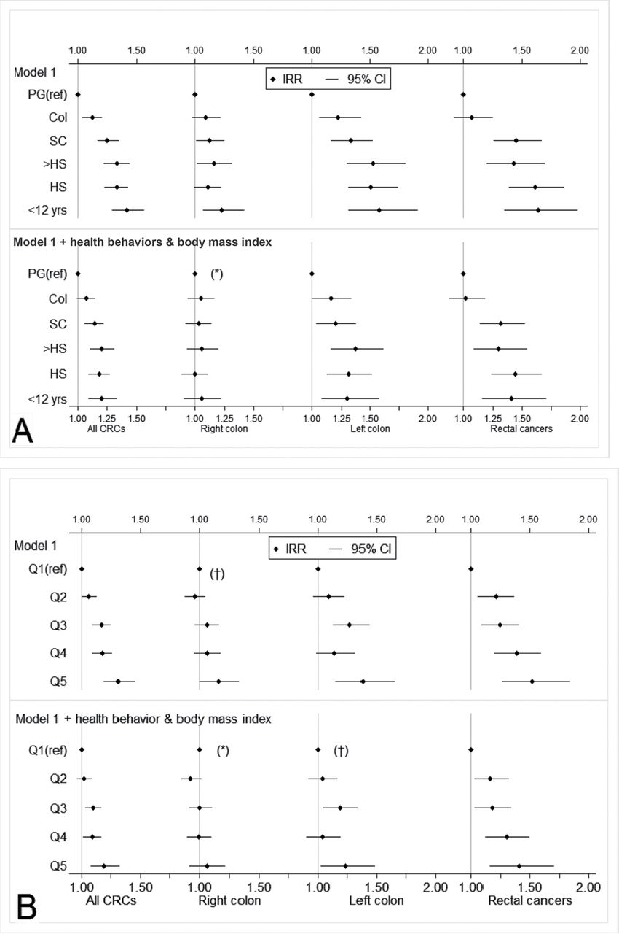
Figure 2. Associations between socioeconomic measures and colorectal cancer incidence according to tumor location ...
Notes:
Figure 2. Associations between socioeconomic measures and colorectal cancer incidence according to tumor location before and after adjustment for behavioral factors and BMI: NIH-AARP Study, 1995–2006. A) Association of educational level with colorectal cancer incidence. The top panel shows incidence rate ratios (IRR) and 95% confidence intervals (CIs) for colorectal cancer risk by tumor location for persons with varying levels of education (PG = postgraduate, Col = college degree, SC = some college, >HS = more than high school, HS = high school diploma) before adjustment, and the bottom panel shows the same associations after adjustment for health behaviors (Mediterranean diet score, physical activity, and smoking) and body mass index. B) Association of neighborhood SES with colorectal cancer incidence. The top panel shows incidence rate ratios (IRR) and 95% confidence intervals (CIs) for colorectal cancer risk by tumor location for persons in varying levels of neighborhood deprivation (by quintile: Q1, least deprived to Q5, most deprived). The vertical lines represent an IRR of 1.0 (referent). All Wald χ2 two-sided P values for trend are less than .01 except those marked by an asterisk (* means ≤.05) or a dagger († means >.05). Model 1 was adjusted for age, sex, race and ethnicity, family history of colorectal cancer in a first-degree relative, and state of residence, which were entered as categorical variables in the models except age (continuous, measured from the baseline date).
Unless provided in the caption above, the following copyright applies to the content of this slide: © The Author 2012. Published by Oxford University Press. All rights reserved. For Permissions, please e-mail: journals.permissions@oup.com.

