Slide 1
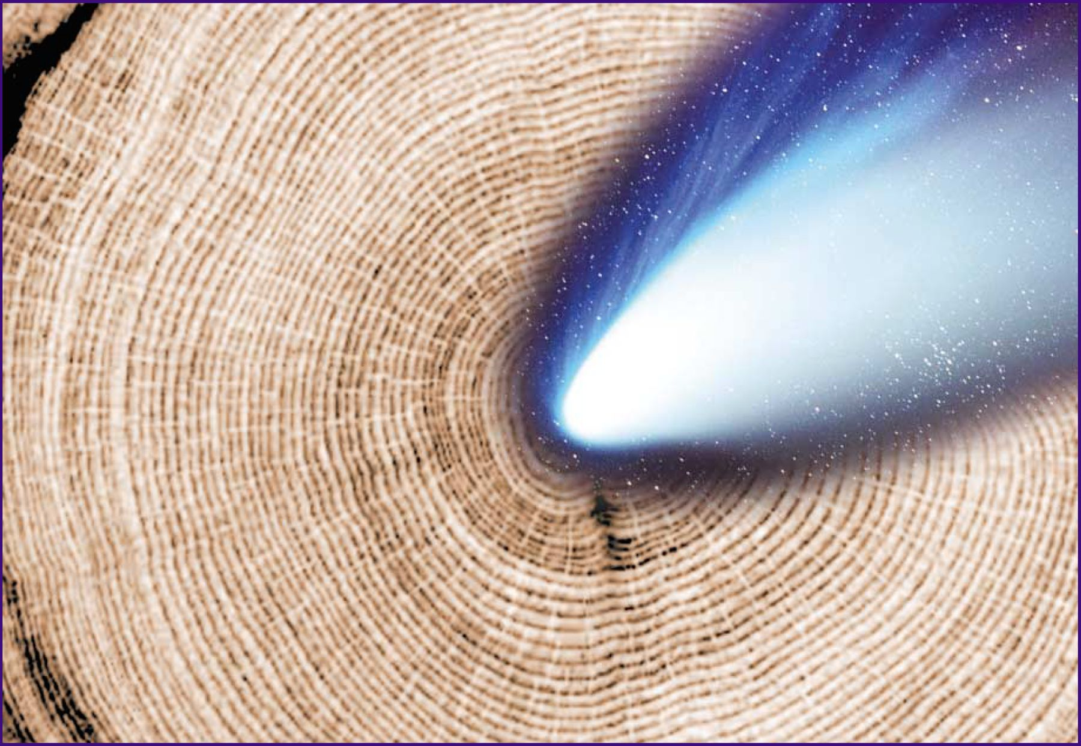
1: Tree-ring data could be evidence for the impact of a comet similar to Hale-Bopp around 1500 years ago. ...
Notes:
1: Tree-ring data could be evidence for the impact of a comet similar to Hale-Bopp around 1500 years ago. (Hale-Bopp image courtesy Peter Böhm.)
Unless provided in the caption above, the following copyright applies to the content of this slide:

Slide 2
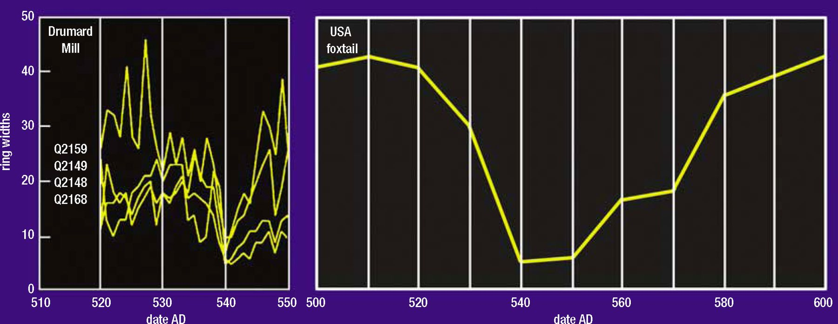
2: Dendrochronological data showing the decreases in the rate of tree-ring growth for the years around AD 540. ...
Notes:
2: Dendrochronological data showing the decreases in the rate of tree-ring growth for the years around AD 540. (Left) Irish oak trees (adapted from Baillie 1999). (Right) US foxtail pine chronologies (adapted from Scuderi 1990).
Unless provided in the caption above, the following copyright applies to the content of this slide:

Slide 3
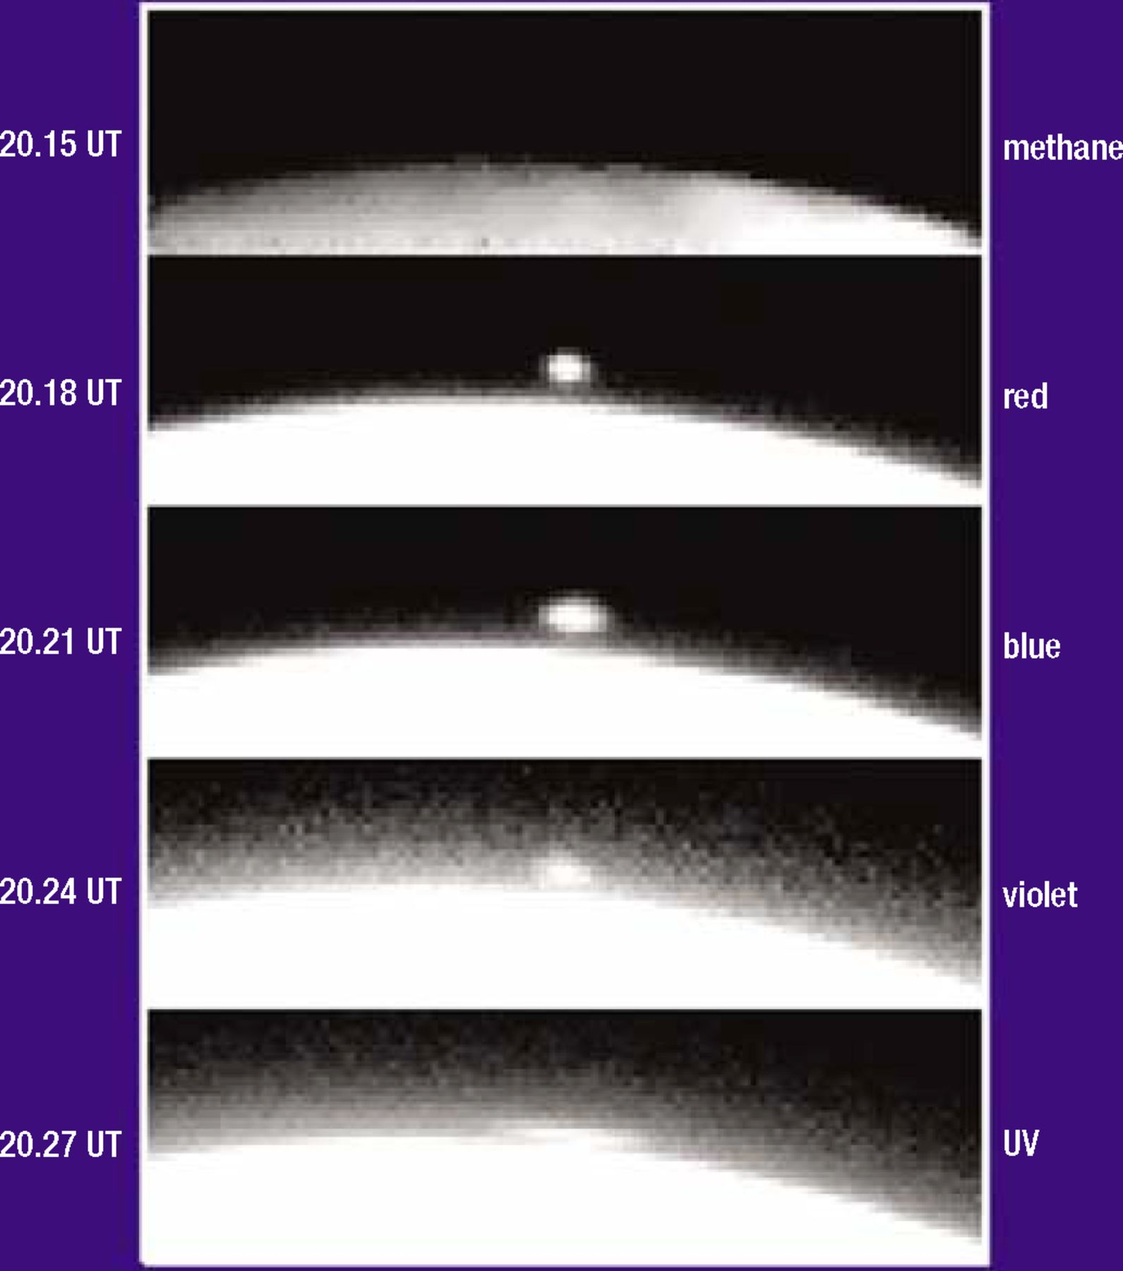
3: A sequence of images of Shoemaker-Levy 9 impacting Jupiter in 1994, showing evidence for a plume near the ...
Notes:
3: A sequence of images of Shoemaker-Levy 9 impacting Jupiter in 1994, showing evidence for a plume near the terminator at the time of the A impact. During the temporal sequence from top to bottom, the spreading of the bright feature is the plume falling back on to the jovian atmosphere (HST data archive).
Unless provided in the caption above, the following copyright applies to the content of this slide:

Slide 4
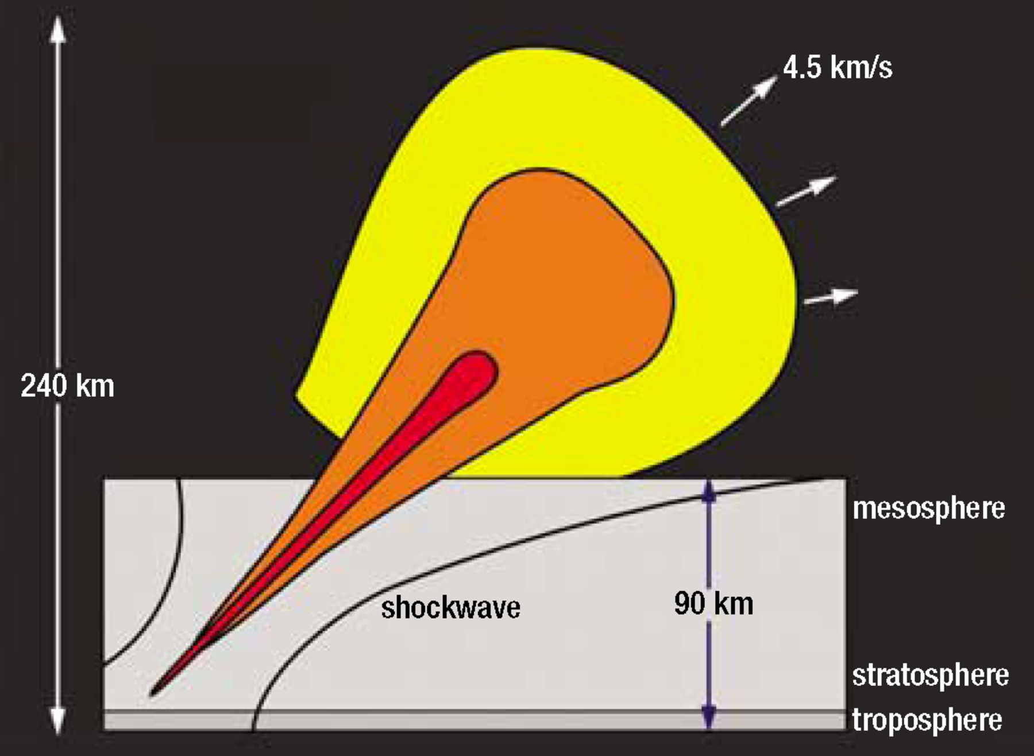
4: Model of a 15 megaton equivalent yield comet airburst forming a plume over the Earth 100 seconds after impact ...
Notes:
4: Model of a 15 megaton equivalent yield comet airburst forming a plume over the Earth 100 seconds after impact (adapted from Boslough and Crawford 1997).
Unless provided in the caption above, the following copyright applies to the content of this slide:

