Slide 1
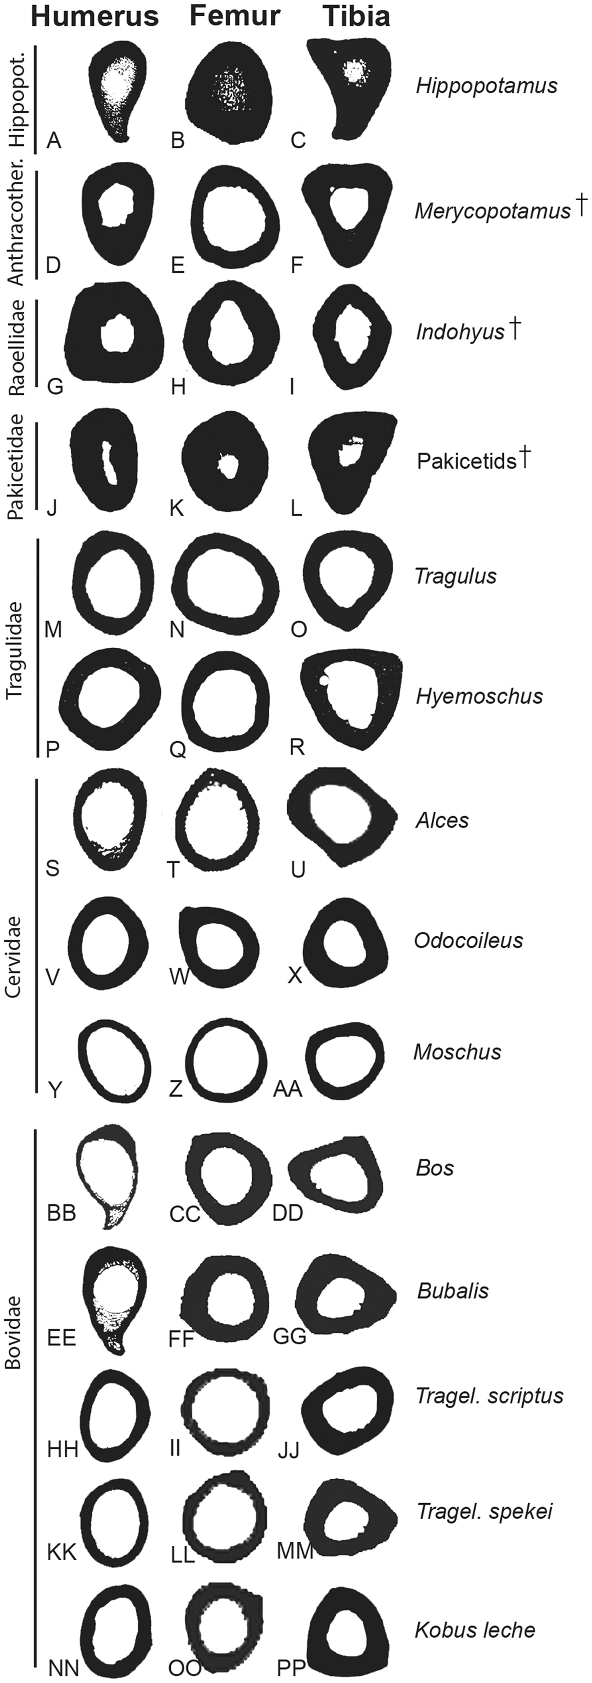
Fig. 2 Extinct and extant cetartiodactyls occupied different habitats and therefore display a range of long bone ...
Notes:
Fig. 2 Extinct and extant cetartiodactyls occupied different habitats and therefore display a range of long bone cross-sectional phenotypes. Data are based on CT scans and histological sections. Analyses accurately differentiated phenotypes of terrestrial and semi-aquatic taxa. An extreme form of hyperostosis is seen in Hippopotamus (A–C) and most extinct taxa (D–L); however, most extant taxa, even those that frequently enter the water (e.g., NN-PP), lack hyperostosis. Humerus, femur, and tibia of (A–C) Hippopotamus (AMNH 15898), humerus and femur of (D–E) of Merycopotamus medioximus (YPM 17587) and (F) tibia of M. nanus (YPM 31826). Humerus, femur, and tibia of Indohyus (RR 42, 157, 301), (J–K) humerus and femur of Ichthyolestes pinfoldi (H-GSP 30345, 96227) and (L) tibia of Pakicetus attocki (H-GSP 30357). Humerus, femur, and tibia of (M–O) Tragulus (CMNH 17917), (P–R) Hyemoschus (AMNH 53613), (S–U) Alces (USNM 275127), (V–X) Odocoileus (USNM 254653), (Y–AA) Moschus (USNM 259384), (BB–DD) Bos (USNM 277262), (EE–GG) Bubalis (AMNH 54765), (HH–JJ) Tragelaphus scriptus (USNM 164560), (KK–MM) Tragelaphus spekii (USNM 164558), and (NN–PP) Kobus leche (USNM 254927). Images scaled to the same height for comparisons. † indicates an extinct taxon.
Unless provided in the caption above, the following copyright applies to the content of this slide: © The Author 2016. Published by Oxford University Press on behalf of the Society for Integrative and Comparative Biology. All rights reserved. For permissions please email: journals.permissions@oup.com.

Slide 2
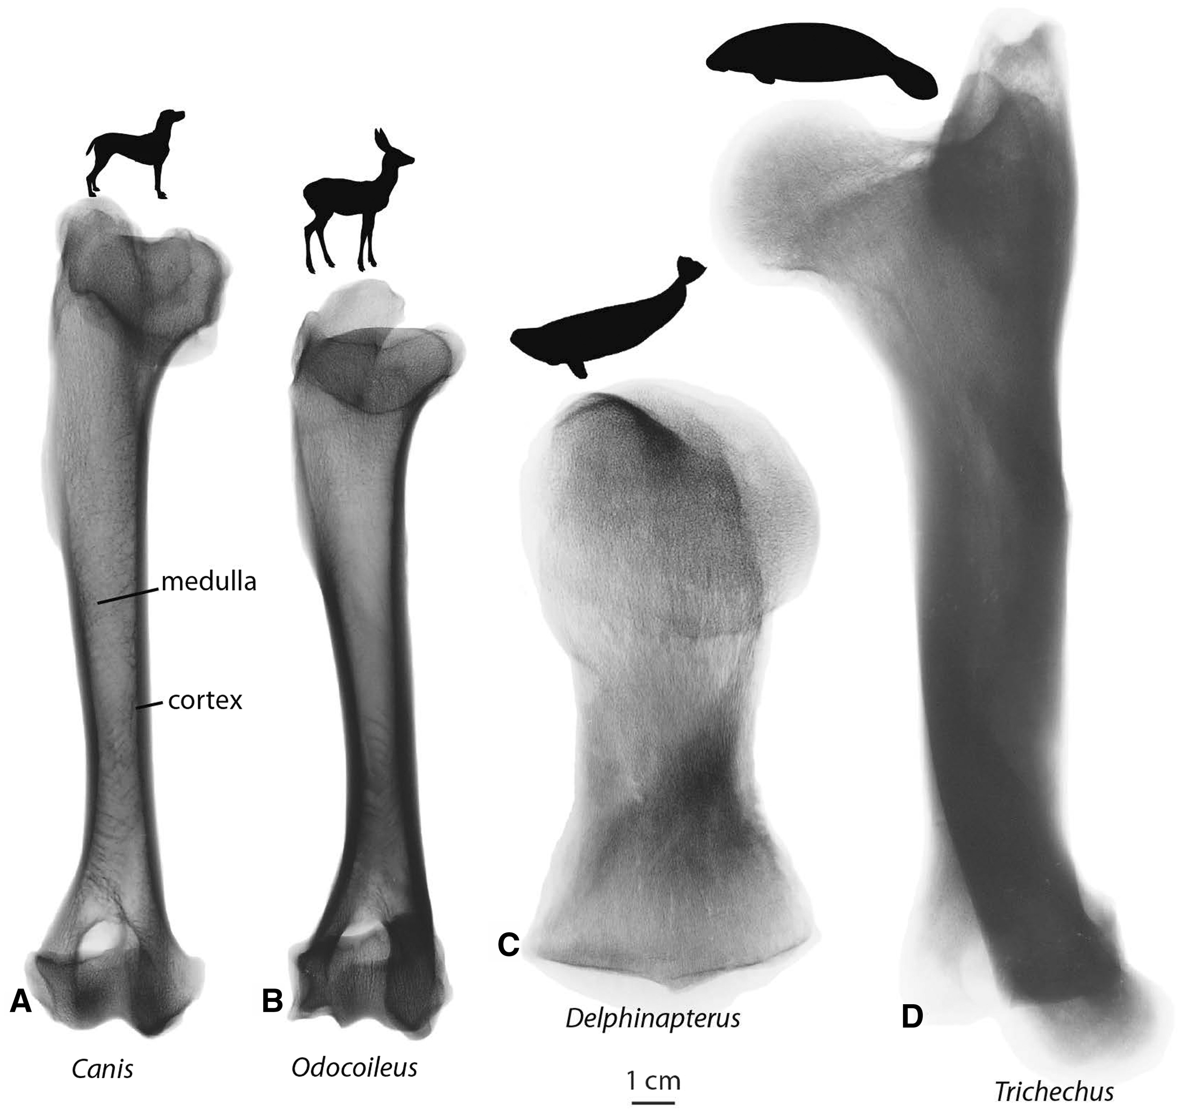
Fig. 1 Mammals living in different habitats display different cortical and medullary bone phenotypes. Terrestrial ...
Notes:
Fig. 1 Mammals living in different habitats display different cortical and medullary bone phenotypes. Terrestrial taxa (A) Canis and (B) Odocoileus display thin cortices and vacant medullary cavities in the midshaft of their humeri. Most modern cetaceans (C) Delphinapterus display a thin cortex and the medulla is filled with a fine latticework of trabeculae (osteoporosis). Modern sirenians (D) Trichechus display a swollen, or thickened, cortex that also lacks a medulla (pachyosteosclerosis).
Unless provided in the caption above, the following copyright applies to the content of this slide: © The Author 2016. Published by Oxford University Press on behalf of the Society for Integrative and Comparative Biology. All rights reserved. For permissions please email: journals.permissions@oup.com.

Slide 3
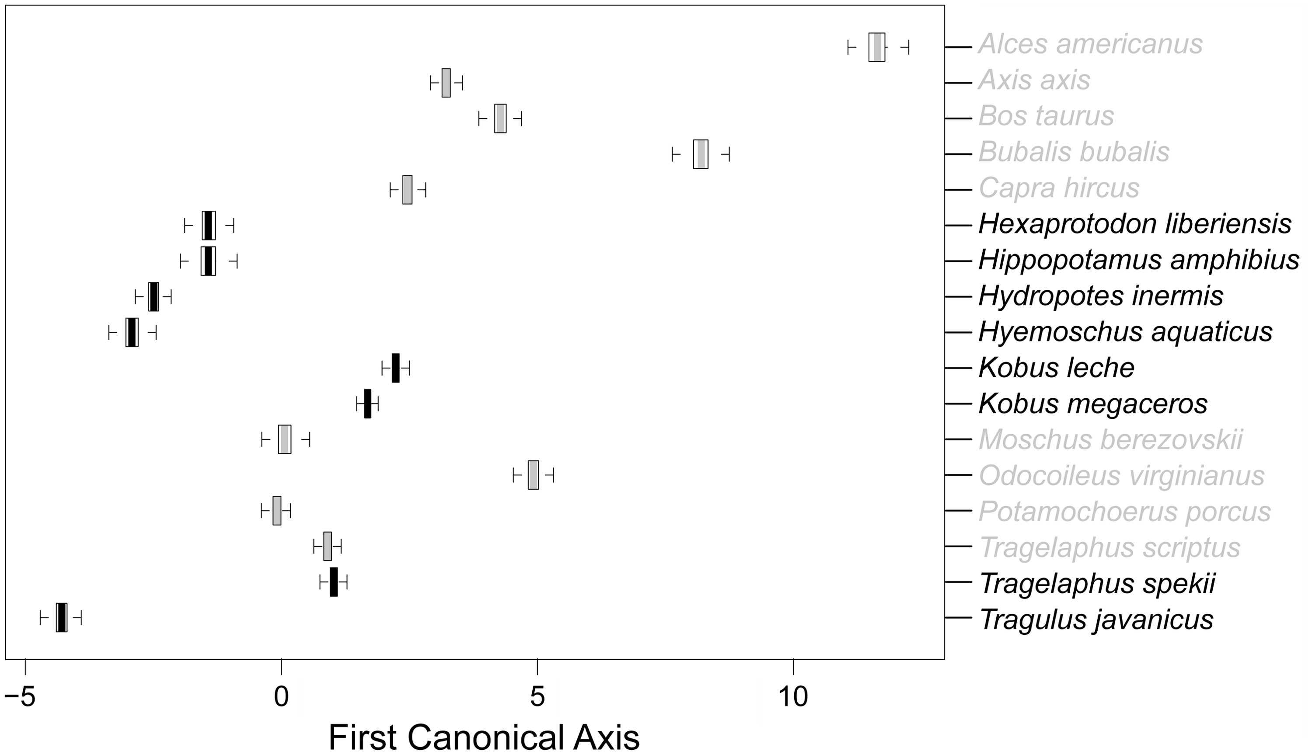
Table 4 PCCorA coefficients for femoral microanatomy and the PCCorA projections of behaviors from PCO analysis Notes: ...
Notes:
Table 4 PCCorA coefficients for femoral microanatomy and the PCCorA projections of behaviors from PCO analysis Notes: The first axis suggests a statistically significant signal in taxa frequently found in water. Rmin corresponds to the bone compactness in the medulla. S-values generally reflect the width of the zone between the cortex and medulla. Cr is a measure of compactness. Table 5PCCorA coefficients for tibial microanatomy and the PCCorA projections of behaviors from PCO analysis CrSPMinFlees to waterFrequently found in waterFrequently fully submergedFeeds in waterrP (r = 0)First axis25.671.0926.86−4.86−8.419.7116.449.500.700.61Second axis3.645.552.05−1.203.854.09−1.88−1.090.320.93Third axis7.05−4.684.160.2111.88−3.723.344.980.210.76Notes: Cr is a measure of compactness. S-values generally reflect the width of the zone between the cortex and medulla. P-values are proportional to the size of the medulla. Min corresponds to the bone compactness in the medulla. Fig. 5Boxplots of taxon microanatomical scores on the first canonical axis of the femoral PCCorA. Boxes and whiskers show quartile ranges for each taxon across the complete sample of phylogenetic trees, and represent the dependence of the results on inferred branch lengths. Taxa scored as positive for fleeing into the water to escape predation are in black, others in gray. Although this is the clearest signal to differentiate terrestrial behavior patterns from facultatively aquatic behavior pattern, there is still notable overlap.
Unless provided in the caption above, the following copyright applies to the content of this slide: © The Author 2016. Published by Oxford University Press on behalf of the Society for Integrative and Comparative Biology. All rights reserved. For permissions please email: journals.permissions@oup.com.

Slide 4
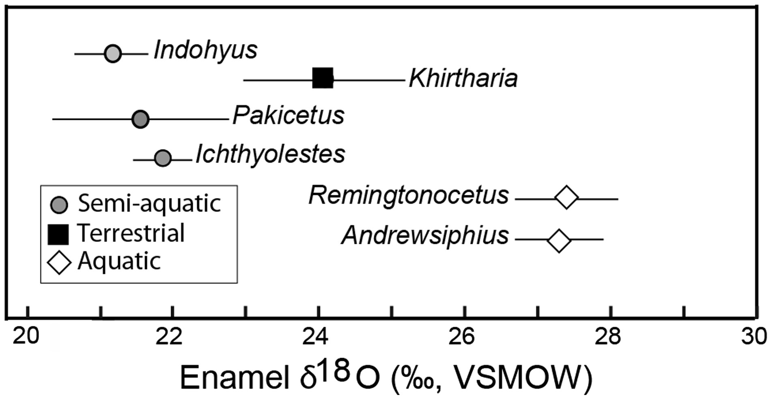
Fig. 6 Analyses of the means and standard deviations or fossil enamel δ18O (‰, VSMOW) values of cetaceans and ...
Notes:
Fig. 6 Analyses of the means and standard deviations or fossil enamel δ18O (‰, VSMOW) values of cetaceans and raoellids in contrast to microanatomy, can identify semi-aquatic taxa. Based on published stable isotope values of the terrestrial raoellid Khirtharia (black square (Thewissen et al. 2007)), the stable isotopes recovered from co-eval cetaceans and raoellids show values consistent with semi-aquatic and aquatic behaviors. Both the earliest cetaceans (Pakicetus and Ichthyolestes) and their close relative (Indohyus) clustered at lower δ18O values, indicating they were semi-aquatic (circles). The remingtonocetid archaeocetes Andrewsiphius and Remingtonocetus (diamond) display high values, indicating an aquatic lifestyle. Both taxa are close relatives of Kutchicetus (Fig. 3).
Unless provided in the caption above, the following copyright applies to the content of this slide: © The Author 2016. Published by Oxford University Press on behalf of the Society for Integrative and Comparative Biology. All rights reserved. For permissions please email: journals.permissions@oup.com.

Slide 5
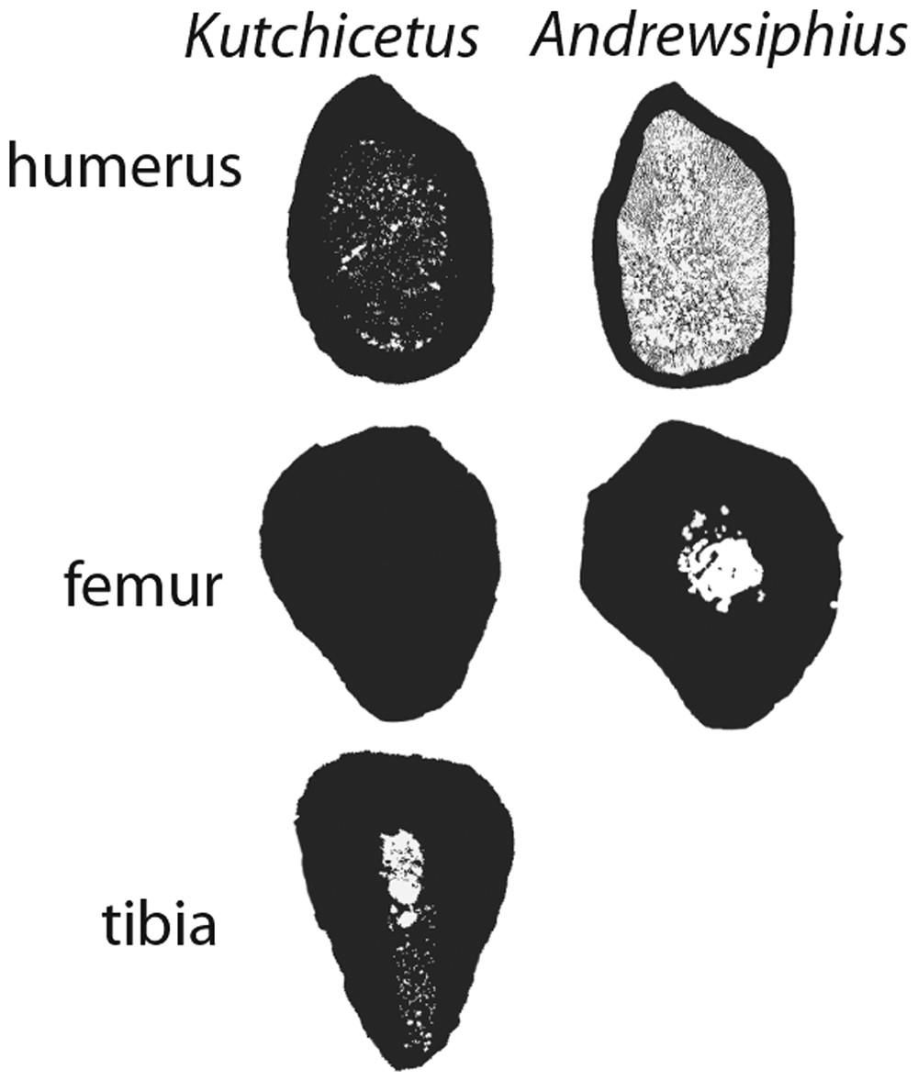
Fig. 3 Cross-sections of the humerus, femur, and tibia of two remingtonocetid archaeocetes (Kutchicetus and ...
Notes:
Fig. 3 Cross-sections of the humerus, femur, and tibia of two remingtonocetid archaeocetes (Kutchicetus and Andrewsiphius) from the middle Eocene Epoch. Although both taxa inhabited similar habitats, the bones of Kutchicetus display the extreme form of hyperostosis seen in pakicetid archaeocetes and modern hippopotamids. The thin-cortex of the humerus of Andrewsiphius encases a medullary cavity filled by trabecular bone. This microanatomy is more typical of non-pakicetid archaeocetes.
Unless provided in the caption above, the following copyright applies to the content of this slide: © The Author 2016. Published by Oxford University Press on behalf of the Society for Integrative and Comparative Biology. All rights reserved. For permissions please email: journals.permissions@oup.com.

Slide 6
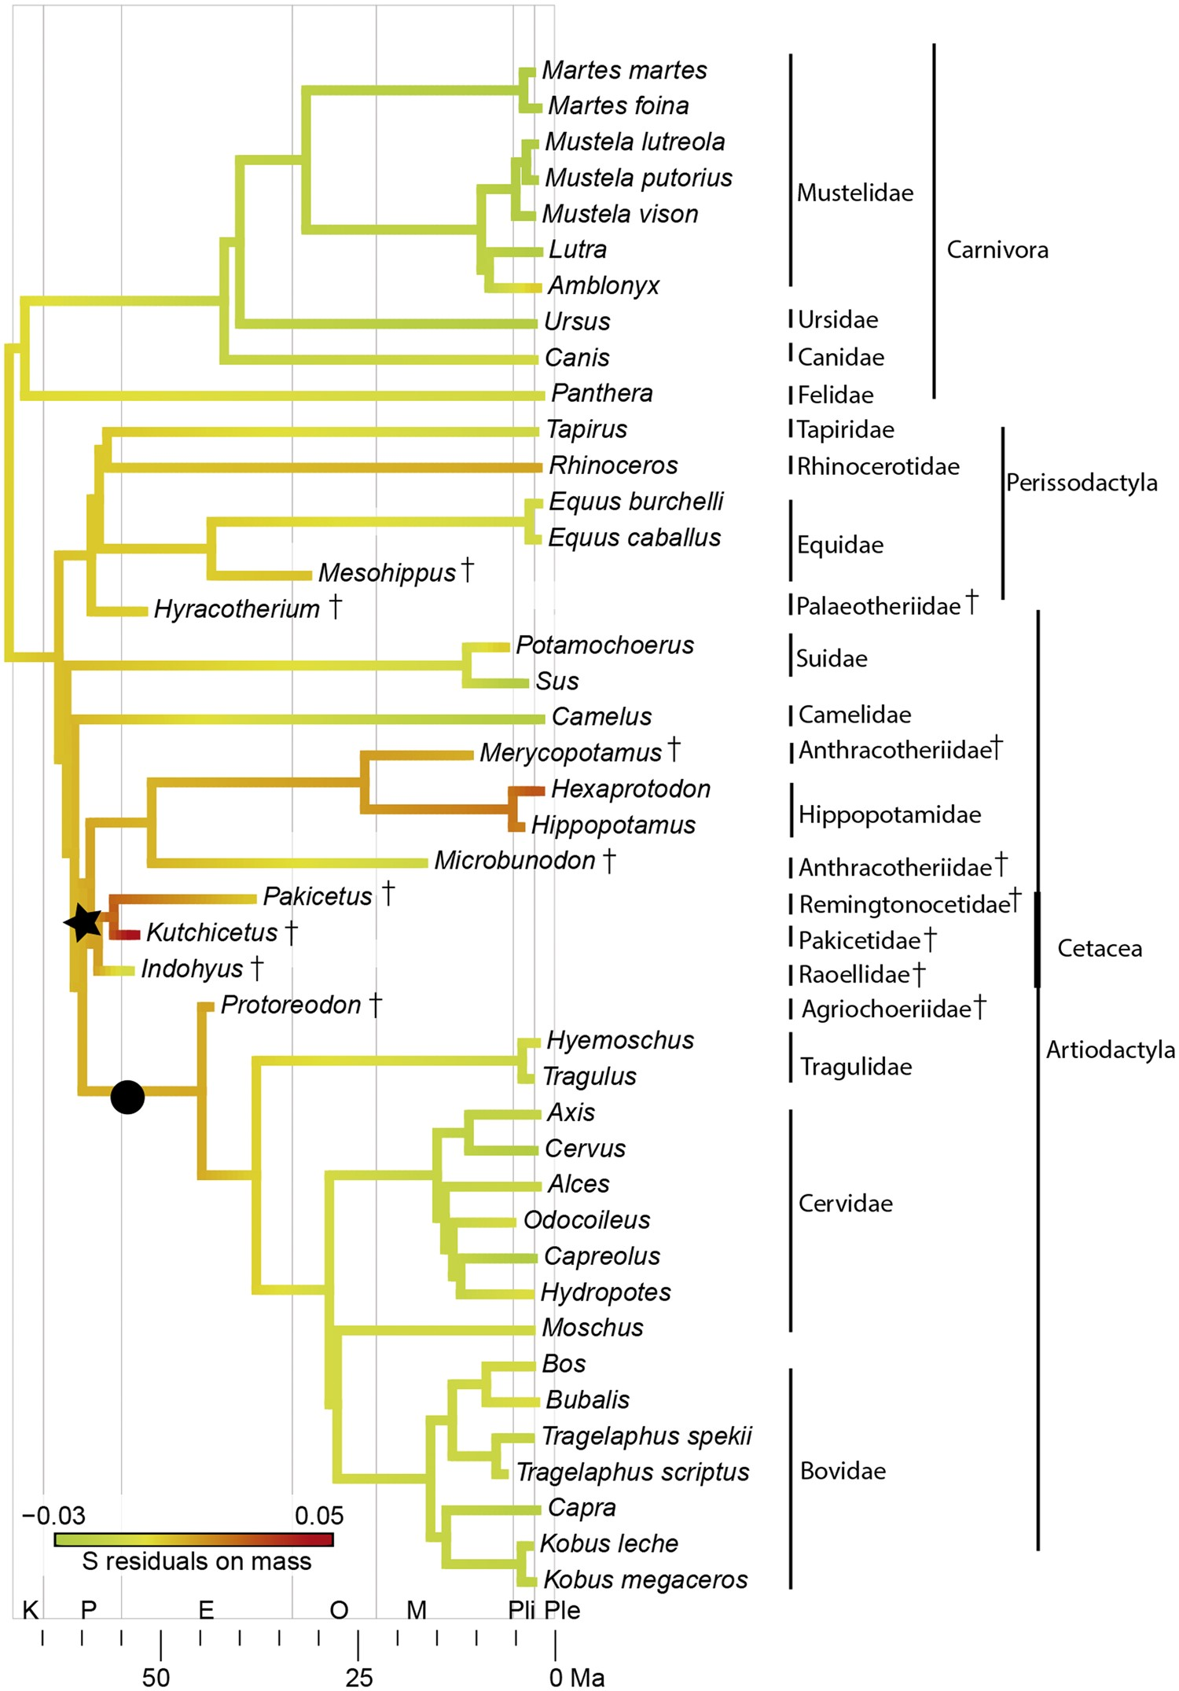
Fig. 4 Phylogenetic tree showing an ancestral character state reconstruction by squared change parsimony of the ...
Notes:
Fig. 4 Phylogenetic tree showing an ancestral character state reconstruction by squared change parsimony of the residuals of S relative to body mass of the tibia of extinct and extant cetartiodactylans based on a composite phylogeny consistent with Boisserie et al. (2005b), Marcot (2007), and Geisler and Theodor (2009). The variable S represents the width of the transition zone from the medullary cavity to the cortical compacta, and displays a strong lifestyle signal in the femur and tibia of our sample. The darkest lines indicate a larger width of the zone between the cortex and medulla. This microanatomy may have arisen in the common ancestor of anthracotheres, hippopotamids, cetaceans, and raoellids (indicated by a star), suggesting that these ancestors may have spent a great deal of time in the water. † indicates a fossil taxon. Low S-values are shown in lighter colors, whereas darker branches indicate high S-values. Consistent with published methods, our microanatomy-based inferences failed to identify morphologies consistent with broadly-defined aquatic behaviors in extant tragulids, cervids, and bovids (circle).
Unless provided in the caption above, the following copyright applies to the content of this slide: © The Author 2016. Published by Oxford University Press on behalf of the Society for Integrative and Comparative Biology. All rights reserved. For permissions please email: journals.permissions@oup.com.

