Slide 1
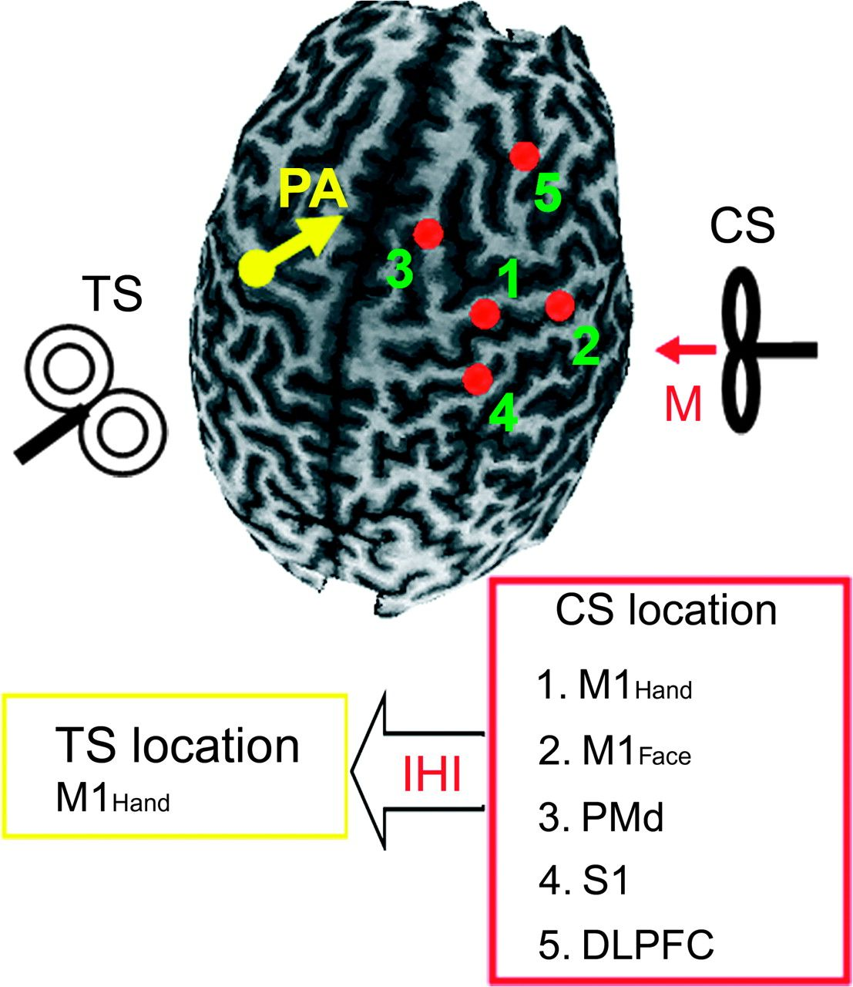
Figure 1. Stimulation sites for the study. A 3-dimensional structural MRI of one representative subject. CS coil (small ...
Notes:
Figure 1. Stimulation sites for the study. A 3-dimensional structural MRI of one representative subject. CS coil (small figure-of-8 coil) was placed over the right hemisphere to induce medially (M) directed current in the brain (red arrow). The 5 red dots represent the areas stimulated with the CS coil. They are M1Hand (1), M1Face (2), PMd (3), S1 (4), and DLPFC (5). The TS (regular figure-of-8 coil) was applied over the hand representation of the left hemisphere which induced current in PA direction in the brain (yellow arrow).
Unless provided in the caption above, the following copyright applies to the content of this slide: © The Author 2008. Published by Oxford University Press. All rights reserved. For permissions, please e-mail: journals.permissions@oxfordjournals.org

Slide 2
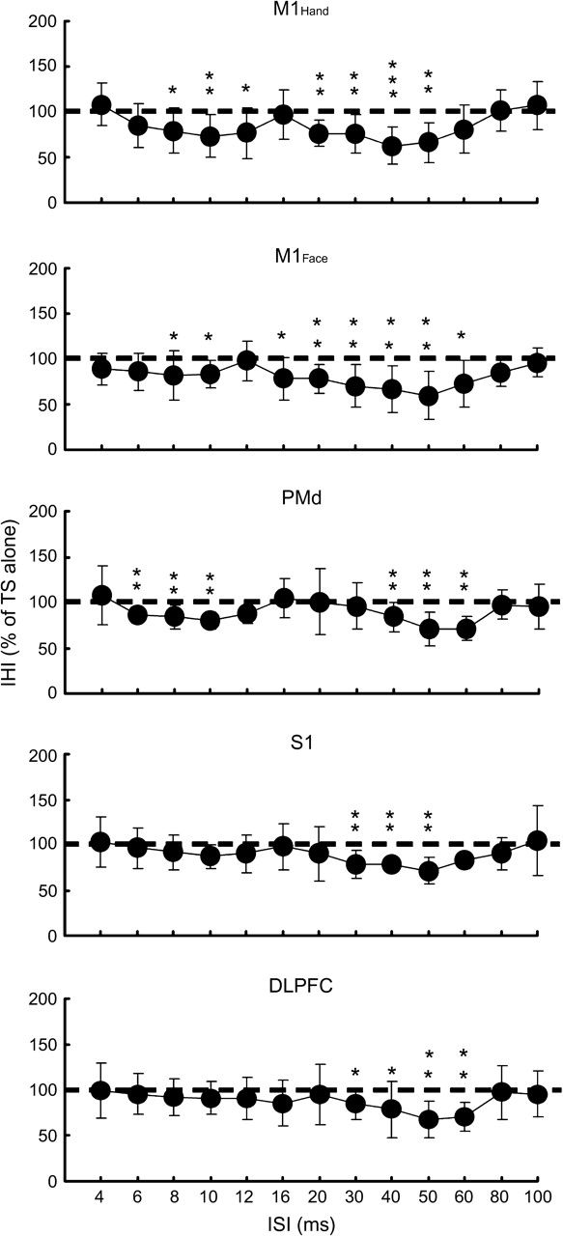
Figure 2. The time courses of IHI. Time courses of IHI (n = 12) from 5 different cortical areas (M1_{Hand}, ...
Notes:
Figure 2. The time courses of IHI. Time courses of IHI (n = 12) from 5 different cortical areas (M1Hand, M1Face, PMd, S1, and DLPFC) to the left motor cortex. The abscissa indicates the ISI. The ordinate indicates the amplitude of conditioned MEP expressed as a percentage of the MEP amplitude from TS alone. The dashed lines indicate the MEP amplitude generated by TS alone (100%). Values below 100% represent inhibition and values above 100% represent facilitation. There are 2 phases of IHI with maximum inhibition at ISIs of ∼10 and ∼50 ms for M1Hand, M1Face, and PMd. For S1 and DFPFC, the early phase of IHI is absent and only the late phase is evident. *P < 0.05, **P < 0.01, ***P < 0.001, compared with TS alone.
Unless provided in the caption above, the following copyright applies to the content of this slide: © The Author 2008. Published by Oxford University Press. All rights reserved. For permissions, please e-mail: journals.permissions@oxfordjournals.org

Slide 3
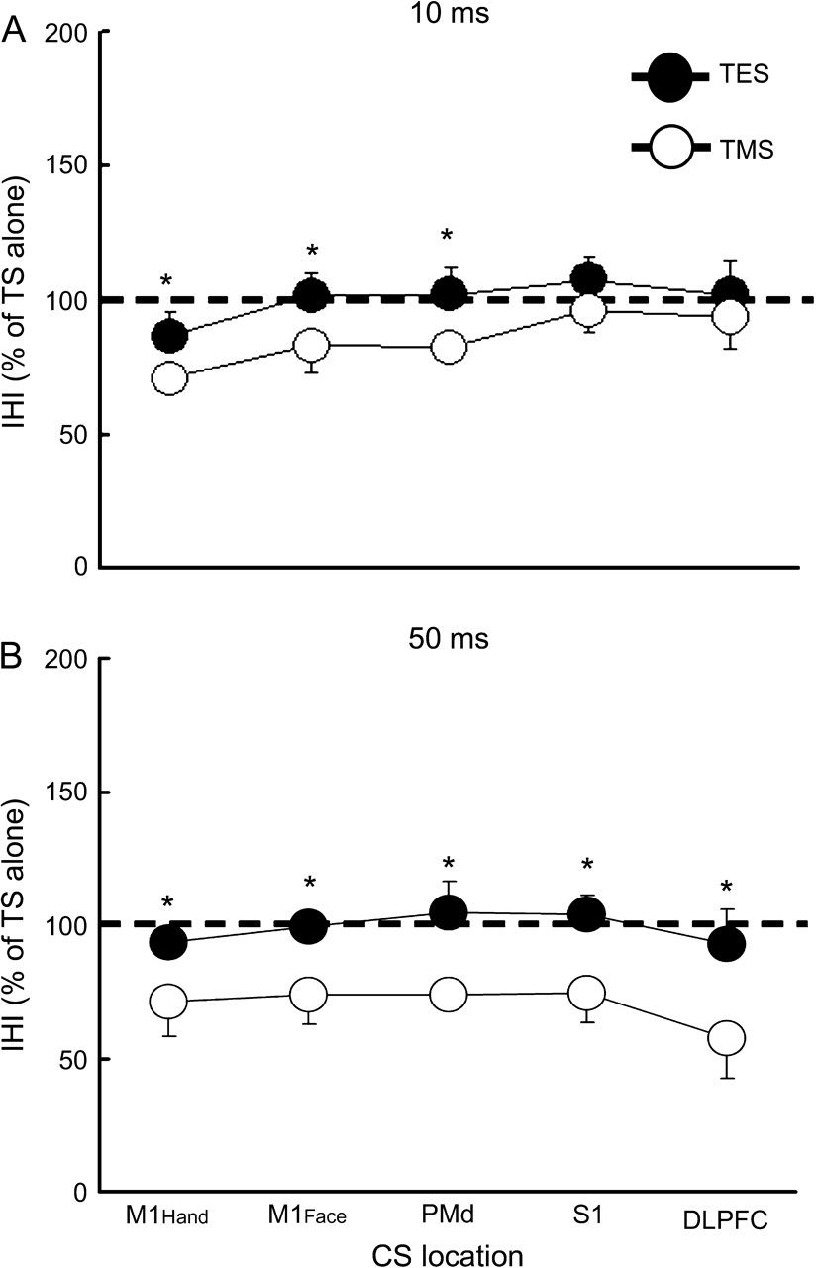
Figure 3. Comparison between TES and TMS as the TS for IHI. Data from 4 subjects. The abscissa indicates the 5 ...
Notes:
Figure 3. Comparison between TES and TMS as the TS for IHI. Data from 4 subjects. The abscissa indicates the 5 different cortical areas (M1Hand, M1Face, PMd, S1, and DLPFC) where CS was applied. The ordinate indicates the amplitude of conditioned MEP expressed as a percentage of the MEP amplitude from TS alone. ISIs of 10 ms (A) and 50 ms (B) were tested. The filled circles represent MEP generated by TES as the TS. The open circles represent MEP generated by TMS as the TS. The dashed lines indicate the MEP amplitude generated by TS alone (100%). *P < 0.05, comparing TES as TS and TMS as TS.
Unless provided in the caption above, the following copyright applies to the content of this slide: © The Author 2008. Published by Oxford University Press. All rights reserved. For permissions, please e-mail: journals.permissions@oxfordjournals.org

Slide 4
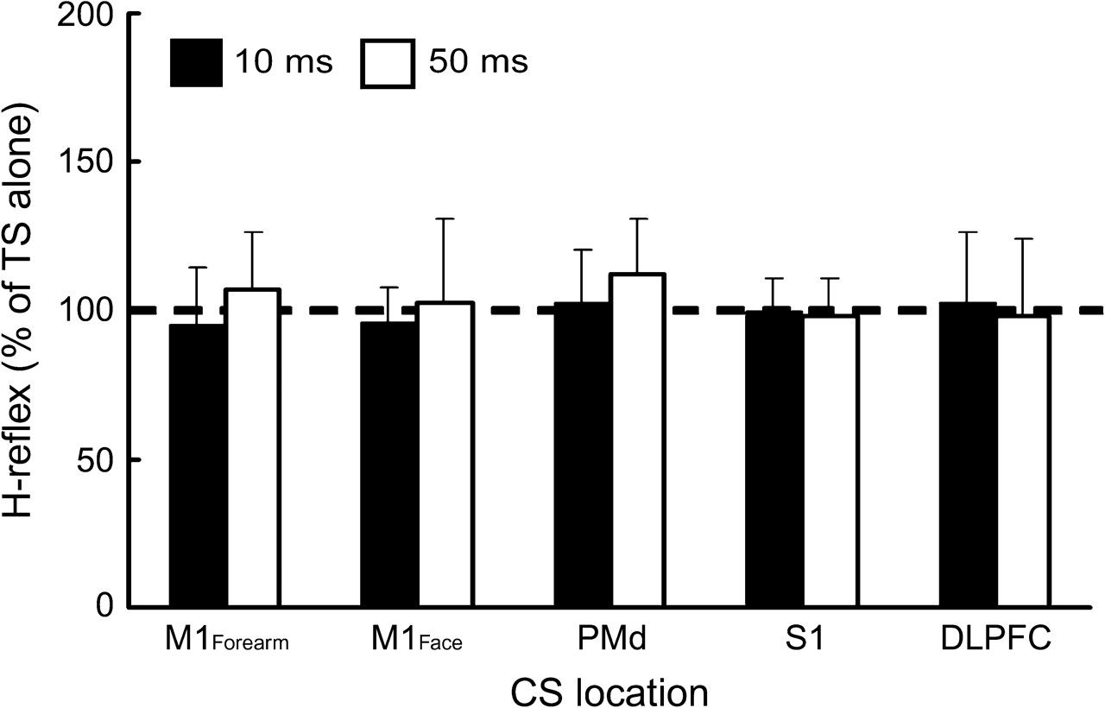
Figure 4. Effects of CS on forearm H-reflex. Data from 5 subjects. The abscissa indicates the 5 different cortical ...
Notes:
Figure 4. Effects of CS on forearm H-reflex. Data from 5 subjects. The abscissa indicates the 5 different cortical areas (M1Forearm, M1Face, PMd, S1, and DLPFC) where CS was applied. The ordinate indicates the amplitude of conditioned H-reflex expressed as a percentage of the H-reflex amplitude induced by TS alone. The filled columns represent ISI of 10 ms and the open columns represent ISI of 50 ms. The dashed line indicates the H-reflex amplitude generated by TS alone (100%).
Unless provided in the caption above, the following copyright applies to the content of this slide: © The Author 2008. Published by Oxford University Press. All rights reserved. For permissions, please e-mail: journals.permissions@oxfordjournals.org

Slide 5
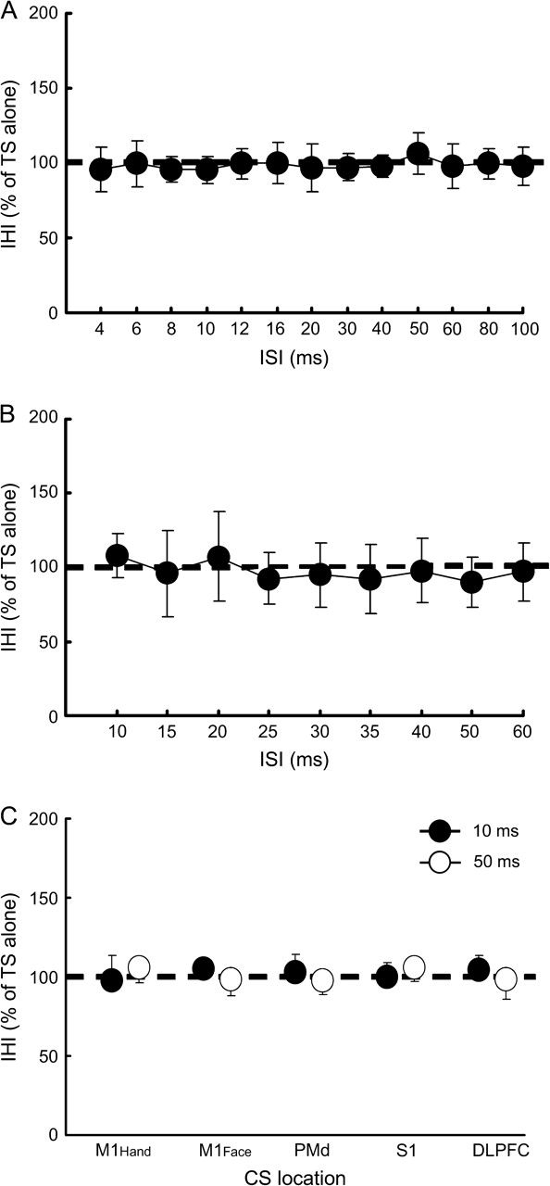
Figure 5. IHI induced by magnetic stimulation over the inion, electrical stimulations of the ulnar nerve or scalp. (A) ...
Notes:
Figure 5. IHI induced by magnetic stimulation over the inion, electrical stimulations of the ulnar nerve or scalp. (A) Time course of IHI with CS placed over the inion (n = 6). The abscissa indicates the ISI. (B) Time course of IHI induced by electrical stimulation of the ulnar nerve at left wrist (n = 5). TS was applied to left M1. The abscissa indicates the ISI. (C) IHI induced by electrical stimulation of the scalp (n = 6). The abscissa indicates the CS location. Filled circles indicate the data from ISI of 10 ms, open circles indicate those from ISI of 50 ms. The ordinates in (A), (B), and (C) indicate the amplitude of conditioned MEP expressed as a percentage of the MEP amplitude from TS alone. The dashed lines indicate the MEP generated by TS alone (100%). No IHI can be found with CS was placed over inion, ulnar nerve stimulation or with scalp electrical stimulation delivered as CS.
Unless provided in the caption above, the following copyright applies to the content of this slide: © The Author 2008. Published by Oxford University Press. All rights reserved. For permissions, please e-mail: journals.permissions@oxfordjournals.org

Slide 6
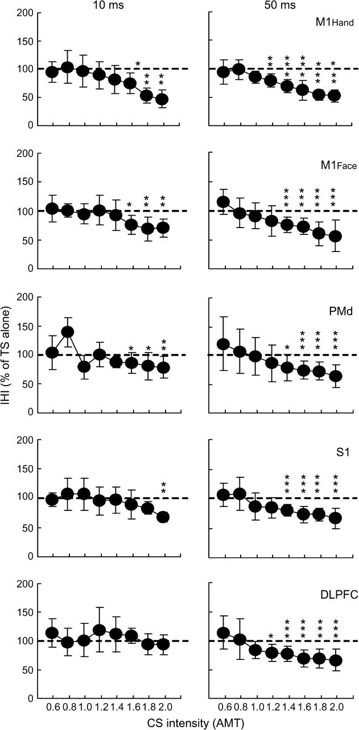
Figure 6. CS recruitment curves for IHI. CS recruitment curves for IHI (n = 10) from 5 different cortical areas ...
Notes:
Figure 6. CS recruitment curves for IHI. CS recruitment curves for IHI (n = 10) from 5 different cortical areas (M1Hand, M1Face, PMd, S1, and DLPFC) at ISIs of 10 (left side) and 50 ms (right side). The abscissa indicates the CS intensity (expressed as a fraction of AMT). The ordinate indicates the amplitude of conditioned MEP expressed as a percentage of the MEP from TS alone. The dashed lines indicate the MEP generated by TS alone (100%). Values below 100% represent inhibition and values above 100% represent facilitation. IHI at ISI of 50 ms occurred at lower CS intensities than that at 10 ms for all brain areas tested. *P < 0.05, **P < 0.01, ***P < 0.001, comparing to TS alone.
Unless provided in the caption above, the following copyright applies to the content of this slide: © The Author 2008. Published by Oxford University Press. All rights reserved. For permissions, please e-mail: journals.permissions@oxfordjournals.org

Slide 7
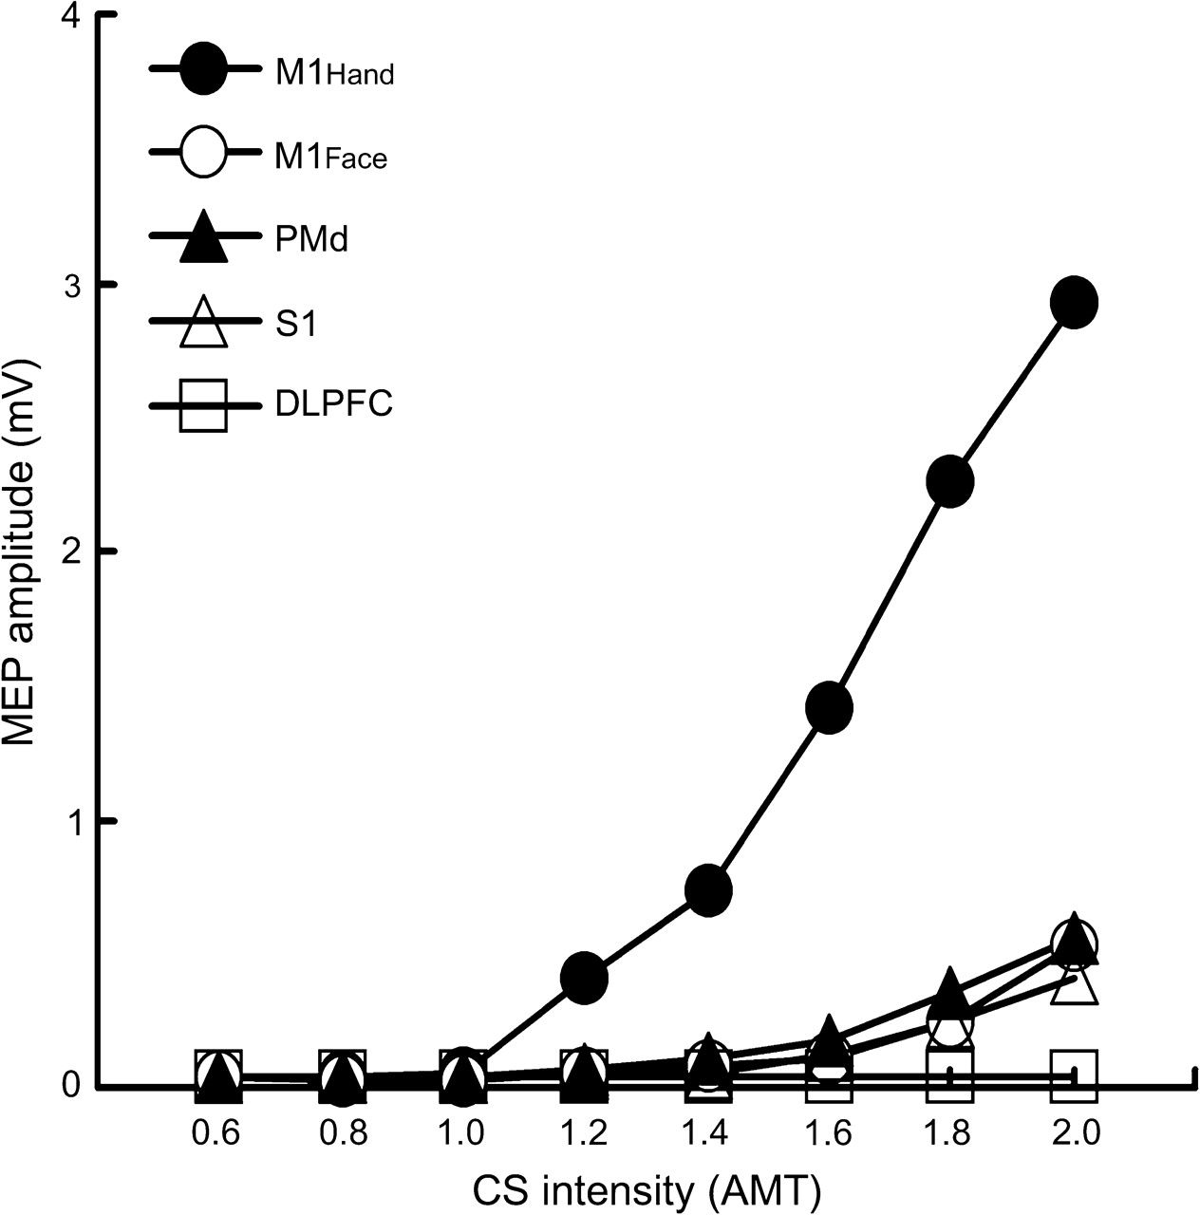
Figure 7. MEP recruitment curve for the left FDI muscle. Mean MEP amplitude (n = 10) in the left FDI muscle generated ...
Notes:
Figure 7. MEP recruitment curve for the left FDI muscle. Mean MEP amplitude (n = 10) in the left FDI muscle generated by CS. CS was placed over one of 5 different cortical areas (M1Hand, M1Face, PMd, S1, and DLPFC). The abscissa indicates the CS intensity (expressed as a fraction of AMT) and ordinate indicates the MEP amplitude in the left FDI muscle.
Unless provided in the caption above, the following copyright applies to the content of this slide: © The Author 2008. Published by Oxford University Press. All rights reserved. For permissions, please e-mail: journals.permissions@oxfordjournals.org

Slide 8
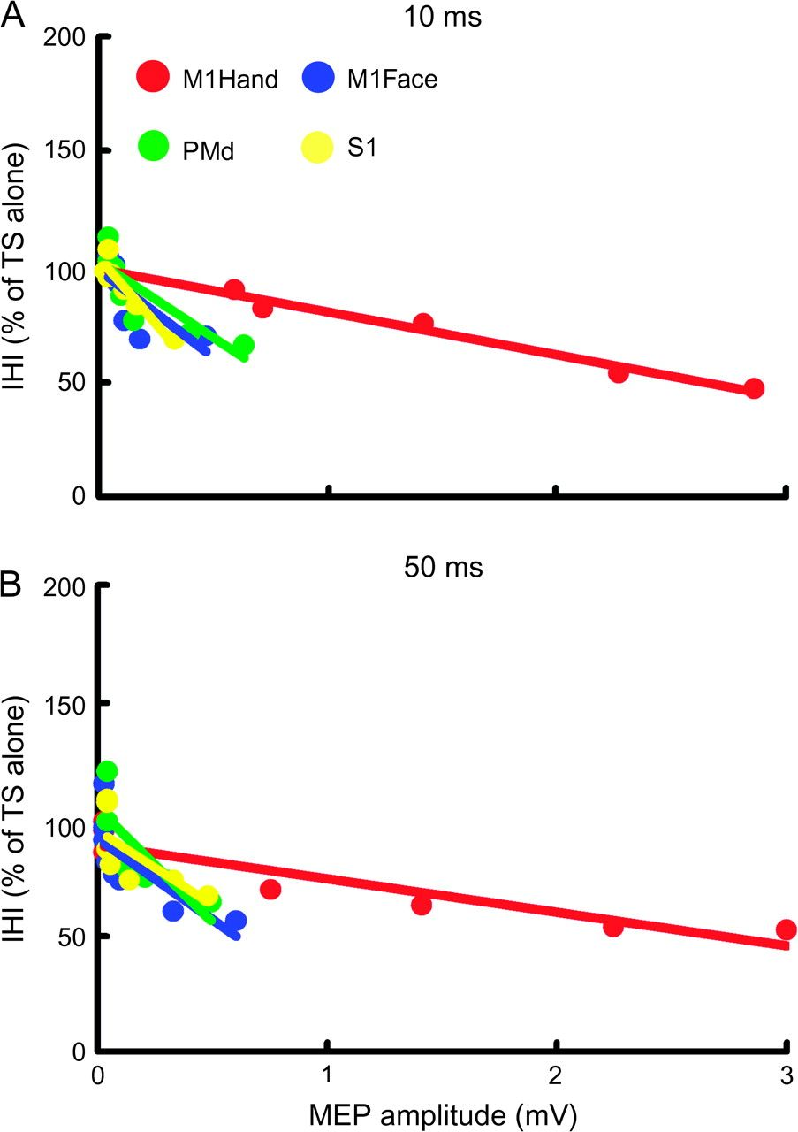
Figure 8. Relationship between IHI and MEP amplitude generated by CS at different locations. Data from 10 subjects. ...
Notes:
Figure 8. Relationship between IHI and MEP amplitude generated by CS at different locations. Data from 10 subjects. Data from ISI of 10 ms is shown in (A) and data from ISI of 50 ms in (B). The abscissa indicates the MEP amplitude in the left FDI muscle generated by the CS. The ordinate indicates the conditioned MEP amplitude expressed as a percentage of MEP amplitude generated by TS alone. Data from stimulation of the M1Hand (red), M1Face (blue), PMd (green), and S1 (yellow) was compared. The relationship between IHI and MEP in the left FDI was different for M1Hand compared with other CS locations.
Unless provided in the caption above, the following copyright applies to the content of this slide: © The Author 2008. Published by Oxford University Press. All rights reserved. For permissions, please e-mail: journals.permissions@oxfordjournals.org

Slide 9
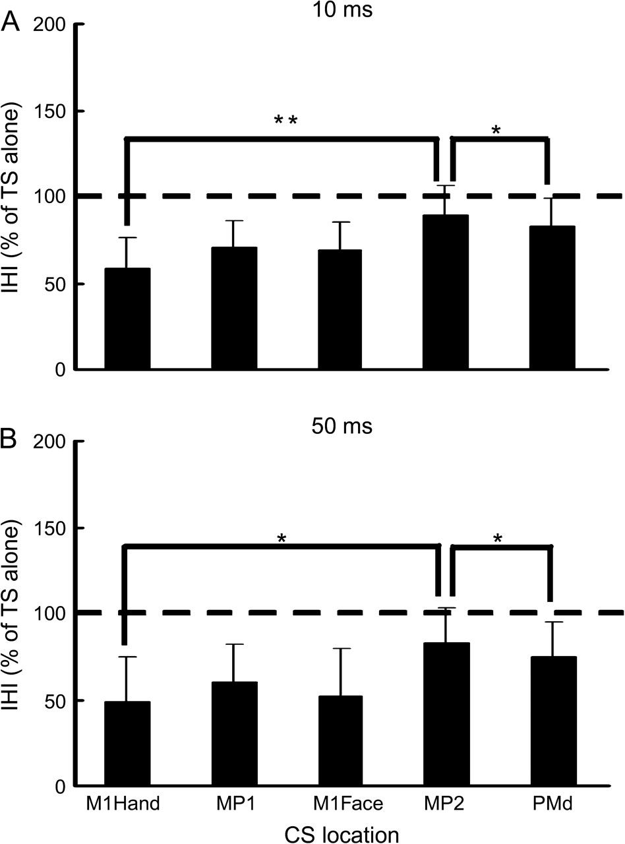
Figure 9. Effects of CS location on IHI. Data from 5 subjects. CS was placed over one of 5 different cortical areas: ...
Notes:
Figure 9. Effects of CS location on IHI. Data from 5 subjects. CS was placed over one of 5 different cortical areas: M1Hand, M1Face, PMd, and MP1 (mid point between M1Hand and M1Face), MP2 (mid point between M1Hand and PMd) at ISIs of 10 (A) and 50 ms (B). The abscissa indicates the CS location. The ordinate indicates conditioned MEP expressed as a percentage of MEP amplitude generated by TS alone. The dashed lines indicate the MEP generated by TS alone (100%). Values below 100% represent inhibition and values above 100% represent facilitation. *P < 0.05, **P < 0.01, comparing 2 different CS locations.
Unless provided in the caption above, the following copyright applies to the content of this slide: © The Author 2008. Published by Oxford University Press. All rights reserved. For permissions, please e-mail: journals.permissions@oxfordjournals.org

Slide 10
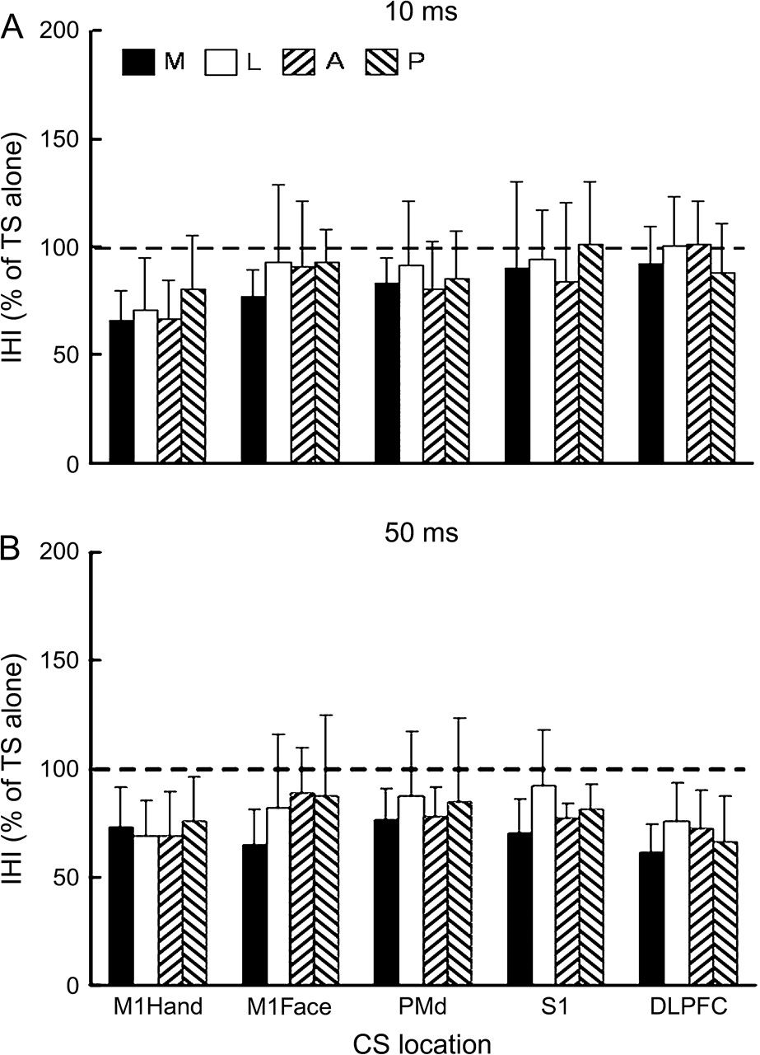
Figure 10. Effects of CS current direction on IHI. CS was placed over one of 5 different cortical areas ...
Notes:
Figure 10. Effects of CS current direction on IHI. CS was placed over one of 5 different cortical areas (M1Hand, M1Face, PMd, S1, and DLPFC) at ISIs of 10 (A) and 50 ms (B). The abscissa indicates the CS location. The ordinate indicates conditioned MEP expressed as a percentage of MEP amplitude generated by TS alone. The dashed lines indicate the MEP generated by TS alone (100%). Values below 100% represent inhibition and values above 100% represent facilitation. M, L, A, P indicate medially, laterally, anteriorly, posteriorly directed induced currents in the brain, respectively.
Unless provided in the caption above, the following copyright applies to the content of this slide: © The Author 2008. Published by Oxford University Press. All rights reserved. For permissions, please e-mail: journals.permissions@oxfordjournals.org

