Slide 1
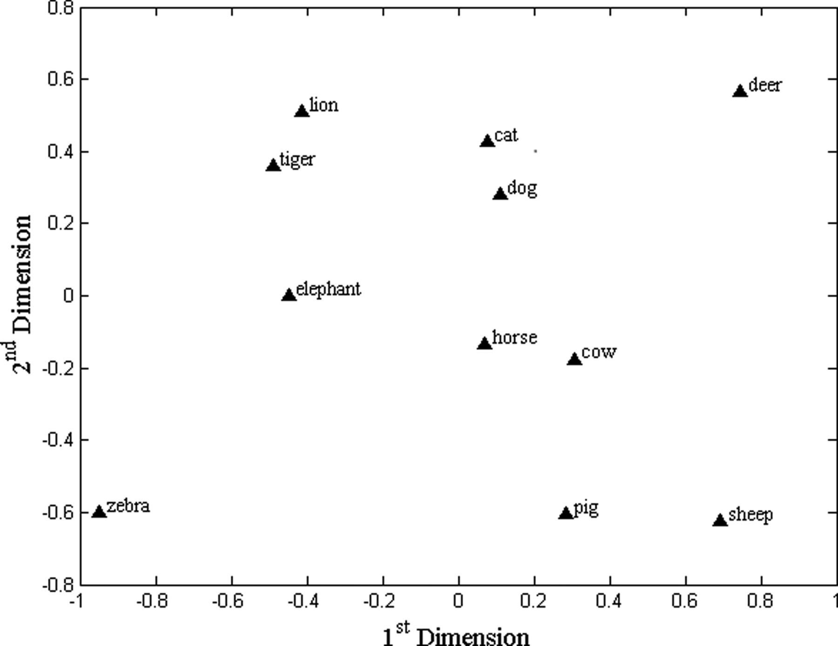
Fig. 1. Control group MDS common space plots.
Notes:
Fig. 1. Control group MDS common space plots.
Unless provided in the caption above, the following copyright applies to the content of this slide: © The Author 2014. Published by Oxford University Press. All rights reserved. For permissions, please e-mail: journals.permissions@oup.com.

Slide 2
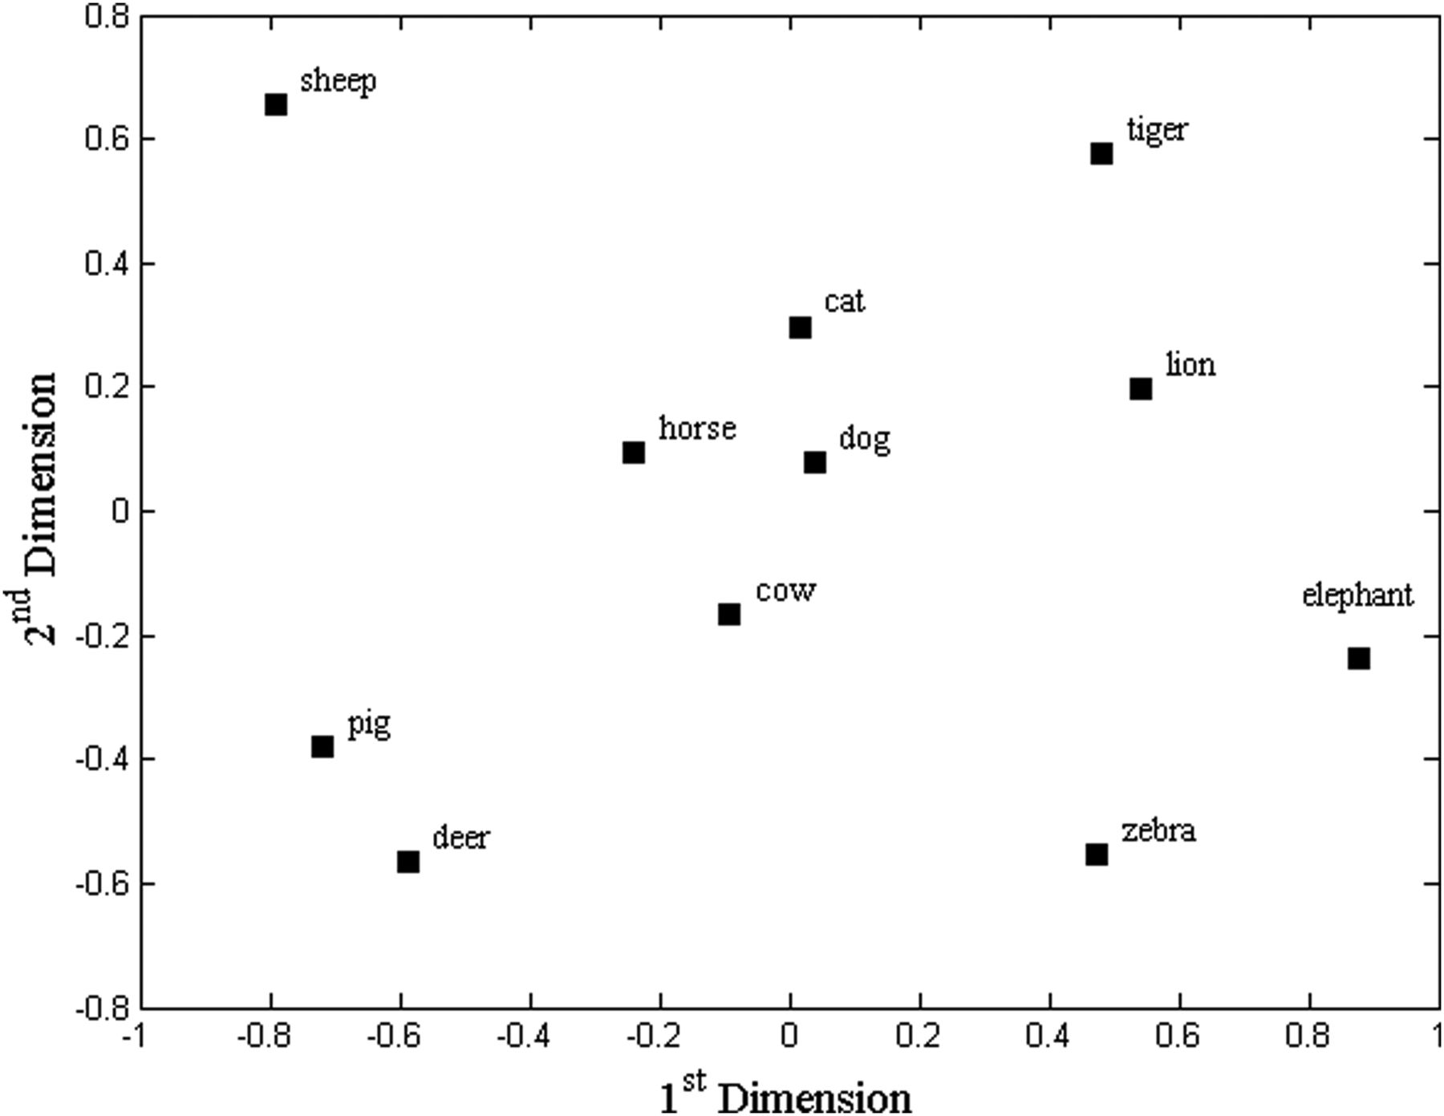
Fig. 2. AD group MDS common space plots.
Notes:
Fig. 2. AD group MDS common space plots.
Unless provided in the caption above, the following copyright applies to the content of this slide: © The Author 2014. Published by Oxford University Press. All rights reserved. For permissions, please e-mail: journals.permissions@oup.com.

Slide 3
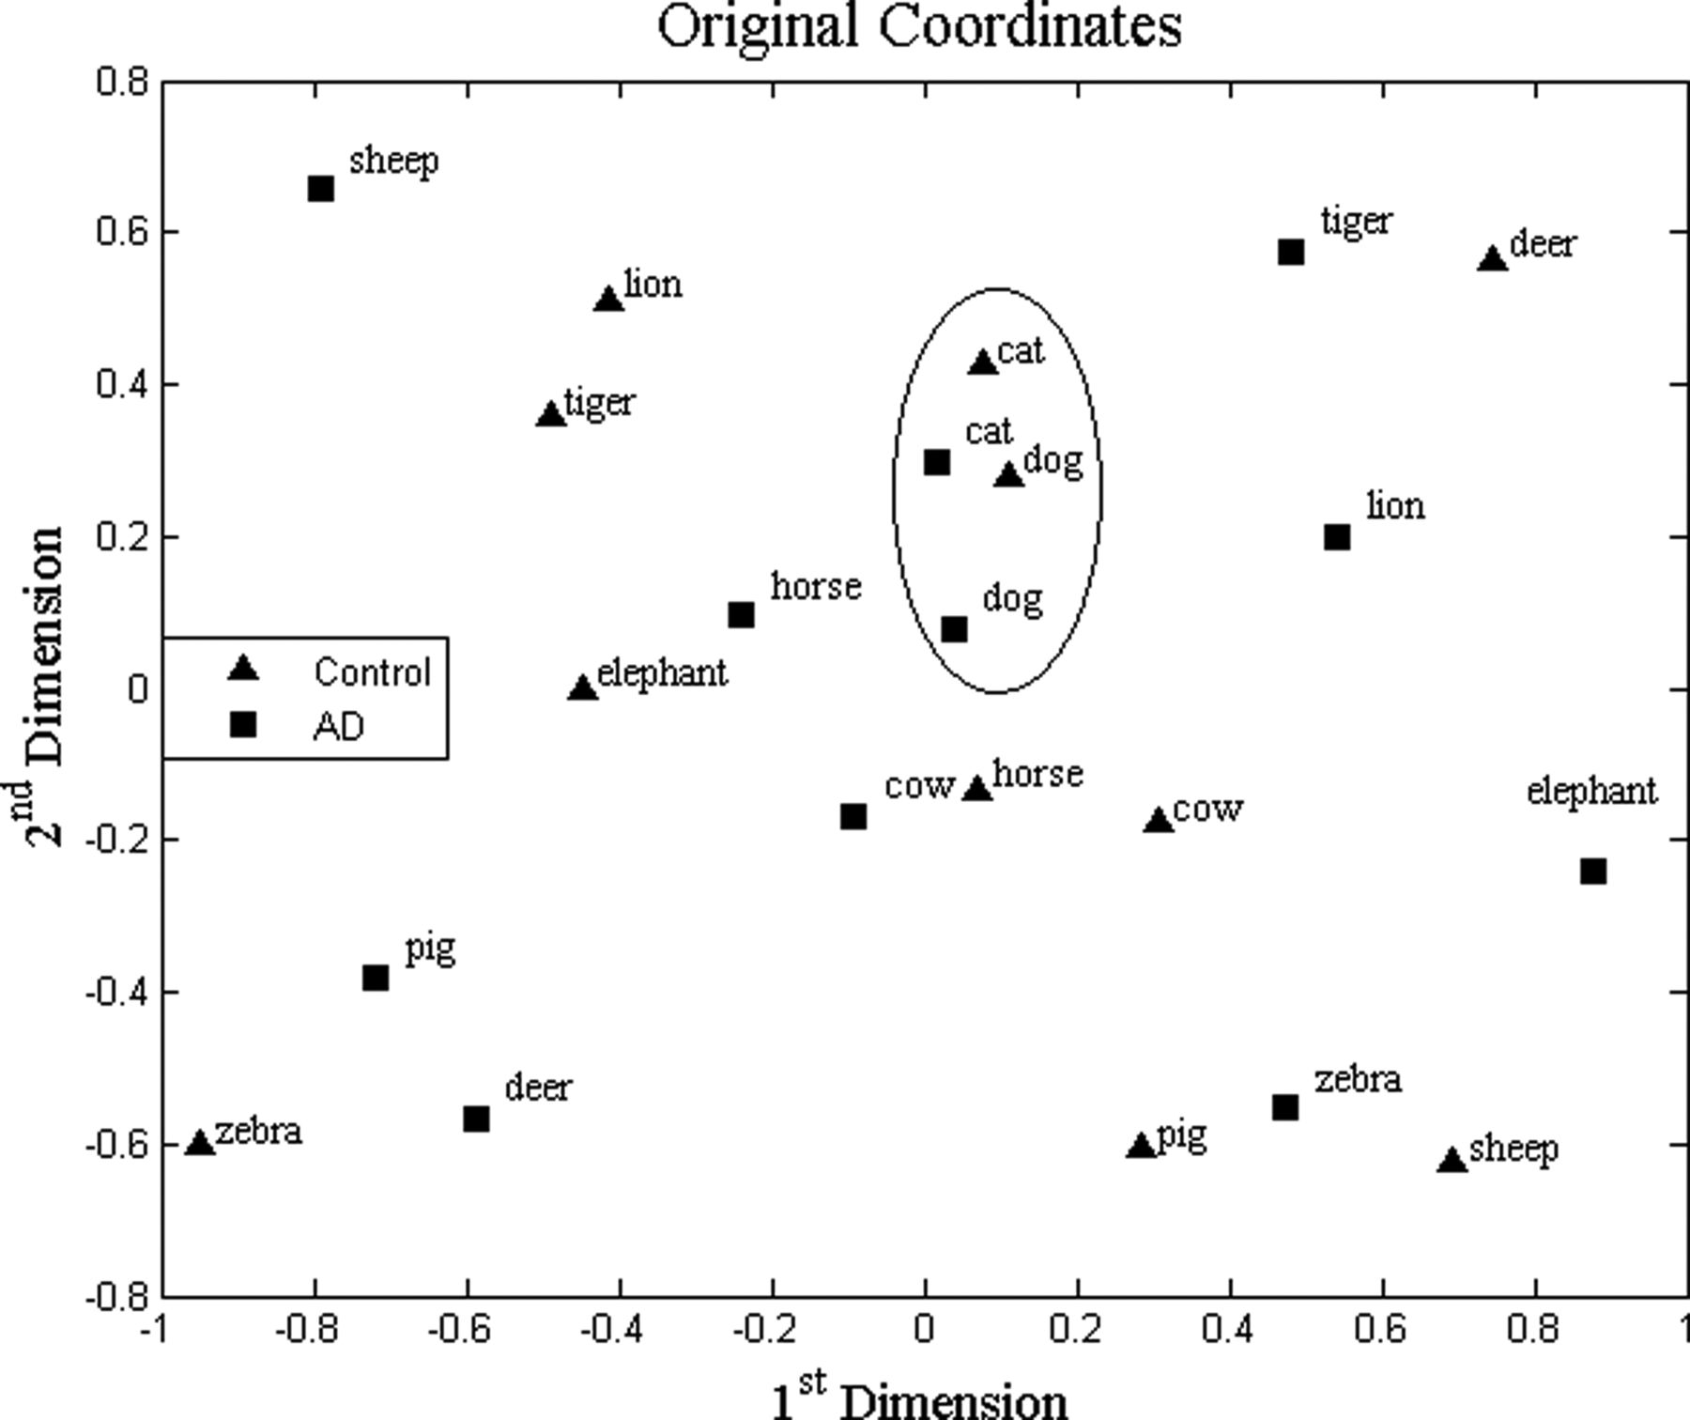
Fig. 3. AD and control group combined MDS common space plots.
Notes:
Fig. 3. AD and control group combined MDS common space plots.
Unless provided in the caption above, the following copyright applies to the content of this slide: © The Author 2014. Published by Oxford University Press. All rights reserved. For permissions, please e-mail: journals.permissions@oup.com.

Slide 4
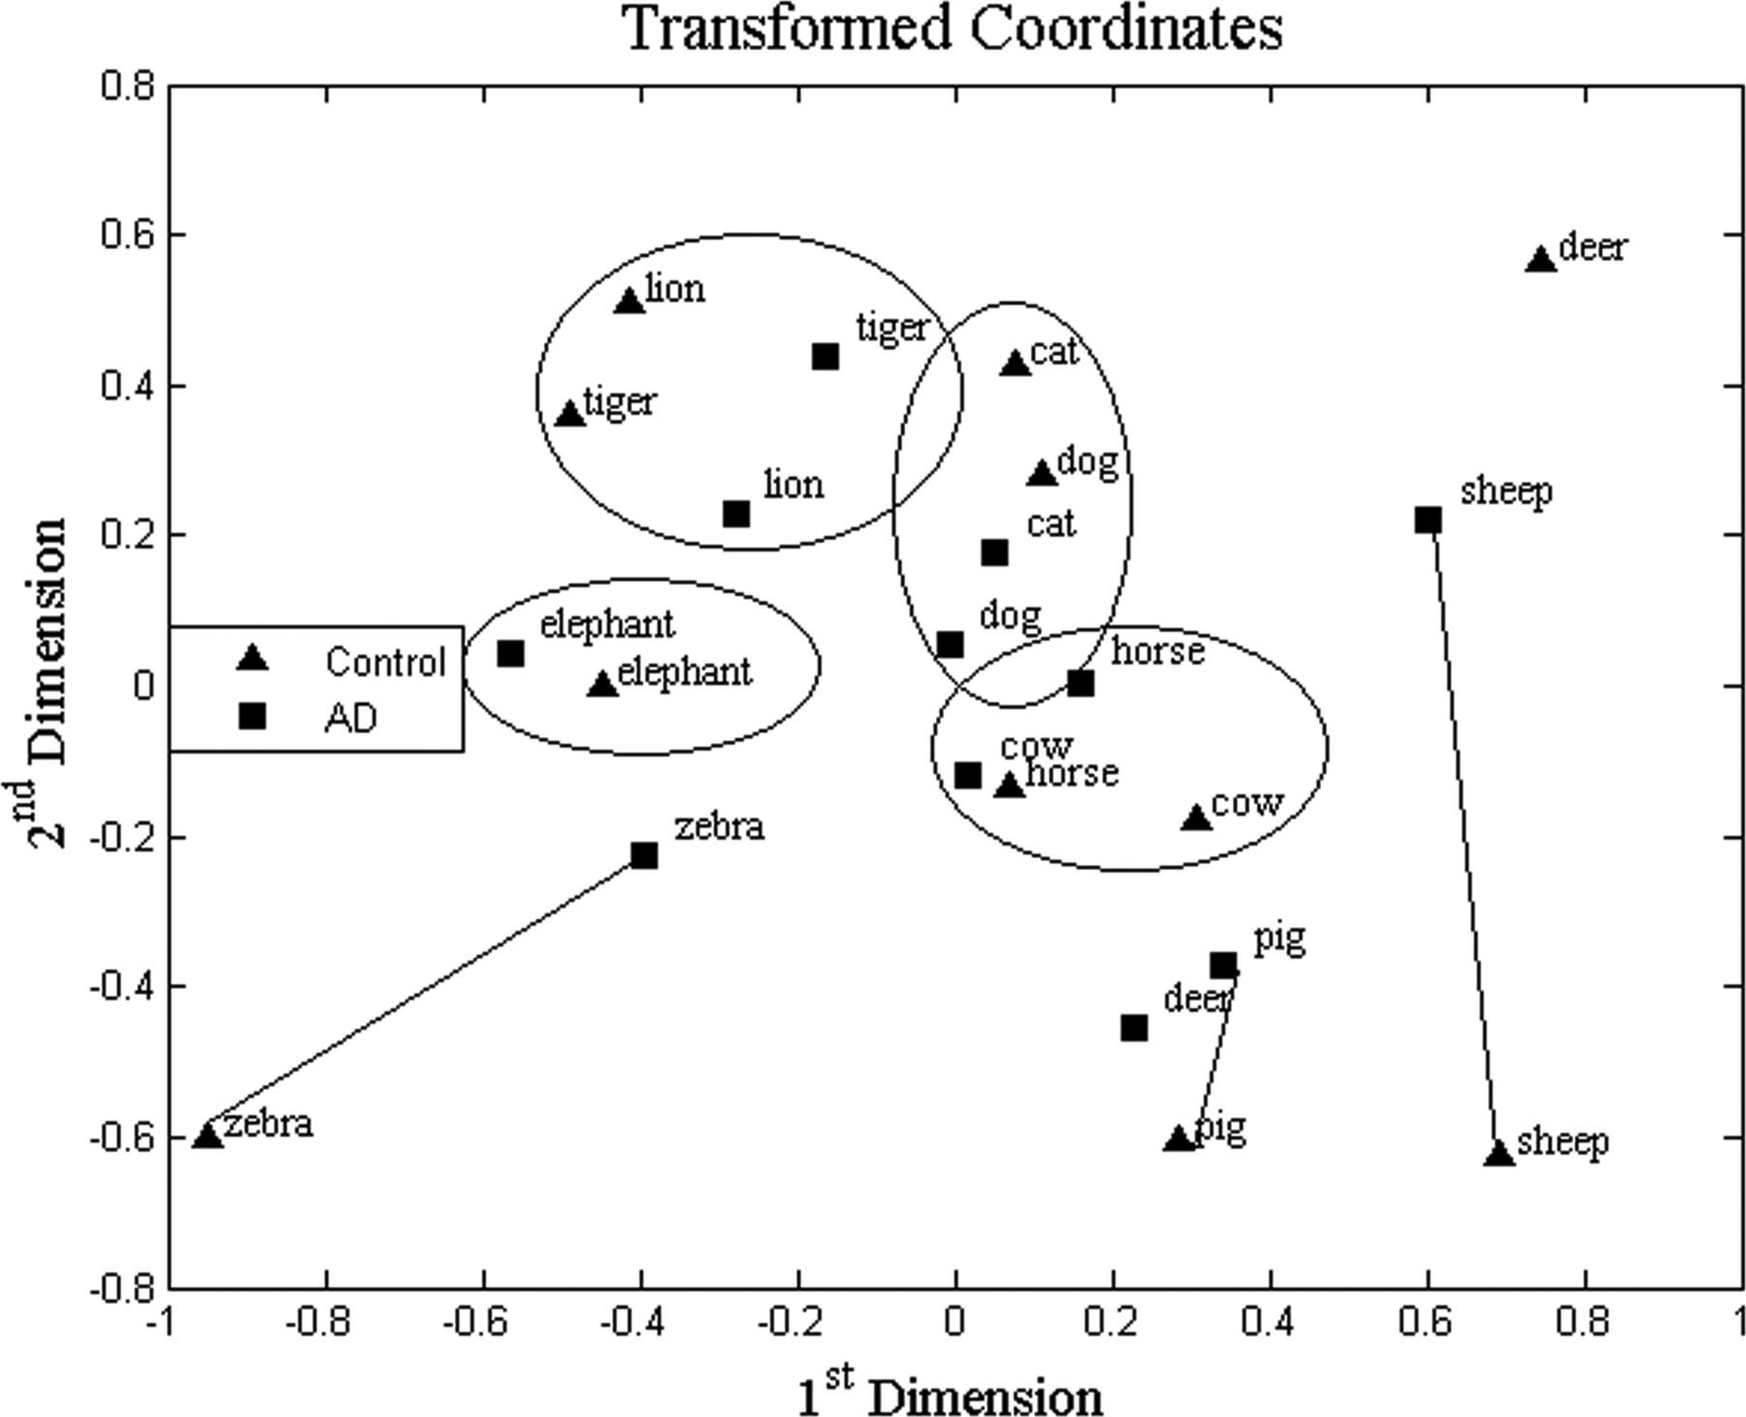
Fig. 4. Procrustes transformed MDS coordinates.
Notes:
Fig. 4. Procrustes transformed MDS coordinates.
Unless provided in the caption above, the following copyright applies to the content of this slide: © The Author 2014. Published by Oxford University Press. All rights reserved. For permissions, please e-mail: journals.permissions@oup.com.

