Slide 1
Figure 1 Theoretical model on professional commitment to changing chronic illness care.
Notes:
Figure 1 Theoretical model on professional commitment to changing chronic illness care.
Unless provided in the caption above, the following copyright applies to the content of this slide: © The Author 2009. Published by Oxford University Press in association with the International Society for Quality in Health Care; all rights reserved

Slide 2
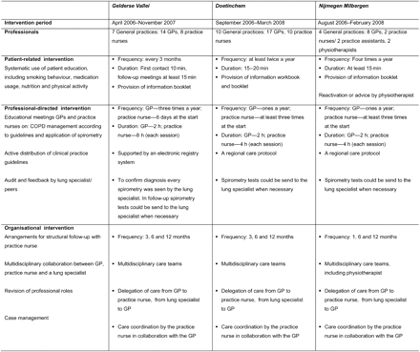
Figure 2 Disease management interventions in the disease management programmes.
Notes:
Figure 2 Disease management interventions in the disease management programmes.
Unless provided in the caption above, the following copyright applies to the content of this slide: © The Author 2009. Published by Oxford University Press in association with the International Society for Quality in Health Care; all rights reserved

