Slide 1
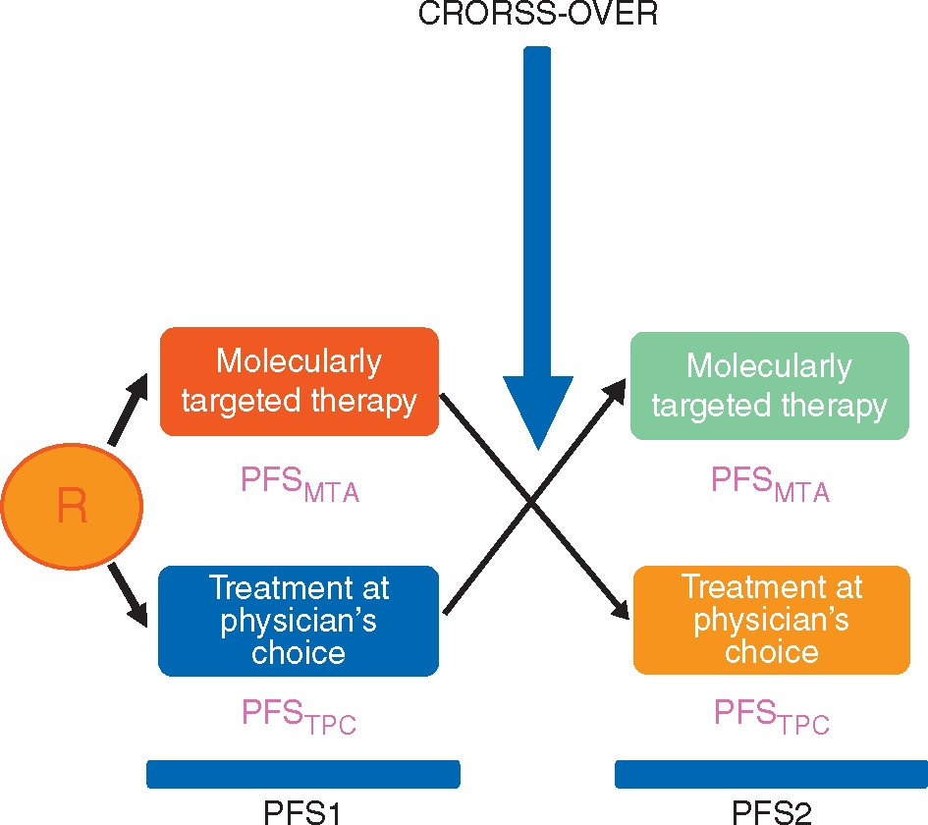
Figure 1. Study design. R, randomization; MTA, molecularly targeted agent; TPC, treatment at physician’s choice; PFS, ...
Notes:
Figure 1. Study design. R, randomization; MTA, molecularly targeted agent; TPC, treatment at physician’s choice; PFS, progression-free survival.
Unless provided in the caption above, the following copyright applies to the content of this slide: © The Author 2016. Published by Oxford University Press on behalf of the European Society for Medical Oncology. All rights reserved. For Permissions, please email: journals.permissions@oup.com.

Slide 2
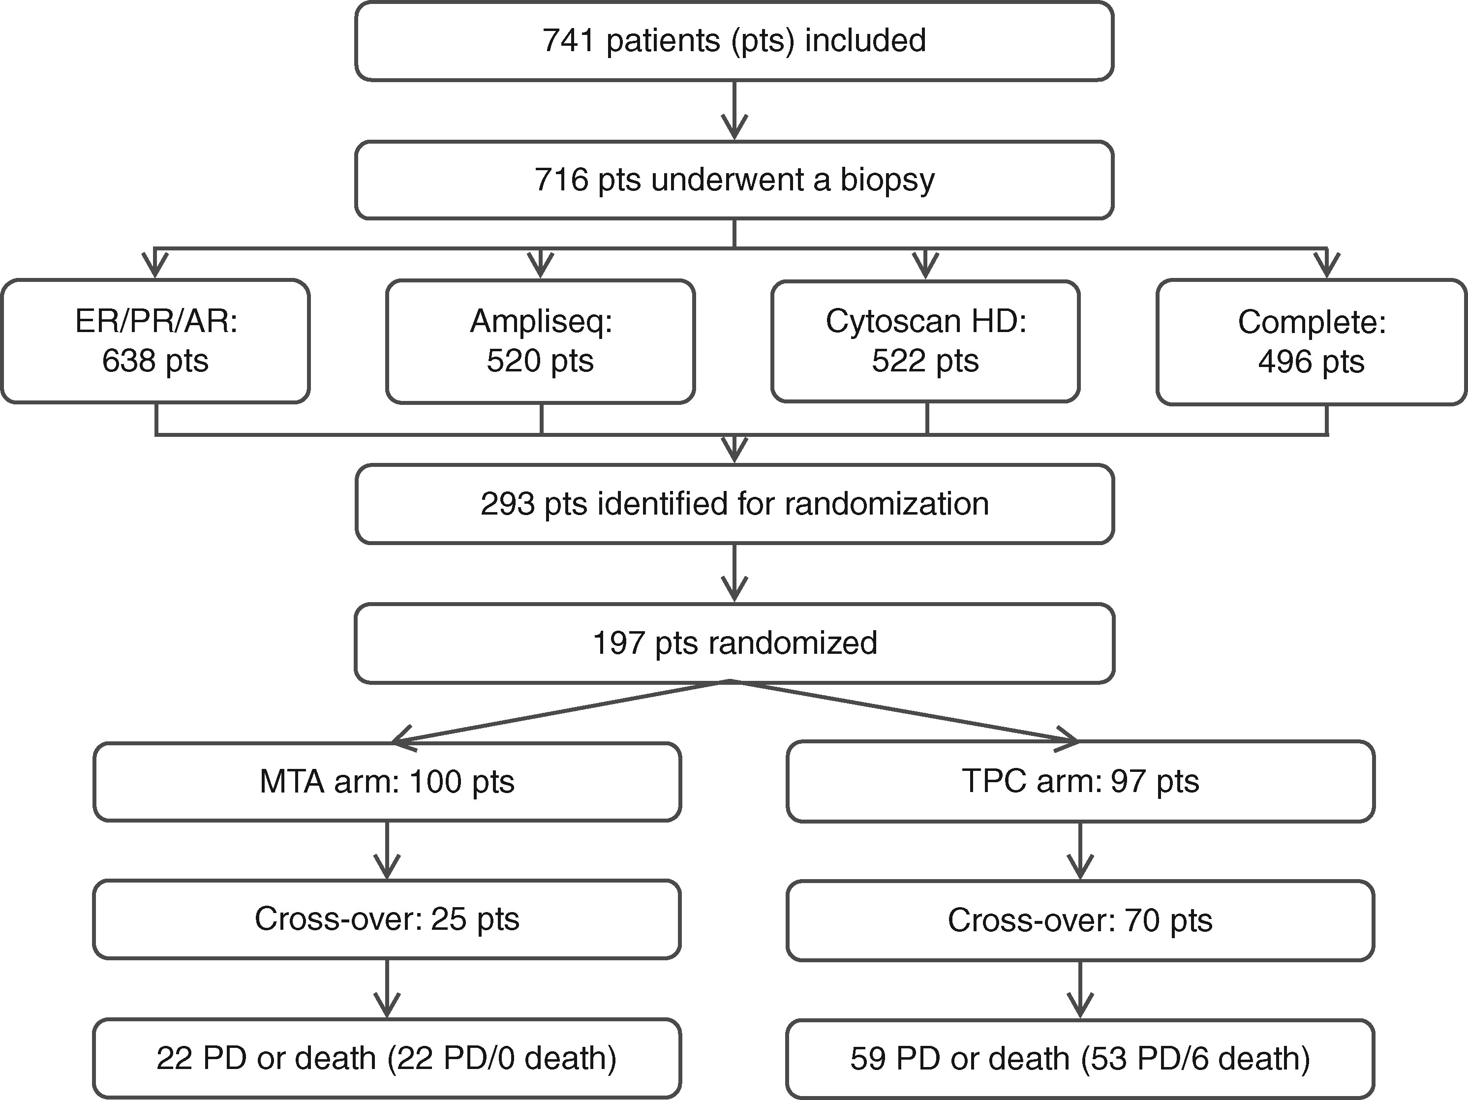
Figure 2. CONSORT diagram. MTA, molecularly targeted agent; TPC, treatment at physician’s choice; PD, progressive ...
Notes:
Figure 2. CONSORT diagram. MTA, molecularly targeted agent; TPC, treatment at physician’s choice; PD, progressive disease. Patient characteristics of randomized patients VariablePatients who crossed-over (N = 95)Patients who did not cross-over (N = 102)P-valueFrom MTA to TPC (N = 25)From TPC to MTA (N = 70)All (N = 95)Age0.14 Median age—yr [range]64 [24–76]63 [30–88]63 [24–88]60 [18–81]Sex—no. (%)0.08 Female18 (72)50 (71)68 (72)61 (60) Male7 (28)20 (29)27 (28)41 (40)Prior lines of treatment0.75 Median number [range]2 [1–8]3 [0–15]3 [0–15]3 [0–13]Royal Marsden Hospital score—no. (%)0.03 0 or 117 (68)42 (60)36 (62)48 (47) 2 or 38 (32)28 (40)59 (38)54 (53)Molecular pathway altered—no. (%)0.10 Hormone receptor pathway15 (60)32 (46)47 (50)37 (36) PI3K/AKT/mTOR pathway9 (36)31 (44)40 (42)49 (48) RAF/MEK pathway1 (4)7 (10)8 (8)16 (16)Tumor type—no. (%)NA Breast adenocarcinoma7 (28)12 (17)19 (47)21 (52) Ovarian cancer0 (0)13 (19)13 (45)16 (55) Lung cancer2 (8)9 (13)11 (55)9 (45) Colorectal cancer1 (4)9 (13)10 (56)8 (44) Cervical cancer7 (28)4 (6)11 (58)8 (42) Head and neck squamous cell carcinoma0 (0)4 (6)4 (36)7 (64) Sarcoma2 (8)4 (6)6 (66)3 (33) Urothelial carcinoma0 (0)2 (3)2 (33)4 (67) Pancreatic adenocarcinoma0 (0)1 (1)1 (20)4 (80) Adenocarcinoma of unknown primary1 (4)1 (1)2 (40)3 (60) Oesogastric cancer0 (0)1 (1)1 (20)4 (80) Adenoid cystic carcinoma (ACC)1 (4)2 (3)3 (75)1 (25) Non-ACC salivary gland tumor0 (0)1 (1)1 (25)3 (75) Hepatocellular carcinoma0 (0)2 (3)2 (67)1 (33) Anal squamous cell carcinoma1 (4)0 (0)1 (33)2 (67) Neuroendocrine tumor0 (0)1 (1)1 (33)2 (67) Biliary tract carcinoma0 (0)1 (1)1 (50)1 (50) Nasopharyngeal carcinoma1 (4)1 (1)2 (100)0 (0) Cutaneous melanoma1 (4)1 (1)2 (100)0 (0) Mesothelioma0 (0)1 (1)1 (100)0 (0) Peritoneal tumor0 (0)0 (0)0 (0)1 (100) Ependymoma1 (4)0 (0)1 (100)0 (0) Prostate adenocarcinoma0 (0)0 (0)0 (0)1 (100) Uveal melanoma0 (0)0 (0)0 (0)1 (100) Germline tumor0 (0)0 (0)0 (0)1 (100) Kidney cancer0 (0)0 (0)0 (0)1 (100)MTA, molecularly targeted agent; TPC, treatment at physician’s choice; NA, not applicable.
Unless provided in the caption above, the following copyright applies to the content of this slide: © The Author 2016. Published by Oxford University Press on behalf of the European Society for Medical Oncology. All rights reserved. For Permissions, please email: journals.permissions@oup.com.

Slide 3
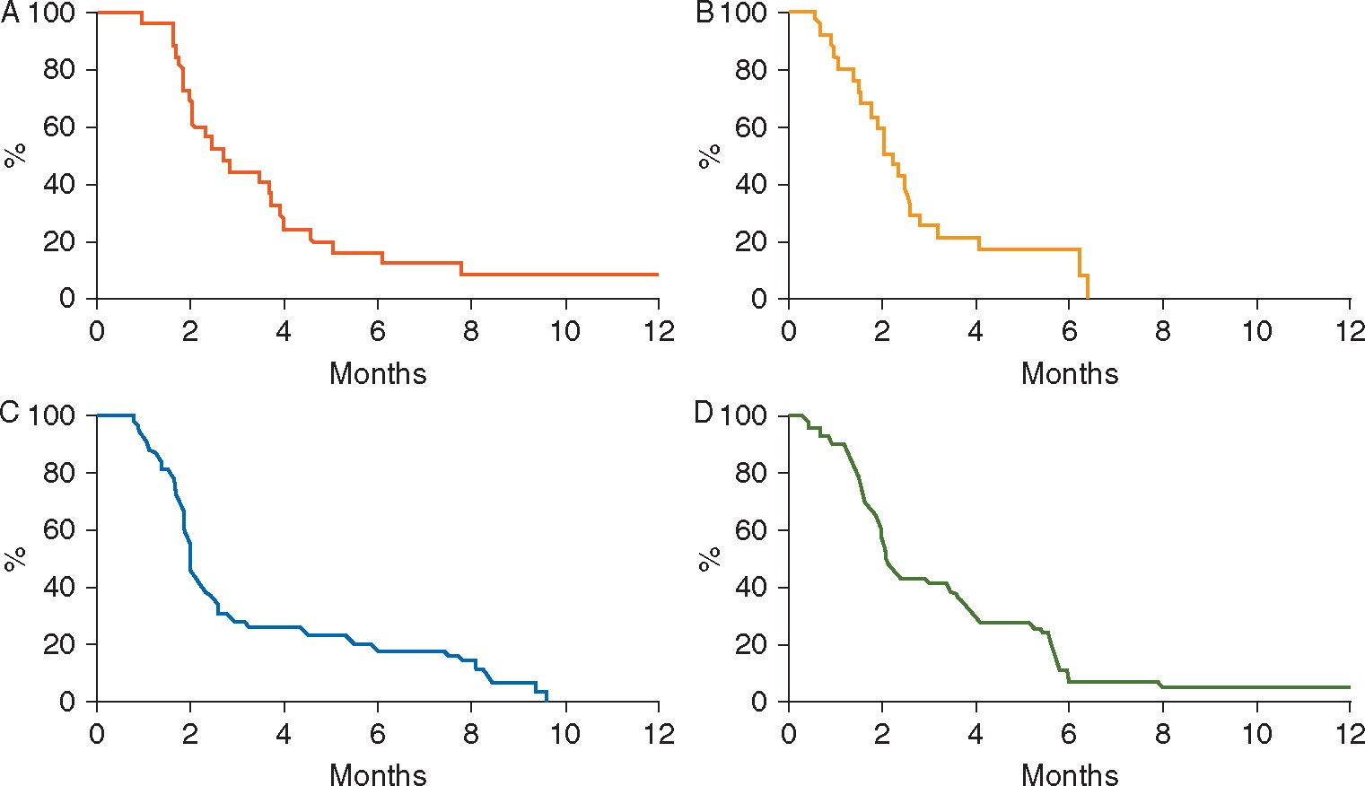
Figure 3. Kaplan–Meier estimates of progression-free survival (PFS) on (A) MTA, and (B) TPC in patients who ...
Notes:
Figure 3. Kaplan–Meier estimates of progression-free survival (PFS) on (A) MTA, and (B) TPC in patients who crossed-over from the MTA arm to the TPC arm, and on (C) TPC, and (D) MTA in patients who crossed-over from the TPC arm to the MTA arm.
Unless provided in the caption above, the following copyright applies to the content of this slide: © The Author 2016. Published by Oxford University Press on behalf of the European Society for Medical Oncology. All rights reserved. For Permissions, please email: journals.permissions@oup.com.

Slide 4
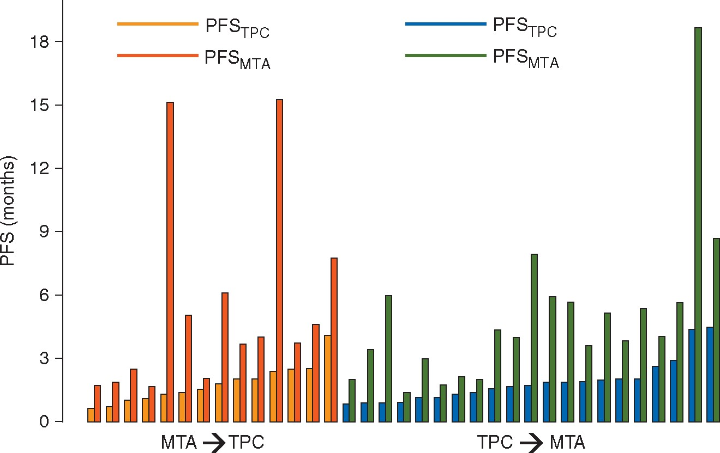
Figure 4. PFS on TPC and MTA for patients with a PFS_{MTA}/PFS_{TPC} ratio exceeding 1.3. Each couple ...
Notes:
Figure 4. PFS on TPC and MTA for patients with a PFSMTA/PFSTPC ratio exceeding 1.3. Each couple of bars represents one patient. MTA, molecularly targeted agent; TPC, treatment at physician’s choice; PFS, progression-free survival. Treatments and progression-free survival (PFS) of the 35 patients with a PFS ratio exceeding 1.3 Tumor typeMolecular alterationTPCMTATreatment sequencePFS on TPC (months)PFS on MTA (months)PFS ratioBreast adenocarcinomaAR overexpressionCapecitabineAbirateroneMTA → TPC1.315.111.5Hepatocellular carcinomaPTEN lossCapecitabineEverolimusTPC → MTA0.966.5Cervical cancerPIK3CA mutationCapecitabineEverolimusMTA → TPC2.415.36.4Hepatocellular carcinomaAR overexpressionNoneAbirateroneTPC → MTA1.77.94.6Breast adenocarcinomaAR overexpressionPaclitaxelAbirateroneTPC → MTA4.418.74.2HNSCCAKT1/AKT2/PIK3CB /RICTOR gainsMethotrexateEverolimusTPC → MTA0.93.43.8Lung cancerPTEN lossGemcitabineEverolimusMTA → TPC1.45.13.6EpendymomaAR overexpressionOral cyclophosphamideAbirateroneMTA → TPC1.86.13.4Breast adenocarcinomaAR overexpressionOral etoposideAbirateroneTPC → MTA1.95.93.1SarcomaPTEN lossOral cyclophosphamideEverolimusTPC → MTA1.95.73Ovarian cancerAR overexpressionTopotecanAbirateroneTPC → MTA1.64.42.7Breast adenocarcinomaAR overexpressionVinorelbinAbirateroneMTA → TPC0.61.72.7HNSCCPTEN lossCarboplatinEverolimusTPC → MTA2.05.42.6Breast adenocarcinomaPIK3CA mutationCisplatin + GemcitabineEverolimusTPC → MTA2.05.22.6Breast adenocarcinomaAR overexpressionEribulinAbirateroneTPC → MTA1.13.02.6Cervical cancerPIK3CA mutation & PTEN lossGemcitabineEverolimusMTA → TPC0.71.92.6ACUPPTEN lossCapecitabineEverolimusMTA → TPC1.02.52.5Urothelial carcinomaPIK3CA mutation & PTEN lossVinorelbinEverolimusTPC → MTA1.74.02.4Lung cancerHER2 amplificationCisplatin + PemetrexedLapatinib + TrastuzumabTPC → MTA0.92.02.3Ovarian cancerER overexpressionOral etoposideTamoxifenTPC → MTA4.58.71.9Breast adenocarcinomaAR overexpressionOral etoposideAbirateroneMTA → TPC4.17.81.9Adenoid cystic carcinomaPDGFRA amplificationGemcitabineSorafenibTPC → MTA2.95.71.9Adenoid cystic carcinomaPDGFRA amplificationCapecitabineSorafenibMTA → TPC2.14.01.9Ovarian cancerAR overexpressionNoneAbirateroneTPC → MTA2.03.91.9Anal squamous cell cancerPIK3CA mutationVinorelbinEverolimusMTA → TPC2.13.71.8Colorectal adenocarcinomaPTEN lossOral cyclophosphamideEverolimusTPC → MTA1.93.61.8Cervical cancerAKT1 mutationPaclitaxelEverolimusMTA → TPC2.64.61.7Ovarian cancerPTEN lossGemcitabineEverolimusTPC → MTA2.64.11.6Colorectal adenocarcinomaPIK3CA mutationLV5FU2EverolimusMTA → TPC2.53.71.5Lung cancerER overexpressionDocetaxelTamoxifenTPC → MTA0.92.01.5Colorectal adenocarcinomaER overexpressionOral cyclophosphamideTamoxifenTPC → MTA1.11.81.5Cervical cancerAR overexpressionPaclitaxelAbirateroneMTA → TPC1.11.71.5HNSCCPTEN lossMethotrexateEverolimusTPC → MTA1.42.01.4Oesogastric cancerRET amplificationNoneImatinibTPC → MTA1.01.41.4Breast adenocarcinomaAR overexpressionCapecitabineAbirateroneMTA → TPC1.52.11.3PFS, progression-free survival; TPC, treatment at physician’s choice; MTA, molecularly targeted agent; HNSCC, head and neck squamous cell carcinoma; ACUP, adenocarcinoma of unknown primary.
Unless provided in the caption above, the following copyright applies to the content of this slide: © The Author 2016. Published by Oxford University Press on behalf of the European Society for Medical Oncology. All rights reserved. For Permissions, please email: journals.permissions@oup.com.

