Slide 1
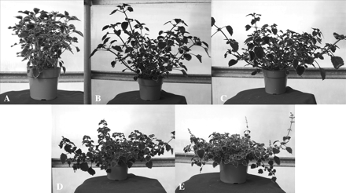
Figure 1 The 5 categories of growth habit in coleus. Plants were rated on a visual 1–5 scale, where (A) 1 = upright, ...
Notes:
Figure 1 The 5 categories of growth habit in coleus. Plants were rated on a visual 1–5 scale, where (A) 1 = upright, (B) 2 = semi-upright, (C) 3 = prostrate, (D) 4 = semitrailing, and (E) 5 = trailing. Photos are representative of plants within each category.
Unless provided in the caption above, the following copyright applies to the content of this slide: © The American Genetic Association. 2008. All rights reserved. For permissions, please email: journals.permissions@oxfordjournals.org.

Slide 2
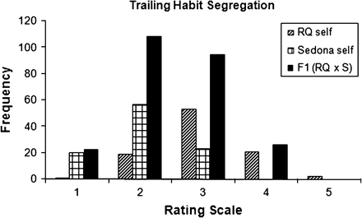
Figure 2 Distribution of the RQ selfed, S selfed, and F₁ populations for growth habit. Growth habit was ...
Notes:
Figure 2 Distribution of the RQ selfed, S selfed, and F1 populations for growth habit. Growth habit was rated on a 1–5 scale, where 1 = upright, 2 = semi-upright, 3 = prostrate, 4 = semitrailing, and 5 = trailing.
Unless provided in the caption above, the following copyright applies to the content of this slide: © The American Genetic Association. 2008. All rights reserved. For permissions, please email: journals.permissions@oxfordjournals.org.

Slide 3
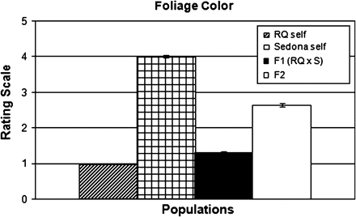
Figure 3 Mean rating values for color brightness for RQ selfed, S selfed, F₁, and the F₂ ...
Notes:
Figure 3 Mean rating values for color brightness for RQ selfed, S selfed, F1, and the F2 population. Color brightness was rated on a visual 1–5 scale, where 1 = dark purple (color as dark as RQ), 2 = purple (color slightly lighter than RQ), 3 = light reddish/purple (color between RQ and S), 4 = dark yellow/orange (color slightly darker than S), and 5 = orange (color as bright as S).
Unless provided in the caption above, the following copyright applies to the content of this slide: © The American Genetic Association. 2008. All rights reserved. For permissions, please email: journals.permissions@oxfordjournals.org.

Slide 4
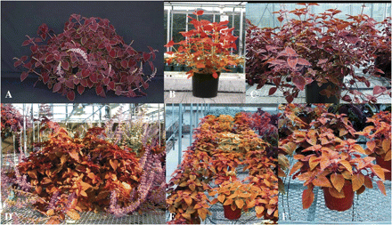
Figure 4 Development of “H05-66-5” with more trailing habit than RQ and bright orange color similar to S. (A) Red ...
Notes:
Figure 4 Development of “H05-66-5” with more trailing habit than RQ and bright orange color similar to S. (A) Red Queen, (B) Sedona, (C) F1 variety H05-66, (D) F2 variety H05-66-5, (E) F3 progeny from selfing H05-66-5, and (F) Close-up picture of one seedling in the F3 population.
Unless provided in the caption above, the following copyright applies to the content of this slide: © The American Genetic Association. 2008. All rights reserved. For permissions, please email: journals.permissions@oxfordjournals.org.

