Slide 1
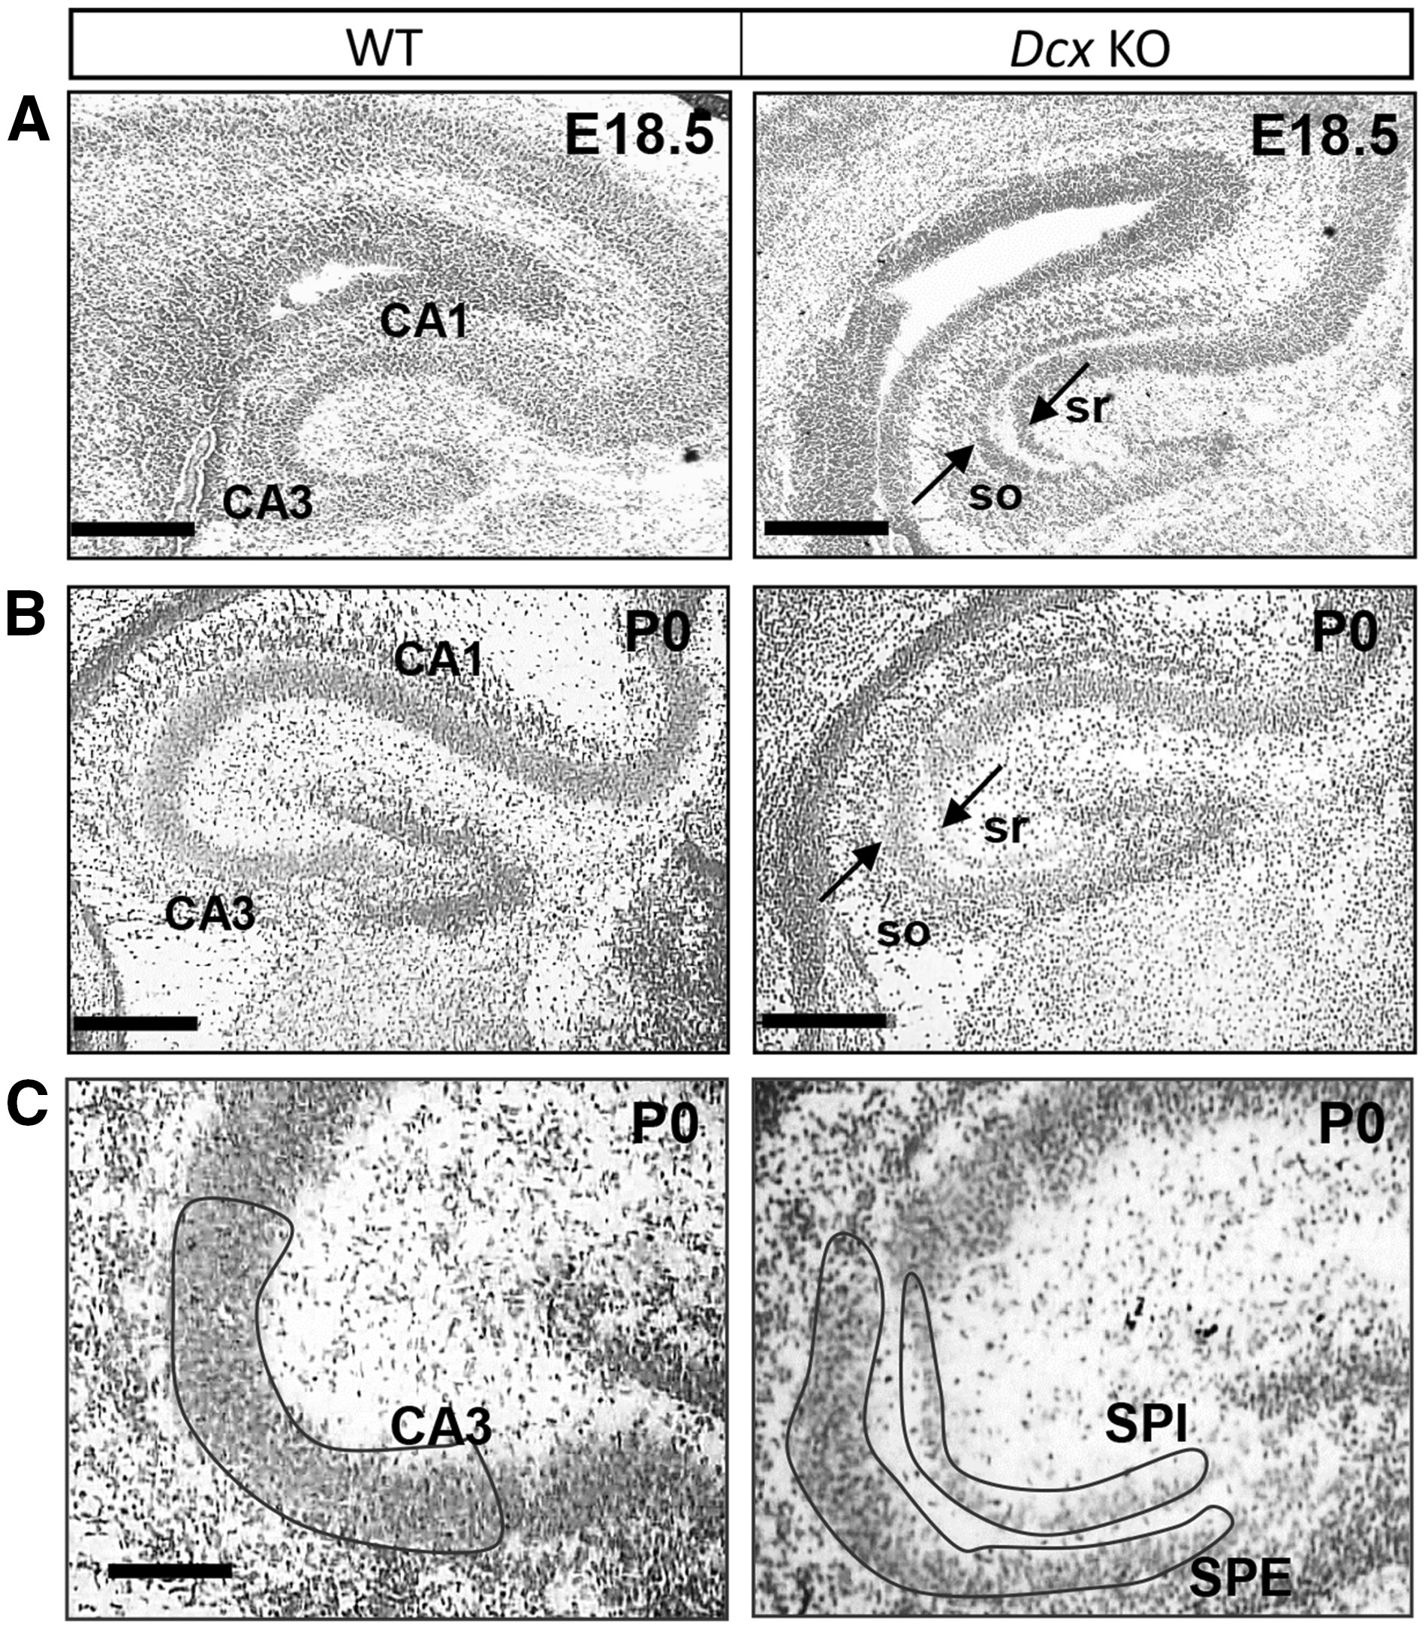
Figure 1. WT versus Dcx KO hippocampus at late embryonic and early postnatal stages. (A,B) Cresyl violet stained ...
Notes:
Figure 1. WT versus Dcx KO hippocampus at late embryonic and early postnatal stages. (A,B) Cresyl violet stained coronal sections of the hippocampus at E18.5 and P0, prior to laser capture microdissection cutting. The CA1 and CA3 fields of the pyramidal cell layer are indicated on the WT section. Arrows on the Dcx KO section indicate the double pyramidal cell layer. So, stratum oriens, sr, stratum radiatum. (C) Laser capture microdissection from cresyl violet stained P0 brain sections. Hippocampal CA3 WT and Dcx KO internal (SPI) and external (SPE) layers are shown, with schematized indications of areas selected for excision. Scale bars, 300 µm (A) E18.5; 300 µm (B) and 70 µm (C) P0.
Unless provided in the caption above, the following copyright applies to the content of this slide: © The Author 2016. Published by Oxford University Press. All rights reserved. For Permissions, please email: journals.permissions@oup.com

Slide 2
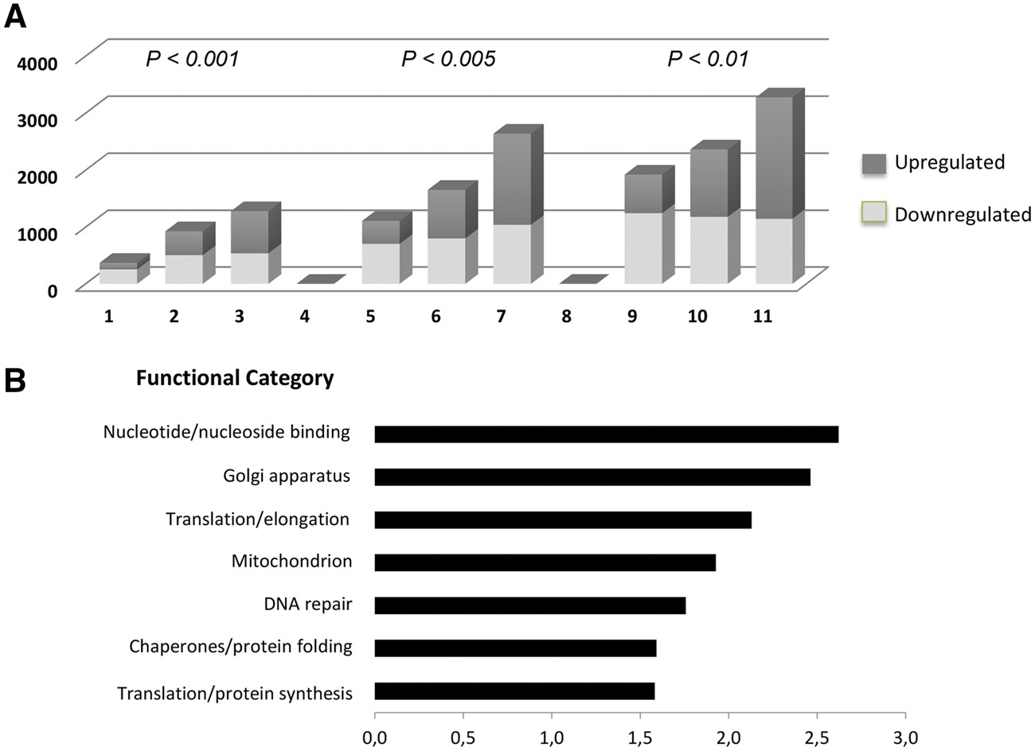
Figure 2. Global gene expression changes in the two Dcx KO layers, compared to WT. (A) Increasing numbers of ...
Notes:
Figure 2. Global gene expression changes in the two Dcx KO layers, compared to WT. (A) Increasing numbers of differentially expressed genes as P value cutoffs are lowered. SPE versus WT, SPI versus WT, and SPI versus SPE comparisons are shown. The y-axis indicates numbers of genes. The dark grey colour indicates up-regulated, and the light grey colour indicates down-regulated genes. (B) Genes commonly de-regulated in SPI and SPE were subjected to DAVID functional clustering analyses. Each significant functional category (y-axis), is plotted against the value of enrichment score (x-axis) obtained using the DAVID pathway analysis software. DAVID analyses are also resumed in Supplementary Material, Table S5.
Unless provided in the caption above, the following copyright applies to the content of this slide: © The Author 2016. Published by Oxford University Press. All rights reserved. For Permissions, please email: journals.permissions@oup.com

Slide 3
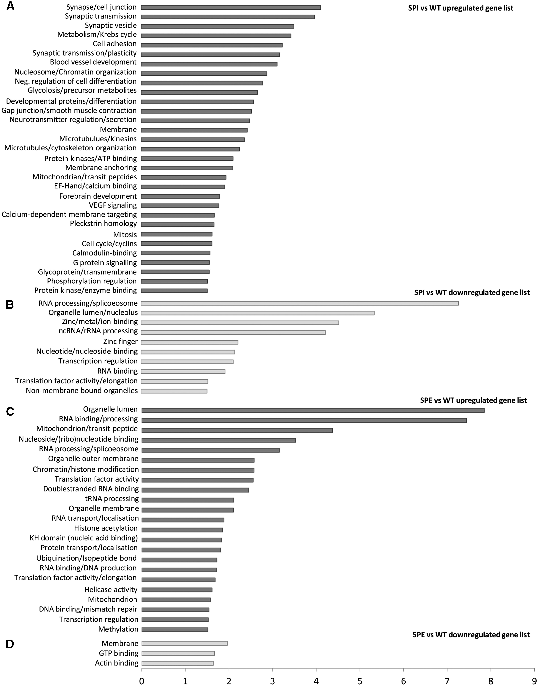
Figure 3. DAVID functional clustering of SPE and SPI layer-specific gene expression differences (A–D). Functional ...
Notes:
Figure 3. DAVID functional clustering of SPE and SPI layer-specific gene expression differences (A–D). Functional clustering of up-regulated and down-regulated differentially expressed genes from comparisons of SPI cells to WT (A,B), and SPE cells to WT (C,D), respectively. Each significant functional category (y-axis), is plotted against the value of enrichment score (x-axis). B. Genes up- or downregulated in SPI vs. WT DefinitionSPI vs. WTSPE vs. WTAldehyde dehydrogenase 1 family, member L1 (Aldh1l1)1,391Aldolase A, fructose-bisphosphate (Aldoa)1,360Enolase 1, alpha non-neuron (Eno1)1,275Solute carrier family 2 (facilitated glucose transporter), member 1 (Slc2a1); Glut11,190Malate dehydrogenase 2, NAD (mitochondrial) (Mdh2)1,160Solute carrier family 2 (facilitated glucose transporter), member 3 (Slc2a3); Glut31,1136-phosphofructo-2-kinase/fructose-2,6-biphosphatase 2 (Pfkfb2)0,8776-phosphofructo-2-kinase/fructose-2,6-biphosphatase 4 (Pfkfb4)0,835
Unless provided in the caption above, the following copyright applies to the content of this slide: © The Author 2016. Published by Oxford University Press. All rights reserved. For Permissions, please email: journals.permissions@oup.com

Slide 4
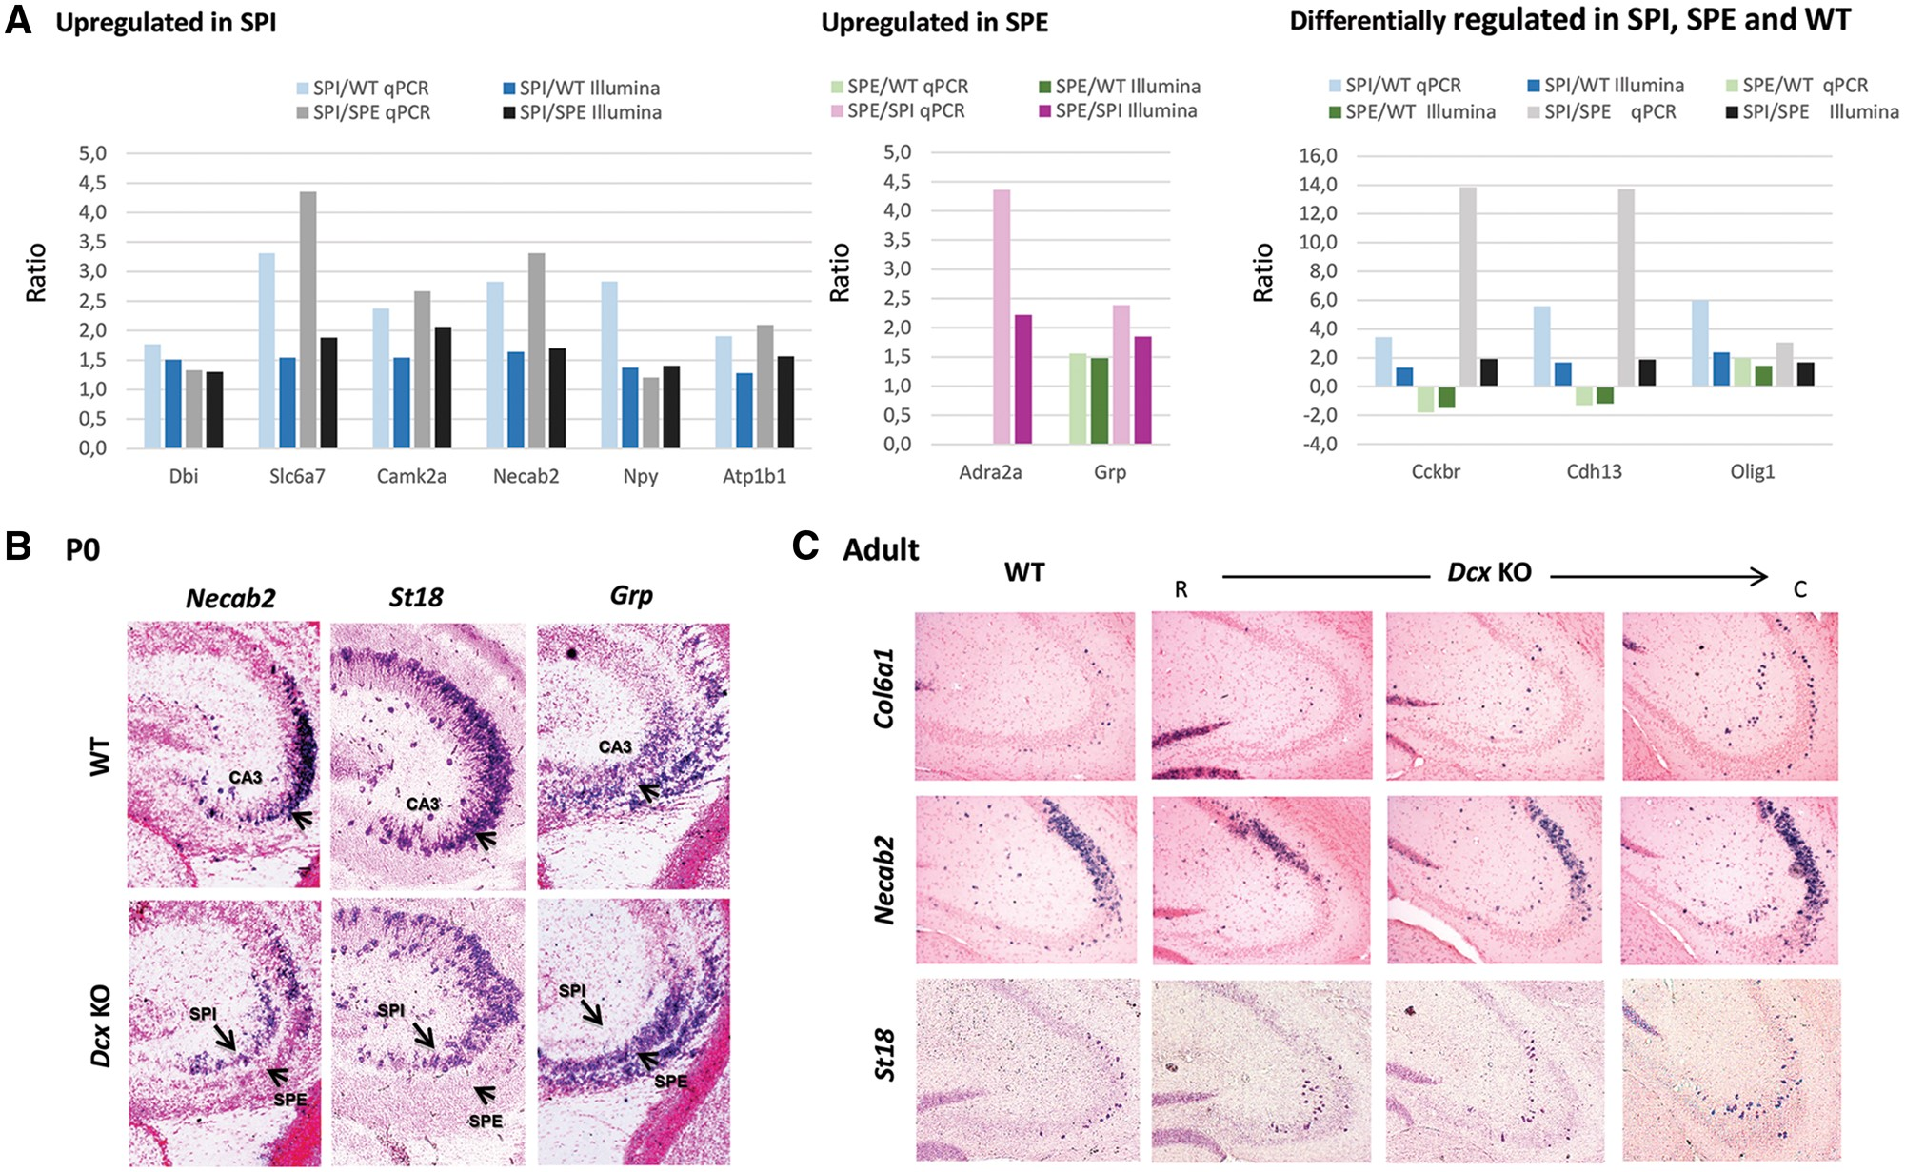
Figure 4. Validation of transcriptome data with quantitative RT-PCR (qPCR) and in situ hybridizations (ISH). (A) qPCR ...
Notes:
Figure 4. Validation of transcriptome data with quantitative RT-PCR (qPCR) and in situ hybridizations (ISH). (A) qPCR analyses for selected genes with comparison to transcriptome data. Y-axis corresponds to relative fluorescence units. Up-regulation compared to WT is indicated as positive values and down-regulation as negative (P < 0.05, Student’s t-tests). Results are presented as the ratio of means +/- SEM (n = 3–5 samples per genotype). (B,C) ISH in coronal sections showing layer-specific CA3 gene expression patterns. In the Dcx KO CA3 at P0 (B), Necab2 and St18 are primarily expressed in SPI, whereas Grp is primarily expressed in SPE, as well as in late-migrating neurons in the intermediate zone (IZ) in both the KO and WT. (C) ISH in coronal sections (R, rostral, C, caudal) in adults. The WT section is equivalent to the most rostral KO section. Col6A1 and St18 label outer-boundary cells closest to the stratum oriens in WT, whereas mainly SPI cells are labelled in the Dcx KO in septal regions, as well as some outer boundary cells in more temporal regions. Necab2 labels CA2 cells and CA3 outer-boundary cells in WT, and similar to Col6A1 and St18, shows a predominant expression in SPI cells in septal regions.
Unless provided in the caption above, the following copyright applies to the content of this slide: © The Author 2016. Published by Oxford University Press. All rights reserved. For Permissions, please email: journals.permissions@oup.com

Slide 5
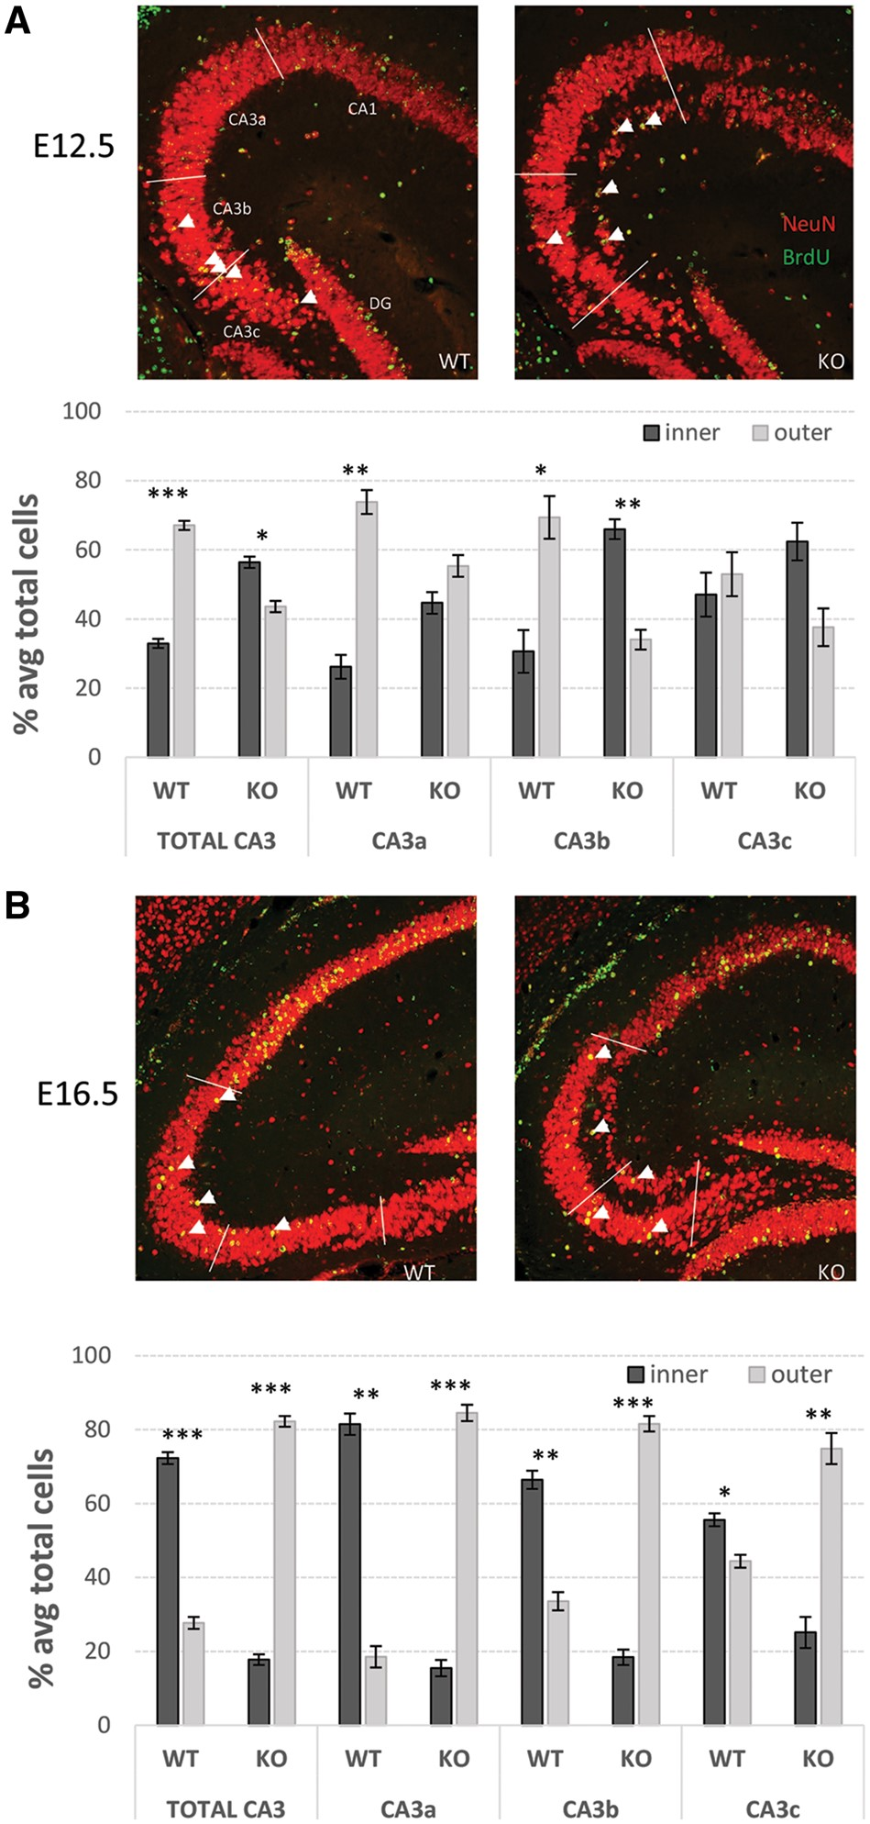
Figure 5. BrdU labeling of early- and late-born neurons. Representative immunohistochemistry images of dorsal ...
Notes:
Figure 5. BrdU labeling of early- and late-born neurons. Representative immunohistochemistry images of dorsal hippocampi from WT (left) and Dcx KO males exposed to BrdU at E12.5 (A) and E16.5 (B) show BrdU (green) and NeuN (red) labeling. White arrow heads indicate co-labelled cells. Bar graphs depict the average percent (+/- SEM) of total BrdU+ neurons (NeuN+) found in SPI (inner) and SPE (outer) heterotopic layers of Dcx KO mice, or the inner and outer halves of the single WT pyramidal layer. The proportions of BrdU+ neurons located in the inner and outer layers, born at either E12.5 or E16.5, were significantly different from WT in the CA3 region and each subregion (CA3a, b, c; Chi-squared tests, P < 0.05, n = 4–5 mice per genotype per injection time). Significant differences between the percentages of total BrdU+ neurons located in SPI/inner and SPE/outer are indicated (paired t-tests, *P < 0.05, **P < 0.01, ***P < 0.001).
Unless provided in the caption above, the following copyright applies to the content of this slide: © The Author 2016. Published by Oxford University Press. All rights reserved. For Permissions, please email: journals.permissions@oup.com

