Slide 1
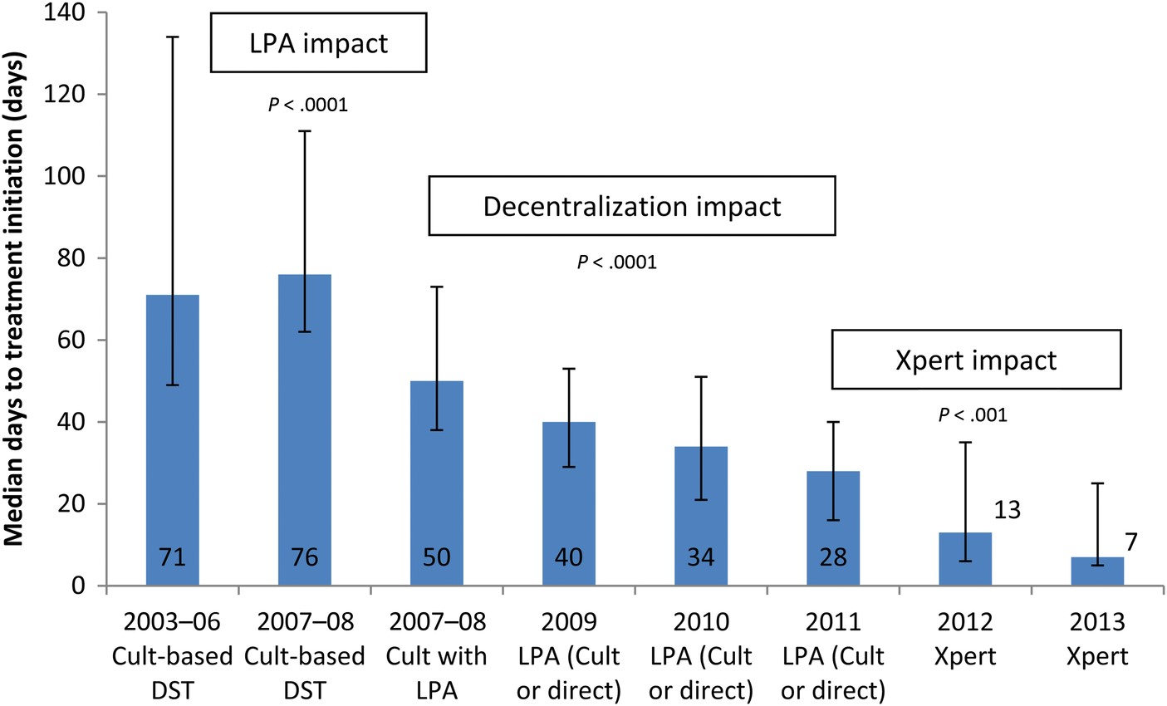
Figure 1. Median time to treatment (days) by year and diagnostic method (error bars represent interquartile range). ...
Notes:
Figure 1. Median time to treatment (days) by year and diagnostic method (error bars represent interquartile range). Abbreviations: DST, drug susceptibility testing; LPA, line probe assay.
Unless provided in the caption above, the following copyright applies to the content of this slide: © The Author 2015. Published by Oxford University Press on behalf of the Infectious Diseases Society of America.This is an Open Access article distributed under the terms of the Creative Commons Attribution License (http://creativecommons.org/licenses/by/4.0/), which permits unrestricted reuse, distribution, and reproduction in any medium, provided the original work is properly cited.

Slide 2
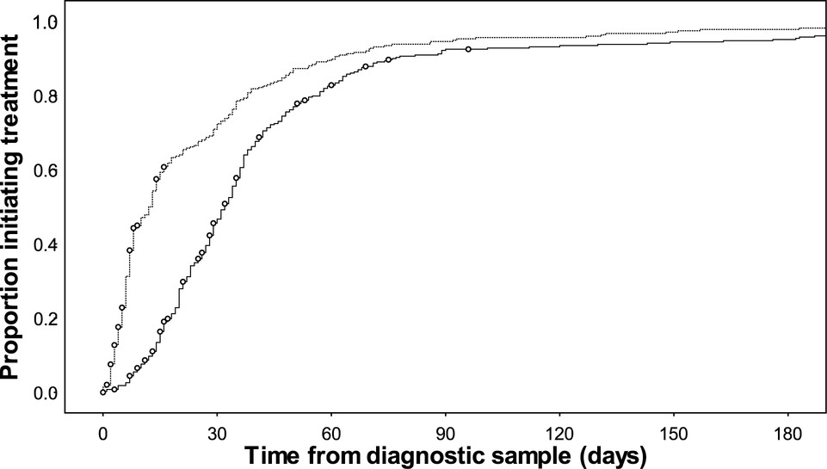
Figure 2. Time to treatment initiation comparing patients diagnosed in 2010–2011 with those diagnosed in 2012–2013 ...
Notes:
Figure 2. Time to treatment initiation comparing patients diagnosed in 2010–2011 with those diagnosed in 2012–2013 (Xpert implementation) (Kaplan–Meier, deaths before treatment censored [○]).
Unless provided in the caption above, the following copyright applies to the content of this slide: © The Author 2015. Published by Oxford University Press on behalf of the Infectious Diseases Society of America.This is an Open Access article distributed under the terms of the Creative Commons Attribution License (http://creativecommons.org/licenses/by/4.0/), which permits unrestricted reuse, distribution, and reproduction in any medium, provided the original work is properly cited.

