Slide 1
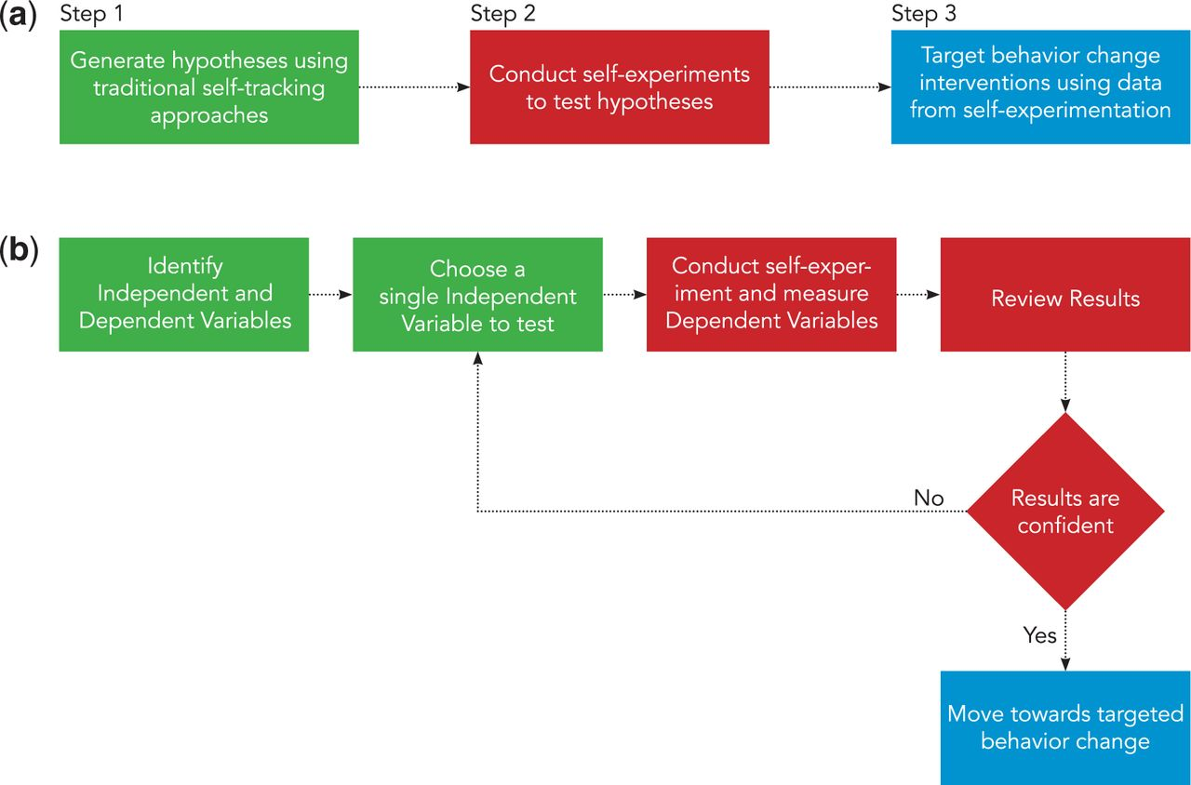
Figure 1: (a) Overall process of personalized health framework. (b) Expanded view of the self-experimentation process ...
Notes:
Figure 1: (a) Overall process of personalized health framework. (b) Expanded view of the self-experimentation process of our framework.
Unless provided in the caption above, the following copyright applies to the content of this slide: © The Author 2015. Published by Oxford University Press on behalf of the American Medical Informatics Association. All rights reserved. For Permissions, please email: journals.permissions@oup.com

Slide 2
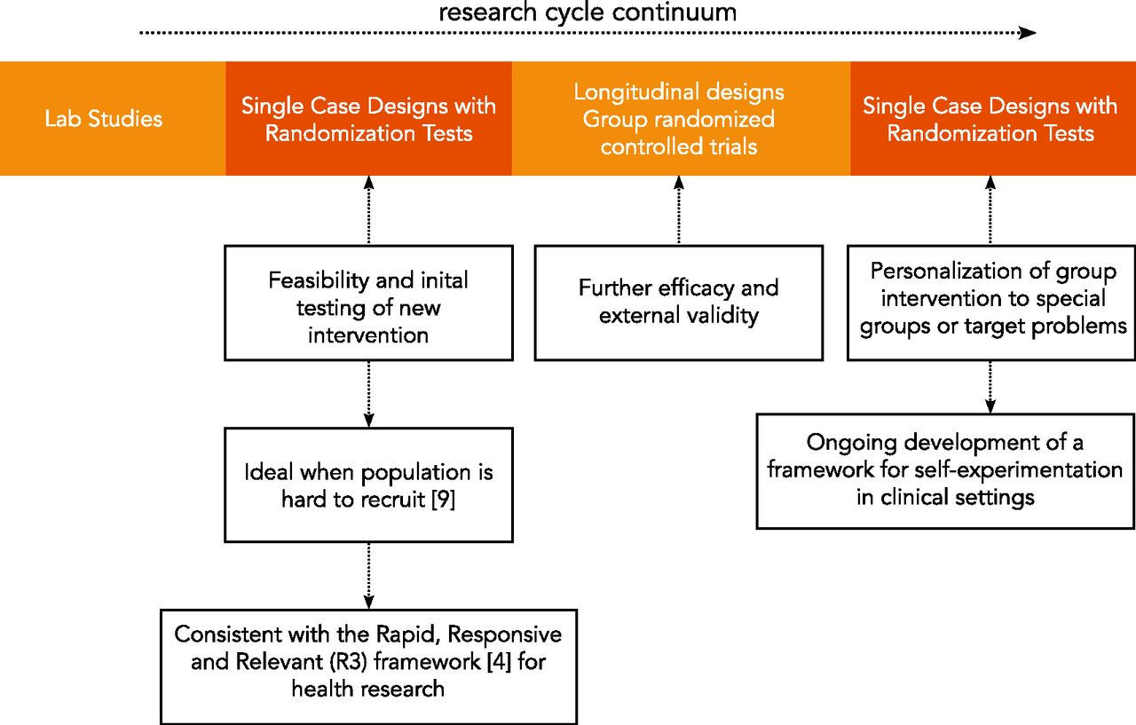
Figure 2: Single case designs’ role within the research cycle continuum.
Notes:
Figure 2: Single case designs’ role within the research cycle continuum.
Unless provided in the caption above, the following copyright applies to the content of this slide: © The Author 2015. Published by Oxford University Press on behalf of the American Medical Informatics Association. All rights reserved. For Permissions, please email: journals.permissions@oup.com

Slide 3
Figure 3: Example visualizations for a completely randomized single-case design of 12 observations showing a ...
Notes:
Figure 3: Example visualizations for a completely randomized single-case design of 12 observations showing a statistical significant effect of lactose on an individual’s abdominal pain. (a) Standard view. (b) Proposed visualization with daily view. (c) Proposed visualization with frequency view.
Unless provided in the caption above, the following copyright applies to the content of this slide: © The Author 2015. Published by Oxford University Press on behalf of the American Medical Informatics Association. All rights reserved. For Permissions, please email: journals.permissions@oup.com

Slide 4
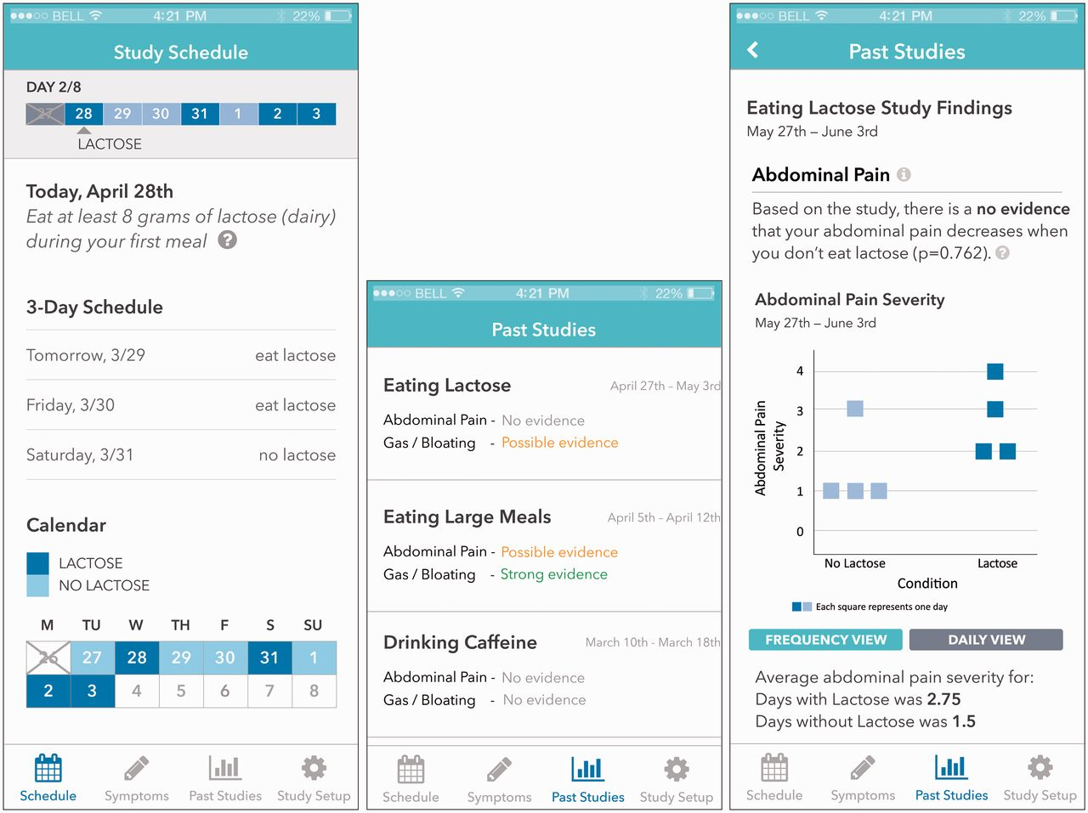
Figure 4: Screenshots of pages from our mobile app prototype. From left to right: study schedule, result summary of ...
Notes:
Figure 4: Screenshots of pages from our mobile app prototype. From left to right: study schedule, result summary of past studies, and results of a study.
Unless provided in the caption above, the following copyright applies to the content of this slide: © The Author 2015. Published by Oxford University Press on behalf of the American Medical Informatics Association. All rights reserved. For Permissions, please email: journals.permissions@oup.com

Slide 5
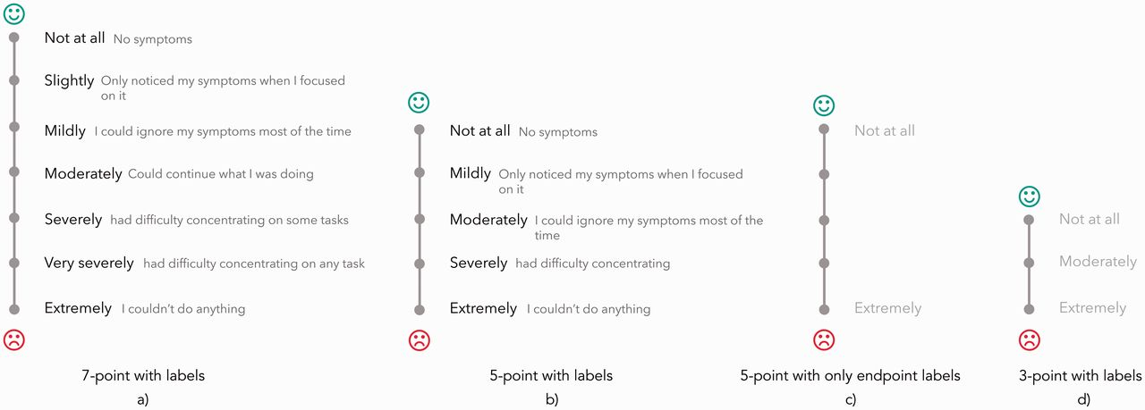
Figure 5: Selection of predefined scales shown during the online survey. From left to right: 7-point scale with labels, ...
Notes:
Figure 5: Selection of predefined scales shown during the online survey. From left to right: 7-point scale with labels, 5-point scale with labels, 5-point scale with only endpoint labels, and 3-point scale with labels.
Unless provided in the caption above, the following copyright applies to the content of this slide: © The Author 2015. Published by Oxford University Press on behalf of the American Medical Informatics Association. All rights reserved. For Permissions, please email: journals.permissions@oup.com

