Slide 1
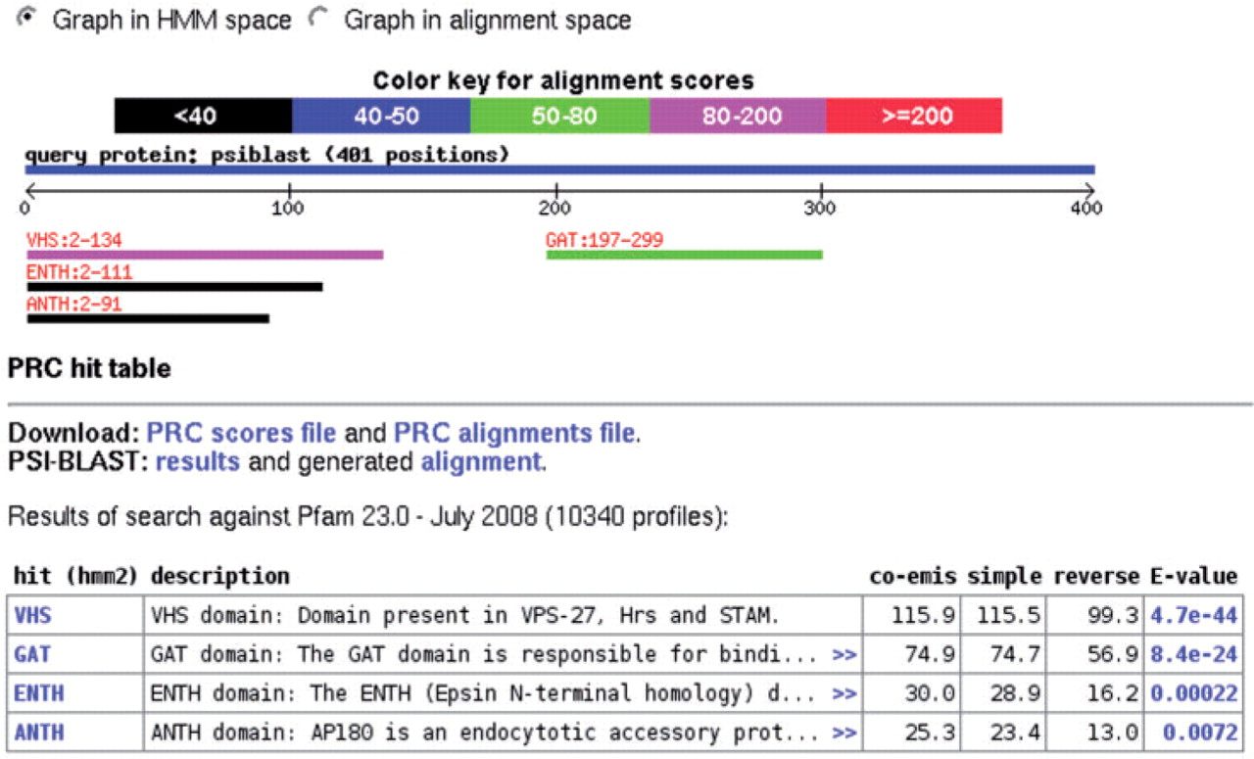
Figure 1. An example of the webPRC domain graphic and hit table section for GGA1_HUMAN run against Pfam (after running ...
Notes:
Figure 1. An example of the webPRC domain graphic and hit table section for GGA1_HUMAN run against Pfam (after running PSI-BLAST). The graph can be viewed in HMM or alignment space and the hits are hyperlinked to the alignments. The PRC hit table provides links to the original PRC and PSI-BLAST output and shows a table with annotated hits, including the name and, after clicking on ‘>>’, the description from the domain database. The hits are hyperlinked to the source database and E-values are hyperlinked to the alignments. Co-emission, simple and reverse scores are calculated by PRC [cf. (12)]. The E-value is calculated from the reverse score.
Unless provided in the caption above, the following copyright applies to the content of this slide: © 2009 The Author(s)This is an Open Access article distributed under the terms of the Creative Commons Attribution Non-Commercial License (http://creativecommons.org/licenses/by-nc/2.0/uk/) which permits unrestricted non-commercial use, distribution, and reproduction in any medium, provided the original work is properly cited.

Slide 2
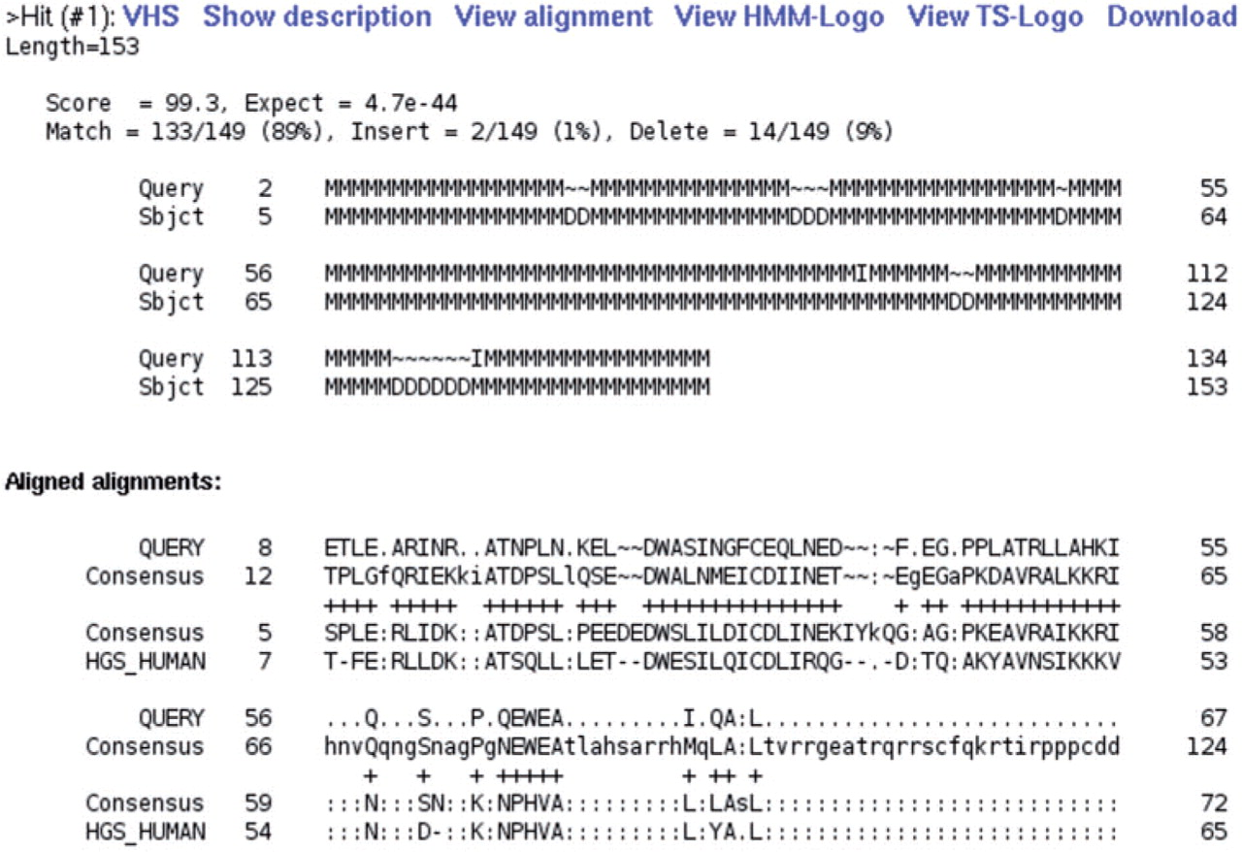
Figure 2. An example alignment showing hit number (#1), links, PRC alignment and aligned alignments (truncated). The ...
Notes:
Figure 2. An example alignment showing hit number (#1), links, PRC alignment and aligned alignments (truncated). The original PRC HMM alignment is formatted in a BLAST-like style and now includes the counts and percentages of the Match, Insert and Delete states (M–M, M–I, D–∼ pairs, respectively). The aligned alignments view shows the PRC result in multiple sequence alignment space and includes the first sequence of the query and hit alignment as well as their consensus sequences. The alignments are separated by a mid-line that indicates the PRC match states (M) with a ‘+’. Gaps present in the seed alignments are indicated by ‘–’, gaps introduced by PRC by ‘∼’ and positions corresponding to columns missing from the HMM by ‘:’. The entire (aligned) alignments can be viewed with Jalview or downloaded by clicking on ‘View alignment’ or ‘Download’, respectively.
Unless provided in the caption above, the following copyright applies to the content of this slide: © 2009 The Author(s)This is an Open Access article distributed under the terms of the Creative Commons Attribution Non-Commercial License (http://creativecommons.org/licenses/by-nc/2.0/uk/) which permits unrestricted non-commercial use, distribution, and reproduction in any medium, provided the original work is properly cited.

