Slide 1
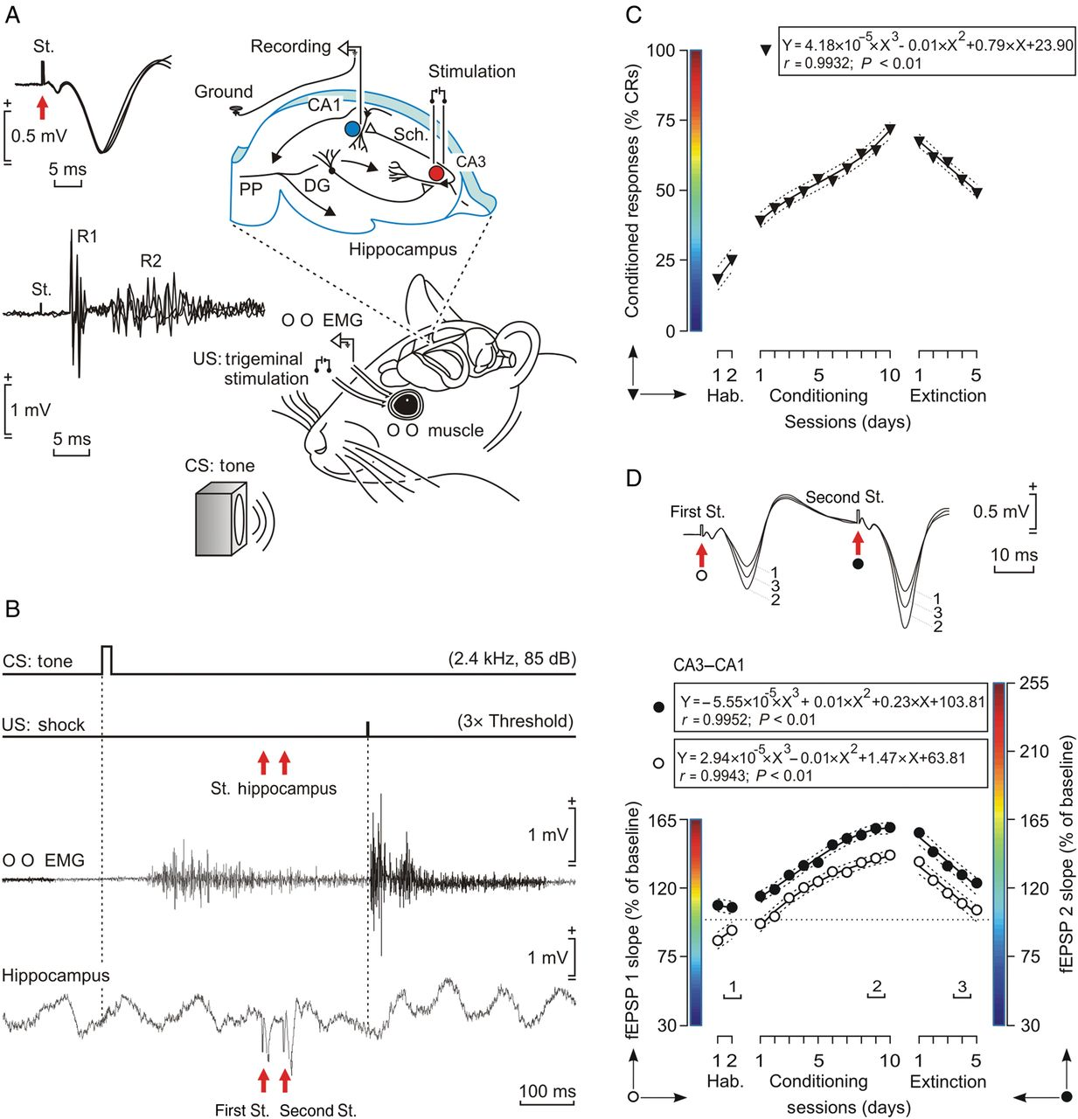
Figure 1. Experimental design. (A) Example of stimulating and recording electrodes aimed to activate the right ...
Notes:
Figure 1. Experimental design. (A) Example of stimulating and recording electrodes aimed to activate the right hippocampal CA3–CA1 synapse. Superimposed recordings at the top left illustrate fEPSPs recorded in the stratum radiatum of the CA1 area after electrical stimulation (St.) of Schaffer (Sch.) collaterals. EMG recording electrodes were implanted in the orbicularis oculi (OO) muscle of the left upper eyelid, and stimulating electrodes were implanted on the trigeminal nerve for US presentation. For classical eyeblink conditioning, we used a tone (20 ms; 2.4 kHz; 85 dB) as CS. Superimposed recordings at the bottom left correspond to the blink reflex evoked in the OO muscle by the electrical stimulation of the trigeminal nerve. Note the 2 short-(R1) and long-(R2) latency components characterizing the blink reflex in mammals. DG, dentate gyrus; PP, perforant pathway. (B) A representation of the conditioning paradigm, illustrating CS and US stimuli, and the moment at which a pair of pulses (100 μs; square; biphasic) was presented to Schaffer collaterals (St. Hippocampus). An example of an EMG recording from the OO muscle obtained from the seventh conditioning session is illustrated, as well as an extracellular recording of hippocampal activity from the same animal, session, and trial. Note the fEPSPs evoked in the CA1 layer following paired-pulse stimulation of Schaffer collaterals. (C) Typical learning curve (expressed as % CRs) calculated from the EMG activity of the OO muscle. (D) At the top are illustrated fEPSPs evoked at the CA3–CA1 synapse by paired-pulse presentations at the moments (1–3) indicated below. The graphs at the bottom show the evolution of synaptic strengths (CA3–CA1 synapse) for the 2 evoked fEPSPs (first, left ordinate; second, right ordinate) during the successive training sessions.
Unless provided in the caption above, the following copyright applies to the content of this slide: © The Author 2014. Published by Oxford University Press. All rights reserved. For Permissions, please e-mail: journals.permissions@oup.com

Slide 2
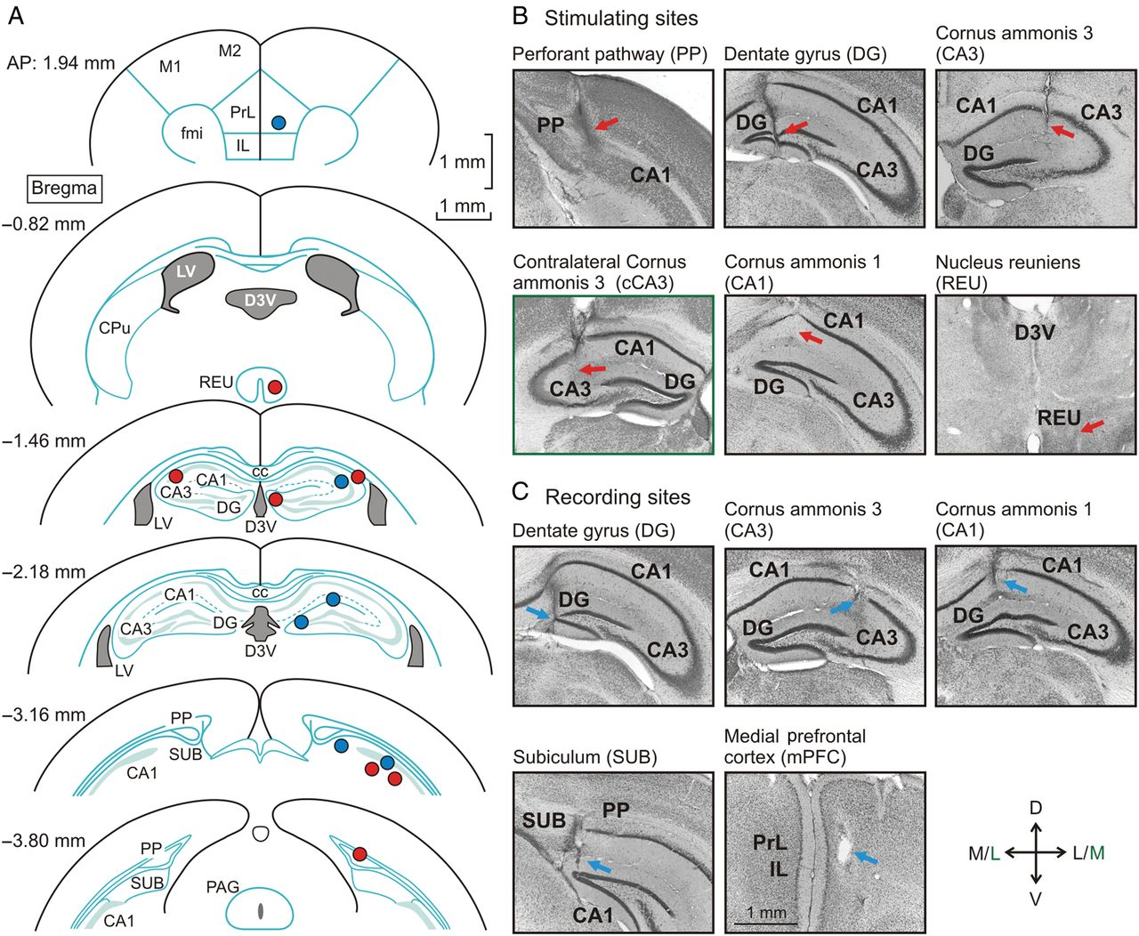
Figure 2. Location of the stimulating and recording sites. (A) Selected sites for the implantation of stimulating (red ...
Notes:
Figure 2. Location of the stimulating and recording sites. (A) Selected sites for the implantation of stimulating (red dots) and recording (blue dots) electrodes corresponding to the 9 synapses included in the study. Diagrams and coordinates relate to the Paxinos and Franklin Atlas 2001. (B,C) Representative photomicrographs illustrating the final location of stimulating (B) and recording (C) electrodes. Electrode tracts are indicated by red (stimulating) or blue (recording) arrows. Calibration is indicated in the bottom middle photomicrograph. Abbreviations: D, L, M, and V, represent dorsal, lateral, medial, and ventral, respectively; CPv, caudate-putamen nuclei; DG, dentate gyrus; D3V, third ventricle, dorsal part; fmi, forceps minor of the corpus callosum; IL, infralimbic cortex; LV, lateral ventricle; M1, M2, motor cortex; PAG, periaqueductal gray; PP, perforant pathway; PrL, prelimbic cortex; REU, thalamic reuniens nucleus; SUB, subiculum. In green are indicated the horizontal coordinates for cCA3 implanted electrodes.
Unless provided in the caption above, the following copyright applies to the content of this slide: © The Author 2014. Published by Oxford University Press. All rights reserved. For Permissions, please e-mail: journals.permissions@oup.com

Slide 3
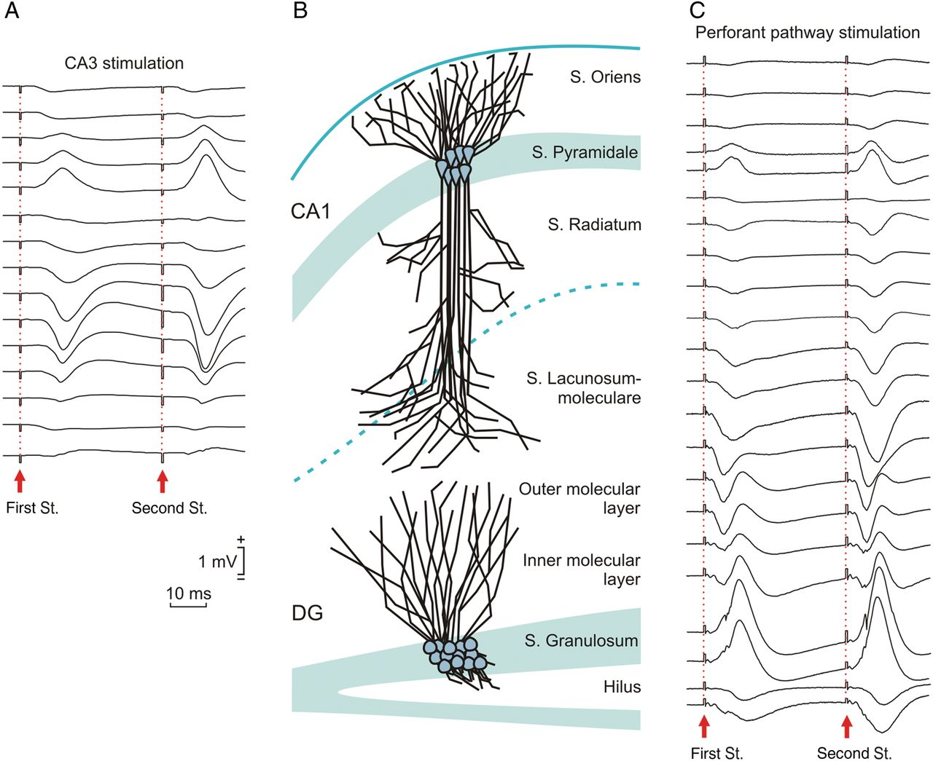
Figure 3. Selective examples of preliminary depth-profile recordings carried out to facilitate the identification of ...
Notes:
Figure 3. Selective examples of preliminary depth-profile recordings carried out to facilitate the identification of fEPSPs evoked at the 9 synapses included in this study. (A), Depth-profile representation of fEPSPs evoked in the hippocampal CA1 area by paired-pulse stimulation (40 ms of interpulse interval, red arrows) of ipsilateral Schaffer collaterals (CA3 stimulation). Stimulus intensity was set at 40% of the intensity (mA) necessary to evoke maximum fEPSP responses. Recordings were carried out in steps of 100 µm. (B) A diagrammatic representation of the location of somas and dendrites corresponding to CA1 pyramidal cells and to dentate granule neurons. The different strata are indicated. (C) Another field-potential depth profile corresponding to fEPSPs evoked in the CA1 and dentate gyrus areas by the paired-pulse stimulation of the perforant pathway. Calibrations in (A) are also for (C).
Unless provided in the caption above, the following copyright applies to the content of this slide: © The Author 2014. Published by Oxford University Press. All rights reserved. For Permissions, please e-mail: journals.permissions@oup.com

Slide 4
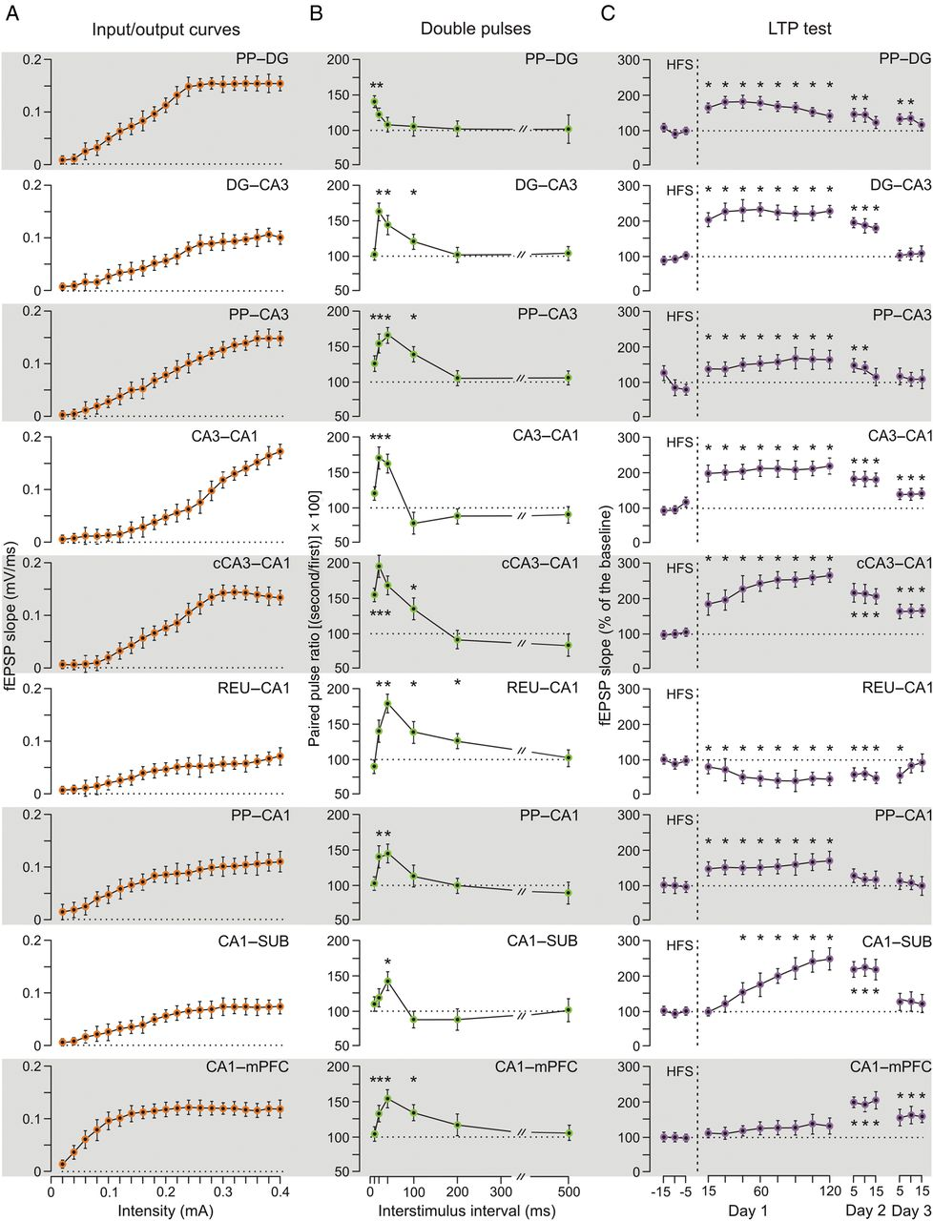
Figure 4. Functional properties of the 9 synapses included in this study. Illustrated data were collected from ...
Notes:
Figure 4. Functional properties of the 9 synapses included in this study. Illustrated data were collected from implanted animals (n = 10 per group) that passed the 3 successive experimental tests: input/output curves, paired-pulse facilitation, and LTP. (A), Input/output curves evoked at the 9 selected synapses. Each circle represents the mean value (with its corresponding SEM) computed from 50 stimulus presentations (5 per experimental animal). (B), Field EPSP facilitation evoked in the 9 synapses. Data shown are mean ± SEM slopes of the second fEPSP expressed as a percentage of the first for the 6 interpulse intervals. Significant fEPSP facilitation was evoked at short (10–40 ms) interstimulus intervals in most of the synapses, but some of them presented facilitation at large intervals (*, P < 0.05). (C) An attempt was made to evoke LTP in the 9 synapses by HFS of the corresponding presynaptic sites. The HFS consisted of 5 trains (200 Hz, 100 ms) of pulses at a rate of 1/s. This protocol was presented 6 times in total, at intervals of 1 min. In order to obtain a baseline, animals were stimulated every 20 s for 15 min in the afferent pathways. After HFS, the same single stimulus was presented at the initial rate (3/min) for another 120 min. Recording sessions were repeated on 2 additional days (15 min each). Note that while most synapses presented significant increases in fEPSP slopes after HFS, some of them presented a low (PP–CA1) or delayed (CA1–mPFC) potentiation, or a significant depression (REU–CA1). *, P < 0.05.
Unless provided in the caption above, the following copyright applies to the content of this slide: © The Author 2014. Published by Oxford University Press. All rights reserved. For Permissions, please e-mail: journals.permissions@oup.com

Slide 5
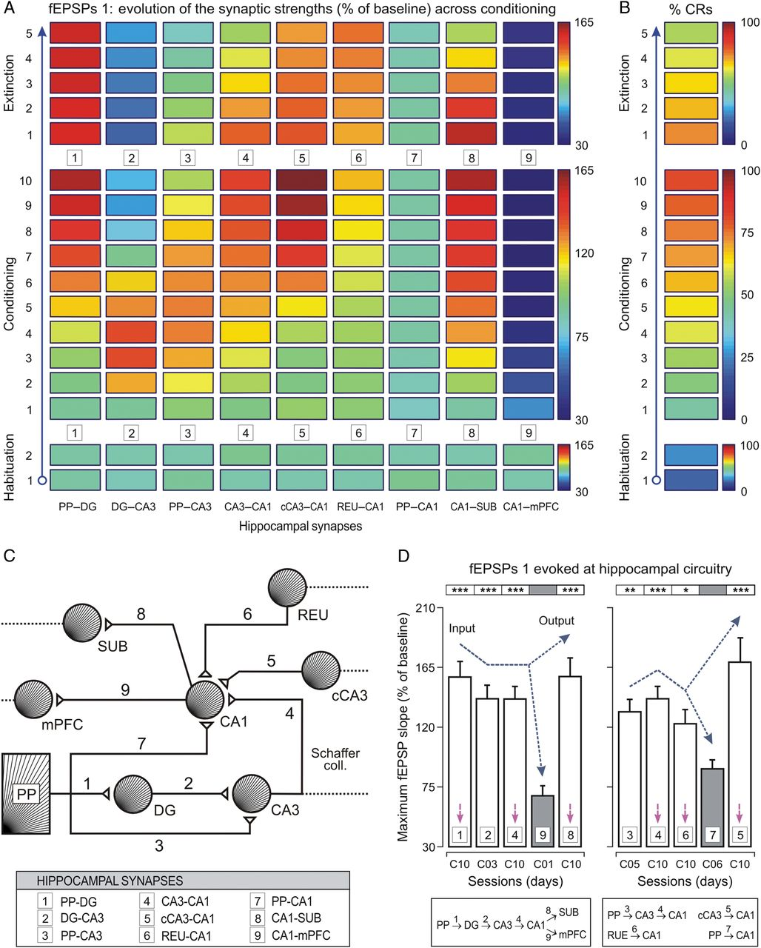
Figure 5. Synaptic-learning states (colored rectangles) and multiple-comparison analyses of their synaptic strengths. ...
Notes:
Figure 5. Synaptic-learning states (colored rectangles) and multiple-comparison analyses of their synaptic strengths. (A,B) Evolution of fEPSP slopes (as % of baseline, see A) collected at 9 hippocampal synapses, and CRs (% CRs, see B) across the successive training sessions. Selected synapses were: 1, perforant pathway (PP)–dentate gyrus (DG); 2, DG–CA3; 3, PP–CA3; 4, CA3–CA1; 5, contralateral CA3 (cCA3)–CA1; 6, thalamic reuniens nucleus (REU)–CA1; 7, PP–CA1; 8, CA1–subiculum (SUB); and 9, CA1–medial prefrontal cortex (mPFC). Note that some synapses increased in learning-dependent strength across training (PP–DG, CA3–CA1, cCA3–CA1, REU–CA1, and CA1–SUB), whilst for others their strengths increased at the beginning of the conditioning sessions and decreased at the end (DG–CA3, and PP–CA3), did not present any significant change (PP–CA1), or decreased across training (CA1–mPFC). See code color bars to the right of (A) and (B). (C) A diagram of hippocampal synapses included in this study, indicating their main input and output connections. (D) Mean values of maximum synaptic strength during learning for the 9 synapses. According to the statistical analyses, 4 synapses (1, 2, 4, and 8) presented maximum synaptic strengths significantly different [F4,36,45 = 11.70; P < 0.001] from those evoked by synapse 9 (left histogram). Note the potentiation [F1,19,18 = 30.37; P < 0.001] of synapse 8 in contrast to the inhibition of synapse 9 during the acquisition process. A similar analysis (right histogram) showed that synapses 3, 4, 6, and 5 presented significantly different [F4,36,45 = 6.22; P < 0.001] maximum synaptic strengths from those shown by synapse 7. However, synapses 1, 4, 5, and 8 presented similar synaptic strengths [F4,36,45 = 1.86; P > 0.05] at the asymptotic level (session C10, see magenta arrows) of the acquisition process. For the multiple-comparison analyses (Tukey's test) with respect to the synapses 9 (left histogram) and 7 (right histogram), the significance level is indicated (*, P < 0.05; **, P < 0.01; ***, P < 0.001). Error bars represent SEM.
Unless provided in the caption above, the following copyright applies to the content of this slide: © The Author 2014. Published by Oxford University Press. All rights reserved. For Permissions, please e-mail: journals.permissions@oup.com

Slide 6
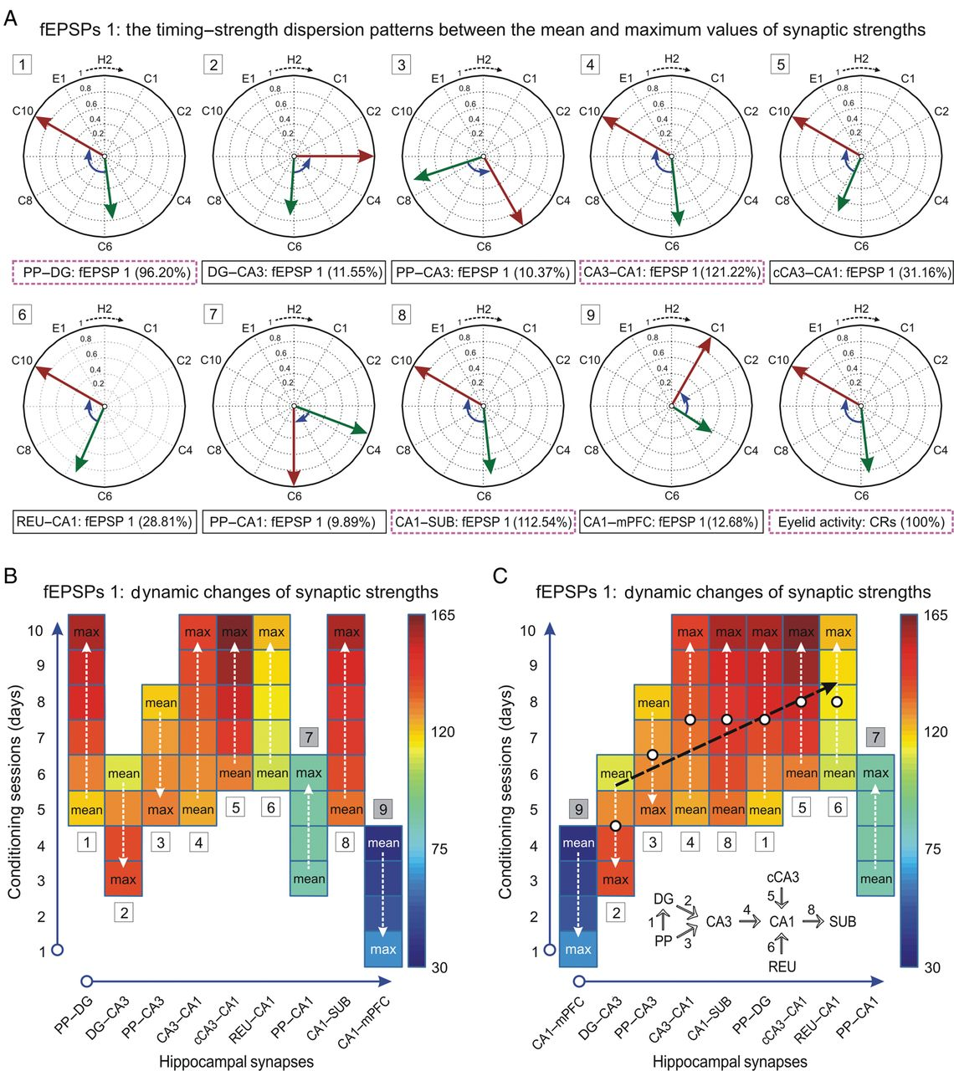
Figure 6. Evolution in timing and strength and functional organization of the 9 selected synapses across learning. (A) ...
Notes:
Figure 6. Evolution in timing and strength and functional organization of the 9 selected synapses across learning. (A) Timing–strength dispersion patterns between the mean (green arrows) and maximum (red arrows) values of synaptic strengths across conditioning. The normalized fEPSP slope determined the strength/magnitude of the vector, while the training session (H2, C1–C10, or E1) determined the timing/orientation of the vector. Three synapses showed a dispersion pattern similar [one way ANOVA F-test, F3,27,36 = 3.68; P > 0.01] to that of eyelid activity (% CRs, 100%; PP–DG, 96.20%; CA3–CA1, 121.22%; CA1–SUB, 112.54%), whilst other synapses (cCA3–CA1, 31.16%; REU–CA1, 28.81%; PP–CA1, 9.89%) presented smaller [one way ANOVA F-test, F3,27,36 = 341.91; P < 0.001] timing–strength dispersion patterns, and the synapses DG–CA3 (11.55%), PP–CA3 (10.37%), and CA1–mPFC (12.68%) showed smaller values [one way ANOVA F-test, F3,27,36 = 415.68; P < 0.001] of the dispersion indices but with angular displacements in opposite directions (see blue bent arrow inside each circumference). (B, C) Color map representations of synaptic strengths (fEPSP slopes, as % of baseline) between mean and maximum (max) values (white dashed arrows) for all the synapses. (B) Preliminary distribution of the 9 synapses according to anatomical criteria and connectivity (Fig. 5C). (C) Proposed functional distribution of synapses according to the timing–strength dispersion index for each synapse (σ¯s) (see eq. 1 and Supplementary Data), the RDI between 2 circular patterns (see eq. 2 and Supplementary Data), and the trend (see black dashed arrow) of the SEI (see eq. 3, Supplementary Data and Fig. 8) across synapses.
Unless provided in the caption above, the following copyright applies to the content of this slide: © The Author 2014. Published by Oxford University Press. All rights reserved. For Permissions, please e-mail: journals.permissions@oup.com

Slide 7
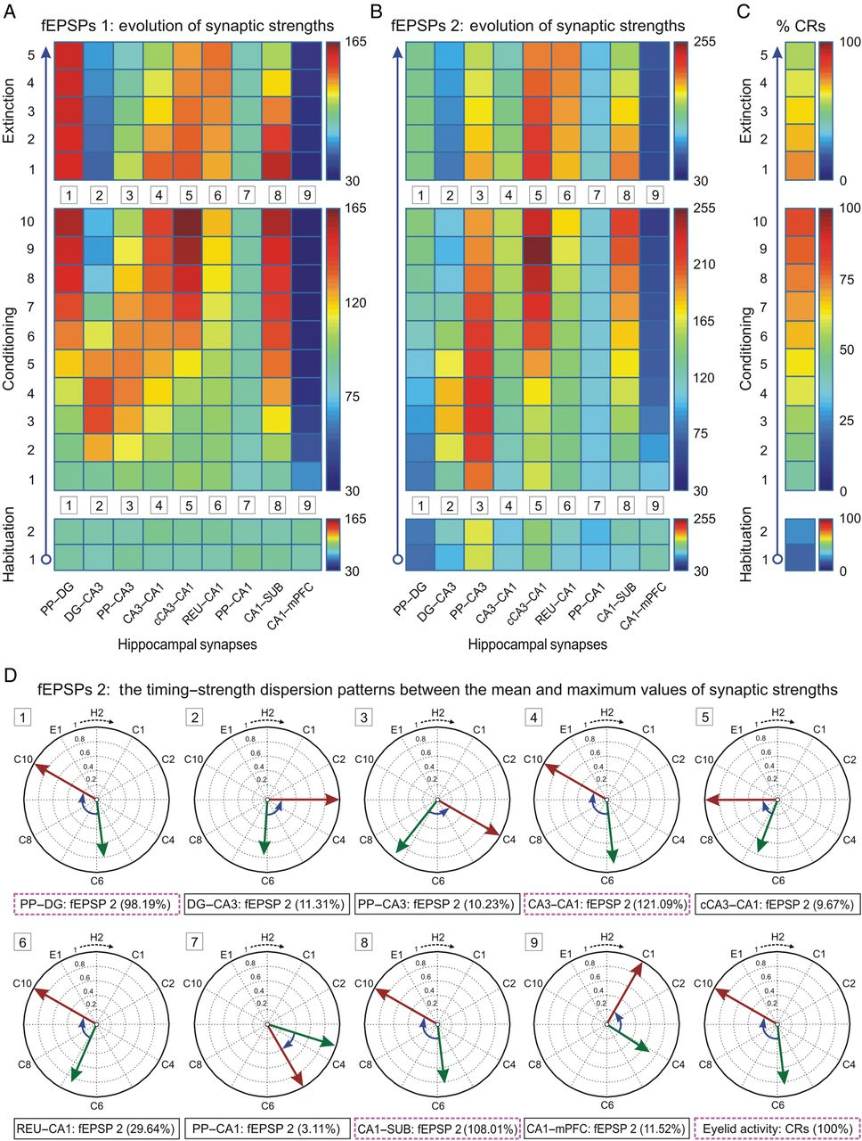
Figure 7. Synaptic-learning states (see the color rectangles) and their timing–strength synaptic evolutions. (A, B) ...
Notes:
Figure 7. Synaptic-learning states (see the color rectangles) and their timing–strength synaptic evolutions. (A, B) Evolution of the synaptic strengths (fEPSP slopes, as % of baseline) collected in the hippocampal circuit following a paired-pulse stimulation paradigm (first and second St.) during a trace eyeblink conditioning. Selected synapses were: perforant pathway (PP)–dentate gyrus (DG); DG–CA3; PP–CA3; CA3–CA1; contralateral CA3 (cCA3)–CA1; thalamic reuniens nucleus (REU)–CA1; PP–CA1; CA1–subiculum (SUB); and CA1–medial prefrontal cortices (mPFC). (C) Evolution of the percentage of conditioned responses (% CRs) across the successive habituation (n = 2), conditioning (n = 10), and extinction (n = 5) sessions. Colors correspond to the quantitative color bars to the right of the panels (A,B). (D) The timing–strength dispersion patterns between the mean (green arrow) and maximum (red arrow) values of synaptic strength (for the normalized fEPSPs 2) across 12 training sessions (H2, C1–C10, and E1). Three synapses showed a dispersion pattern similar [one-way ANOVA F-test, F3,27,36 = 1.92; P > 0.05] to that of the eyelid activity (% CRs, 100%; PP–DG, 98.19%; CA3–CA1, 121.09%; CA1–SUB, 108.01%), other synapses (cCA3–CA1, 9.67%; REU–CA1, 29.64%; PP–CA1, 3.11%) presented smaller [one-way ANOVA F-test, F3,27,36 = 436.49; P < 0.001] timing–strength dispersion patterns; and the synapses DG–CA3 (11.31%), PP–CA3 (10.23%), CA1–mPFC (11.52%) showed smaller values [one-way ANOVA F-test, F3,27,36 = 433.80; P < 0.001] of the dispersion indices (σ¯s, see eq. 1 and Supplementary Data; RDI, see eq. 2 and Supplementary Data) but with angular displacements in opposite directions (see blue bent arrows inside each circumference).
Unless provided in the caption above, the following copyright applies to the content of this slide: © The Author 2014. Published by Oxford University Press. All rights reserved. For Permissions, please e-mail: journals.permissions@oup.com

Slide 8
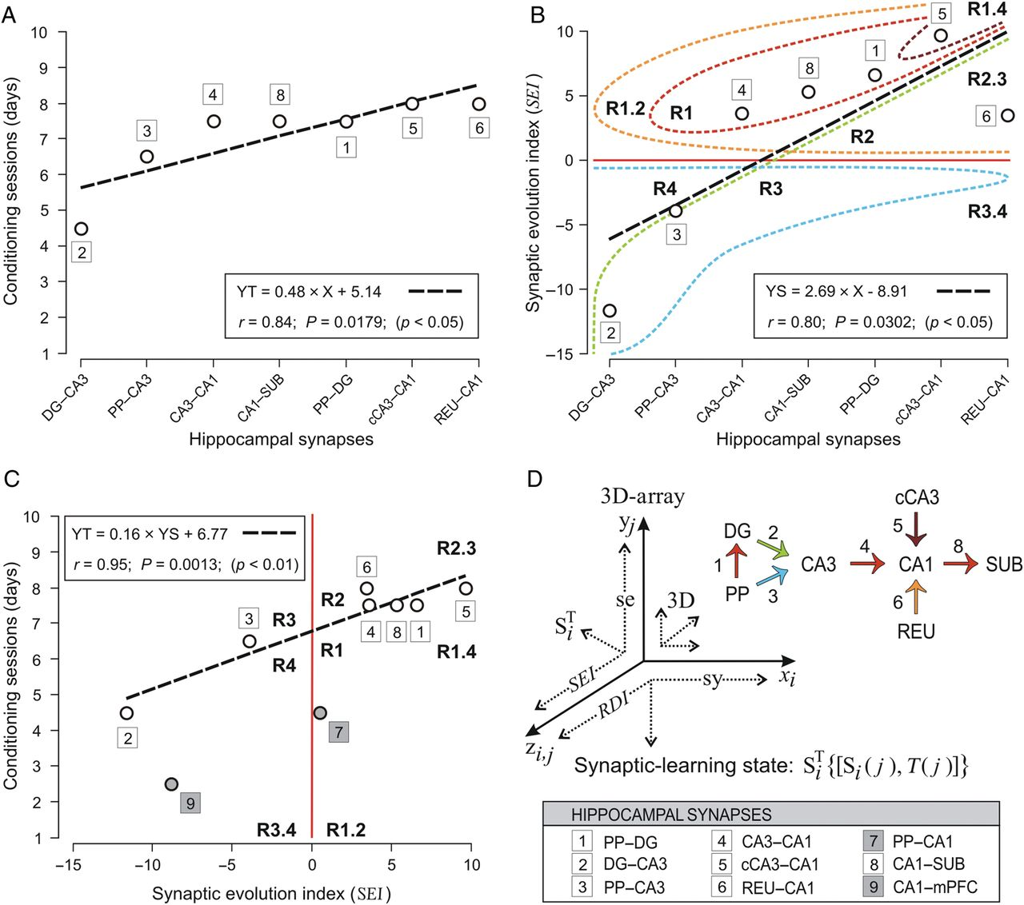
Figure 8. A 3D learning-dependent array constructed in accordance with the SEI. (A) The evolution of the mean timing ...
Notes:
Figure 8. A 3D learning-dependent array constructed in accordance with the SEI. (A) The evolution of the mean timing between the mean and maximum values of the synaptic strength (see black dashed arrow in Fig. 6C). (B) Trends of SEI in relation to the proposed functional distribution of the synapses (Fig. 6C). The color-dashed curves represent the contours of the different regions (R1–R4 and R1.2–R3.4) where the SEI values are distributed with respect to the zero reference line (in red) and the regression line (in black). (C) The regression analysis showed a strong dependence (r = 0.95; P < 0.01) between the mean timing and the SEI values. For all the regression analyses (in A–C) the linear equations, the correlation coefficients (r), and the significance levels (P) are indicated. (D) At the left is illustrated a 3D-array representing the synaptic-learning states. The proposed distribution of the synapses according to the SEI (in this order: 2, 3, 4, 8, 1, 5, and 6) allowed establishing an alternative model of functional connections (see the right diagram of connections) in the hippocampal circuit. The colors of the arrows in the diagram of connections correspond with those of the contours of the regions (in B).
Unless provided in the caption above, the following copyright applies to the content of this slide: © The Author 2014. Published by Oxford University Press. All rights reserved. For Permissions, please e-mail: journals.permissions@oup.com

