Slide 1
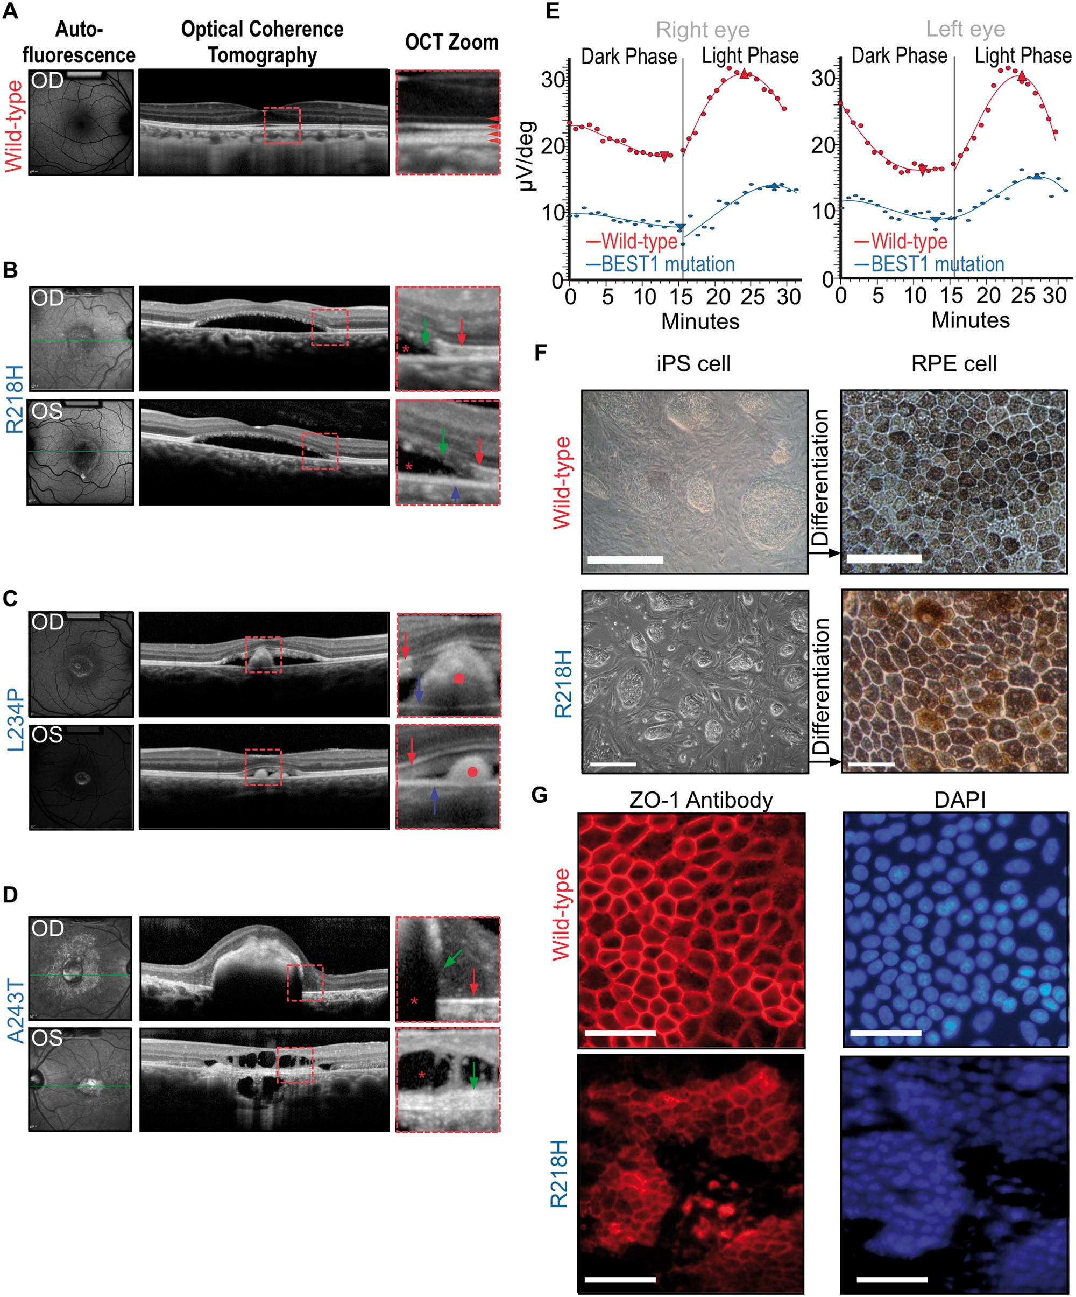
Figure 1. Human BEST1 mutations cause defective fluid transport in RPE and accumulation of serous fluid (*) in the ...
Notes:
Figure 1. Human BEST1 mutations cause defective fluid transport in RPE and accumulation of serous fluid (*) in the subretinal space with a defective EOG light peak. (A) Autofluorescence and optical coherence tomography (OCT) images from a normal eye. Red square shows zoomed in area (right panel). Red arrowheads point to the four distinct reflective bands of the outer retinal layers in a normal eye under OCT scan. From top to bottom: external limiting membrane—boundary between photoreceptor nuclei and inner segments; EZ (ellipsoid zone)—formed by mitochondria in the outer portion of photoreceptor inner segments; interdigitation zone—where photoreceptor outer segments (POSs) interface with the RPE; RPE (retinal pigmented epithelium). (B) Phenotypic manifestation in a 52-yo VMD patient with R218H mutation. Right (OD) and left (OS) eyes showed vitelliform lesions. The central photoreceptor layer is thin compared with that of a healthy control with a loss of integrity of the retinal bands, and serous fluid has developed subretinally in OCT imaging. Green arrows point to POS debris due to diseased RPE. Red arrows point to EZ. Blue arrow points to RPE layer. Red star marks the subretinal fluid accumulation. (C) Phenotypic manifestation in a 7-yo VMD patient with L234P mutation. Right and left eyes showed vitelliform lesions. Subretinal fluid and outer segment debris are visible in the SD-OCT images. Red circles mark POS debris due to diseased RPE. Red arrows point to EZ. Blue arrows point to RPE.(D) Phenotypic manifestation in a 61-yo VMD patient with A243T mutation; Photoreceptor bands have disintegrated at various points. Red star indicates subretinal fluid accumulation. Green arrows point to POS debris due to diseased RPE. Red arrow points to EZ (upper panel). (E) A reduction in EOG light rise is seen in BEST1 VMD. Light-rise of the EOG is generated by Cl− mediated depolarization of the basal membrane of the RPE. The graphs show mean EOG responses to light of a normal (red line) and a VMD patient with R218H mutation (blue line). The normal increase in electrical response to light began after ∼15 min and reached a peak after 25 min. In the mutant case, this light rise response is both attenuated and slower. (F) Characteristic light microscopy images of cultured iPSCs from a WT control (top panels) and from the R218H patient in A before differentiation (left), and the RPE cells derived from these iPS after 12 weeks of differentiation (right). Scale bar: 100 μm. (G) Characteristic RPE cultures from a WT control (top panels) and the R218H patient (bottom panels) immunolabeled for the epithelial specific tight junction marker ZO-1 (left) with a corresponding DAPI (nuclear) stain (right). Scale bar: 100 μm.
Unless provided in the caption above, the following copyright applies to the content of this slide: © The Author 2016. Published by Oxford University Press. All rights reserved. For permissions, please e-mail: journals.permissions@oup.com

Slide 2
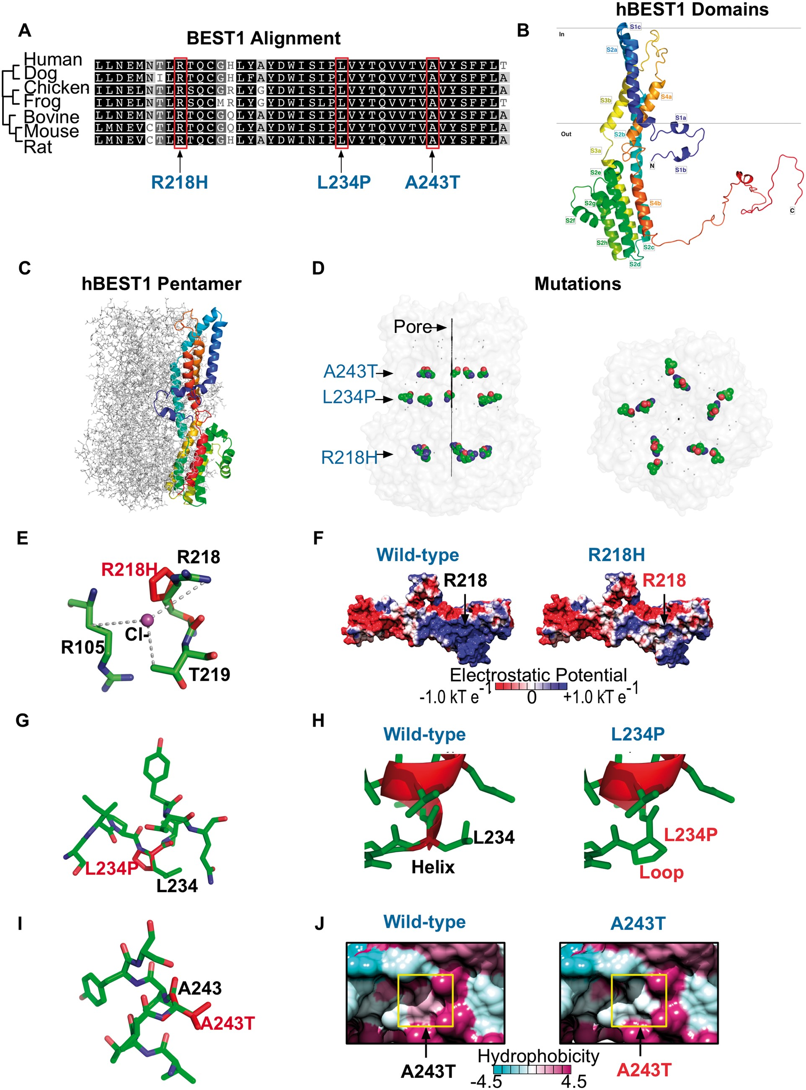
Figure 2. Modeling of VMD mutations on human bestrophin-1 structure. (A) Species sequence alignments of BEST1 shows ...
Notes:
Figure 2. Modeling of VMD mutations on human bestrophin-1 structure. (A) Species sequence alignments of BEST1 shows that the patient VMD mutations fell on conserved residues. (B) Homology model of hBEST1 generated using cBEST1 (PDB: 4RDQ) as a template. (C) Superimposition of the hBEST1 monomer on the channel pentamer. (D) Location of the patient VMD mutations in relationship to the channel pore. (E) Visualization of the putative Cl−-binding site in hBEST1 formed by the interface of R105, R218 and T219. The R218H mutation disrupts this binding site. (F) Electrostatic potential surfaces of the WT hBEST1 monomer and R218H hBEST1 reveal a change in positive to neutral potential in the residues surrounding the mutation. (G) Visualization of the location of L234P mutation in hBEST1. (H) Substitution of L234 with a proline would disrupt the secondary structure of the channel pore. Red represents helical residues while green represents residues that form disordered loops.(I) Visualization of the location of A243T mutation in hBEST1. (J) Hydrophobicity surface representations of the WT hBEST1 monomer and A243T mutant reveal a substitution of a hydrophobic residue to an uncharged, polar amino acid in a helix that is partially embedded in the membrane. The color scheme for the surface hydrophobicity is based on the Kyte and Doolittle scale.
Unless provided in the caption above, the following copyright applies to the content of this slide: © The Author 2016. Published by Oxford University Press. All rights reserved. For permissions, please e-mail: journals.permissions@oup.com

Slide 3
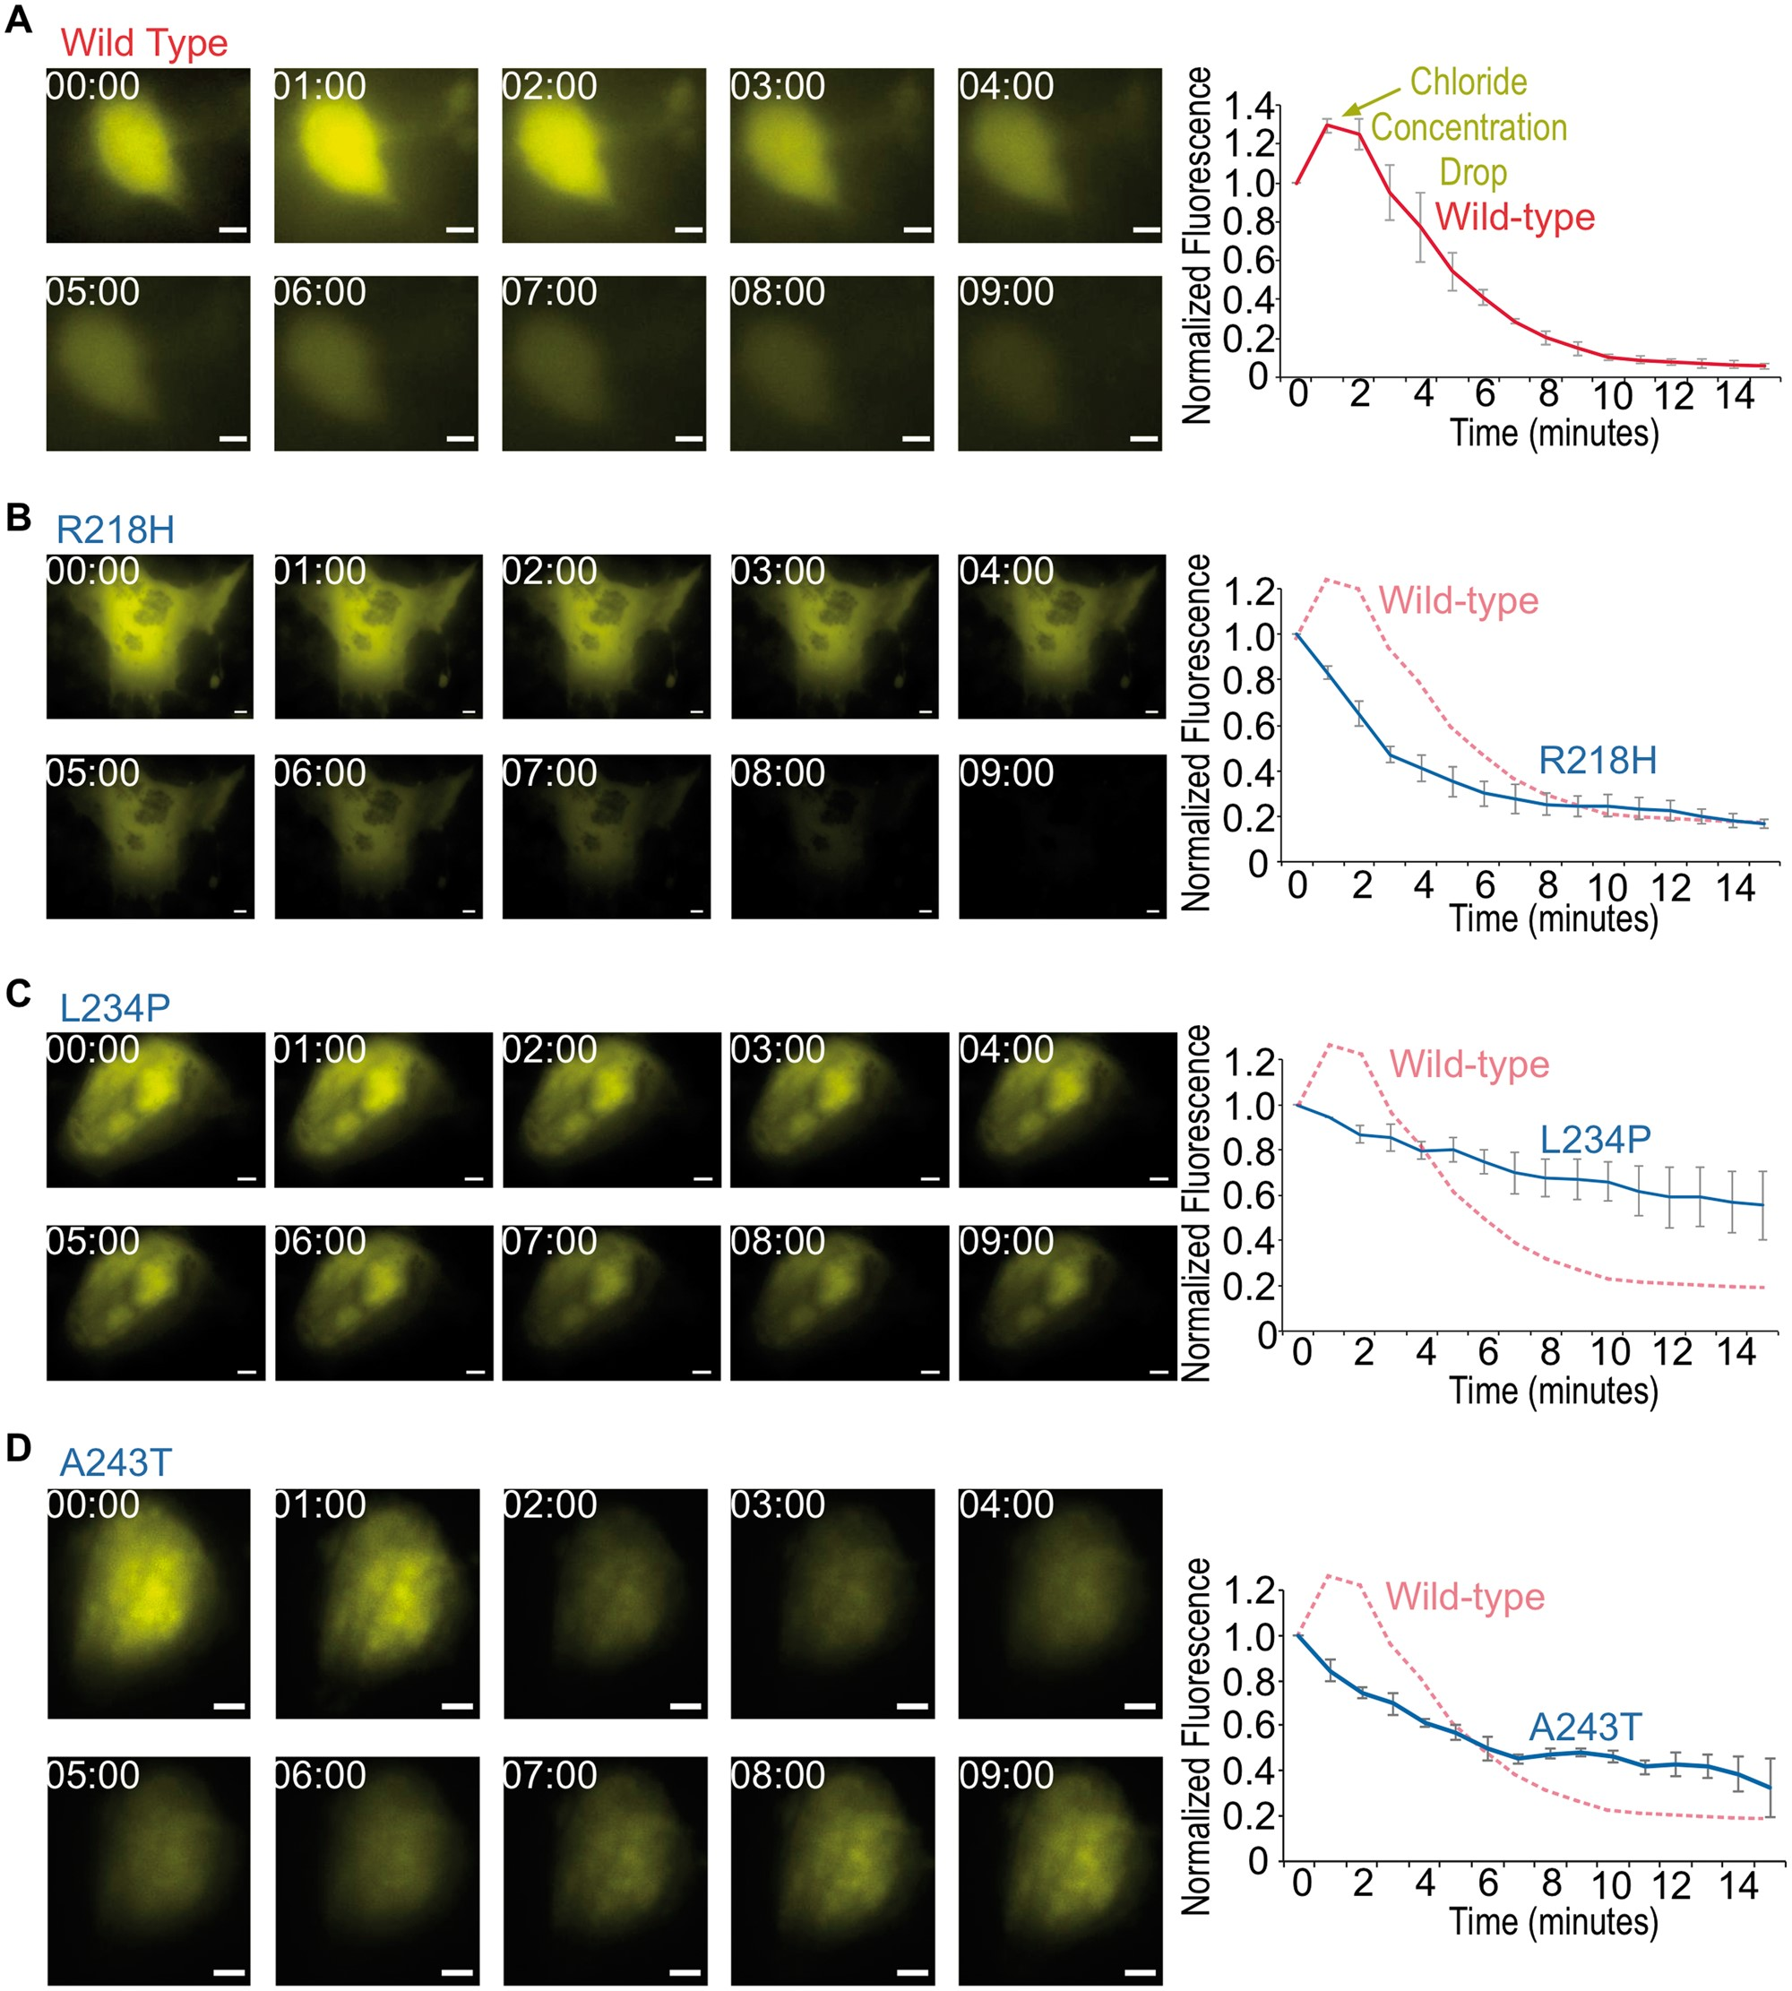
Figure 3. Defective Cl⁻ export in patient-specific iRPE revealed by biosensor imaging following calcium ...
Notes:
Figure 3. Defective Cl− export in patient-specific iRPE revealed by biosensor imaging following calcium release. Representative still images of WT (A), R218H (B), L234P (C) and A243T (D) patient-derived RPE cells expressing Cl− biosensor and stimulated with 5 μM A23187 (left panels). Images were acquired at the given time in minutes after stimulation. Quantification of mean whole-cell biosensor emission intensity, normalized to t = 0 time point (right graphs). Data are represented as mean ± Standard error of the mean. Scale bar = 5 μm.
Unless provided in the caption above, the following copyright applies to the content of this slide: © The Author 2016. Published by Oxford University Press. All rights reserved. For permissions, please e-mail: journals.permissions@oup.com

Slide 4
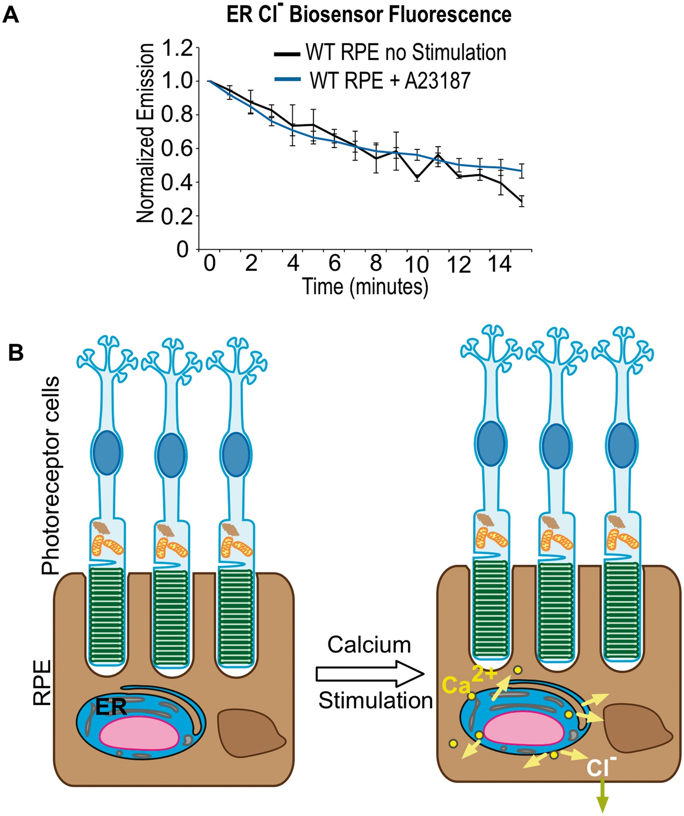
Figure 4. BEST1 Cl⁻ current does not pass through ER. (A) Biosensor imaging of ER Cl⁻ currents. ...
Notes:
Figure 4. BEST1 Cl− current does not pass through ER. (A) Biosensor imaging of ER Cl− currents. Quantification of mean biosensor emission from WT RPE cells. Cl− biosensor was targeted to the ER and cells were imaged with and without A23187 stimulation. No significant change in Cl− ions was found in the ER. (B) Model of bestrophin-mediated Cl− current in RPE cells. Light induced activation of MerTK results in the generation of inositol-1,4,5-trisphosphate which triggers Ca2+ release from ER stores (pink arrows) and Cl− ion outflux (blue arrow).
Unless provided in the caption above, the following copyright applies to the content of this slide: © The Author 2016. Published by Oxford University Press. All rights reserved. For permissions, please e-mail: journals.permissions@oup.com

