Slide 1
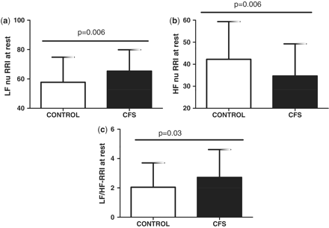
Figure 1 HRV at rest. (a) LF-nu RRI (sympathetic) is significantly increased while (b) HF-nu RRI (parasympathetic) is ...
Notes:
Figure 1 HRV at rest. (a) LF-nu RRI (sympathetic) is significantly increased while (b) HF-nu RRI (parasympathetic) is reduced and the (c) sympathetic–vagal balance is significantly increased.
Unless provided in the caption above, the following copyright applies to the content of this slide: © The Author 2012. Published by Oxford University Press on behalf of the Association of Physicians. All rights reserved. For Permissions, please email: journals.permissions@oup.com

Slide 2
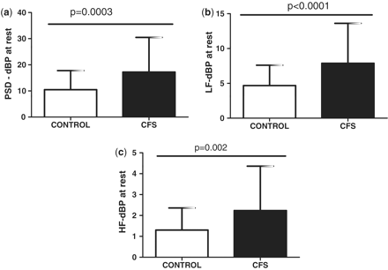
Figure 2 DBPV at rest. (a) Total DBP PSD is significantly higher at rest in CFS; this is due to an increase in both ...
Notes:
Figure 2 DBPV at rest. (a) Total DBP PSD is significantly higher at rest in CFS; this is due to an increase in both (b) LF DBPV and (c) HF DBPV.
Unless provided in the caption above, the following copyright applies to the content of this slide: © The Author 2012. Published by Oxford University Press on behalf of the Association of Physicians. All rights reserved. For Permissions, please email: journals.permissions@oup.com

Slide 3
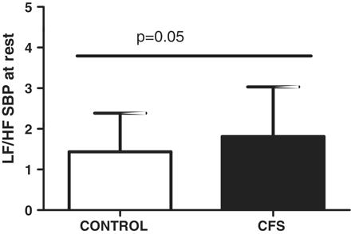
Figure 3 The balance between LF and HF SBPV at rest is significantly increased in CFS compared to controls.
Notes:
Figure 3 The balance between LF and HF SBPV at rest is significantly increased in CFS compared to controls.
Unless provided in the caption above, the following copyright applies to the content of this slide: © The Author 2012. Published by Oxford University Press on behalf of the Association of Physicians. All rights reserved. For Permissions, please email: journals.permissions@oup.com

Slide 4
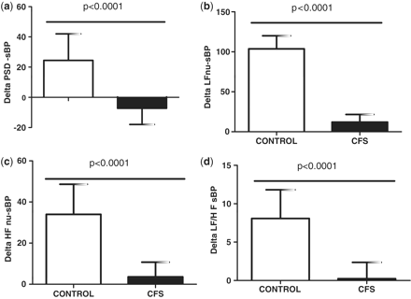
Figure 4 Change in SBPV on standing. (a) Total PSD SBPV responses significantly less well on standing in CFS compared ...
Notes:
Figure 4 Change in SBPV on standing. (a) Total PSD SBPV responses significantly less well on standing in CFS compared to controls; this comprises reductions in both LF SBPV (b) and HF SBPV (c), although the balance is significantly reduced (d).
Unless provided in the caption above, the following copyright applies to the content of this slide: © The Author 2012. Published by Oxford University Press on behalf of the Association of Physicians. All rights reserved. For Permissions, please email: journals.permissions@oup.com

Slide 5
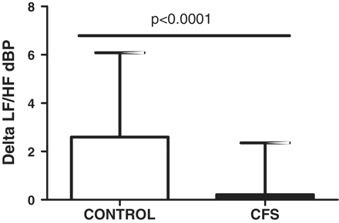
Figure 5 Change in the sympathetic–vagal (LF/HF) balance of DBPV on standing is significantly reduced compared to ...
Notes:
Figure 5 Change in the sympathetic–vagal (LF/HF) balance of DBPV on standing is significantly reduced compared to controls.
Unless provided in the caption above, the following copyright applies to the content of this slide: © The Author 2012. Published by Oxford University Press on behalf of the Association of Physicians. All rights reserved. For Permissions, please email: journals.permissions@oup.com

Slide 6
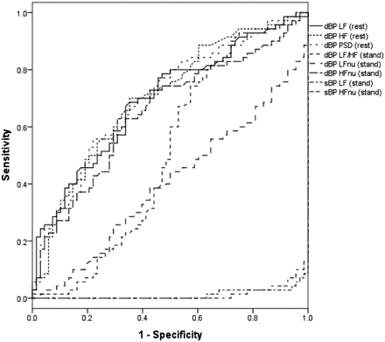
Figure 6 ROC analysis of variables at rest from which the 85% thresholds have been derived. The variables at rest have ...
Notes:
Figure 6 ROC analysis of variables at rest from which the 85% thresholds have been derived. The variables at rest have greater validity than those in response to standing, and hence these parameters were incorporated into the biomarker model.
Unless provided in the caption above, the following copyright applies to the content of this slide: © The Author 2012. Published by Oxford University Press on behalf of the Association of Physicians. All rights reserved. For Permissions, please email: journals.permissions@oup.com

