Slide 1
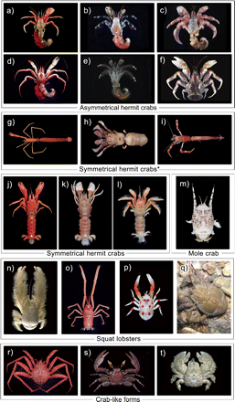
FIGURE 1. Body forms and morphological diversity of Anomura. a) Bathypaguropsis kuroshioensis (Paguridae). b) Calcinus ...
Notes:
FIGURE 1. Body forms and morphological diversity of Anomura. a) Bathypaguropsis kuroshioensis (Paguridae). b) Calcinus elegans (Diogenidae). c) Coenobita rugosus (Coenobitidae). d) Sympagurus burkenroadi (Parapaguridae). e) Clibanarius virescens (Diogenidae). f) Birgus latro (Coenobitidae). g) Xylopagurus philippinensis (Paguridae). h) Cancellis panglaoensis (Diogenidae). i) Tsunogaipagurus chuni (Parapaguridae). j) Xylocheles macrops (Pylochelidae: Pylochelinae). k) Pylocheles mortensenii (Pylochelidae). l) Trizocheles sakaii (Pylochelidae). m) Hippa marmorata (Hippidae). n) Kiwa hirsuta (Kiwaidae). o) Uroptychus orientalis (Chirostylidae). p) Galathea rubromaculata (Galatheidae). q) Aegla neuquensis (Aeglidae). r) Neolithodes nipponensis (Lithodidae). s) Petrolisthes coccineus (Porcellanidae). t) Lomis hirta (Lomisidae). * These hermit crabs belong to the families predominately having asymmetrical abdomen and possess asymmetrical pleopods and uropods, in spite of their symmetrical abdomen.
Unless provided in the caption above, the following copyright applies to the content of this slide: © The Author(s) 2011. Published by Oxford University Press, on behalf of the Society of Systematic Biologists.

Slide 2
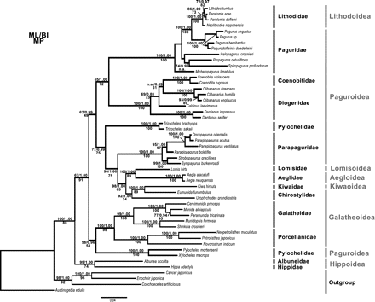
FIGURE 2. Bayesian consensus topology of the combined five-gene data set partitioned by gene. Nodal supports are ...
Notes:
FIGURE 2. Bayesian consensus topology of the combined five-gene data set partitioned by gene. Nodal supports are denoted on the corresponding branches and values under 50 (for MP and ML) or 0.5 (for BI) are represented by “n.a.”. The superfamily and family classifications are denoted by the grey and black bars at the right, respectively.
Unless provided in the caption above, the following copyright applies to the content of this slide: © The Author(s) 2011. Published by Oxford University Press, on behalf of the Society of Systematic Biologists.

Slide 3
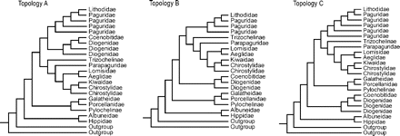
FIGURE 3. The three topologies resulting from the phylogenetic analyses under different partition schemes in the ...
Notes:
FIGURE 3. The three topologies resulting from the phylogenetic analyses under different partition schemes in the present study. Only the family/subfamily names are presented in the diagram for ease of comparison. Please refer to Supplementary Material for the detailed phylogeny and nodal supports.
Unless provided in the caption above, the following copyright applies to the content of this slide: © The Author(s) 2011. Published by Oxford University Press, on behalf of the Society of Systematic Biologists.

Slide 4
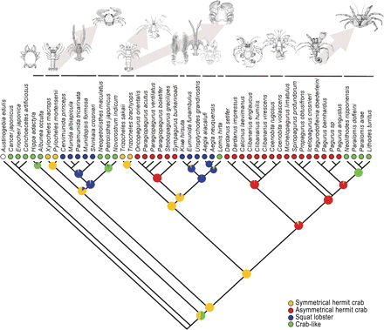
FIGURE 4. Maximum likelihood ancestral state reconstruction of the different body forms of the anomuran lineages based ...
Notes:
FIGURE 4. Maximum likelihood ancestral state reconstruction of the different body forms of the anomuran lineages based on the Bayesian consensus tree (partition by gene). The relative likelihoods of alternative ancestral states are indicated by pie charts on the corresponding nodes. The circles below the species names indicate the body form of the species and the bars above encompass members of the same family. The sketches are representatives of the corresponding families but may not illustrate the species examined in the present study. The arrows indicate the inferred direction of evolution in body form among the families.
Unless provided in the caption above, the following copyright applies to the content of this slide: © The Author(s) 2011. Published by Oxford University Press, on behalf of the Society of Systematic Biologists.

Slide 5
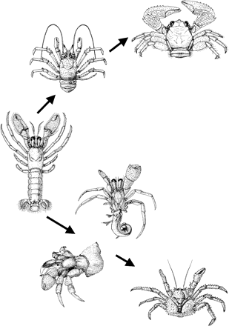
FIGURE 5. Schematic representation of stages of carcinization starting from a symmetrical hermit crab form ...
Notes:
FIGURE 5. Schematic representation of stages of carcinization starting from a symmetrical hermit crab form (Pylochelidae) leading to crab-like forms via different pathways. Upper path, via squat lobster form (e.g., Galatheidae) to crab-like form (e.g., Porcellanidae). Lower path, via asymmetrical hermit crab form (e.g., Diogenidae, Paguridae) to crab-like form (e.g., Lithodidae).
Unless provided in the caption above, the following copyright applies to the content of this slide: © The Author(s) 2011. Published by Oxford University Press, on behalf of the Society of Systematic Biologists.

