Slide 1
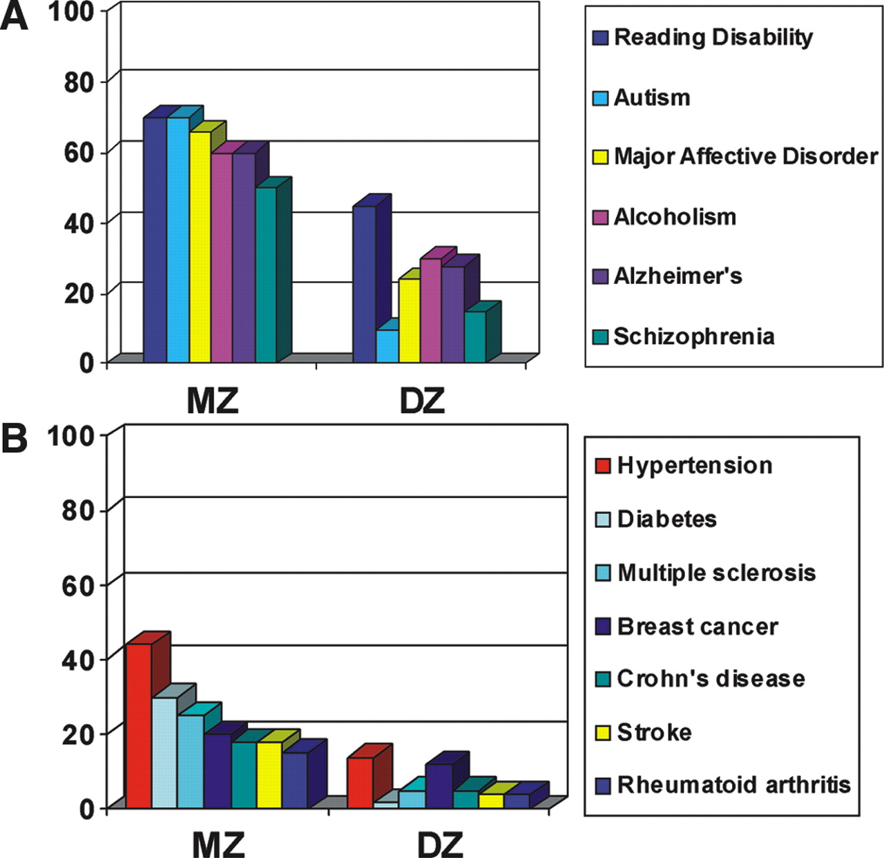
Figure 1. The MZ and DZ concordance rates for (A) some common behavioral (5–7,60–63) and (B) medical ...
Notes:
Figure 1. The MZ and DZ concordance rates for (A) some common behavioral (5–7,60–63) and (B) medical disorders (64–70). The concordance rates (%) shown are an approximate mid-range value derived from multiple reported figures.
Unless provided in the caption above, the following copyright applies to the content of this slide: © The Author 2005. Published by Oxford University Press. All rights reserved. For Permissions, please email: journals.permissions@oupjournals.org

Slide 2
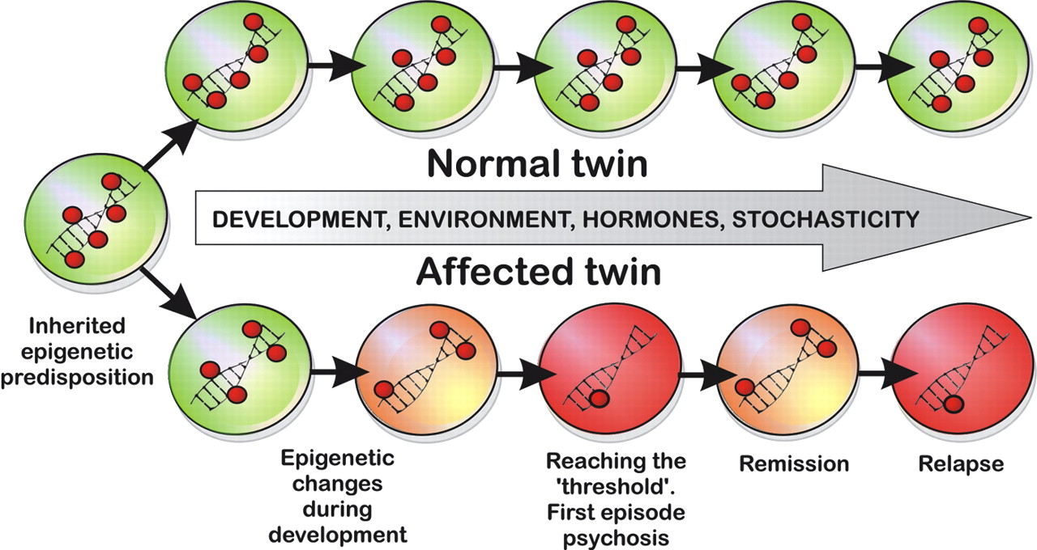
Figure 2. Epigenetic model of MZ twin discordance in complex disease, e.g. schizophrenia. Red circles ...
Notes:
Figure 2. Epigenetic model of MZ twin discordance in complex disease, e.g. schizophrenia. Red circles represent methylated cytosines. From the epigenetic point of view, phenotypic disease differences in MZ twins result from their epigenetic differences. Due to the partial stability of epigenetic signals, a substantial degree of epigenetic dissimilarity can be accumulated over millions of mitotic divisions of cells of MZ co-twins. Although the figure shows that disease is caused by gene hypomethylation, scenarios where pathological condition is associated with gene hypermethylation are equally possible.
Unless provided in the caption above, the following copyright applies to the content of this slide: © The Author 2005. Published by Oxford University Press. All rights reserved. For Permissions, please email: journals.permissions@oupjournals.org

Slide 3
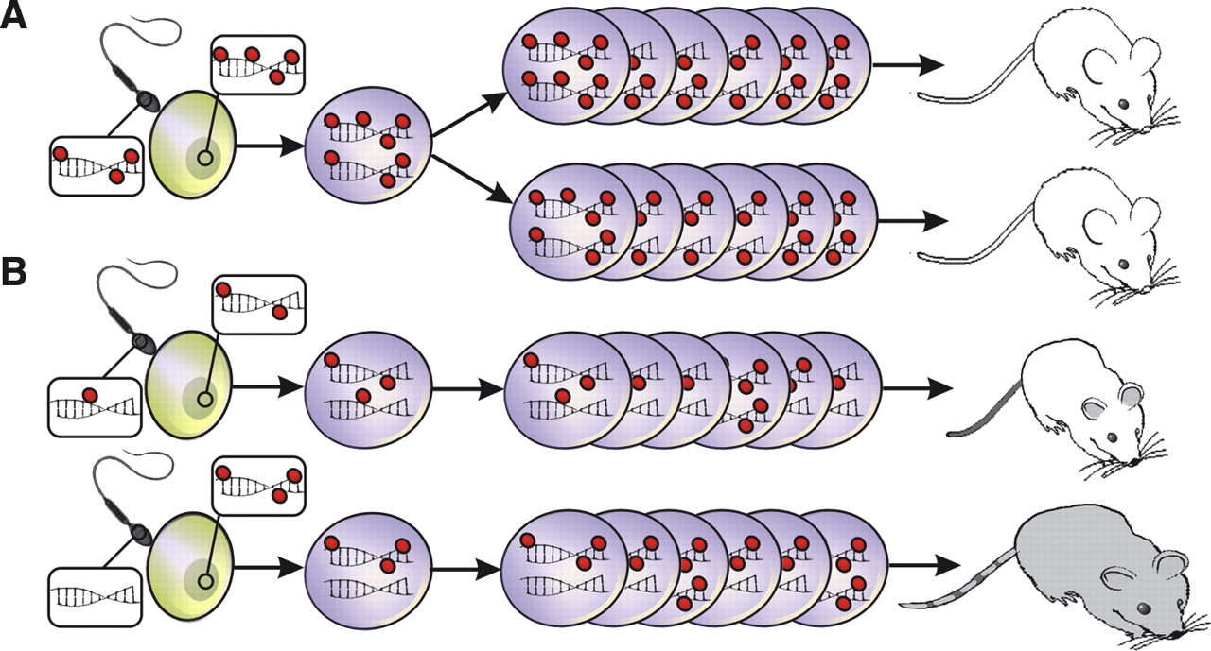
Figure 3. Epigenetic interpretation of Gartner's ‘third component’. Phenotypic differences in MZ isogenic ...
Notes:
Figure 3. Epigenetic interpretation of Gartner's ‘third component’. Phenotypic differences in MZ isogenic animals (A) and DZ isogenic animals (B) can be explained by epigenetic variation in the germline. MZ animals derive from the same zygote and therefore their epigenetic ‘starting point’ is identical, whereas DZ animals originate from different sperm and oocytes that may carry quite different epigenomic profiles. As in Figure 2, red circles represent methyl groups attached to cytosines.
Unless provided in the caption above, the following copyright applies to the content of this slide: © The Author 2005. Published by Oxford University Press. All rights reserved. For Permissions, please email: journals.permissions@oupjournals.org

