Slide 1
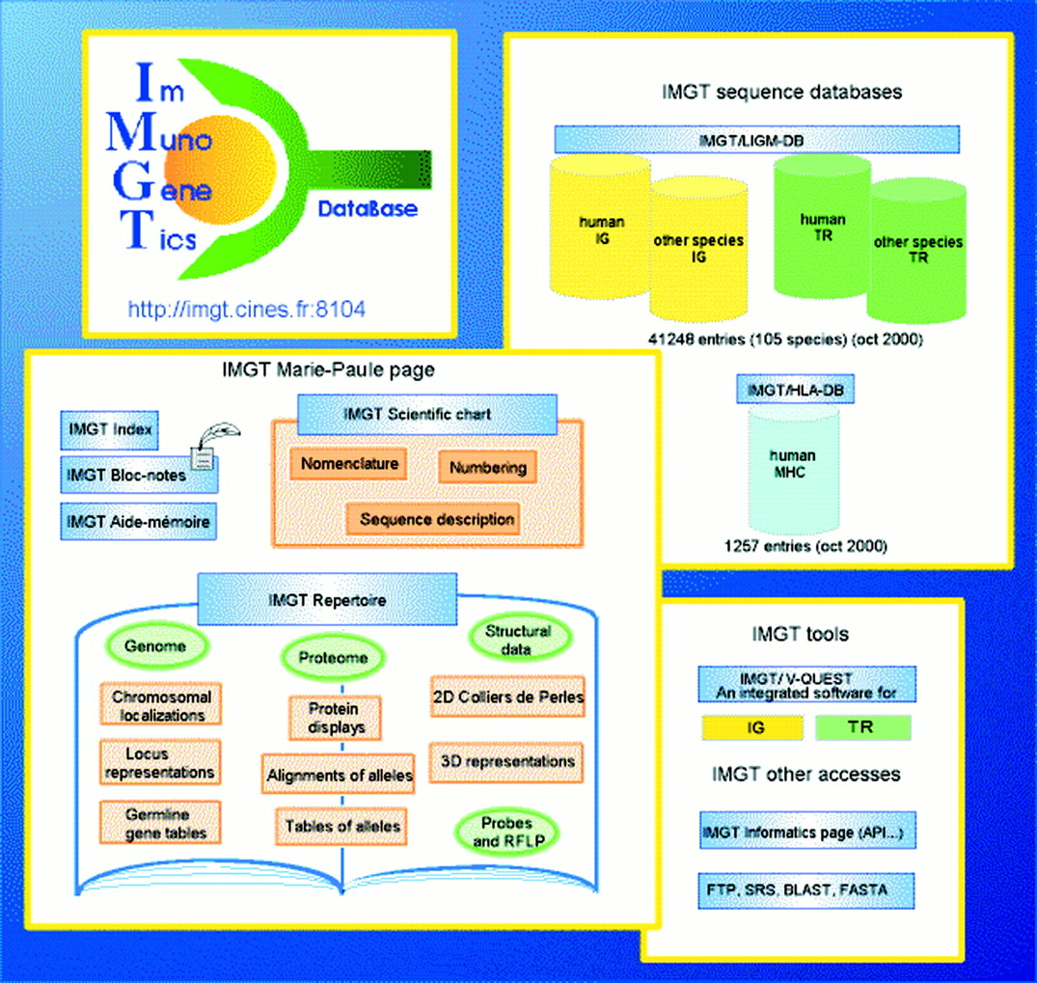
Figure 1. Overview of the IMGT information system.
Notes:
Figure 1. Overview of the IMGT information system.
Unless provided in the caption above, the following copyright applies to the content of this slide:

