Slide 1
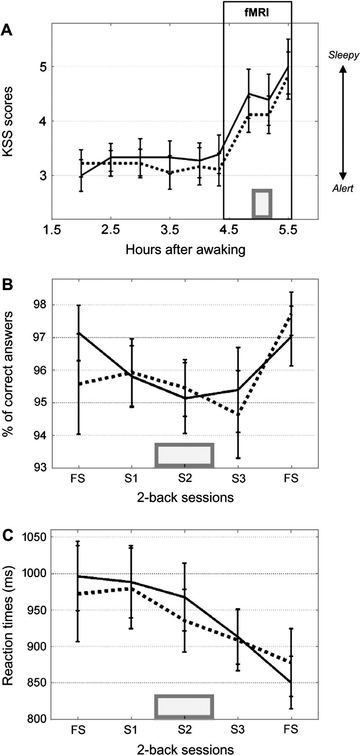
Figure 2. Behavioral results. Solid line, blue light condition; dotted line, green light condition; gray rectangle, ...
Notes:
Figure 2. Behavioral results. Solid line, blue light condition; dotted line, green light condition; gray rectangle, light exposure period. (A) Mean KSS scores (±standard error of the mean [SEM]). Box: fMRI period. Time relative to scheduled wake time (hours). (B) Mean accuracy (±SEM). S1–S3: 2-back sessions 1–3. (C) Mean reaction times (±SEM). S1–S3: 2-back sessions 1–3. FS, flanking sessions.
Unless provided in the caption above, the following copyright applies to the content of this slide: © The Author 2007. Published by Oxford University Press. All rights reserved. For permissions, please e-mail: journals.permissions@oxfordjournals.org

Slide 2
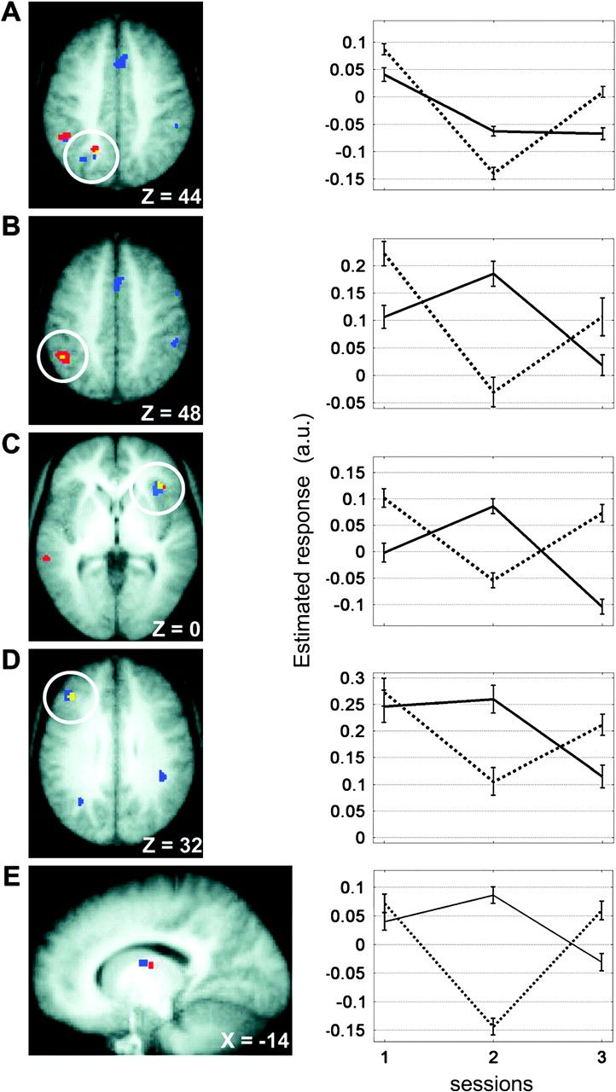
Figure 3. Comparison of the brain modulations observed during blue light condition (470 nm) and green light condition ...
Notes:
Figure 3. Comparison of the brain modulations observed during blue light condition (470 nm) and green light condition (550 nm). (A) Left IPS; (B) left supramarginal gyrus; (C) right insula; (D) left MFG; (E) left thalamus. Left panels: responses are displayed over the mean structural image of all subjects (Puncorrected green) by session (2 > 1) interaction is displayed in red. The light condition by session (2 > 3) interaction is displayed in blue. Overlaps are in yellow. Right panels: mean parameter estimates in the first, second, and third sessions (arbitrary units ± standard error of the mean). Solid line, blue light day; dotted line, green light day.
Unless provided in the caption above, the following copyright applies to the content of this slide: © The Author 2007. Published by Oxford University Press. All rights reserved. For permissions, please e-mail: journals.permissions@oxfordjournals.org

Slide 3
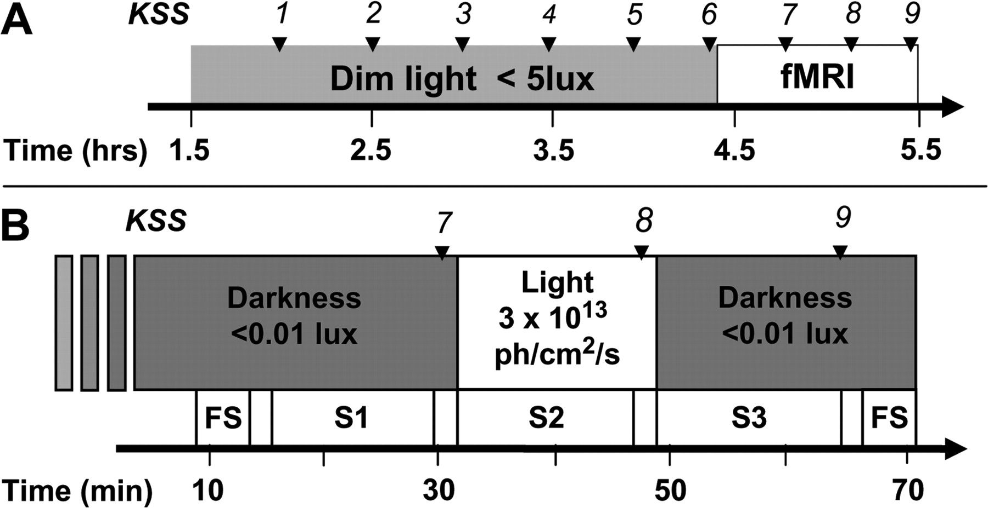
Figure 1. Experimental design. (A) General time line. Time relative to scheduled wake time (hours). Arrows: subjective ...
Notes:
Figure 1. Experimental design. (A) General time line. Time relative to scheduled wake time (hours). Arrows: subjective sleepiness assessment (KSS 1–9). (B) Time line of the fMRI period. S1–S3, 2-back sessions 1–3; FS, flanking sessions. Time in minutes after entering the scanner. Arrows: subjective sleepiness assessment (KSS 7–9).
Unless provided in the caption above, the following copyright applies to the content of this slide: © The Author 2007. Published by Oxford University Press. All rights reserved. For permissions, please e-mail: journals.permissions@oxfordjournals.org

