Slide 1
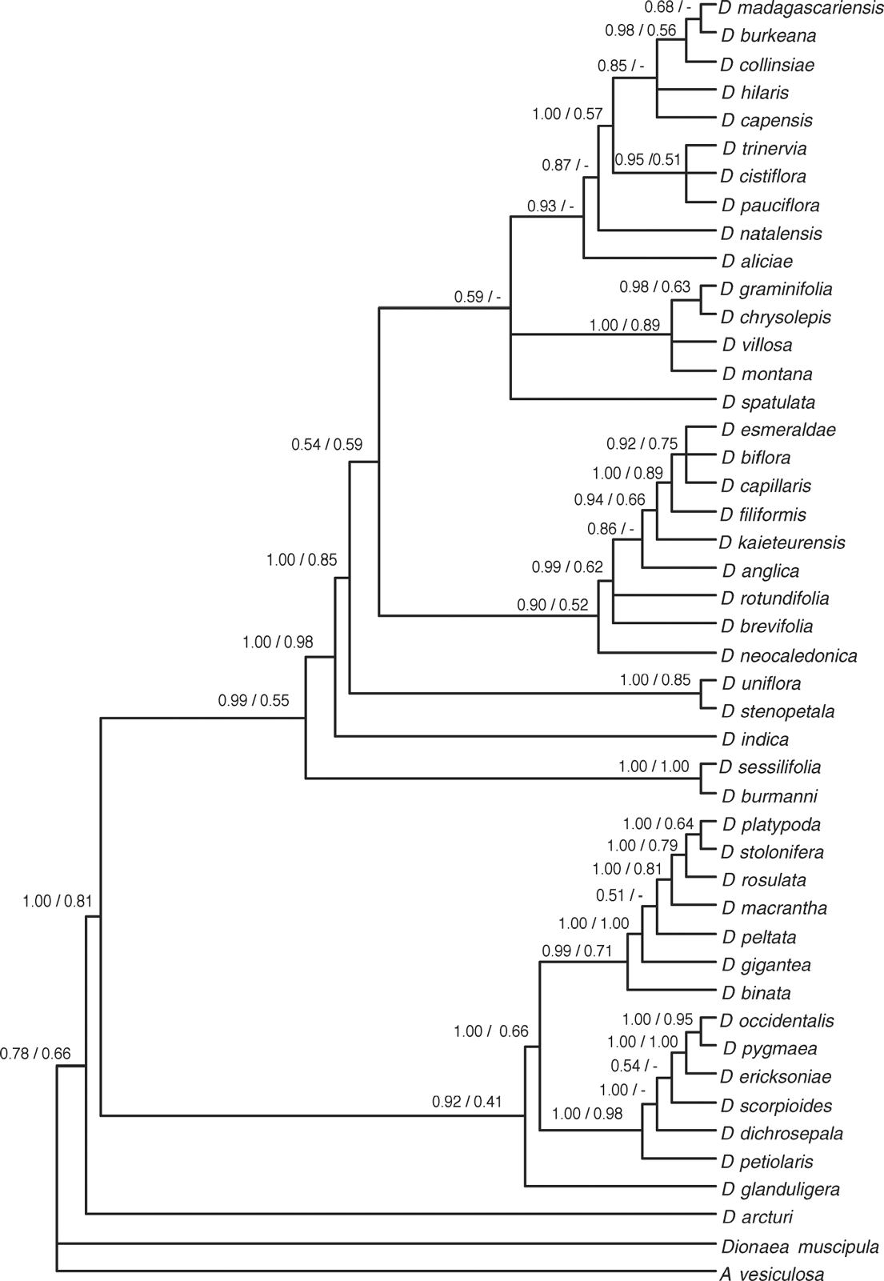
Figure 1 Majority rule consensus tree of Bayesian replicates (using sumt command in MrBayes). Posterior probabilities ...
Notes:
Figure 1 Majority rule consensus tree of Bayesian replicates (using sumt command in MrBayes). Posterior probabilities displayed at nodes before “/”. Bootstrap support displayed after. Bootstrap replicates calculated in PAUP* using 100,000 replicates using the “fast” stepwise addition.
Unless provided in the caption above, the following copyright applies to the content of this slide: © 2006 Society of Systematic BiologistsThis article is published and distributed under the terms of the Oxford University Press, Standard Journals Publication Model (https://academic.oup.com/journals/pages/open_access/funder_policies/chorus/standard_publication_model)

Slide 2
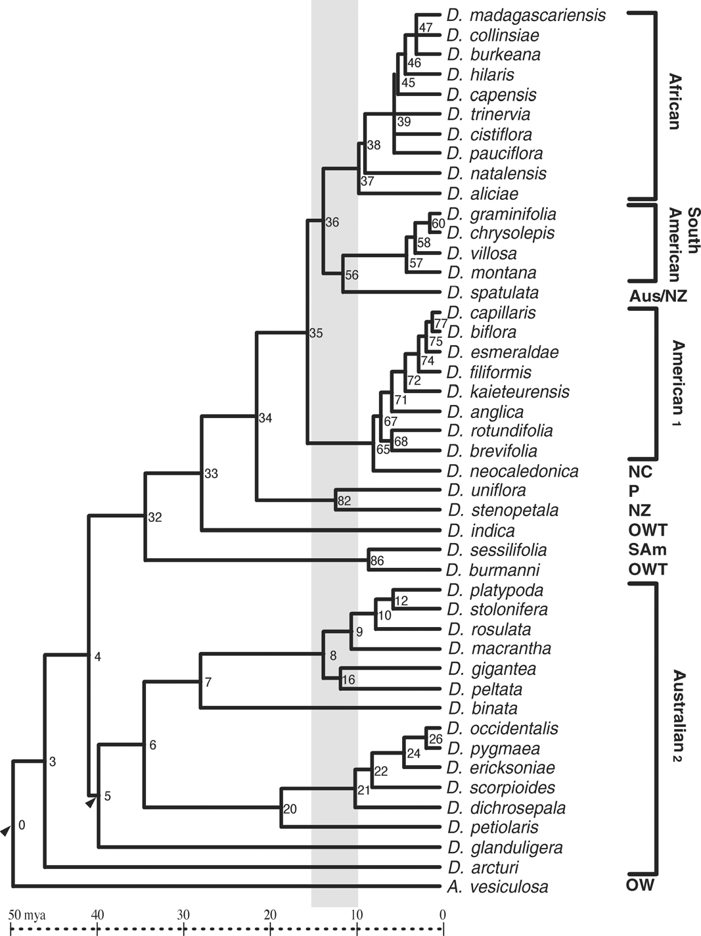
Figure 2 Chronogram of one of the optimal Bayesian replicates. This is also the topology used to construct the ...
Notes:
Figure 2 Chronogram of one of the optimal Bayesian replicates. This is also the topology used to construct the bootstrap replicates. Numbers at internal nodes refer to Table 3. Arrows indicate fossil calibration points. Some node ages on this tree are outside the 95% confidence intervals of Table 3. The grey bar shows 15 to 10 Mya origin of Mediterranean climate. Distribution is indicated for several clades (Note 1: D. anglica and D. rotundifolia are widespread throughout the northern hemisphere; Note 2: D. peltata has Australasian and East Asian distribution, D. pygmaea and D. arcturi also in New Zealand). Aus = Australia; NC = New Caledonia; P = Patagonia; NZ = New Zealand; OW = Old World; OWT = Old World Tropics and Australia; SAm = South America.
Unless provided in the caption above, the following copyright applies to the content of this slide: © 2006 Society of Systematic BiologistsThis article is published and distributed under the terms of the Oxford University Press, Standard Journals Publication Model (https://academic.oup.com/journals/pages/open_access/funder_policies/chorus/standard_publication_model)

Slide 3
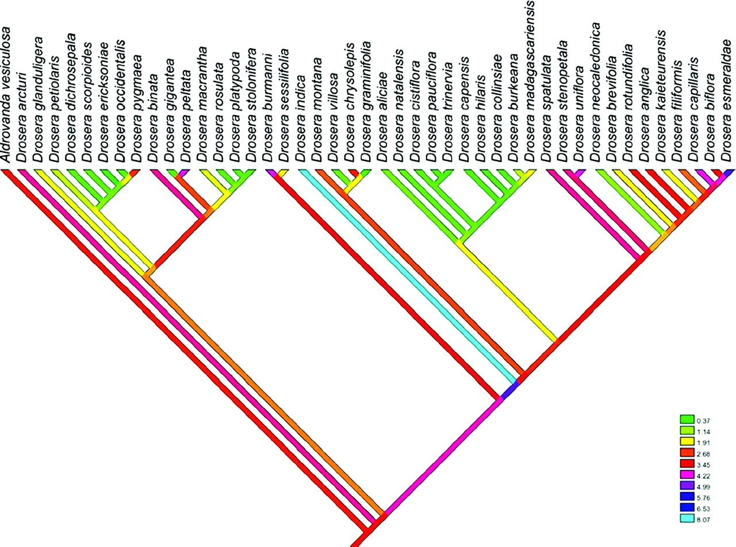
Figure 3 Continuous square change parsimony optimization of the maximum range of mean daily precipitation in the ...
Notes:
Figure 3 Continuous square change parsimony optimization of the maximum range of mean daily precipitation in the driest month. Optimization in Mesquite. QVI = 0.36.
Unless provided in the caption above, the following copyright applies to the content of this slide: © 2006 Society of Systematic BiologistsThis article is published and distributed under the terms of the Oxford University Press, Standard Journals Publication Model (https://academic.oup.com/journals/pages/open_access/funder_policies/chorus/standard_publication_model)

Slide 4
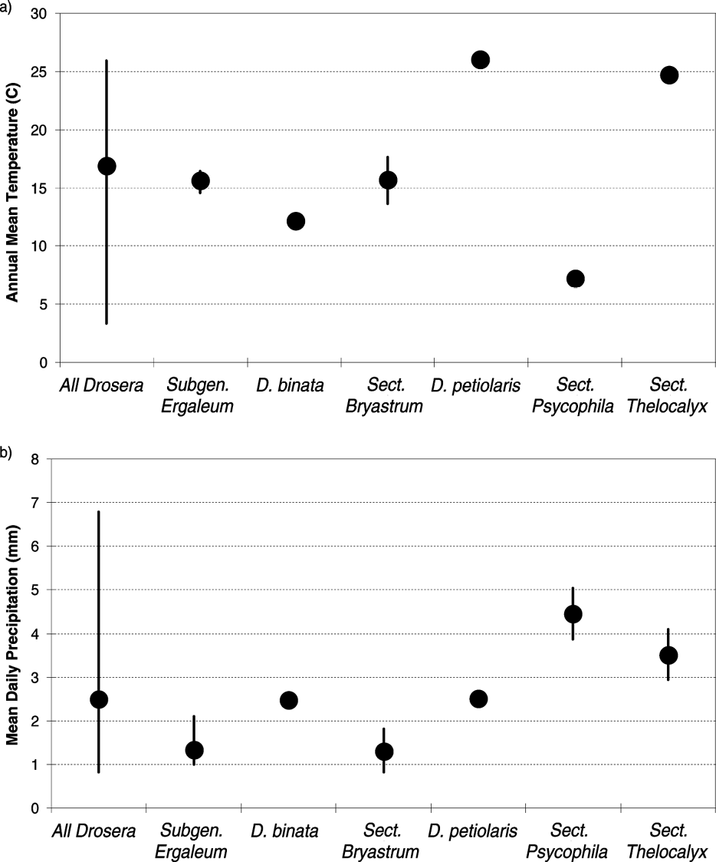
Figure 4 Mean annual temperature (a) and daily precipitation (b) for selected groups of extant taxa. Lines show range ...
Notes:
Figure 4 Mean annual temperature (a) and daily precipitation (b) for selected groups of extant taxa. Lines show range of values within the groups, dots show mean of group.
Unless provided in the caption above, the following copyright applies to the content of this slide: © 2006 Society of Systematic BiologistsThis article is published and distributed under the terms of the Oxford University Press, Standard Journals Publication Model (https://academic.oup.com/journals/pages/open_access/funder_policies/chorus/standard_publication_model)

Slide 5
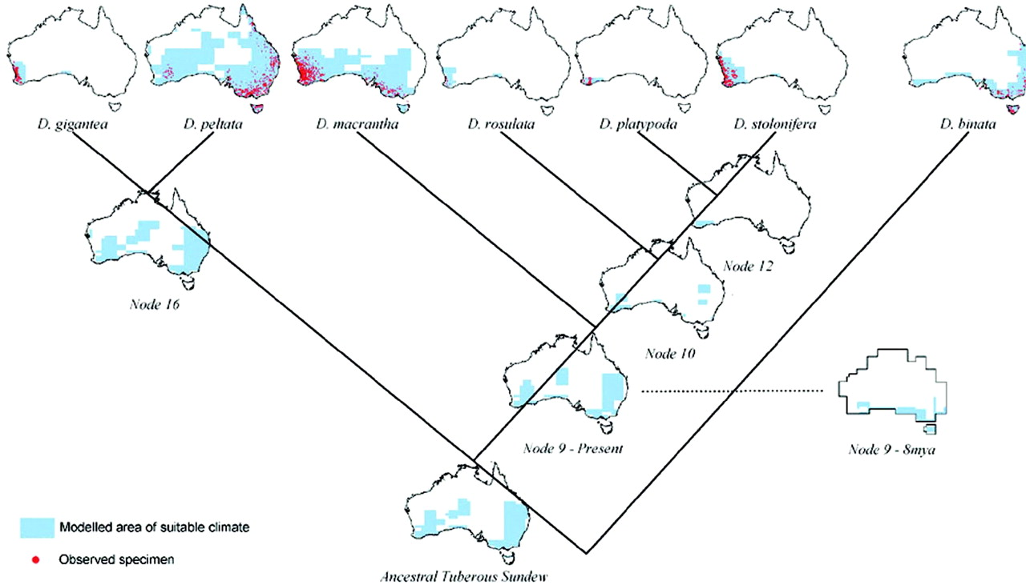
Figure 5 Bioclimatic models projected into modeled present-day climate of Australia. Full extent of bioclimatic range ...
Notes:
Figure 5 Bioclimatic models projected into modeled present-day climate of Australia. Full extent of bioclimatic range marked blue. Red dots show locality data used to construct models. Internal nodes projected into the same present climate to demonstrate model similarity. (Node 9 also projected into model of 8 Mya.)
Unless provided in the caption above, the following copyright applies to the content of this slide: © 2006 Society of Systematic BiologistsThis article is published and distributed under the terms of the Oxford University Press, Standard Journals Publication Model (https://academic.oup.com/journals/pages/open_access/funder_policies/chorus/standard_publication_model)

Slide 6
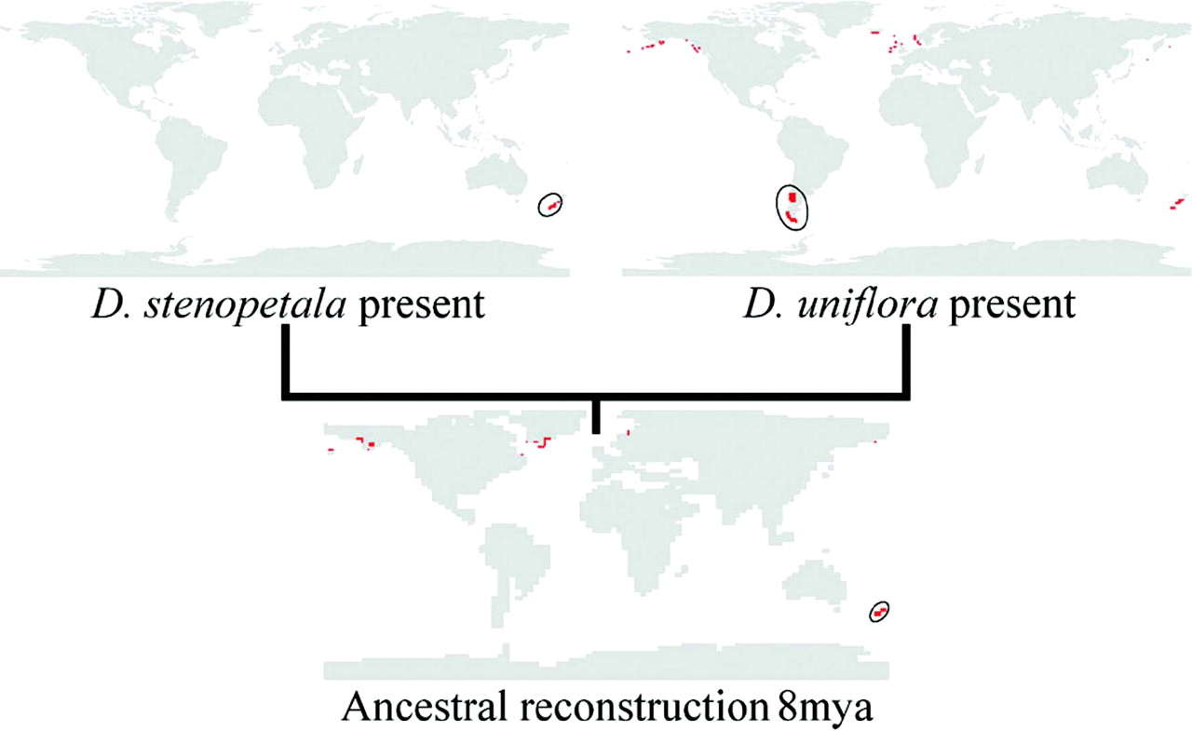
Figure 6 Bioclim models for sister taxa D. stenopetala and D. uniflora, projected into present-day modeled climate. ...
Notes:
Figure 6 Bioclim models for sister taxa D. stenopetala and D. uniflora, projected into present-day modeled climate. Current distribution circled. Reconstruction of ancestral bioclimatic model (dated at 8.4 to 7.95 Mya) projected into modeled climate for 8 Mya. Late Miocene New Zealand (circled) is the only suitable climate projected in the southern hemisphere. Northern areas with similar climate have also been identified by the models. There is no evidence of long-distance dispersal to these regions.
Unless provided in the caption above, the following copyright applies to the content of this slide: © 2006 Society of Systematic BiologistsThis article is published and distributed under the terms of the Oxford University Press, Standard Journals Publication Model (https://academic.oup.com/journals/pages/open_access/funder_policies/chorus/standard_publication_model)

Slide 7
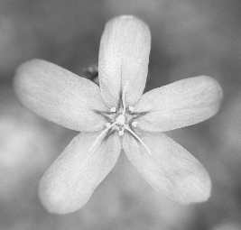
A single flower of Drosera leucoblasta (section Bryastrum), from south-west Australia. Photo by A. Culham.
Notes:
A single flower of Drosera leucoblasta (section Bryastrum), from south-west Australia. Photo by A. Culham.
Unless provided in the caption above, the following copyright applies to the content of this slide: © 2006 Society of Systematic BiologistsThis article is published and distributed under the terms of the Oxford University Press, Standard Journals Publication Model (https://academic.oup.com/journals/pages/open_access/funder_policies/chorus/standard_publication_model)

