Slide 1
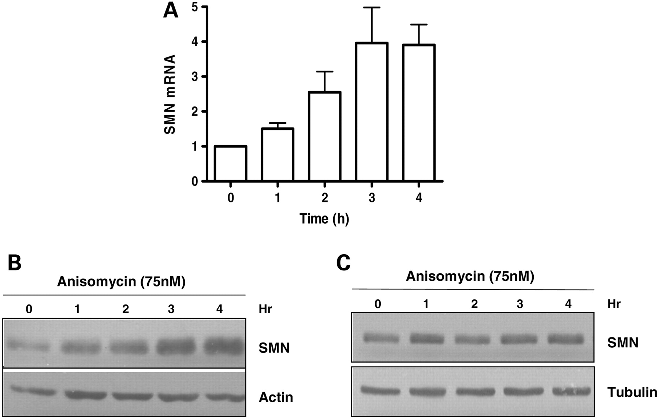
Figure 1. Anisomycin upregulates SMN mRNA and protein in vitro . Anisomycin treatment causes 2–3-fold induction in SMN ...
Notes:
Figure 1. Anisomycin upregulates SMN mRNA and protein in vitro . Anisomycin treatment causes 2–3-fold induction in SMN mRNA and protein. NT2 or MN-1 cells were treated with Anisomycin (75 n m ) and then harvested at indicated intervals for RT–PCR or western blot analyses. ( A ) Quantification of SMN mRNA relative to β-actin in NT2 cells (the ratio at 0 h was set as 1). Mean ± SD (bars) of three independent experiments. ( B ) Representative western blot showing effect of Anisomycin on SMN protein in NT2 cells. ( C ) Representative western blot showing effect of Anisomycin on SMN protein in MN-1 cells.
Unless provided in the caption above, the following copyright applies to the content of this slide: © The Author 2009. Published by Oxford University Press. All rights reserved. For Permissions, please email: journals.permissions@oxfordjournals.org

Slide 2
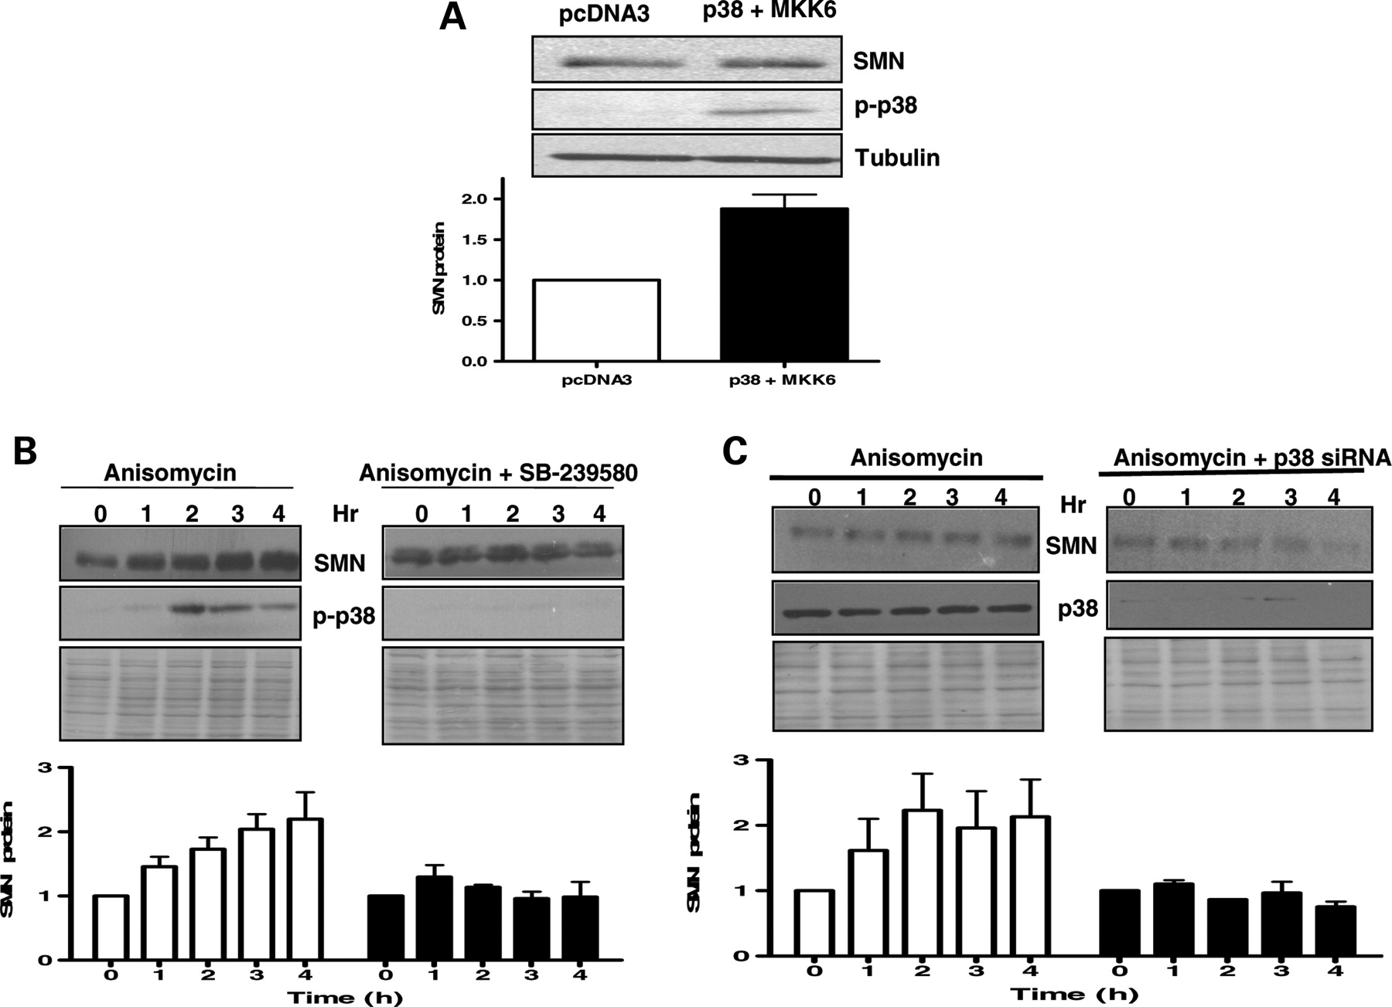
Figure 2. p38 MAPK pathway regulates SMN protein level. ( A ) MN-1 cells were transfected with either pcDNA3 vector or ...
Notes:
Figure 2. p38 MAPK pathway regulates SMN protein level. ( A ) MN-1 cells were transfected with either pcDNA3 vector or constitutively activated p38 + MKK6 overexpression plasmid (2 µg/ml). Cells were harvested for western blot analysis 24 h after transfection. Representative western blot and densitometric quantification [mean ± SD (bars) of three independent experiments] are shown. ( B ) Representative western blots showing the effect of p38 inhibition on Anisomycin-induced increase in SMN protein. Quantification of SMN protein relative to β-actin (the ratio at 0 h was set as 1). P38 inhibitor (SB-239580) blocked the Anisomycin-induced increase in SMN protein in NT2 cells. NT2 cells were treated with SB-239580 (3 μ m ) for 1 h and then treated with Anisomycin (75 n m ) for up to 4 h. Cells were harvested for western blot analysis at hourly intervals. Mean ± SD (bars) of three independent experiments. ( C ) Representative western blots showing both p38 knockdown and its effect on Anisomycin-induced increase in SMN protein. Quantification of SMN protein relative to β-actin (the ratio at 0 h was set as 1). The siRNA knockdown of p38 protein attenuates Anisomycin-induced increase in SMN protein. NT2 cells were transfected with p38 siRNA (25 n m ) or scrambled sequence (25 n m ) for 48 h and then treated with Anisomycin (75 n m ) for up to 4 h. Cells were harvested for western blot analysis at hourly intervals. Mean ± SD (bars) of three independent experiments.
Unless provided in the caption above, the following copyright applies to the content of this slide: © The Author 2009. Published by Oxford University Press. All rights reserved. For Permissions, please email: journals.permissions@oxfordjournals.org

Slide 3
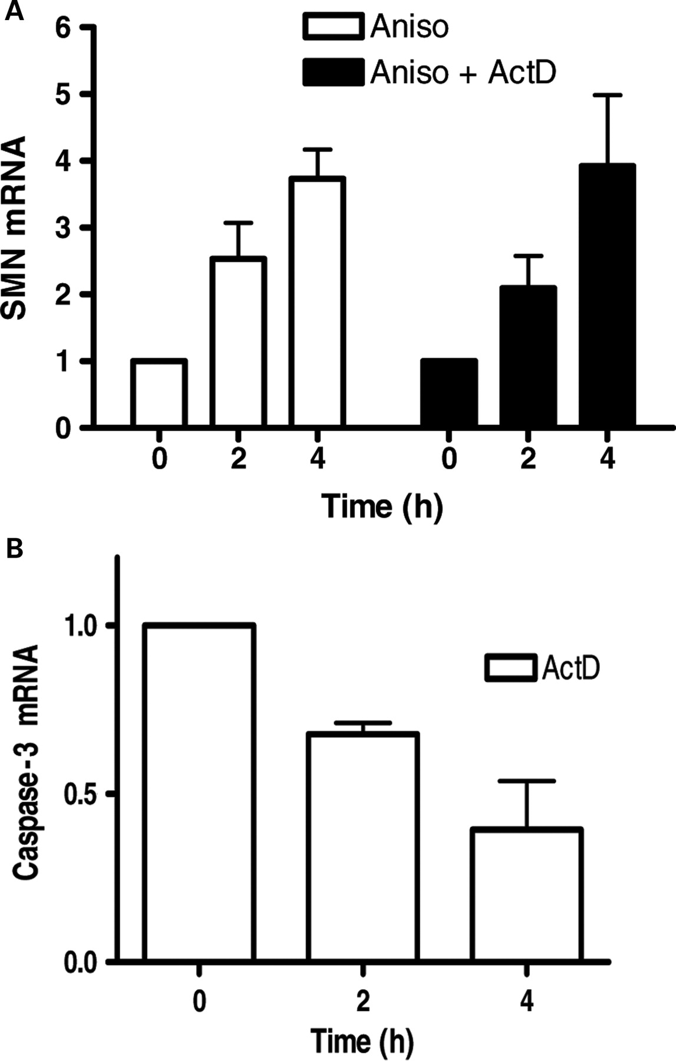
Figure 3. SMN mRNA stabilization by Anisomycin in NT2 cells. Anisomycin-induced increase in SMN mRNA content is ...
Notes:
Figure 3. SMN mRNA stabilization by Anisomycin in NT2 cells. Anisomycin-induced increase in SMN mRNA content is independent of transcriptional upregulation. ( A ) NT2 cells were treated with Anisomycin (75 n m ) with/without transcriptional inhibitor Actinomycin D (2.5 µg/ml) at different time points (0, 2 and 4 h) and then harvested for RT–PCR. Quantification of SMN mRNA relative to β-actin. Mean ± SD (bars) of three independent experiments performed in triplicate. ( B ) NT2 cells were treated with transcriptional inhibitor Actinomycin D (2.5 µg/ml) at different time points (0, 2 and 4 h) and then harvested for RT–PCR. Quantification of Caspase-3 mRNA relative to β-actin. Mean ± SD (bars) of three independent experiments performed in triplicate.
Unless provided in the caption above, the following copyright applies to the content of this slide: © The Author 2009. Published by Oxford University Press. All rights reserved. For Permissions, please email: journals.permissions@oxfordjournals.org

Slide 4
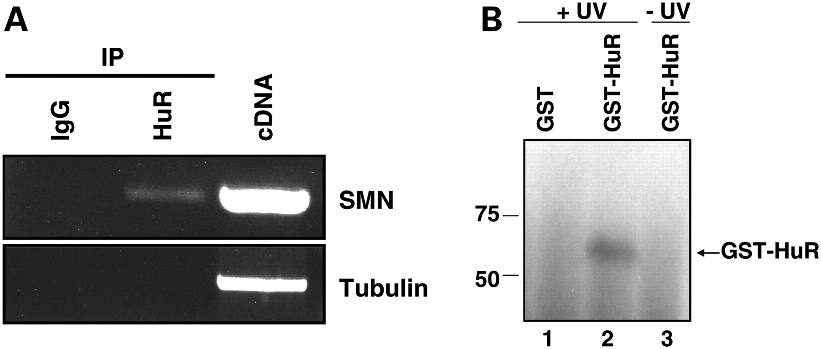
Figure 4. HuR interacts with SMN mRNA. ( A ) Endogenous HuR interacts with SMN mRNA in vivo . In NT2 cells, ...
Notes:
Figure 4. HuR interacts with SMN mRNA. ( A ) Endogenous HuR interacts with SMN mRNA in vivo . In NT2 cells, RNA–protein complexes were crosslinked with formaldehyde and immunoprecipitated after cell lysis using antibodies against HuR and IgG. Following crosslink reversal the RNA was isolated from the immunoprecipitate and was used to produce cDNA by reverse transcription, followed by PCR amplification with SMN and Tubulin primers. A representative agarose gel of three independent experiments is shown. ( B ) HuR binds directly to the 3′-UTR of SMN mRNA in vitro . GST (lane 1) or GST-HuR (lane 2) were incubated with 32 P-labeled 3′-UTR of SMN mRNA probe, UV cross-linked and then separated by SDS–PAGE and visualized by autoradiography. As a negative control, GST-HuR (lane 3) was incubated with 32 P-labeled 3′-UTR of SMN mRNA probe without UV cross-linking.
Unless provided in the caption above, the following copyright applies to the content of this slide: © The Author 2009. Published by Oxford University Press. All rights reserved. For Permissions, please email: journals.permissions@oxfordjournals.org

Slide 5
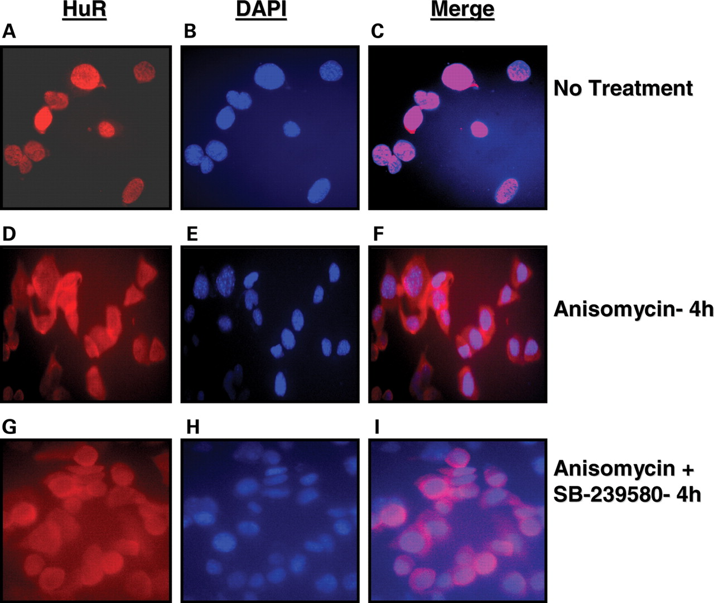
Figure 5. Anisomycin causes p38 pathway-mediated accumulation of HuR in the cytoplasm in MN-1 cells. ...
Notes:
Figure 5. Anisomycin causes p38 pathway-mediated accumulation of HuR in the cytoplasm in MN-1 cells. Immunohistochemistry was performed in MN-1 cells which were treated with Anisomycin for 4 h with or without 1 h pretreatment with p38 inhibitor SB-239580 (3 µ m ). MN-1 cells were stained with monoclonal antibody for HuR (red, A,D,G ), counter stained with DAPI (blue, B,E,H ) with merged images of both shown in ( C,F and I ). Representative images of three independent experiments are shown.
Unless provided in the caption above, the following copyright applies to the content of this slide: © The Author 2009. Published by Oxford University Press. All rights reserved. For Permissions, please email: journals.permissions@oxfordjournals.org

Slide 6
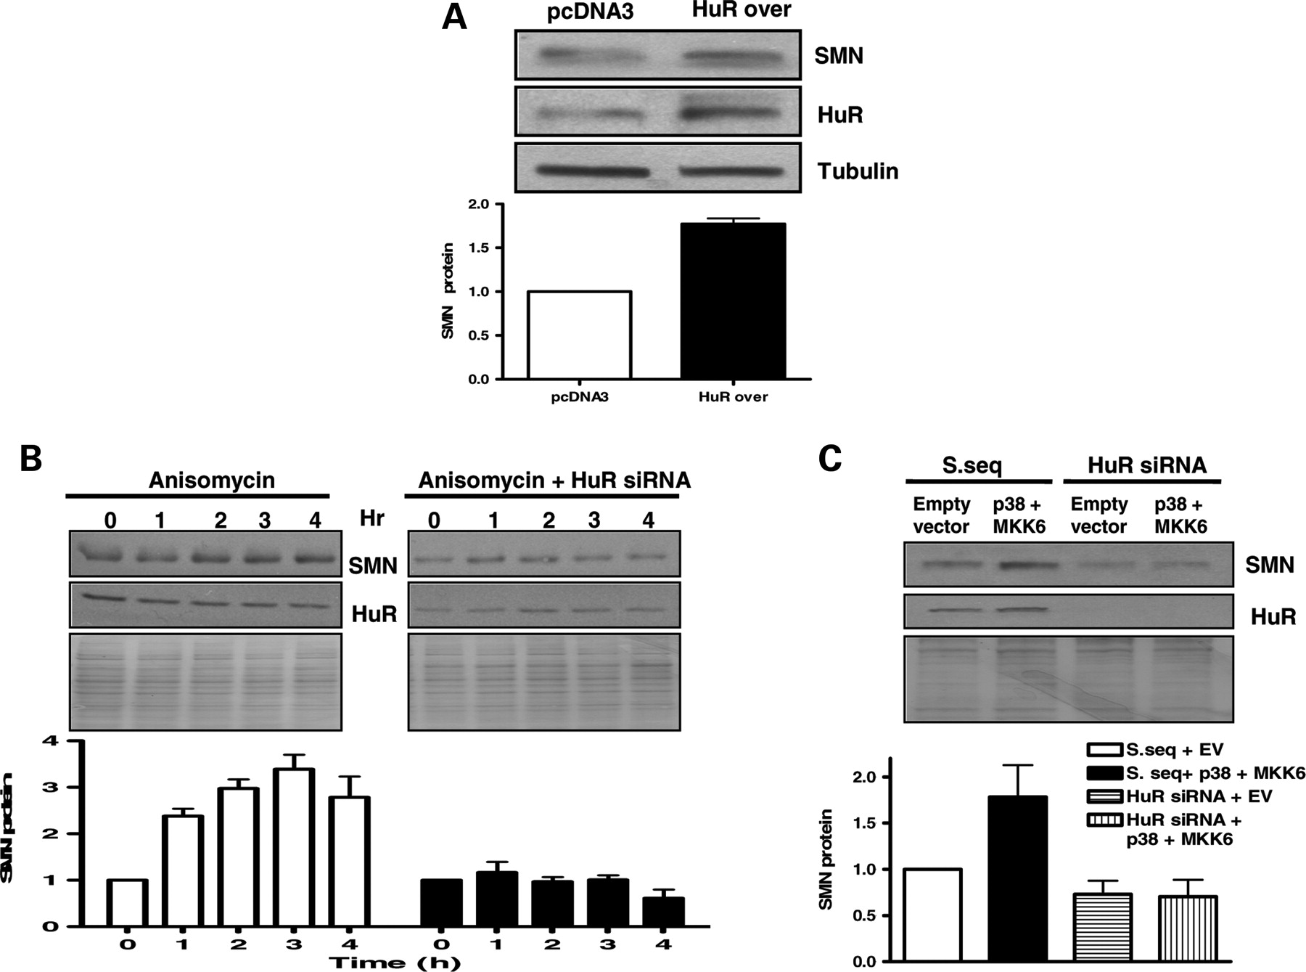
Figure 6. HuR is sufficient to induce SMN levels and is required for p38-mediated upregulation of SMN protein. ( A ) ...
Notes:
Figure 6. HuR is sufficient to induce SMN levels and is required for p38-mediated upregulation of SMN protein. ( A ) Overexpression of HuR protein increases SMN protein content. MN-1 cells were transfected with either pcDNA3 vector or HuR overexpression plasmid (2 µg/ml). Cells were harvested for western blot analysis after 24 h of transfection. Representative western blot and densitometric quantification [mean ± SD (bars) of three independent experiments] are shown. ( B ) The siRNA knockdown of HuR abrogates Anisomycin-induced increase in SMN protein. NT2 cells were transfected with HuR siRNA (100 n m ) or non-targeting control sequence (100 n m ) for 48 h and then treated with Anisomycin (75 n m ) for up to 4 h. Cells were harvested for western blot analysis at indicated time points. Representative western blot and densitometric quantification [mean ± SD (bars) of three independent experiments; SMN protein relative to β-actin (the ratio at 0 h was set as 1)] are shown. ( C ) The siRNA knockdown of HuR protein attenuates p38 + MKK6 overexpression plasmid-induced increase in SMN protein. MN-1 cells were transfected with HuR siRNA (100 n m ) or non-targeting control sequence (100 n m ) for 48 h followed by transfection with p38 + MKK6 overexpression plasmid for 24 h. Cells were harvested for western blot analysis. Representative western blot and densitometric quantification of SMN protein relative to Tubulin (the ratio at 0 h was set as 1); [mean ± SD (bars) of three independent experiments] are shown.
Unless provided in the caption above, the following copyright applies to the content of this slide: © The Author 2009. Published by Oxford University Press. All rights reserved. For Permissions, please email: journals.permissions@oxfordjournals.org

Slide 7
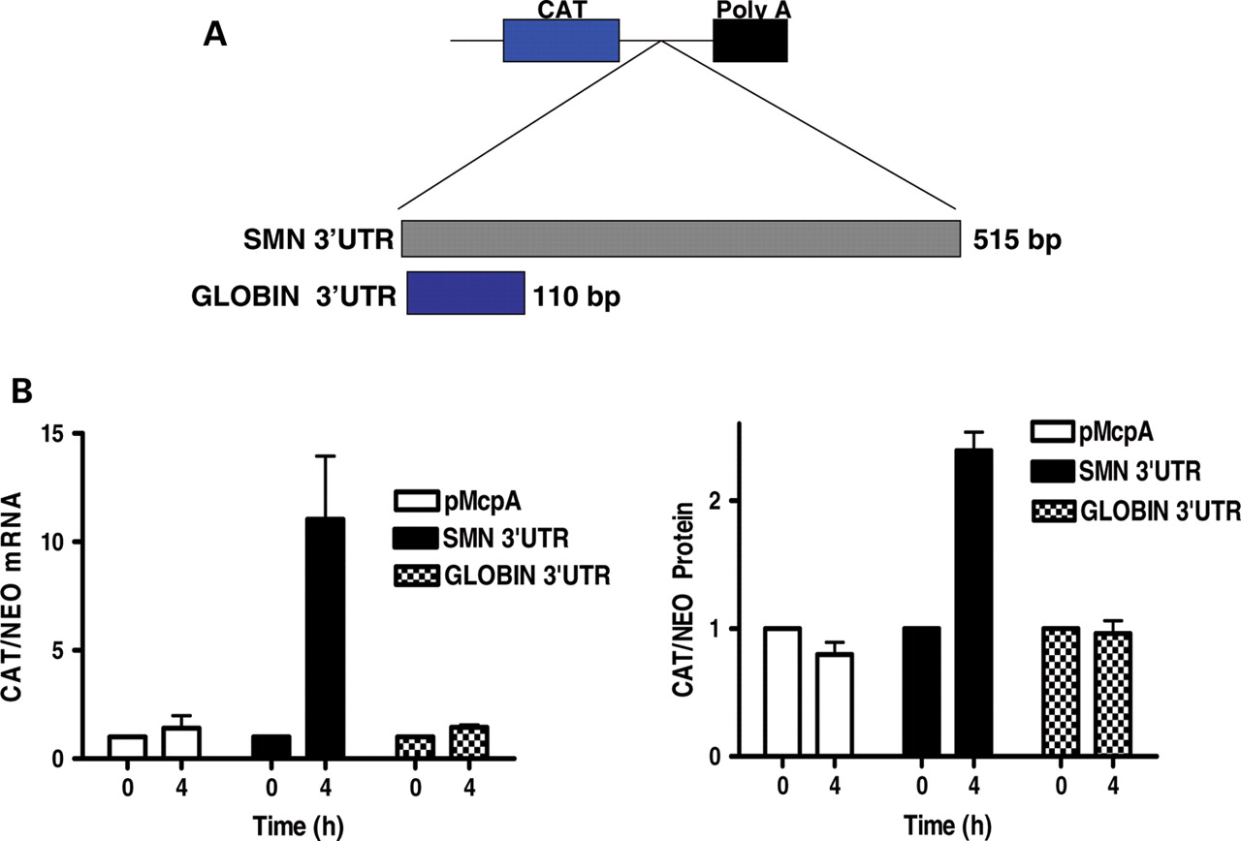
Figure 7. The 3′-UTR of SMN mRNA is required for Anisomycin-induced increase in SMN mRNA and protein. MN-1 cells were ...
Notes:
Figure 7. The 3′-UTR of SMN mRNA is required for Anisomycin-induced increase in SMN mRNA and protein. MN-1 cells were transfected with CAT reporter plasmids containing either the full-length 3′-UTR of human SMN mRNA (SMN UTR), α-globin mRNA (GLOBIN 3′-UTR) or an empty vector (pMcpA) with/without Anisomycin treatment (75 n m ). CAT and Neomycin (used as transfection control) expression was assessed by RT–PCR and ELISA. Mean ± SD (bars) of three independent experiments performed in triplicate.
Unless provided in the caption above, the following copyright applies to the content of this slide: © The Author 2009. Published by Oxford University Press. All rights reserved. For Permissions, please email: journals.permissions@oxfordjournals.org

Slide 8
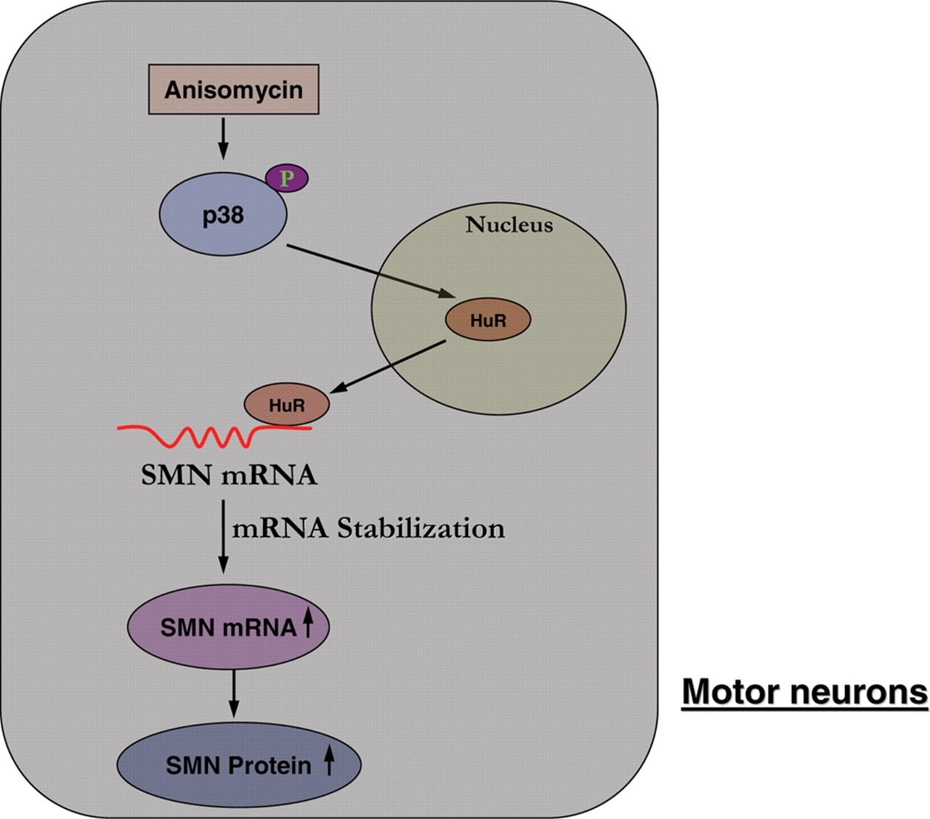
Figure 8. Proposed model for Anisomycin-mediated induction of SMN. Anisomycin treatment causes phosphorylation and ...
Notes:
Figure 8. Proposed model for Anisomycin-mediated induction of SMN. Anisomycin treatment causes phosphorylation and activation of p38 which results in accumulation of HuR in the cytoplasm where it is able to interact with the 3′-UTR of SMN transcript. This binding stabilizes SMN mRNA which results in an increase in SMN steady-state mRNA levels and ultimately increases SMN protein expression.
Unless provided in the caption above, the following copyright applies to the content of this slide: © The Author 2009. Published by Oxford University Press. All rights reserved. For Permissions, please email: journals.permissions@oxfordjournals.org

