Slide 1
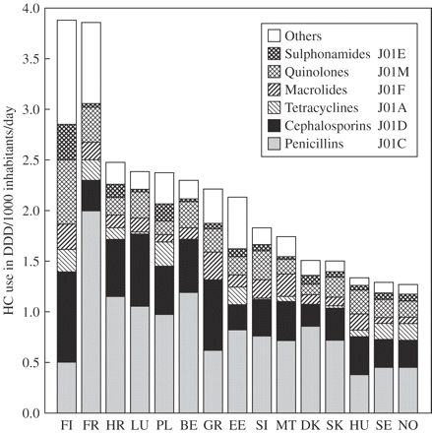
Figure 1 Antibiotic use and distribution over main classes in hospital care (HC) in Europe (2002). Note: data from ...
Notes:
Figure 1 Antibiotic use and distribution over main classes in hospital care (HC) in Europe (2002). Note: data from Finland include primary healthcare centres and nursing homes.
Unless provided in the caption above, the following copyright applies to the content of this slide: © The Author 2006. Published by Oxford University Press on behalf of the British Society for Antimicrobial Chemotherapy. All rights reserved. For Permissions, please e-mail: journals.permissions@oxfordjournals.org

Slide 2
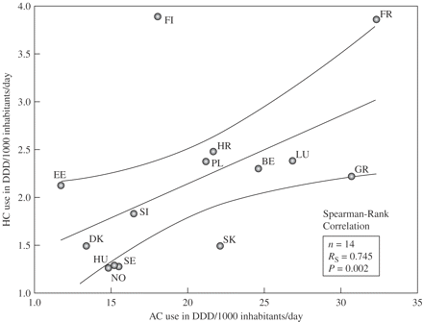
Figure 2 Relationship between antibiotic use in ambulatory care (AC) and hospital care (HC) in Europe (2002).
Notes:
Figure 2 Relationship between antibiotic use in ambulatory care (AC) and hospital care (HC) in Europe (2002).
Unless provided in the caption above, the following copyright applies to the content of this slide: © The Author 2006. Published by Oxford University Press on behalf of the British Society for Antimicrobial Chemotherapy. All rights reserved. For Permissions, please e-mail: journals.permissions@oxfordjournals.org

Slide 3
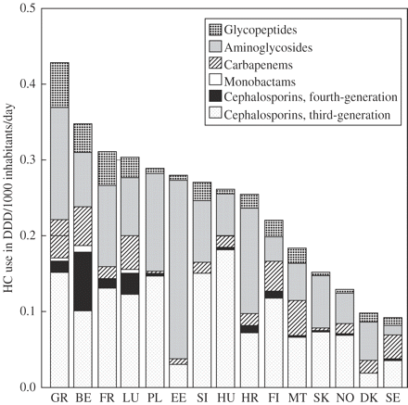
Figure 3 Use of hospital-specific antibiotics in hospital care (HC) in Europe (2002).
Notes:
Figure 3 Use of hospital-specific antibiotics in hospital care (HC) in Europe (2002).
Unless provided in the caption above, the following copyright applies to the content of this slide: © The Author 2006. Published by Oxford University Press on behalf of the British Society for Antimicrobial Chemotherapy. All rights reserved. For Permissions, please e-mail: journals.permissions@oxfordjournals.org

Slide 4
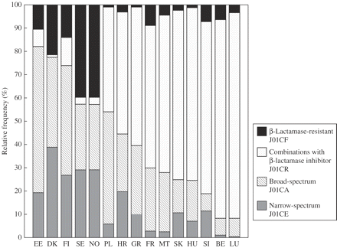
Figure 4 Proportional use within penicillins in hospital care in Europe (2002).
Notes:
Figure 4 Proportional use within penicillins in hospital care in Europe (2002).
Unless provided in the caption above, the following copyright applies to the content of this slide: © The Author 2006. Published by Oxford University Press on behalf of the British Society for Antimicrobial Chemotherapy. All rights reserved. For Permissions, please e-mail: journals.permissions@oxfordjournals.org

Slide 5
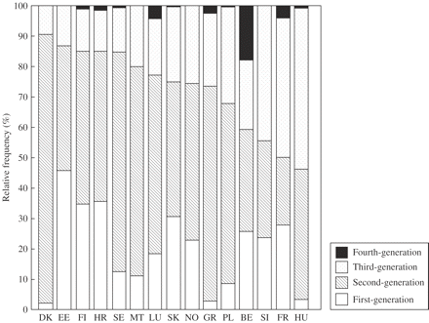
Figure 5 Proportional use within cephalosporins in hospital care in Europe (2002).
Notes:
Figure 5 Proportional use within cephalosporins in hospital care in Europe (2002).
Unless provided in the caption above, the following copyright applies to the content of this slide: © The Author 2006. Published by Oxford University Press on behalf of the British Society for Antimicrobial Chemotherapy. All rights reserved. For Permissions, please e-mail: journals.permissions@oxfordjournals.org

Slide 6
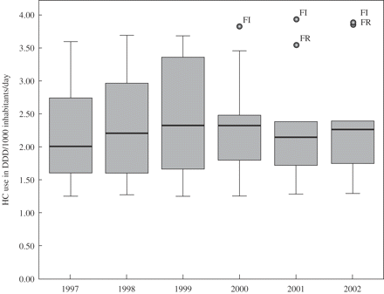
Figure 6 Evolution of antibiotic use in hospital care (HC) in Europe (1997–2002) (n = 10 countries).
Notes:
Figure 6 Evolution of antibiotic use in hospital care (HC) in Europe (1997–2002) (n = 10 countries).
Unless provided in the caption above, the following copyright applies to the content of this slide: © The Author 2006. Published by Oxford University Press on behalf of the British Society for Antimicrobial Chemotherapy. All rights reserved. For Permissions, please e-mail: journals.permissions@oxfordjournals.org

Slide 7
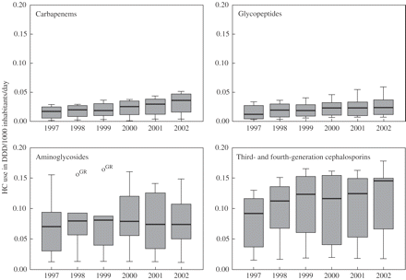
Figure 7 Evolution of the use of hospital-specific antibiotics in Europe (1997–2002) (n = 10 countries). Open circles ...
Notes:
Figure 7 Evolution of the use of hospital-specific antibiotics in Europe (1997–2002) (n = 10 countries). Open circles indicate extreme values.
Unless provided in the caption above, the following copyright applies to the content of this slide: © The Author 2006. Published by Oxford University Press on behalf of the British Society for Antimicrobial Chemotherapy. All rights reserved. For Permissions, please e-mail: journals.permissions@oxfordjournals.org

