Slide 1
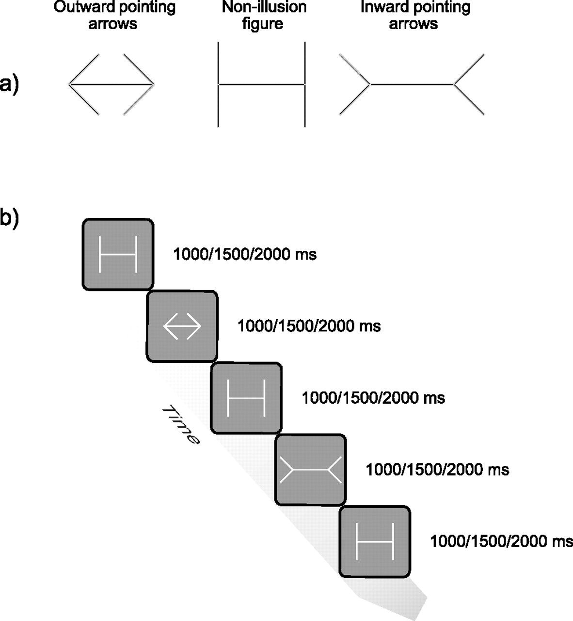
Figure 1. (a) Müller-Lyer figures used in the experiment. Müller-Lyer figure with inward-pointing arrows resulting in a ...
Notes:
Figure 1. (a) Müller-Lyer figures used in the experiment. Müller-Lyer figure with inward-pointing arrows resulting in a reduced line length perception (left), a nonillusion figure with straight lines attached to its end (middle) and a Müller-Lyer figure with outward-pointing arrows result in an increased perceived line length (right). Note that the horizontal lines of the 3 figures are of equal length. (b) Example trial sequences indicating alterations between illusion and no-illusion stimuli.
Unless provided in the caption above, the following copyright applies to the content of this slide: © The Author 2009. Published by Oxford University Press. All rights reserved. For permissions, please e-mail: journals.permissions@oxfordjournals.org

Slide 2
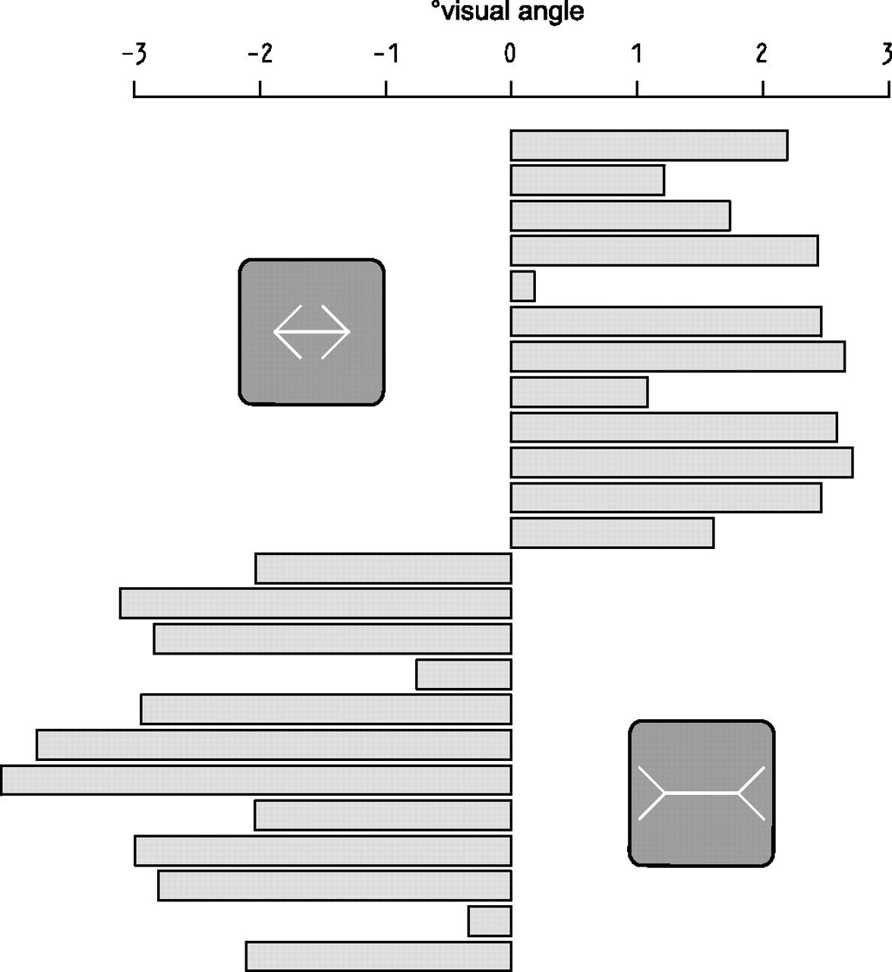
Figure 2. Perceived alterations in line length related to inward wings (upper half) and the perceived alterations in ...
Notes:
Figure 2. Perceived alterations in line length related to inward wings (upper half) and the perceived alterations in line length related to outward wings (lower half) presented separately for 12 subjects.
Unless provided in the caption above, the following copyright applies to the content of this slide: © The Author 2009. Published by Oxford University Press. All rights reserved. For permissions, please e-mail: journals.permissions@oxfordjournals.org

Slide 3
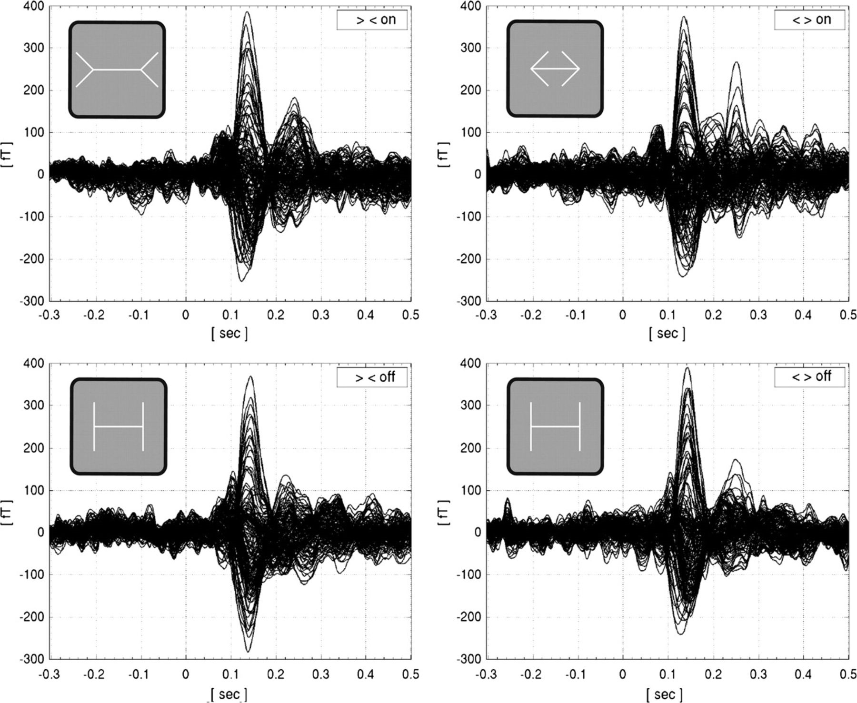
Figure 3. Event-related MEG signals as response to the onset (top) and the offset (bottom) of the illusion, separately ...
Notes:
Figure 3. Event-related MEG signals as response to the onset (top) and the offset (bottom) of the illusion, separately shown for the illusion involving inward-pointing arrows (left) and outward-pointing arrows (right).
Unless provided in the caption above, the following copyright applies to the content of this slide: © The Author 2009. Published by Oxford University Press. All rights reserved. For permissions, please e-mail: journals.permissions@oxfordjournals.org

Slide 4
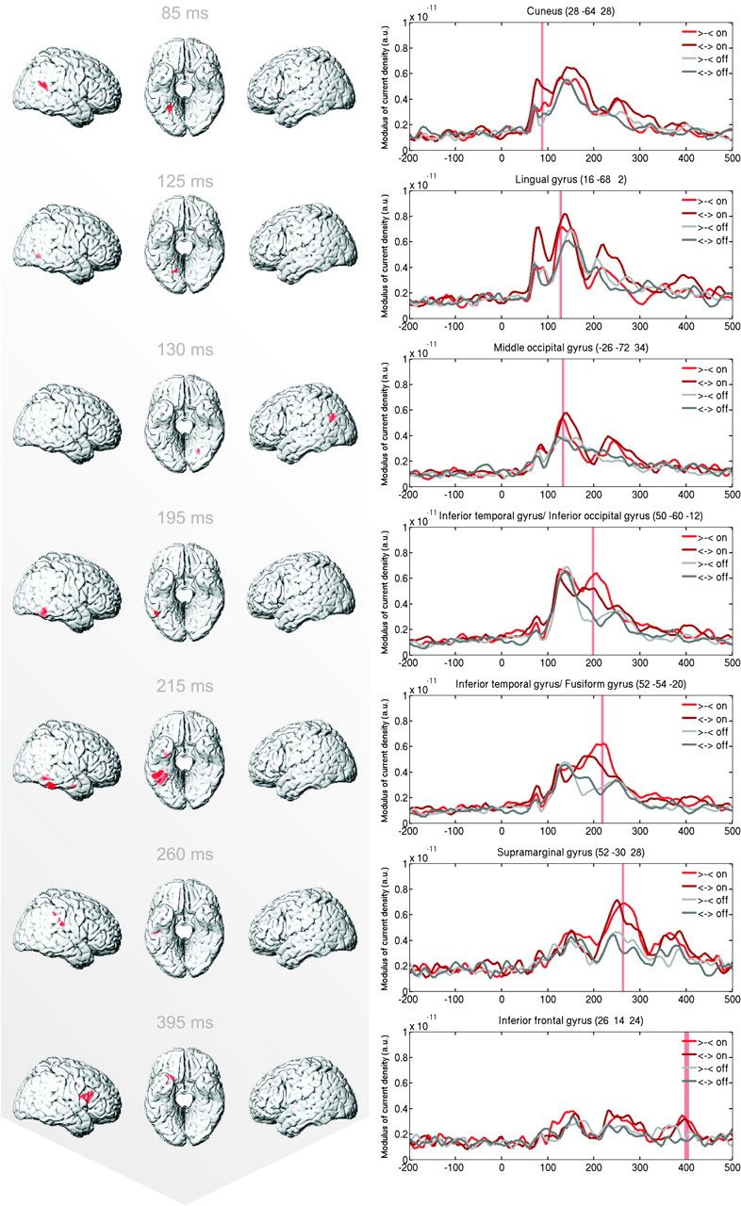
Figure 4. Surface renderings of stronger activation related to the onset relative to the offset of the Müller-Lyer ...
Notes:
Figure 4. Surface renderings of stronger activation related to the onset relative to the offset of the Müller-Lyer illusion. A conjunction analysis tested for the consistency of effects of both variants of the illusion (statistical parametric mapping 5: [(>--< offset) ∩ ( onset vs. offset)]; FWE-corrected P < 0.01 with an extent threshold of 10 voxels) separately for different time points relative to illusion onset (left). Time courses extracted at the location of the maximal t-value depicted separately for the onset and offset of the different variants of the illusion. Shaded areas mark intervals exceeding the threshold according to FWE-corrected P 10 voxel (right).
Unless provided in the caption above, the following copyright applies to the content of this slide: © The Author 2009. Published by Oxford University Press. All rights reserved. For permissions, please e-mail: journals.permissions@oxfordjournals.org

Slide 5
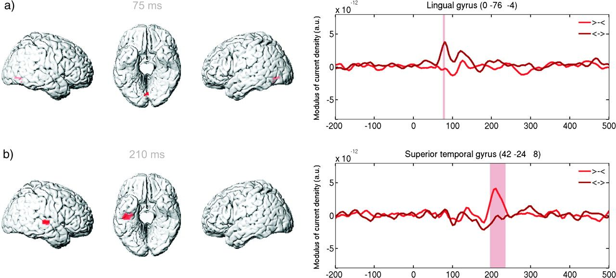
Figure 5. Surface renderings of stronger activation related to (a) inward relative to outward wings and (b) outward ...
Notes:
Figure 5. Surface renderings of stronger activation related to (a) inward relative to outward wings and (b) outward relative to inward wings (FWE-corrected P < 0.01 with an extent threshold of 10 voxels) (left) and time courses extracted at the location of the maximal t-value separately for illusion onset and offset within the time range 200 ms before until 500 ms after illusion onset. Shaded areas mark intervals exceeding the threshold according to FWE-corrected P 10 voxel (right).
Unless provided in the caption above, the following copyright applies to the content of this slide: © The Author 2009. Published by Oxford University Press. All rights reserved. For permissions, please e-mail: journals.permissions@oxfordjournals.org

