Slide 1
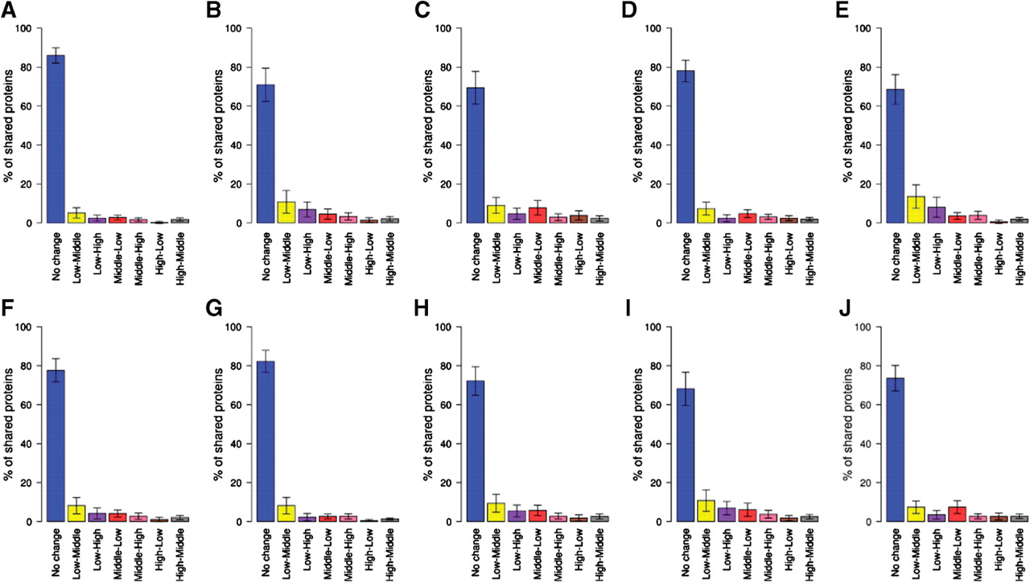
Fig. 1. Proteins were grouped into three categories: low-, middle- and high degree (see Section 2). Then, we assessed ...
Notes:
Fig. 1. Proteins were grouped into three categories: low-, middle- and high degree (see Section 2). Then, we assessed the percentages of proteins that fall into the same (or different) categories in pair-wise comparisons of two databases. For most comparisons, 60–80% of proteins fall into the same category in both databases compared. (A) HPRD-HIPPIE; (B) MINT-HPRD; (C) INTACT-HPRD; (D) BIOGRID-HPRD; (E) MINT-HIPPIE; (F) INTACT-HIPPIE; (G) BIOGRID-HIPPIE; (H) MINT-INTACT; (I) MINT-BIOGRID; (J) INTACT-BIOGRID.
Unless provided in the caption above, the following copyright applies to the content of this slide: © The Author 2011. Published by Oxford University Press. All rights reserved. For Permissions, please email: journals.permissions@oup.com

Slide 2
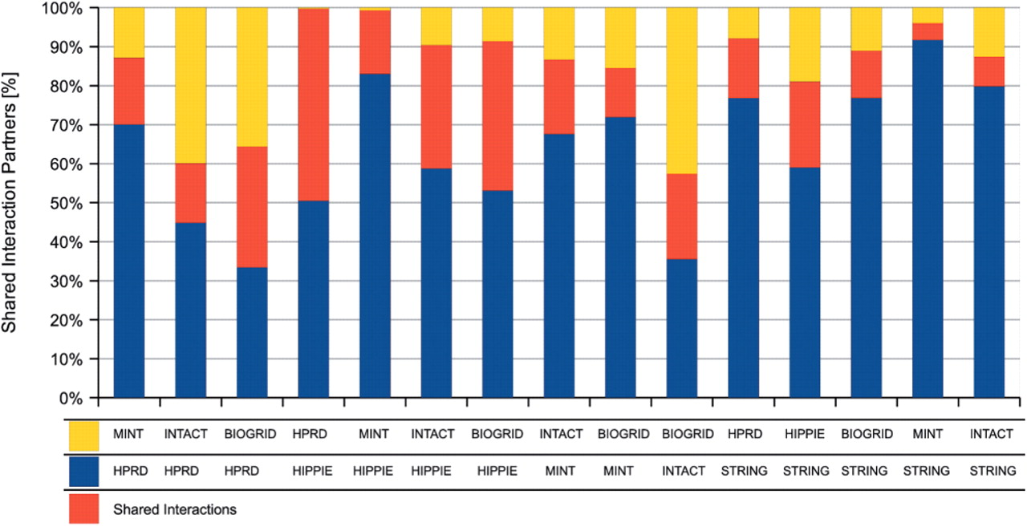
Fig. 2. Shared and exclusive interaction partners in a pair-wise comparison of PPI databases. For proteins shared ...
Notes:
Fig. 2. Shared and exclusive interaction partners in a pair-wise comparison of PPI databases. For proteins shared between two databases, we identified their interaction partners in each of the databases, and then compared the interaction partners. Yellow and blue represent the indicated databases. Shown in red are the interaction partners predicted in both databases.
Unless provided in the caption above, the following copyright applies to the content of this slide: © The Author 2011. Published by Oxford University Press. All rights reserved. For Permissions, please email: journals.permissions@oup.com

Slide 3
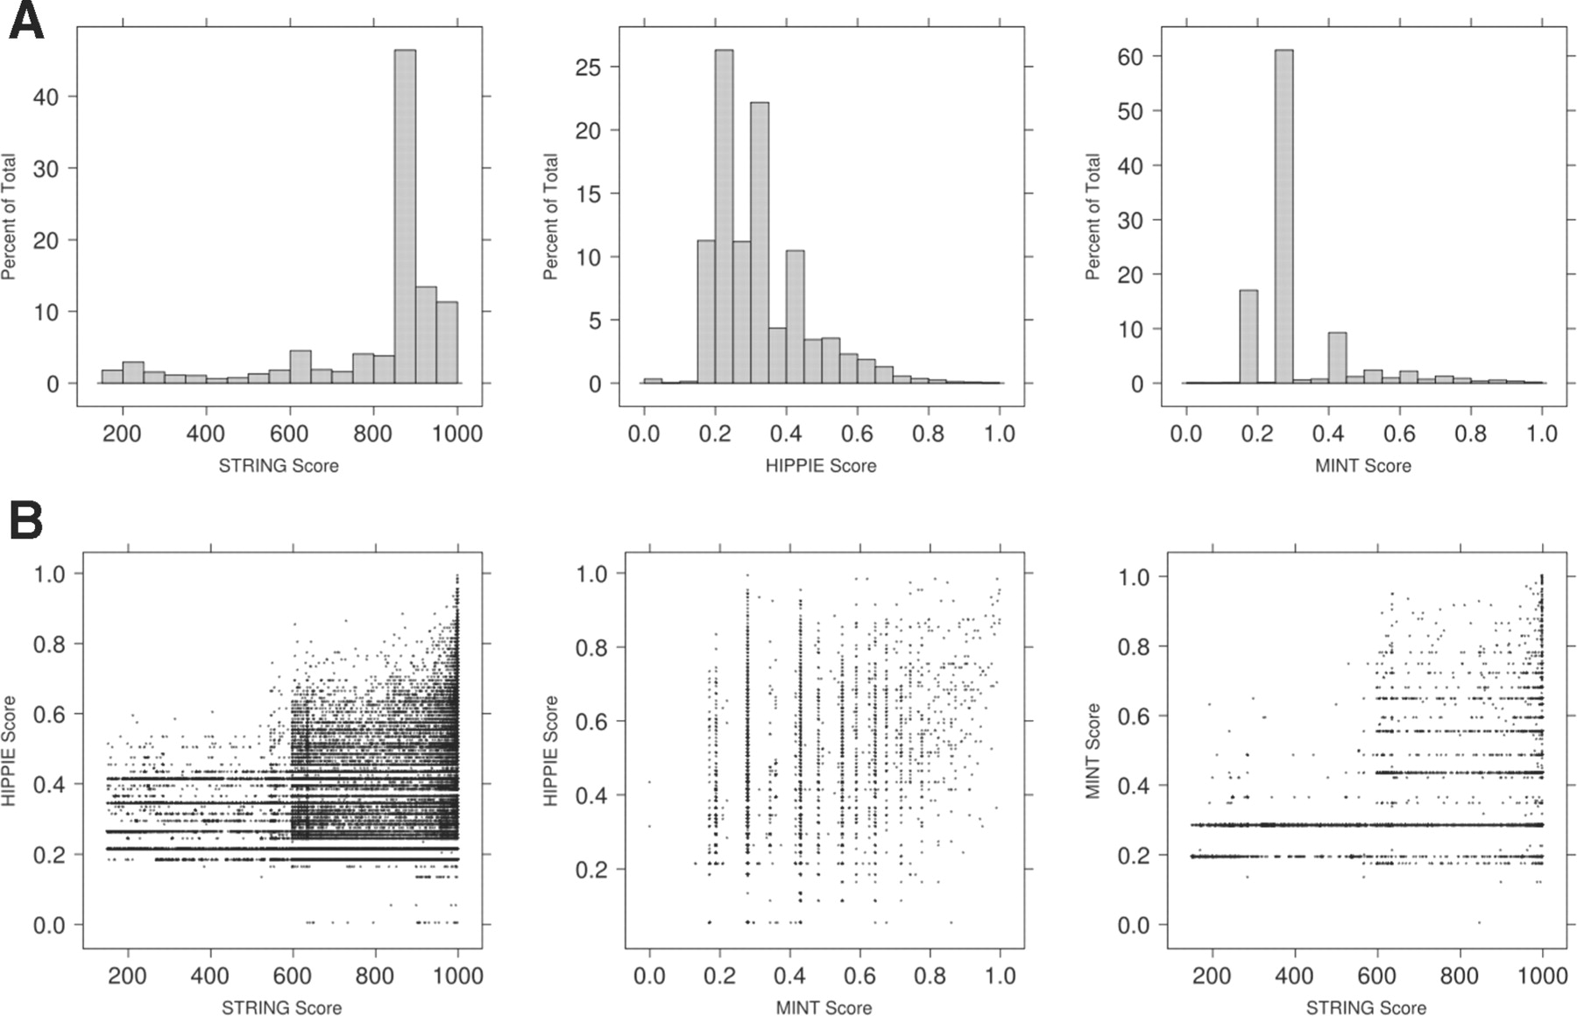
Fig. 3. (A) Three databases assign quality scores for protein interactions (HIPPIE, MINT) or functional associations ...
Notes:
Fig. 3. (A) Three databases assign quality scores for protein interactions (HIPPIE, MINT) or functional associations (STRING). MINT and HIPPIE have a stringent quality score based on cumulative evidence from multiple sources and therefore the majority of its interactions have scores below 0.5. STRING on the other hand assigns a high score for proteins that are reported in pathway databases (Szklarczyk et al., 2011). (B) Confidence scores of interactions that involve intensively studied proteins. We observed that in general there is no agreement between the database scores, with the exception that among the 31 229 interactions shared between STRING and HIPPIE, 4539 have high confidence score in both databases. In addition, in both comparisons involving STRING, no proteins had high confidence score in MINT or HIPPIE and low confidence score in STRING.
Unless provided in the caption above, the following copyright applies to the content of this slide: © The Author 2011. Published by Oxford University Press. All rights reserved. For Permissions, please email: journals.permissions@oup.com

