Slide 1
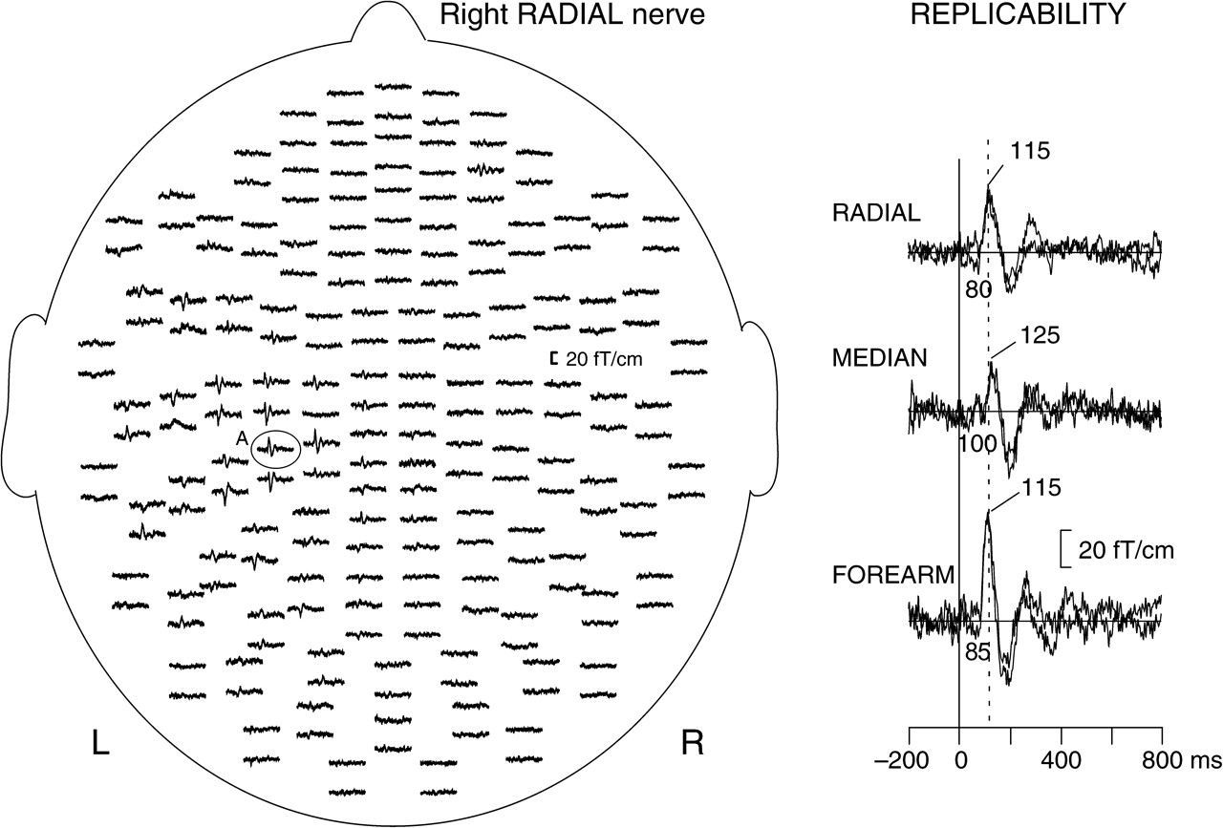
Figure 1. SEFs to electric stimulation. Left: Whole-scalp spatial distribution of the MEG signals, to right radial ...
Notes:
Figure 1. SEFs to electric stimulation. Left: Whole-scalp spatial distribution of the MEG signals, to right radial nerve stimulation, viewed from the top of the head. The pairs of traces represent the longitudinal and latitudinal derivatives of the magnetic field at each sensor location. Right: Replicability of responses to electric radial nerve (RADIAL), median nerve (MEDIAN), and forearm skin (FOREARM) stimulations. Latencies are indicated for the response onset (time of rise of the main deflection) and the response peak (maximum amplitude of the main deflection).
Unless provided in the caption above, the following copyright applies to the content of this slide: © The Authors 2009. Published by Oxford University Press.This is an Open Access article distributed under the terms of the Creative Commons Attribution Non-Commercial License (http://creativecommons.org/licenses/by-nc/2.5/), which permits unrestricted non-commercial use, distribution, and reproduction in any medium, provided the original work is properly cited.

Slide 2
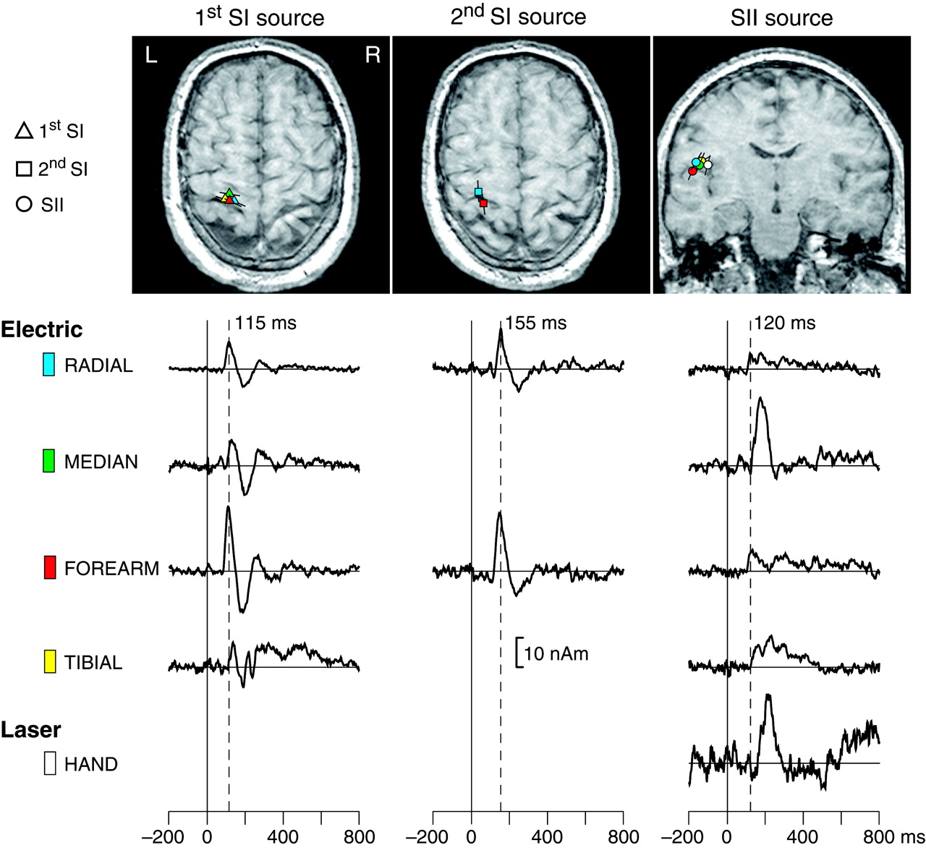
Figure 2. Multidipole models and source waveforms for electrical and laser stimulation conditions. All stimuli were ...
Notes:
Figure 2. Multidipole models and source waveforms for electrical and laser stimulation conditions. All stimuli were applied on the right body-half. Top: SI and SII sources are superimposed on I.W.’s individual axial and coronal MRIs, respectively. Triangles, squares, and circles represent the first SI, second SI, and SII sources, respectively. Source orientations are indicated by black lines. Bottom: SI and SII source strengths as a function of time derived from the multidipole model.
Unless provided in the caption above, the following copyright applies to the content of this slide: © The Authors 2009. Published by Oxford University Press.This is an Open Access article distributed under the terms of the Creative Commons Attribution Non-Commercial License (http://creativecommons.org/licenses/by-nc/2.5/), which permits unrestricted non-commercial use, distribution, and reproduction in any medium, provided the original work is properly cited.

Slide 3
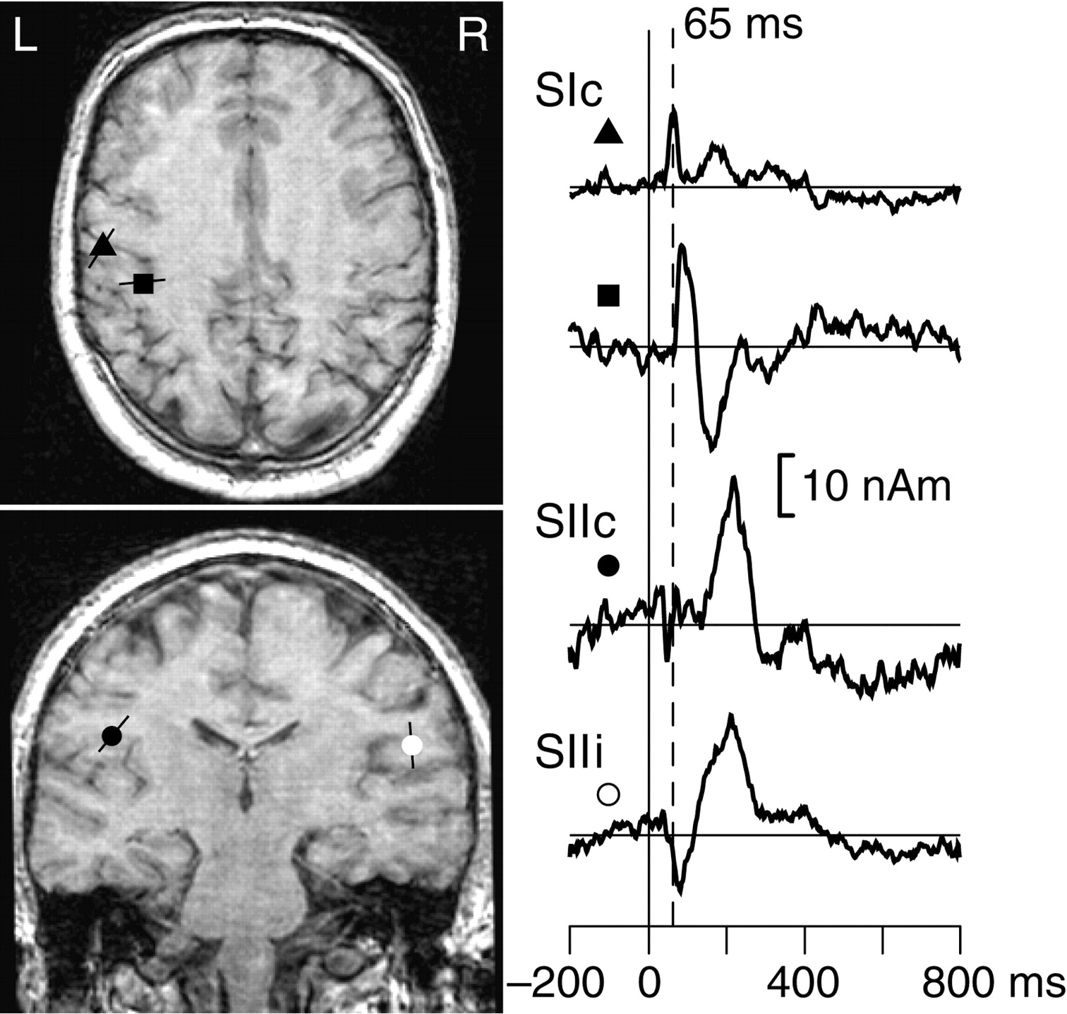
Figure 3. Four-dipole model and source waveforms for mechanical stimulation of the right lower lip (intact ...
Notes:
Figure 3. Four-dipole model and source waveforms for mechanical stimulation of the right lower lip (intact innervation). Left: SI and SII sources are superimposed on I.W.’s individual axial and coronal MRIs, respectively. Source orientations are indicated by black lines. Right: SI and SII source strengths as a function of time.
Unless provided in the caption above, the following copyright applies to the content of this slide: © The Authors 2009. Published by Oxford University Press.This is an Open Access article distributed under the terms of the Creative Commons Attribution Non-Commercial License (http://creativecommons.org/licenses/by-nc/2.5/), which permits unrestricted non-commercial use, distribution, and reproduction in any medium, provided the original work is properly cited.

