Slide 1
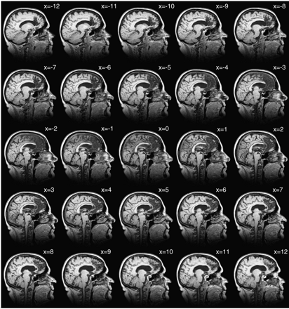
Fig. 1 1 mm Sagittal sections through GT’s brain, extending 12 mm left (x values are negative) to 12 mm right ...
Notes:
Fig. 1 1 mm Sagittal sections through GT’s brain, extending 12 mm left (x values are negative) to 12 mm right (x values positive) of the midline, demonstrating extensive cortical damage in both hemispheres and, generally, greater sub‐cortical involvement in the right hemisphere.
Unless provided in the caption above, the following copyright applies to the content of this slide: The Guarantors of Brain 2004

Slide 2
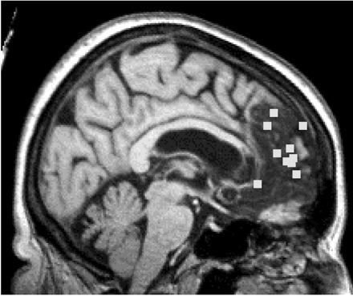
Fig. 2 Foci of ToM activations from ten different neuroimaging studies rendered onto a normalised version of ...
Notes:
Fig. 2 Foci of ToM activations from ten different neuroimaging studies rendered onto a normalised version of GT’s lesion. Note all foci are projected onto the medial surface, regardless of lateralisation to left or right hemisphere. The plotted co‐ordinates are 8, 54, 12 (Gallagher et al., 2002), 8, 53, 9 (McCabe et al., 2001), –12, 42, 40 (Fletcher et al., 1995), –12, 38, 32 (Goel et al., 1995), 0, 44, 15 (Baron‐Cohen, et al.,1999b), –8, 50, 10 (Gallagher et al., 2000), 8, 32, –4 (Brunet et al., 2000), –4, 60, 32 (Castelli et al., 2000), 6, 56, 2 (Vogeley et al., 2001) and –8, 52, 18 (Berthoz et al., 2002).
Unless provided in the caption above, the following copyright applies to the content of this slide: The Guarantors of Brain 2004

Slide 3
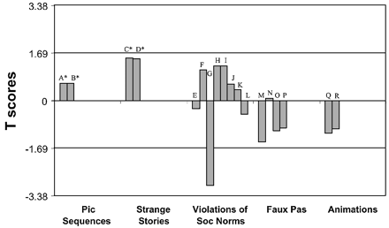
Fig. 3 Task 1: picture sequences. A = ToM stories; B = behavioural stories; * = performance at ceiling ...
Notes:
Fig. 3 Task 1: picture sequences. A = ToM stories; B = behavioural stories; * = performance at ceiling (t‐scores calculated from control data from Baron‐Cohen et al., 1986). Task 2: strange stories. C = ToM stories; B = physical state stories; * = performance at ceiling (t‐scores calculated from control data from Fletcher et al., 1995). Task 3: violations of social norms. E = all conditions, embarrassment judgements; F = all conditions, appropriateness judgements; G = ‘embarrassing’ conditions, embarrassment judgements; H = ‘embarrassing’ conditions, appropriateness judgements; I = ‘inappropriate’ conditions, embarrassment judgements; J = ‘inappropriate’ conditions, appropriateness judgements; K = control conditions, embarrassment judgements; L = control conditions, appropriateness judgements; details of controls in text. Task 4: faux pas. M = hits; N = correct rejections; O = control questions; P = composite score (control data from Gregory et al., 2000). Task 5: animations. Q = ToM interactions; R = physical interaction (details of control in text). For impairment, T must be <–1.69 in all cases.
Unless provided in the caption above, the following copyright applies to the content of this slide: The Guarantors of Brain 2004

