Slide 1
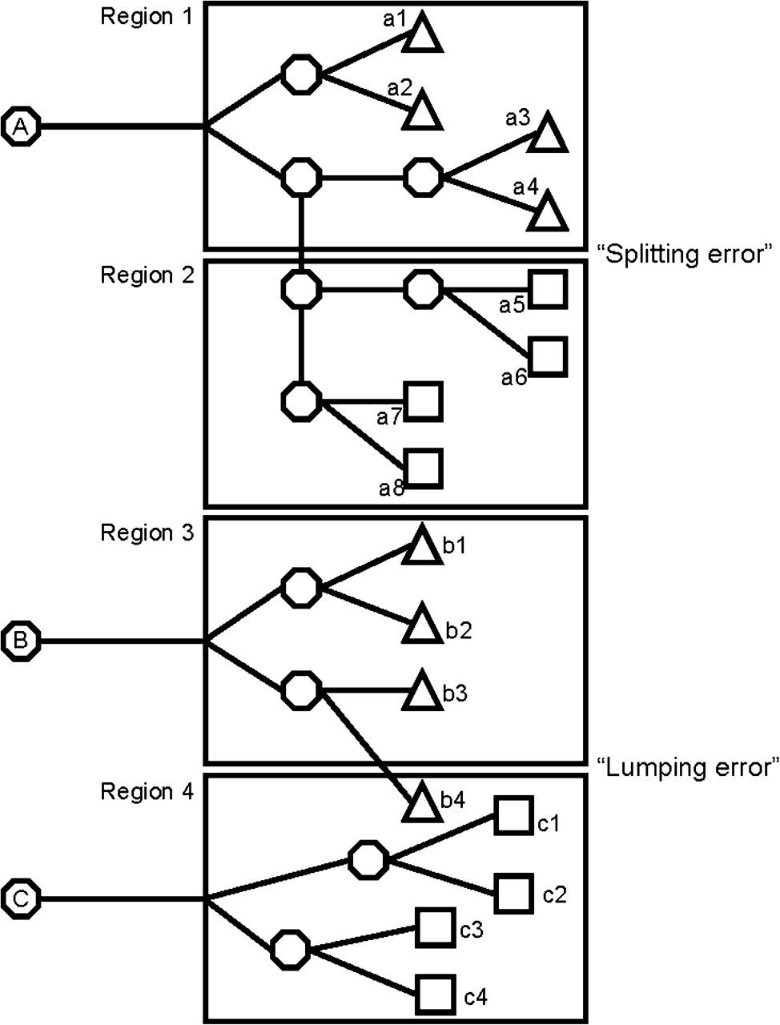
Figure 1. Splitting and lumping errors in clonal analysis. Schematic representation of neurons (triangles) and glial ...
Notes:
Figure 1. Splitting and lumping errors in clonal analysis. Schematic representation of neurons (triangles) and glial cells (squares) derived from 3 individual progenitors (A, B, and C) and distributed into 4 anatomically defined regions. The progeny of the cell A splits into regions 1 and 2, leading to a “splitting error”: cells a1–4 are classified as a pure neuronal clone, whereas cells a5–8 as a pure glial clone. In contrast, the progenitor B gives rise to a neuron (b4) that mixes up with glial cells (c1–4) derived from another progenitor (C). In this case, a pure glial clone would be mistakenly classified as mixed—“lumping error.” The progeny of cell B is also underestimated, as only 3 out of 4 cells are observed in region 3.
Unless provided in the caption above, the following copyright applies to the content of this slide: © The Author 2009. Published by Oxford University Press. All rights reserved. For permissions, please e-mail: journals.permissions@oxfordjournals.org

Slide 2
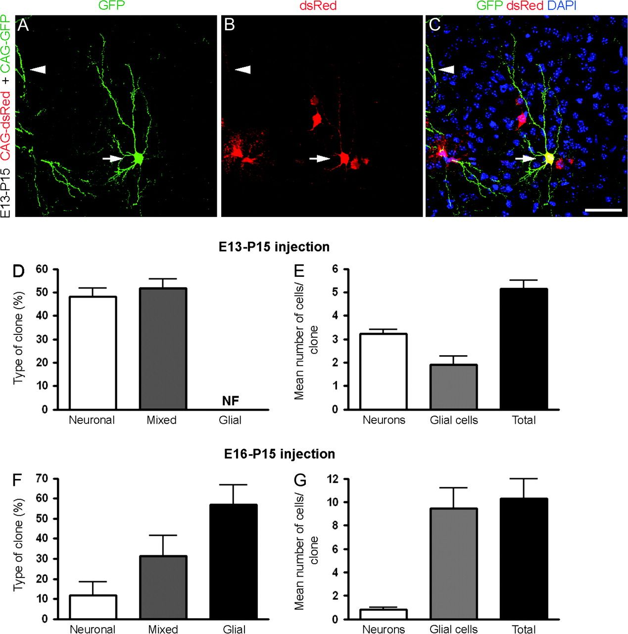
Figure 2. Absence of glia-restricted progenitors at early neurogenesis in vivo. (A–C) Coronal section of a P15 brain ...
Notes:
Figure 2. Absence of glia-restricted progenitors at early neurogenesis in vivo. (A–C) Coronal section of a P15 brain after injection with CAG-GFP and CAG-dsRed retroviruses at E13 in utero showing a double-labeled spiny neuron in layer 2/3 (arrow). Some processes of a sister neuron found in the adjacent section can also be visualized (arrowhead). These neurons belong to a mixed clone containing 7 cells. (D–G) Quantification of the frequency of different types of clones (D, F) and the number of cells per clone (E, G) generated from E13 (n = 63 clones; 3 animals) or E16 cortical progenitors (n = 43 clones; 3 animals). NF, not found. Calibration bar: 50 μm.
Unless provided in the caption above, the following copyright applies to the content of this slide: © The Author 2009. Published by Oxford University Press. All rights reserved. For permissions, please e-mail: journals.permissions@oxfordjournals.org

Slide 3
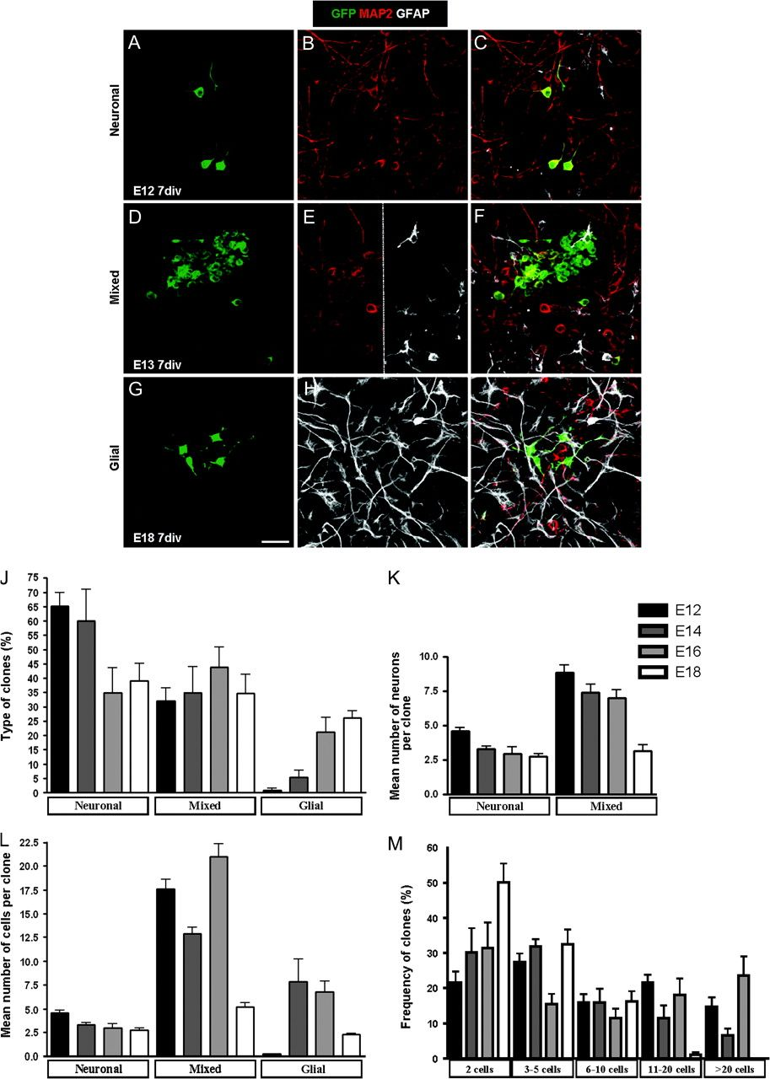
Figure 3. Clones derived from cortical progenitor cells in vitro. Pure neuronal (A–C), mixed (D–F), and pure ...
Notes:
Figure 3. Clones derived from cortical progenitor cells in vitro. Pure neuronal (A–C), mixed (D–F), and pure nonneuronal or glial (G–I) clones derived from E12, E13, and E18 cortical progenitors, respectively. (J–L) The frequency of these clone types in E12–18 cortical cell cultures was plotted (J), as well as their neuronal content (K) and size (L). Note the complementary tendency between pure neuronal and nonneuronal clones. (M) Histogram showing the frequency of clones with different sizes obtained from E12 to 18 cell cultures (E12: n = 274 clones; E14: n = 196 clones; E16: n = 154 clones; E18: n = 133 clones). Calibration bar: 20 μm.
Unless provided in the caption above, the following copyright applies to the content of this slide: © The Author 2009. Published by Oxford University Press. All rights reserved. For permissions, please e-mail: journals.permissions@oxfordjournals.org

Slide 4
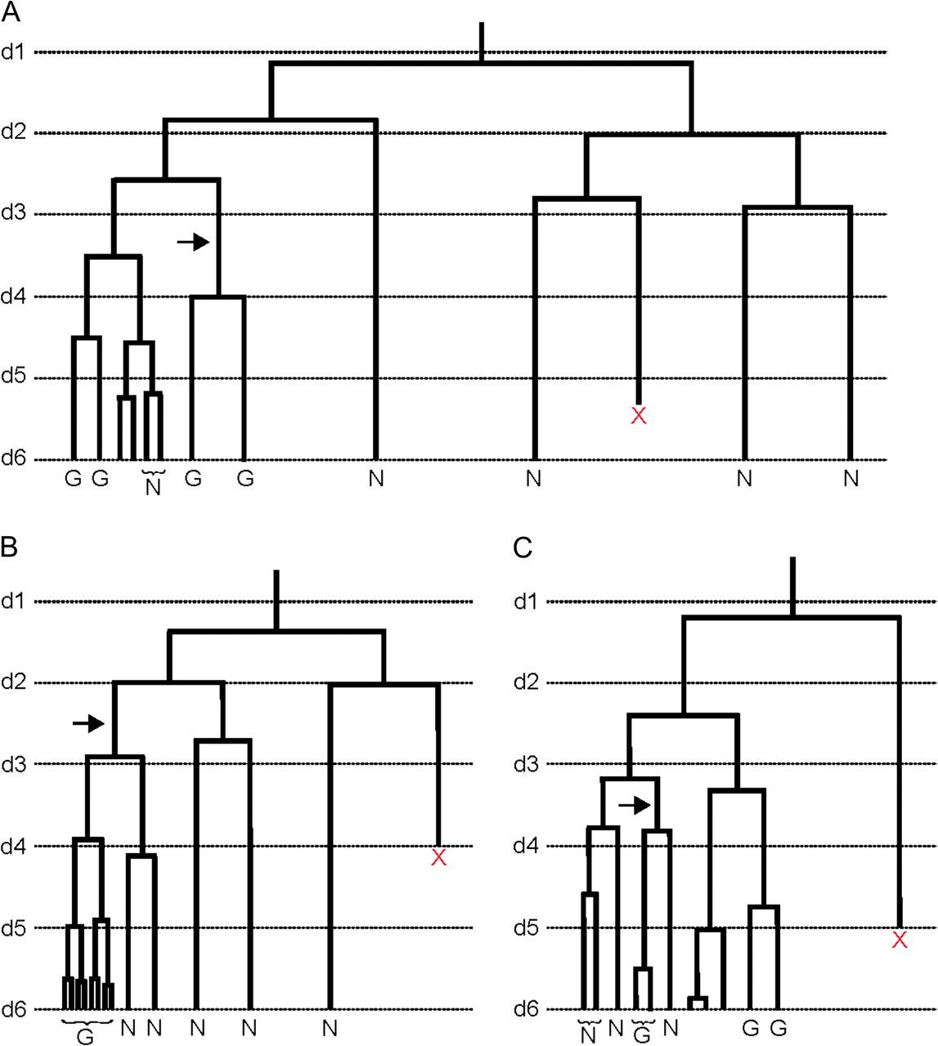
Figure 4. Glial cells are generated from bipotent progenitors. (A–C) Examples of lineage trees from E13 cortical ...
Notes:
Figure 4. Glial cells are generated from bipotent progenitors. (A–C) Examples of lineage trees from E13 cortical progenitors obtained from video time-lapse microscopy images taken every 2 min for 6 days. Imaging started 1 day after plating, so that the total time of culture was 7 days. Horizontal lines indicate every 24 h of experimentation (d1, d2, d3, …). Note that most cells dividing in the last 48 h gave rise to glial cells and that these cells belong to a complex lineage containing many MAP-2-positive neurons (see also Supplementary Fig. 4). Observe that glial progenitors may appear before neurogenesis has came to an end into an individual lineage (arrow in A) and that some glial progenitors may arise from a true asymmetric cell division (arrow in C), whereas the classically described neuron-to-glia transition can be visualized in the lineage tree (B) (arrow). N, neurons; G, glial cells; X, cell death.
Unless provided in the caption above, the following copyright applies to the content of this slide: © The Author 2009. Published by Oxford University Press. All rights reserved. For permissions, please e-mail: journals.permissions@oxfordjournals.org

