Slide 1
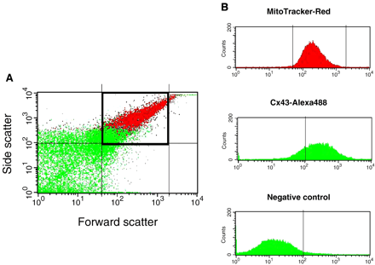
Fig. 1 FACS analysis. (A) Scatter dot plot of isolated rat mitochondria double stained for MitoTracker Red and Cx43. ...
Notes:
Fig. 1 FACS analysis. (A) Scatter dot plot of isolated rat mitochondria double stained for MitoTracker Red and Cx43. (B) Upper panel: MitoTracker positive events were selected for further Cx43-Alexa488 fluorescence analysis. Middle panel: Fluorescence histogram from Cx43-Alexa488 labeled MitoTracker-selected mitochondria from rat heart. Events under 102 fluorescence units were considered as negative (laser output was adjusted to include 1% of events in non-stained mitochondria). Lower panel: Fluorescence histogram in negative control mitochondria (primary antibody omitted). Both the number of positive events (95% vs. 15%) and mean fluorescence (411 vs. 31 fluorescence units) demonstrate the presence of Cx43 in a vast proportion of mitochondria (p<0.001 for both).
Unless provided in the caption above, the following copyright applies to the content of this slide: Copyright © 2005, European Society of Cardiology

Slide 2
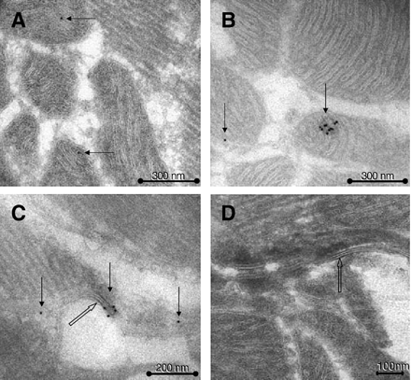
Fig. 2 Representative images of immuno-electron labeling of Cx43 in cardiomyocytes from control (A) and ...
Notes:
Fig. 2 Representative images of immuno-electron labeling of Cx43 in cardiomyocytes from control (A) and preconditioned (B) rat hearts. 10 nM colloidal gold labeling was associated with mitochondrial cristae. Panels C and D show gap junction zones as positive (C), and negative controls (D). In D, the primary antibody was omitted.
Unless provided in the caption above, the following copyright applies to the content of this slide: Copyright © 2005, European Society of Cardiology

Slide 3
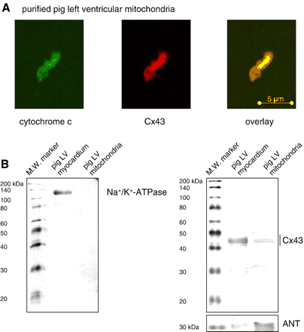
Fig. 4 Cx43 is present in pig left ventricular mitochondria. (A) Purified pig left ventricular mitochondria were ...
Notes:
Fig. 4 Cx43 is present in pig left ventricular mitochondria. (A) Purified pig left ventricular mitochondria were stained with antibodies against cytochrome c (green) and Cx43 (red) and analyzed by confocal laser scan microscopy. Merged image shows co-localization of pixels in yellow. (B) Western blot analysis was performed for Na+/K+-ATPase (left panel) or Cx43 and ANT (right panel) on pig total LV myocardial proteins and on pig LV mitochondrial proteins (30 μg/lane) in order to demonstrate the purity of the mitochondrial preparations as well as the specificity of the antibodies.
Unless provided in the caption above, the following copyright applies to the content of this slide: Copyright © 2005, European Society of Cardiology

Slide 4
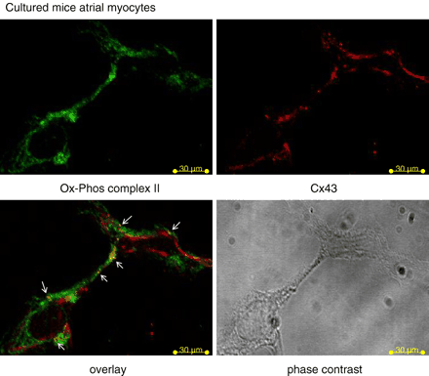
Fig. 3 Cultured mice atrial HL-1 cardiomyocytes were stained with antibodies against Cx43 (red) and mitochondria ...
Notes:
Fig. 3 Cultured mice atrial HL-1 cardiomyocytes were stained with antibodies against Cx43 (red) and mitochondria (Ox-Phos Complex II, green) and analyzed by confocal laser scan microscopy. Merged image demonstrates co-localization as yellow points (arrows). Additionally, the phase contrast image is shown.
Unless provided in the caption above, the following copyright applies to the content of this slide: Copyright © 2005, European Society of Cardiology

Slide 5
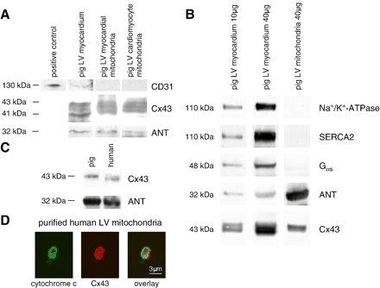
Fig. 5 Cx43 is localized at pig and human left ventricular mitochondria. (A) Western blot analysis was performed for ...
Notes:
Fig. 5 Cx43 is localized at pig and human left ventricular mitochondria. (A) Western blot analysis was performed for CD31, Cx43 and ANT on total pig left ventricular (LV) myocardium, or on mitochondria, which where extracted from isolated pig LV cardiomyocytes or from pig LV tissue (30 μg/lane). Additionally, a positive control for the CD31 antibody was used. (B) To demonstrate the purity of the mitochondrial extracts, Western blot analysis for Cx43 was performed using either the same protein amount (40 μg) of LV myocardial and mitochondrial proteins or the same Cx43 signal intensities between the control LV myocardial and the mitochondrial proteins, which was achieved by loading 10 μg myocardial proteins and 40 μg mitochondrial proteins. Na+/K+-ATPase, Gαs-protein, SERCA2 and ANT were used as markers of sarcolemma, cytosol, sarcoplasmic reticulum and mitochondria, respectively. (C) Western blot analysis was performed for Cx43 and ANT on purified LV myocardial pig and human mitochondria. (D) Purified human LV myocardial mitochondria were stained with antibodies against cytochrome c (green) and Cx43 (red) and were analyzed by confocal laser scan microscopy. Merged image shows co-localization pixels in yellow.
Unless provided in the caption above, the following copyright applies to the content of this slide: Copyright © 2005, European Society of Cardiology

Slide 6
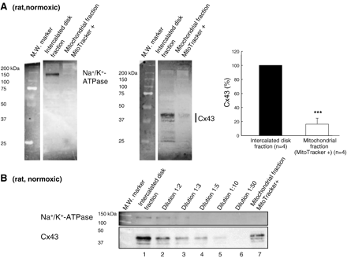
Fig. 6 Cx43 is present in rat myocardial mitochondria. (A) Representative Western blots performed on 10% ...
Notes:
Fig. 6 Cx43 is present in rat myocardial mitochondria. (A) Representative Western blots performed on 10% polyacrylamide gels showing Na+/K+-ATPase (left panel) and Cx43 (middle panel) immunoreactivity in intercalated disk and mitochondrial fractions from normoxic rat hearts (15 μg protein/lane). Right panel: Mean mitochondrial Cx43 immunoreactivity (white bar) represented as percentage of that found in intercalated disk fractions (black bar). *** (p<0.001) indicates significant differences vs. intercalated disc fraction. (B) Western blots showing Cx43 (71-0700 rabbit antibody) and Na+/K+-ATPase immunoreactivity in serial dilutions of the intercalated disk fraction and on the mitochondrial fraction from normoxic rat hearts (10 μg protein/lane).
Unless provided in the caption above, the following copyright applies to the content of this slide: Copyright © 2005, European Society of Cardiology

Slide 7
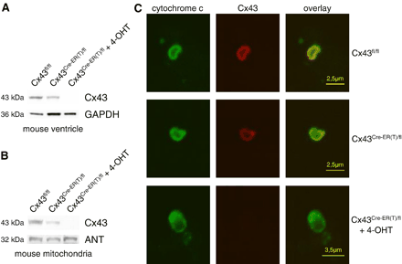
Fig. 7 Specificity of the anti-Cx43 antibody. (A) Western blot analysis was performed for Cx43 (upper panel) or as ...
Notes:
Fig. 7 Specificity of the anti-Cx43 antibody. (A) Western blot analysis was performed for Cx43 (upper panel) or as loading control for GAPDH (lower panel) on 30 μg ventricular protein extracts of Cx43fl/fl, untreated Cx43Cre-ER(T)/fl or 4-hydroxytamoxifen (4-OHT) injected Cx43Cre-ER(T)/fl mice. (B) Western blot analysis was performed for Cx43 (upper panel) or for the mitochondrial marker protein ANT (lower panel) on 30 μg protein extracts of ventricular mitochondria isolated from Cx43fl/fl, untreated Cx43Cre-ER(T)/fl or 4-hydroxytamoxifen (4-OHT) injected Cx43Cre-ER(T)/fl mice. (C) Mitochondria isolated from the ventricles of Cx43fl/fl, untreated Cx43Cre-ER(T)/fl or 4-hydroxytamoxifen (4-OHT) injected Cx43Cre-ER(T)/fl mice were stained with antibodies against Cx43 (red) or the mitochondrial marker cytochrome c (green) and analyzed by confocal laser scan microscopy. Merged image shows co-localization pixels in yellow.
Unless provided in the caption above, the following copyright applies to the content of this slide: Copyright © 2005, European Society of Cardiology

Slide 8
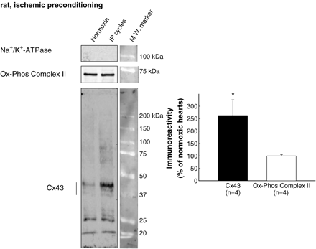
Fig. 8 Cx43 content in rat myocardial mitochondria after ischemic preconditioning. Left panel: Representative ...
Notes:
Fig. 8 Cx43 content in rat myocardial mitochondria after ischemic preconditioning. Left panel: Representative Western blots showing immunoreactivity to Cx43, Ox-Phos Complex II and Na+/K+-ATPase in mitochondrial fractions from normoxic rat hearts and from hearts submitted to IP cycles (12 μg protein/lane). Right panel: Mean mitochondrial Cx43 (black bars) and Ox-Phos Complex II (white bars) immunoreactivity, as percentage of that found in mitochondrial fractions from normoxic hearts. * (p<0.05) indicates significant differences vs. normoxic hearts.
Unless provided in the caption above, the following copyright applies to the content of this slide: Copyright © 2005, European Society of Cardiology

Slide 9
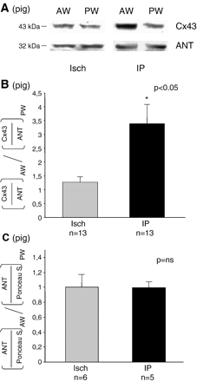
Fig. 9 Cx43 in mitochondria of non-preconditioned and preconditioned pig hearts. (A) Western blot analysis of the ...
Notes:
Fig. 9 Cx43 in mitochondria of non-preconditioned and preconditioned pig hearts. (A) Western blot analysis of the Cx43 or ANT protein level in mitochondria isolated from the anterior wall (AW) and posterior wall (PW) of non-preconditioned (Isch) or preconditioned (IP) pig hearts (30 μg/lane). (B) Bar graphs are representing the ratios of the mitochondrial Cx43 level (normalized to ANT) in the AW and PW of pig hearts without or with IP. (C) Bar graphs are representing the ratios of the mitochondrial marker ANT (normalized to Ponceau S staining) in the AW and PW of pig hearts without or with IP.
Unless provided in the caption above, the following copyright applies to the content of this slide: Copyright © 2005, European Society of Cardiology

