Slide 1
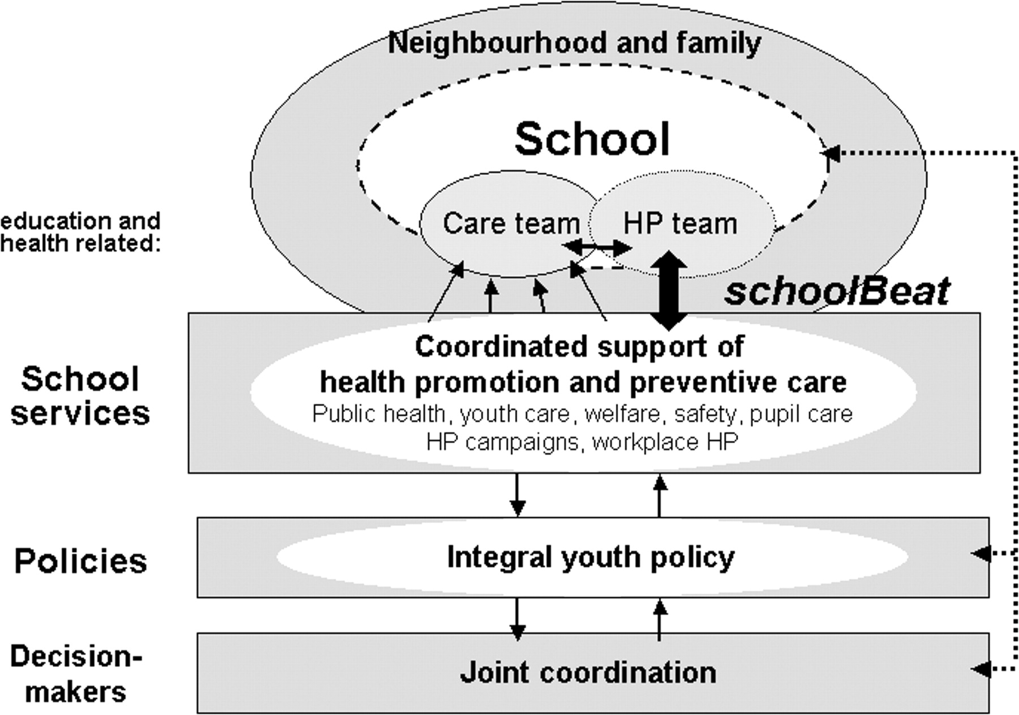
Fig. 2: Desired organizational school-health support structure.
Notes:
Fig. 2: Desired organizational school-health support structure.
Unless provided in the caption above, the following copyright applies to the content of this slide: © The Author 2005. Published by Oxford University Press. All rights reserved. For Permissions, please email: journals.permissions@oupjournals.org

Slide 2
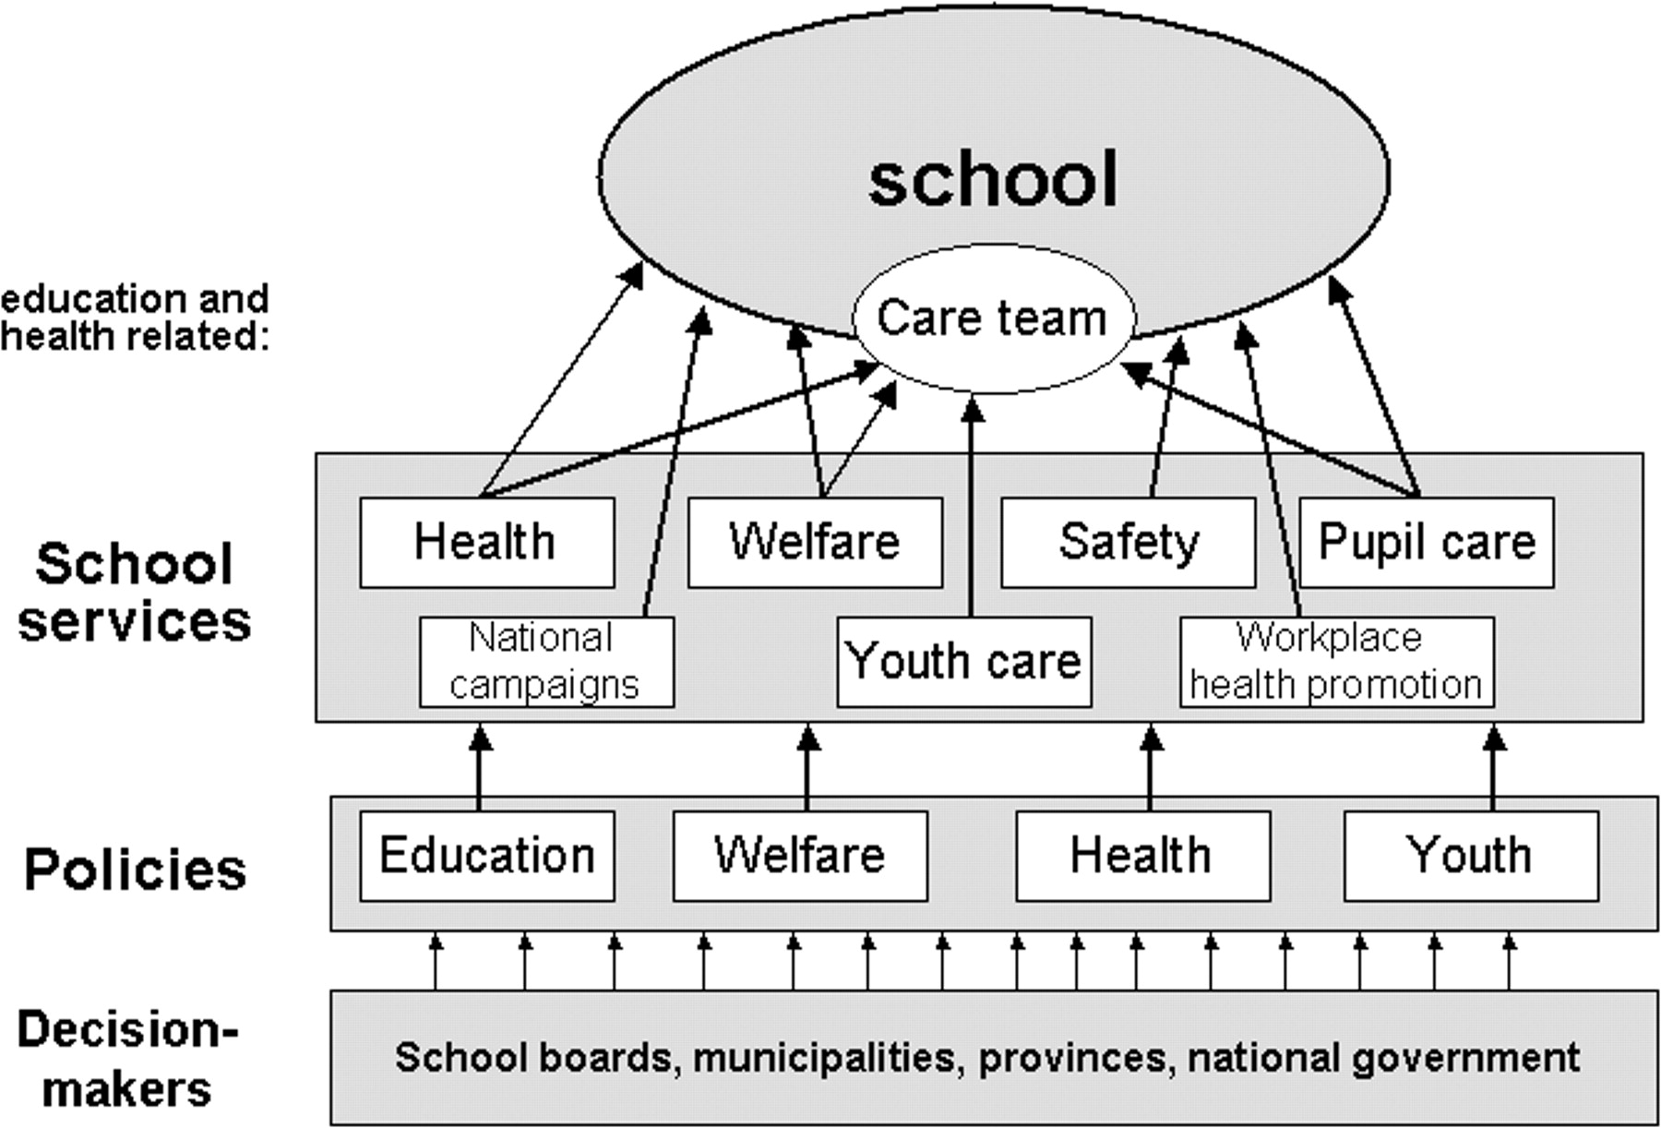
Fig. 1: Current organizational structure of school health in the Netherlands.
Notes:
Fig. 1: Current organizational structure of school health in the Netherlands.
Unless provided in the caption above, the following copyright applies to the content of this slide: © The Author 2005. Published by Oxford University Press. All rights reserved. For Permissions, please email: journals.permissions@oupjournals.org

