Slide 1
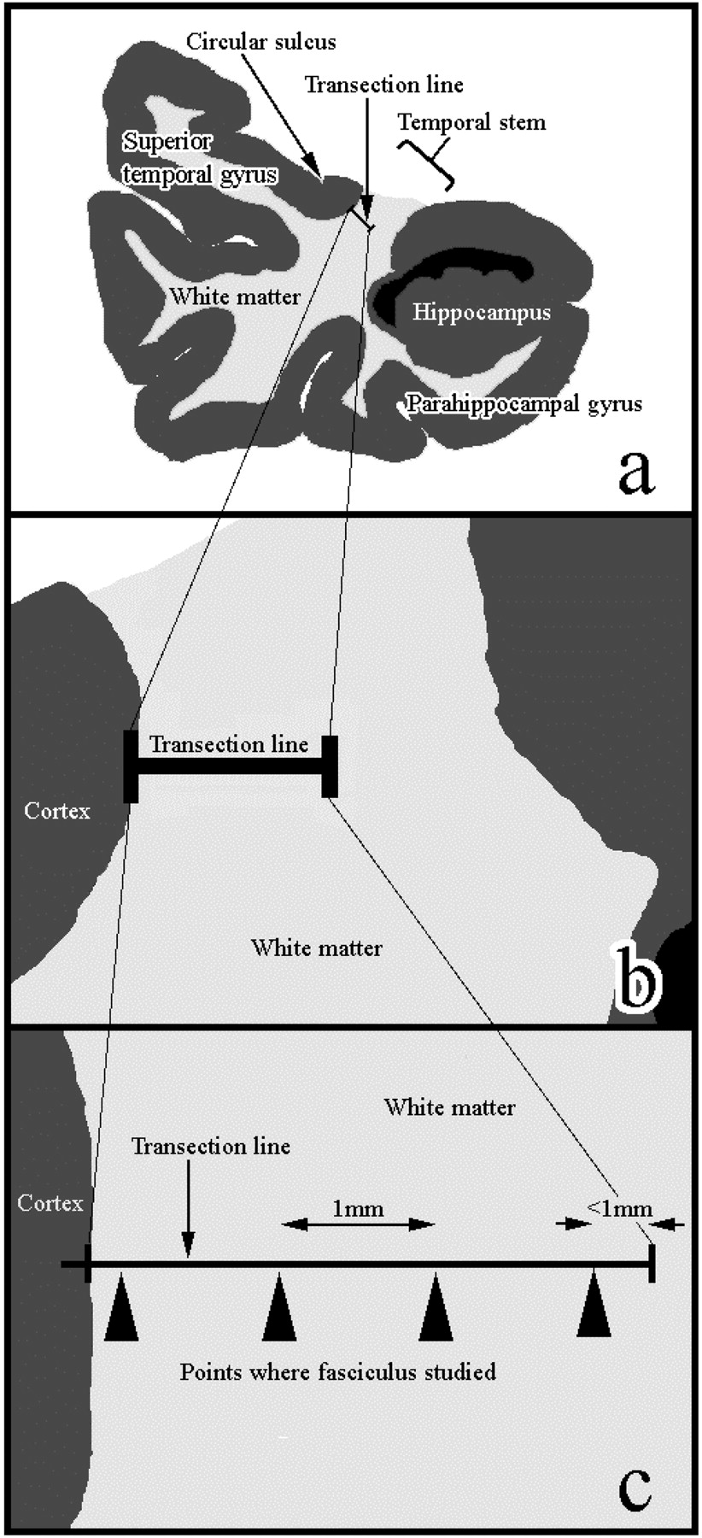
Figure 1. Strategy used to define and sample from the uncinate fasciculus. For details see text.
Notes:
Figure 1. Strategy used to define and sample from the uncinate fasciculus. For details see text.
Unless provided in the caption above, the following copyright applies to the content of this slide: © Oxford University Press

Slide 2
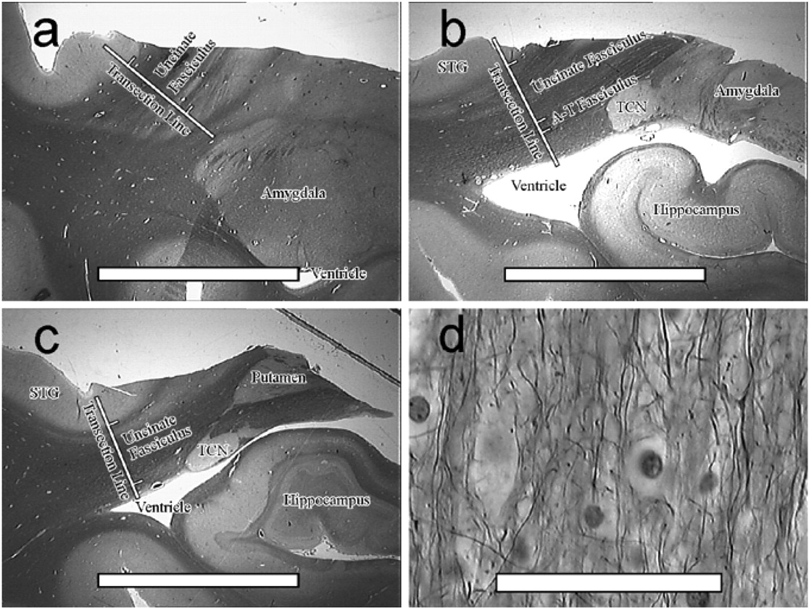
Figure 2. Delineation of the human uncinate fasciculus. In (a–c), Palmgren-stained coronal sections at three ...
Notes:
Figure 2. Delineation of the human uncinate fasciculus. In (a–c), Palmgren-stained coronal sections at three antero-posterior levels show the uncinate fasciculus and surrounding structures. In (d), a higher-power micrograph shows the fibres of the uncinate fasciculus. In (a–c), bar = 1 cm; in (d), bar = 50 mm. A-T, amygdalo-temporal; STG, superior temporal gyrus; TCN, tail of the caudate nucleus.
Unless provided in the caption above, the following copyright applies to the content of this slide: © Oxford University Press

Slide 3
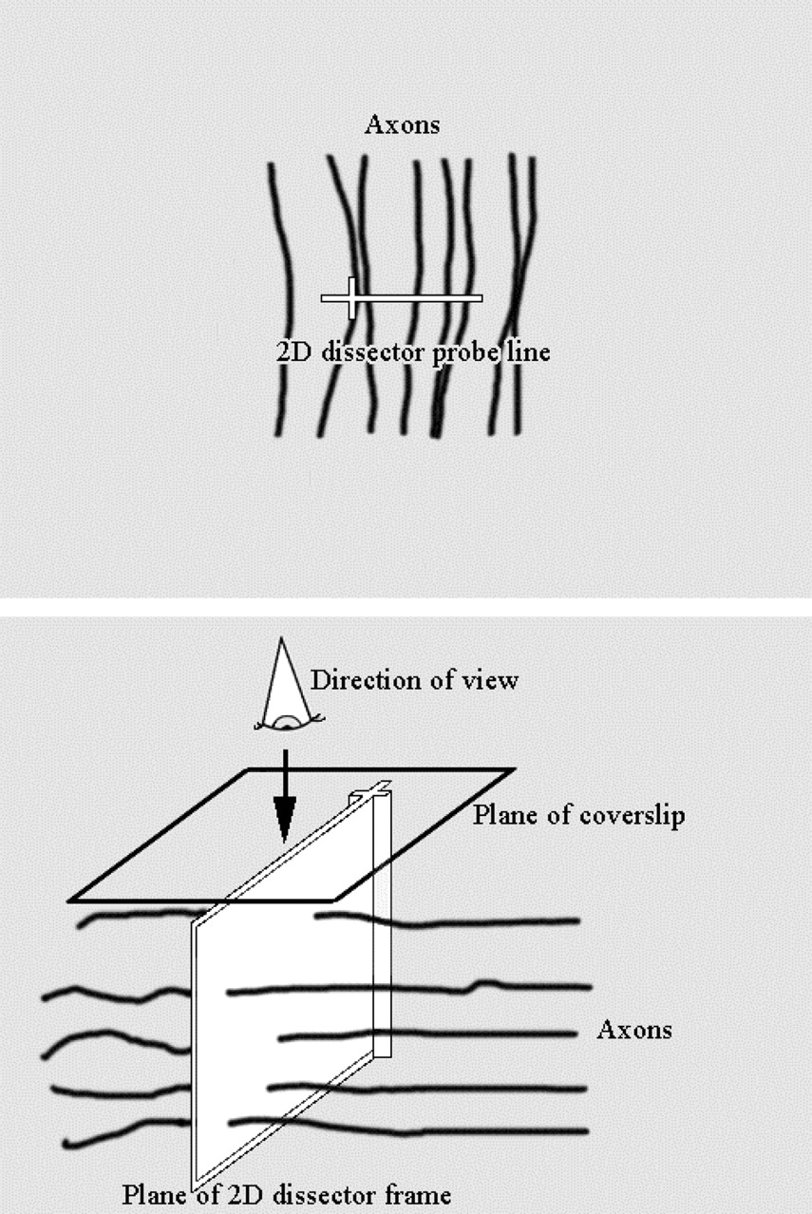
Figure 3. The 2-D dissector used to measure fibres in the uncinate fasciculus. For details, see text.
Notes:
Figure 3. The 2-D dissector used to measure fibres in the uncinate fasciculus. For details, see text.
Unless provided in the caption above, the following copyright applies to the content of this slide: © Oxford University Press

Slide 4
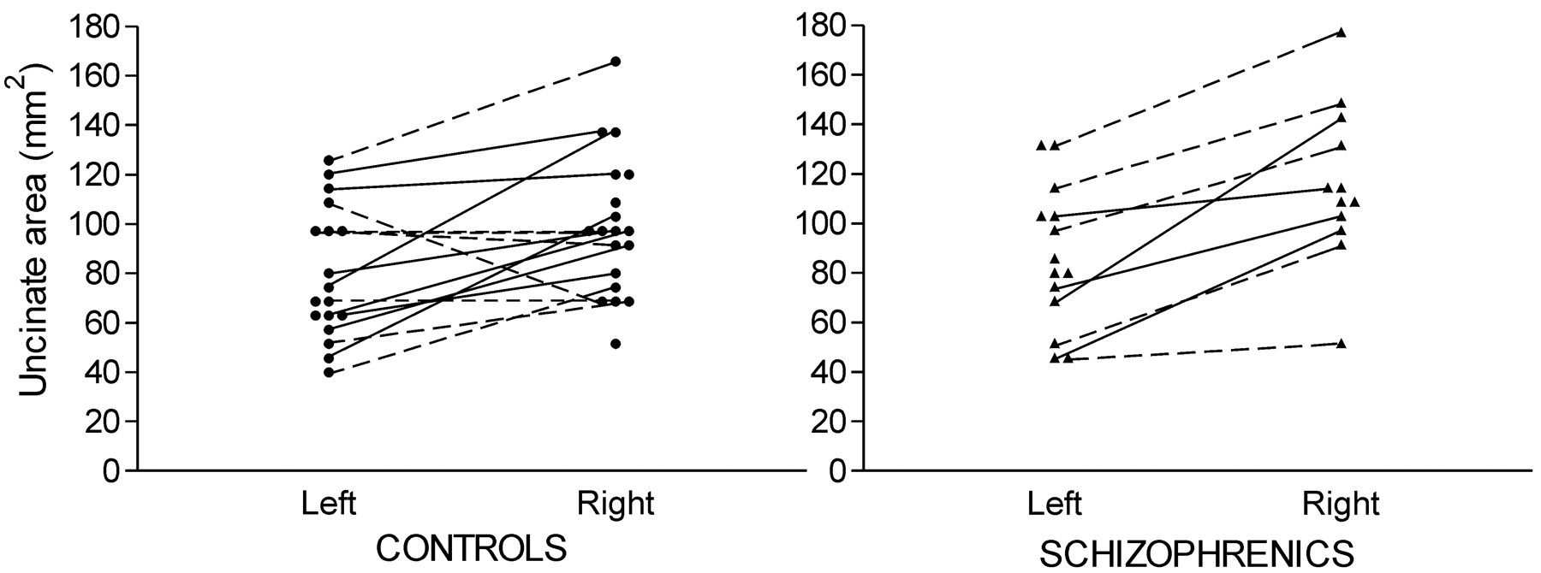
Figure 4. Cross-sectional area of the uncinate fasciculus in controls (circles) and patients with schizophrenia ...
Notes:
Figure 4. Cross-sectional area of the uncinate fasciculus in controls (circles) and patients with schizophrenia (triangles). Left and right hemisphere measurements from the same individual are joined by solid (men) or dashed (women) lines. The right side is larger than the left, repeated-measures ANOVA [F(1,21) = 32.66, P = 0.0001].
Unless provided in the caption above, the following copyright applies to the content of this slide: © Oxford University Press

Slide 5
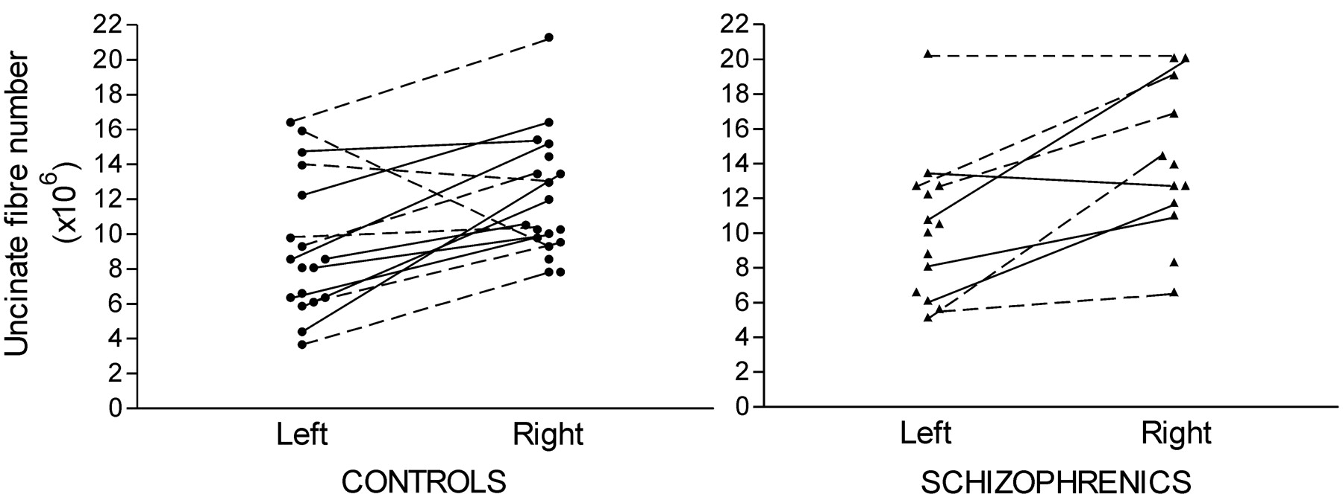
Figure 5. Estimated fibre number of the uncinate fasciculus in controls (circles) and patients with schizophrenia ...
Notes:
Figure 5. Estimated fibre number of the uncinate fasciculus in controls (circles) and patients with schizophrenia (triangles). Left and right hemisphere measurements from the same individual are joined by solid (men) or dashed (women) lines. There are more fibres in the right than the left uncinate fasciculus, repeated measures ANOVA [F(1,21) = 21.20, P = 0.0002].
Unless provided in the caption above, the following copyright applies to the content of this slide: © Oxford University Press

