Slide 1
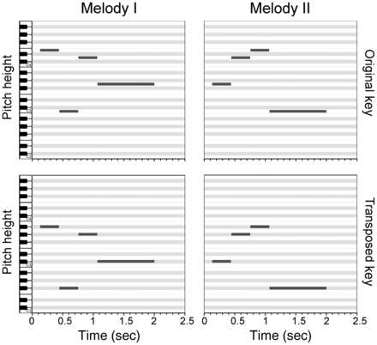
Figure 1. Melodies in piano-roll notation. Both stimuli are shown in the original key as well as in the transposed ...
Notes:
Figure 1. Melodies in piano-roll notation. Both stimuli are shown in the original key as well as in the transposed version, 6 semitones lower. Note that in the transposed condition all 4 pitches comprise different chromae as compared with the original key. A behavioral experiment prior to fMRI scanning assured that all participants were able to distinguish between both melodies.
Unless provided in the caption above, the following copyright applies to the content of this slide: © The Author 2012. Published by Oxford University Press.This is an Open Access article distributed under the terms of the Creative Commons Attribution Non-Commercial License (http://creativecommons.org/licenses/by-nc/3.0), which permits unrestricted non-commercial use, distribution, and reproduction in any medium, provided the original work is properly cited.

Slide 2
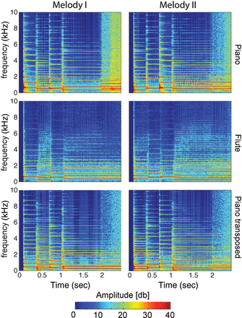
Figure 2. Time-frequency spectrograms of melodic stimuli. As expected, after transposition to a different key ...
Notes:
Figure 2. Time-frequency spectrograms of melodic stimuli. As expected, after transposition to a different key systematic frequency shifts between original and transposed melodies exist. Moreover, different distributions of harmonic power between piano and flute reflect their difference in timbre.
Unless provided in the caption above, the following copyright applies to the content of this slide: © The Author 2012. Published by Oxford University Press.This is an Open Access article distributed under the terms of the Creative Commons Attribution Non-Commercial License (http://creativecommons.org/licenses/by-nc/3.0), which permits unrestricted non-commercial use, distribution, and reproduction in any medium, provided the original work is properly cited.

Slide 3
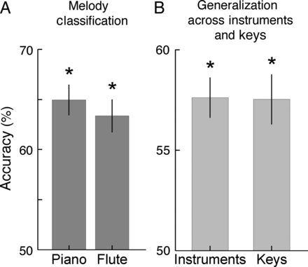
Figure 3. De-coding results based on fMRI voxel patterns of early auditory cortex. (A) Performance of classification ...
Notes:
Figure 3. De-coding results based on fMRI voxel patterns of early auditory cortex. (A) Performance of classification between melodies, tested separately on 2 instruments. (B) Classification performance between melodies played on different instruments and different keys. All results were confirmed using a sub-sample of 5 participants and adapted versions of our melodic stimuli where all pitches were of matched duration (Supplementary Table S2). *P < 0.05, Bonferroni corrected for 4 comparisons.
Unless provided in the caption above, the following copyright applies to the content of this slide: © The Author 2012. Published by Oxford University Press.This is an Open Access article distributed under the terms of the Creative Commons Attribution Non-Commercial License (http://creativecommons.org/licenses/by-nc/3.0), which permits unrestricted non-commercial use, distribution, and reproduction in any medium, provided the original work is properly cited.

Slide 4
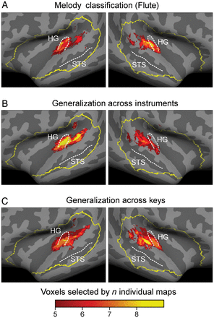
Figure 4. Multiparticipant consistency maps of discriminative voxels shown on a standard brain surface of the temporal ...
Notes:
Figure 4. Multiparticipant consistency maps of discriminative voxels shown on a standard brain surface of the temporal lobes. The yellow outline illustrates the anatomically defined region of interest from which all analyses started from. All group maps were created by summation of the individual discriminative voxel maps of all 8 participants. Each map was thresholded such that a voxel had to be selected in at least 5 individuals to appear on the group map. Color coding indicates consistency across participants. Across all classifications no lateralization bias was found (c.f. Supplementary Table S1). For group map of melody classification on piano see Supplemental Figure S1.
Unless provided in the caption above, the following copyright applies to the content of this slide: © The Author 2012. Published by Oxford University Press.This is an Open Access article distributed under the terms of the Creative Commons Attribution Non-Commercial License (http://creativecommons.org/licenses/by-nc/3.0), which permits unrestricted non-commercial use, distribution, and reproduction in any medium, provided the original work is properly cited.

Slide 5
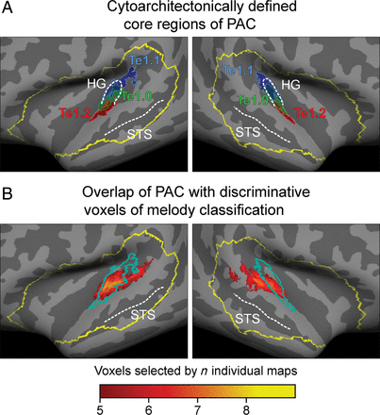
Figure 5. (A) Spatial overlap between the cytoarchitectonically defined PAC (areas Te 1.0, 1.1, and 1.2, probabilistic ...
Notes:
Figure 5. (A) Spatial overlap between the cytoarchitectonically defined PAC (areas Te 1.0, 1.1, and 1.2, probabilistic threshold: 30%) and an average group map of discriminative voxels for all melody classifications (B). Substantial overlap exists between our results and areas Te.
Unless provided in the caption above, the following copyright applies to the content of this slide: © The Author 2012. Published by Oxford University Press.This is an Open Access article distributed under the terms of the Creative Commons Attribution Non-Commercial License (http://creativecommons.org/licenses/by-nc/3.0), which permits unrestricted non-commercial use, distribution, and reproduction in any medium, provided the original work is properly cited.

